Slide 1
Naviance/Clever
Complete Do What you are Personality Assessment

Slide 2
How do Students Log-in to their account:
Students, please follow the directions given below.
(Screenshots of directions below are in the following 3 screens.)
Students go to :
https://clever.com/
  Go to “Log In As a Student”
  Type in school name as “Flora”, then choose AC Flora from Drop down menu
Username: Student ID, example 11344
Student password: M/D/YYYY Ex: 5/9/2004
            MM/DD/YYYY Ex: 12/24/2003

Slide 3
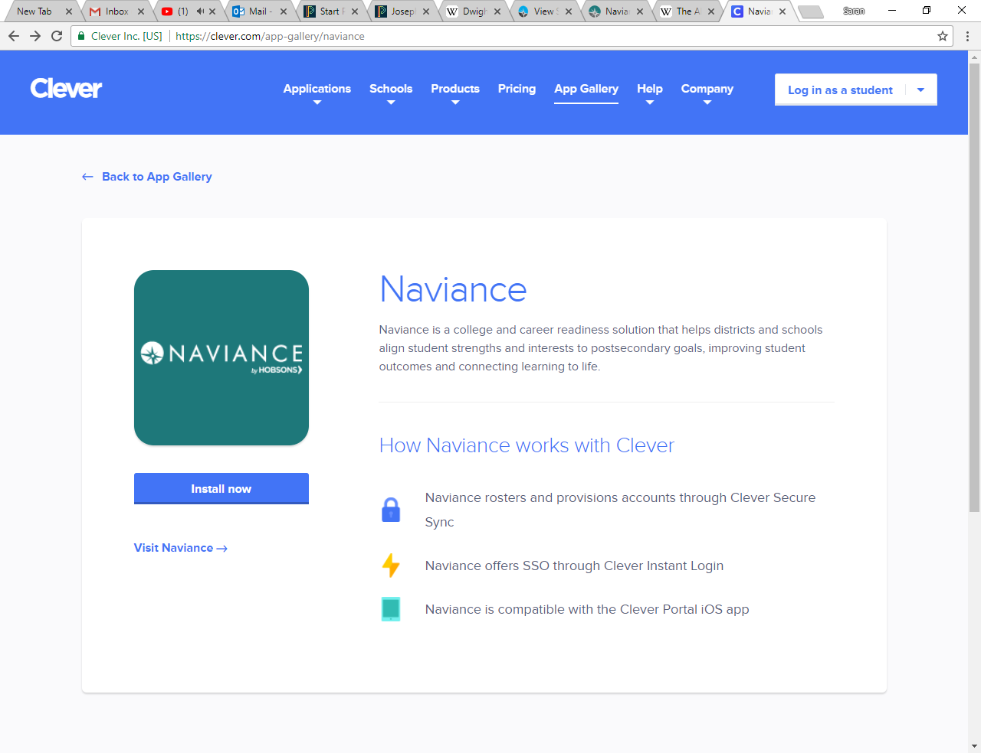
In the upper right hand corner, click on the log in tab

Slide 4
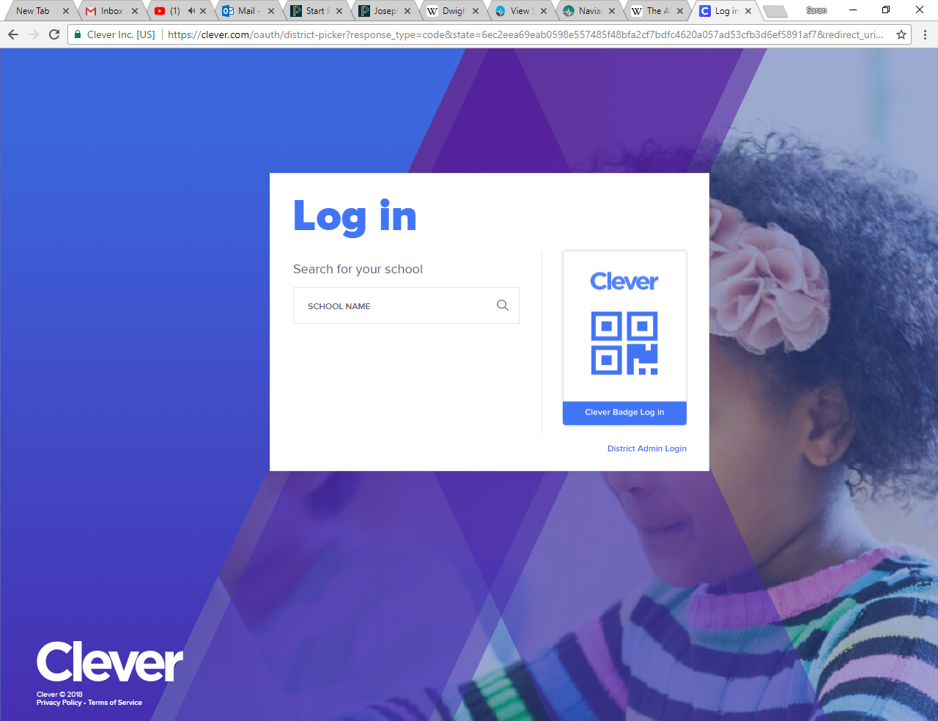
If this screen appears: Type Flora in the school name section; and then select AC Flora High School.

Slide 5
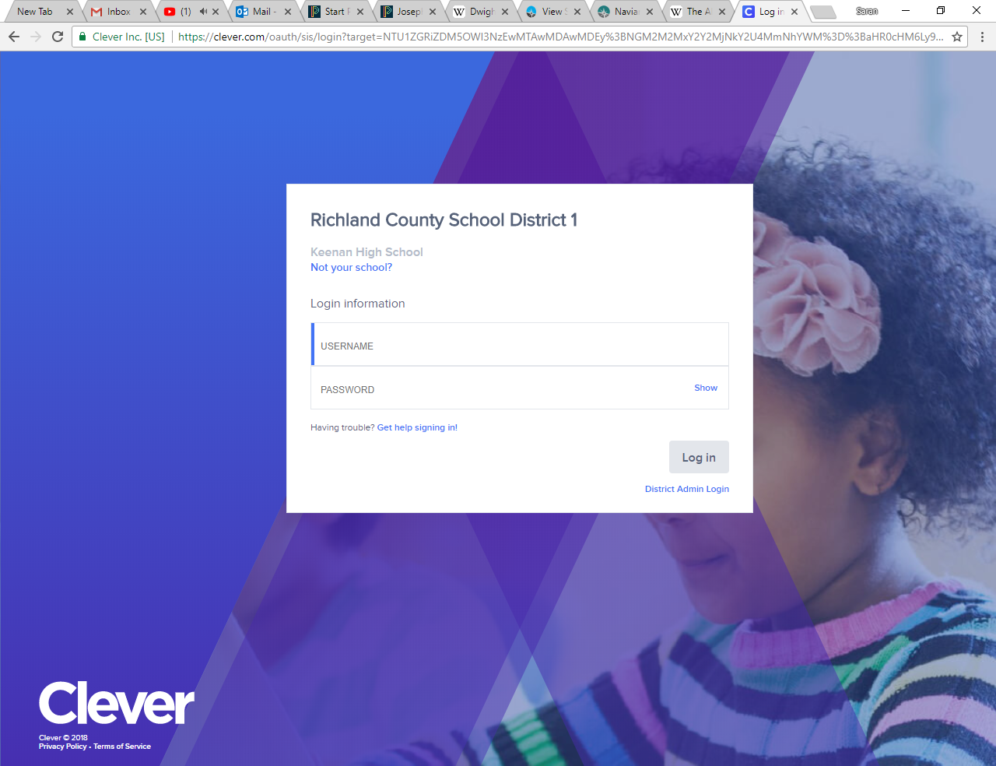
Your username is your school ID (the entire ID number)
Your password is your birthday (if you have a 0 at the beginning of the month or day of your birthday DO NOT TYPE THE ZERO). For example students born in the month of January should write 1/2/2001.

Slide 6
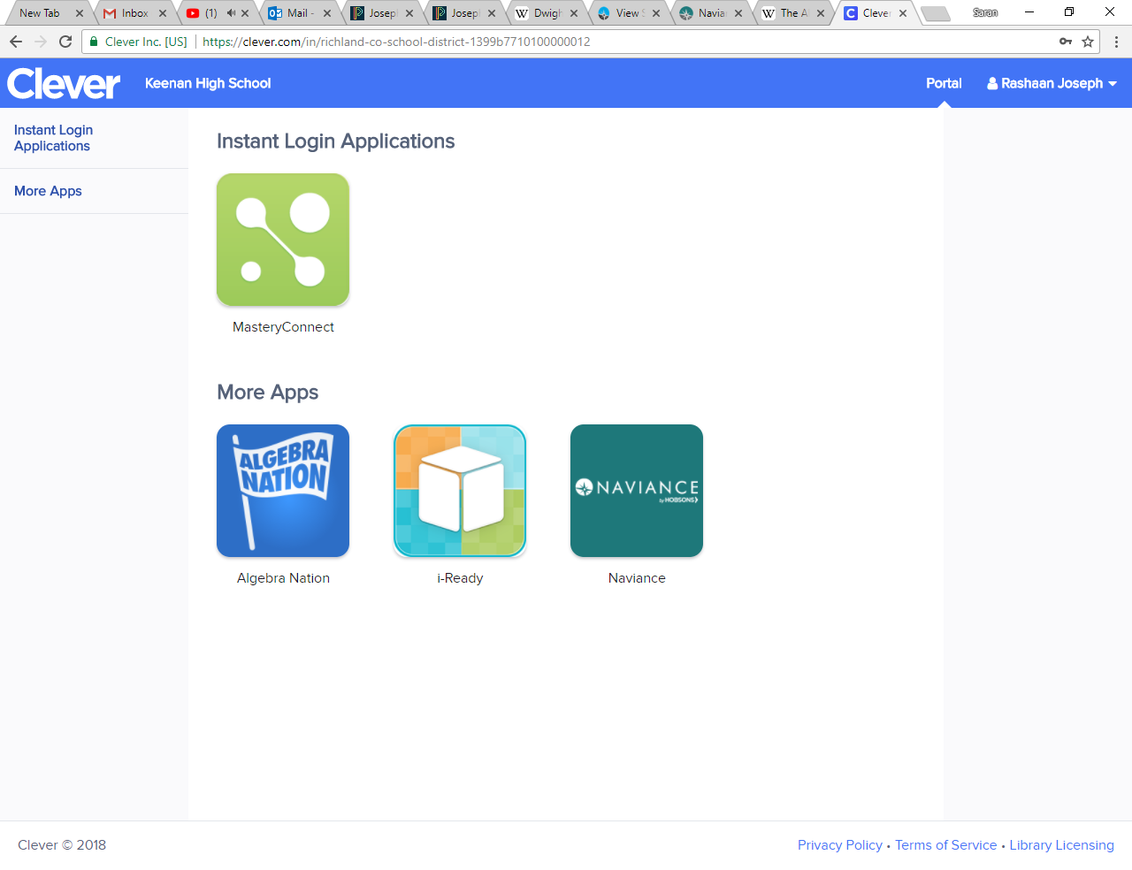
Once in the site, go to the Naviance tab

Slide 7
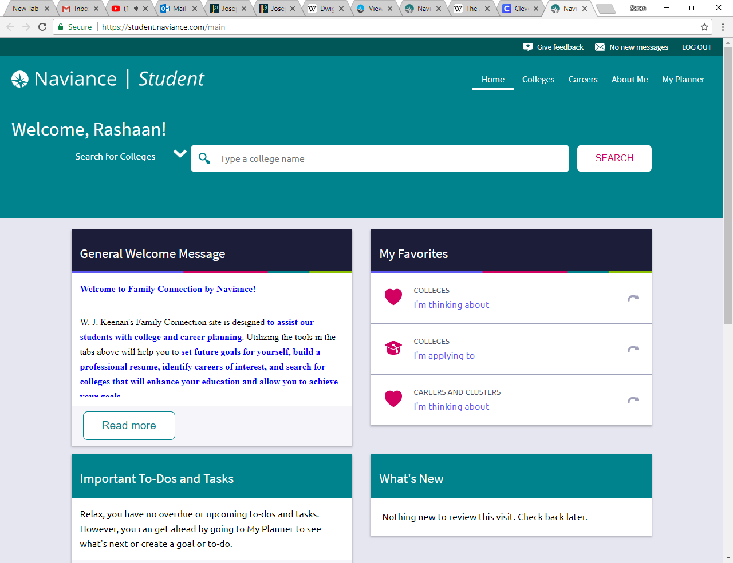
Go to ABOUT ME

Slide 8
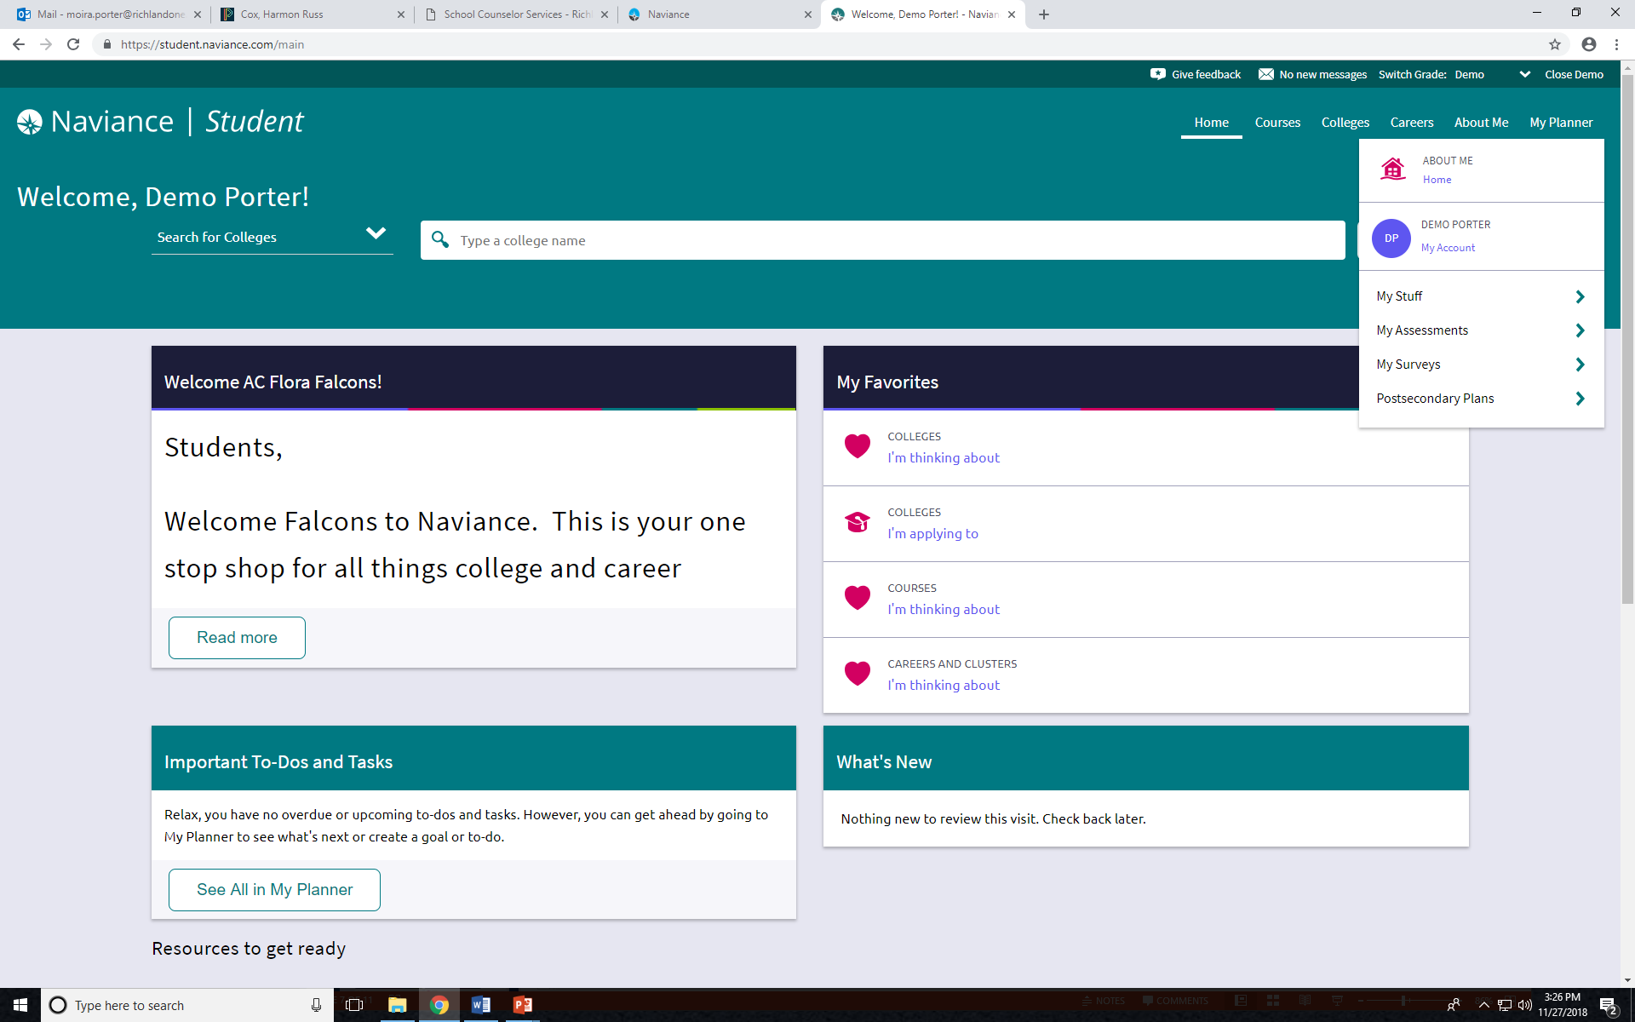
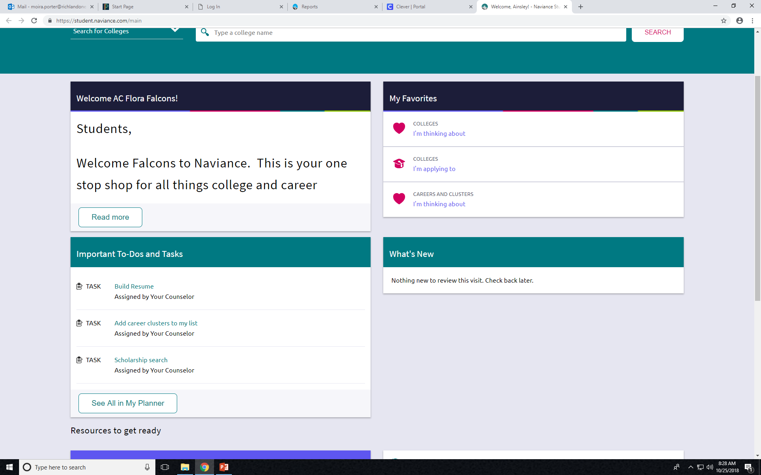
All students: Now, go to the Important To-DoGo to MY Assessments.

Slide 9

Begin by clicking on Do What You Are.

Slide 10
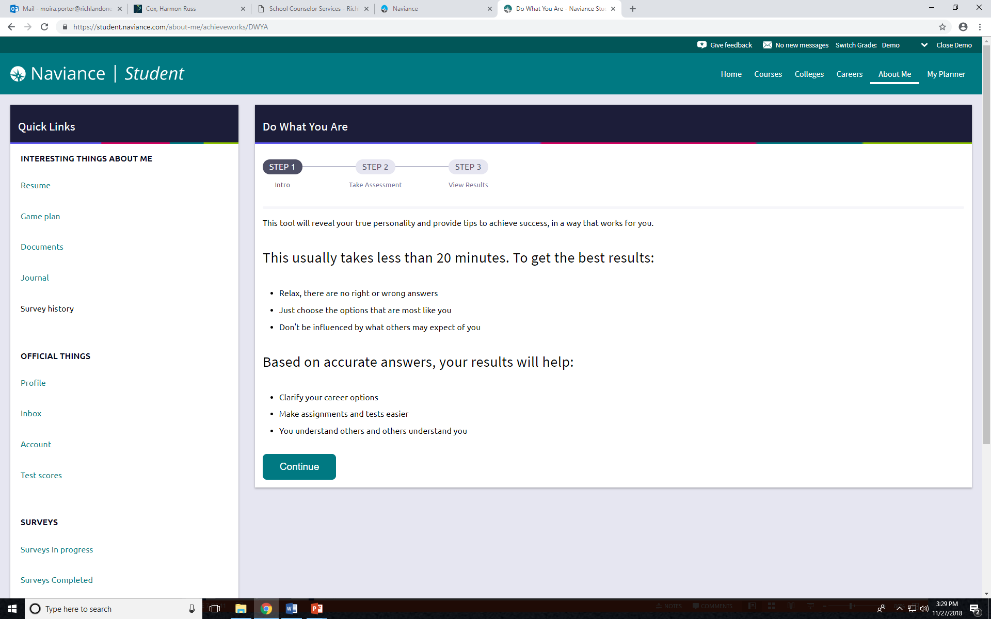
Begin the assessment by clicking continue and answering the questions.

Slide 11
If you complete your survey quickly, continue to Build Your Resume, search for scholarships, or review other tasks that you have completed and may need to be updated.

