Slide 1
Naviance/Clever
Roadtrip Nation - Complete “What’s Your Road?”

Slide 2
How do Students Log-in to their account:
Students, please follow the directions given below.
(Screenshots of directions below are in the following 3 screens.)
Students go to :
https://clever.com/
  Go to “Log In As a Student”
  Type in school name as “Flora”, then choose AC Flora from Drop down menu
Username: Student ID, example 11344
Student password: M/D/YYYY Ex: 5/9/2004
            MM/DD/YYYY Ex: 12/24/2003

Slide 3
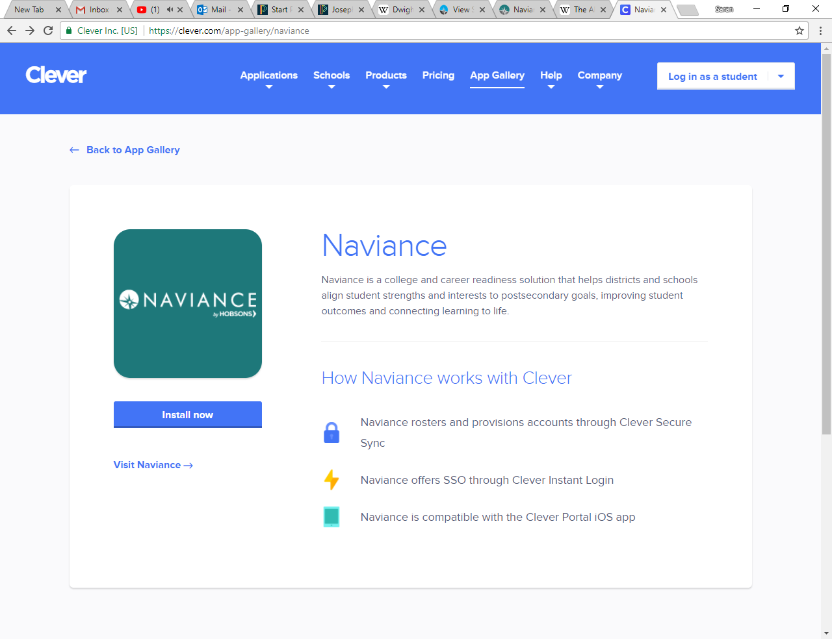
In the upper right hand corner, click on the log in tab

Slide 4
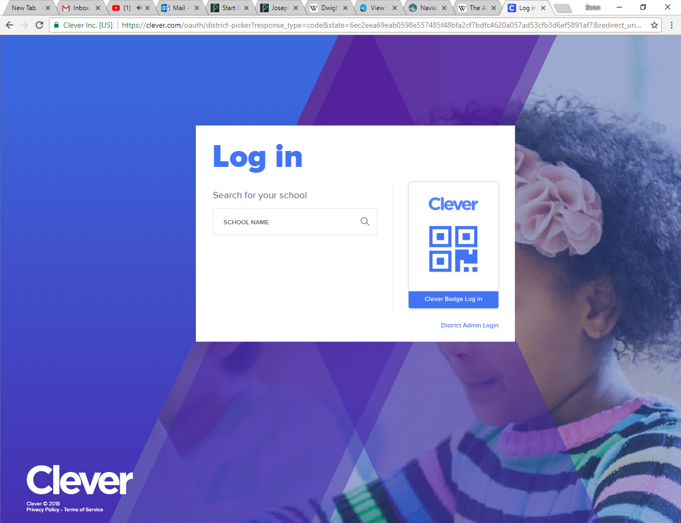
If this screen appears: Type Flora in the school name section; and then select AC Flora High School.

Slide 5
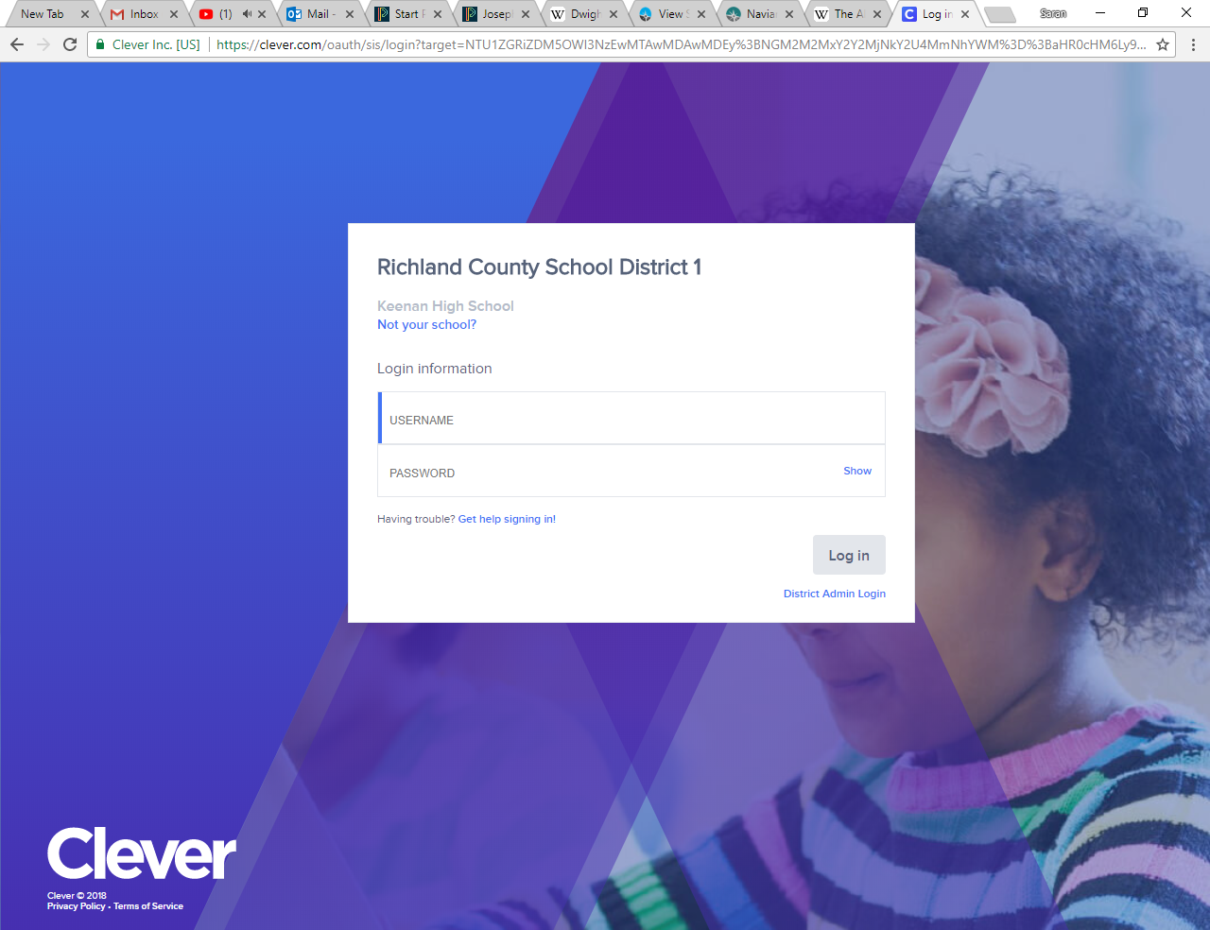
Your username is your school ID (the entire ID number)
Your password is your birthday (if you have a 0 at the beginning of the month or day of your birthday DO NOT TYPE THE ZERO). For example students born in the month of January should write 1/2/2001.

Slide 6
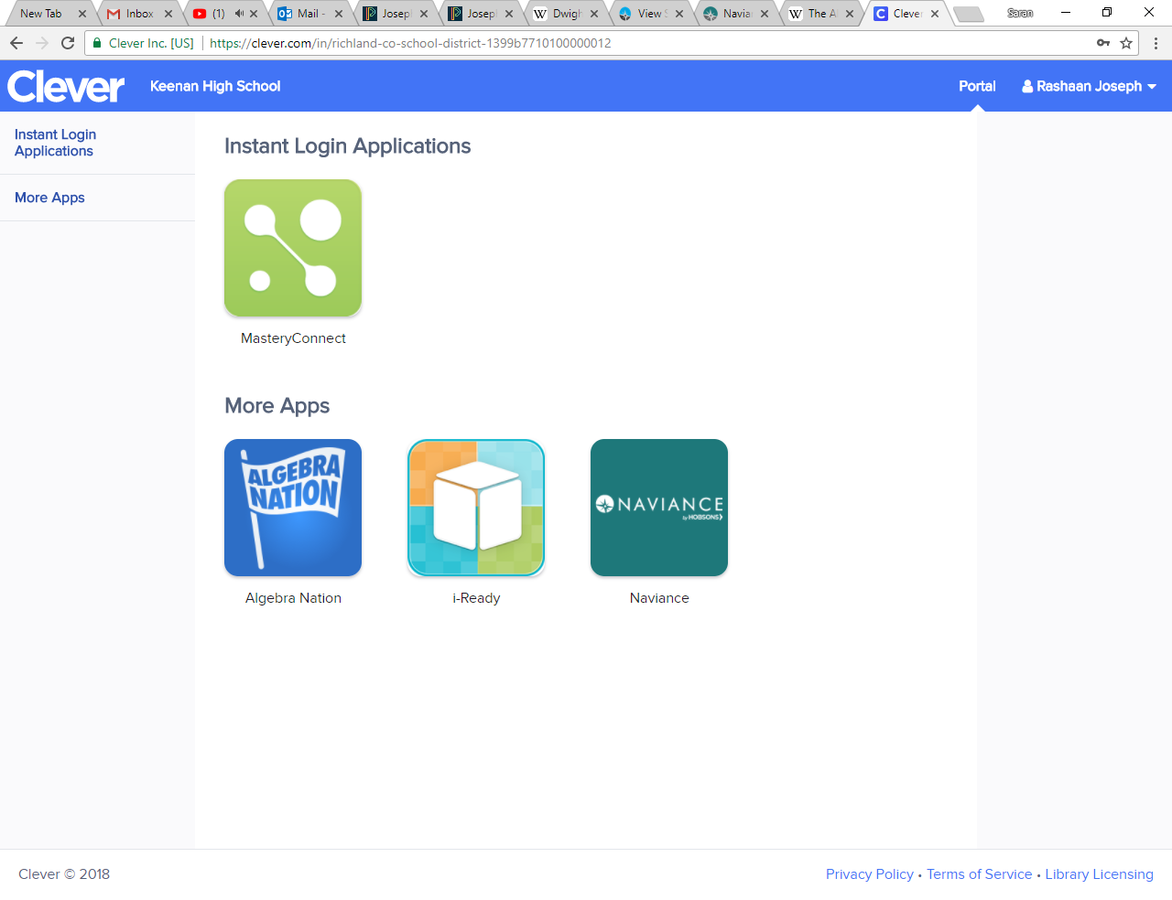
Once in the site, go to the Naviance tab

Slide 7
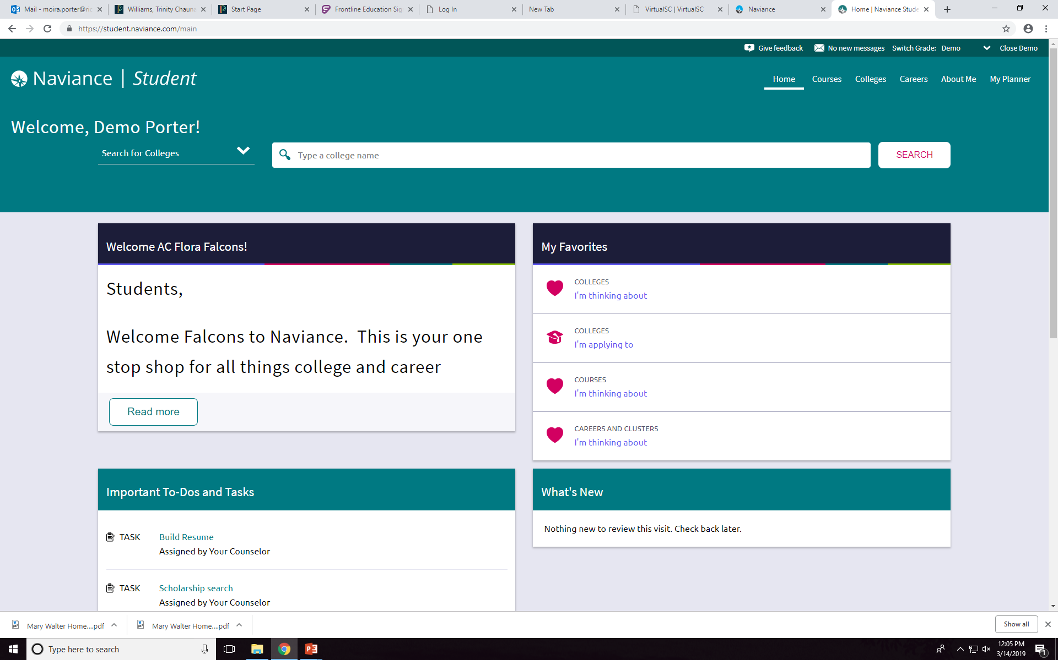
Go to Careers

Slide 8
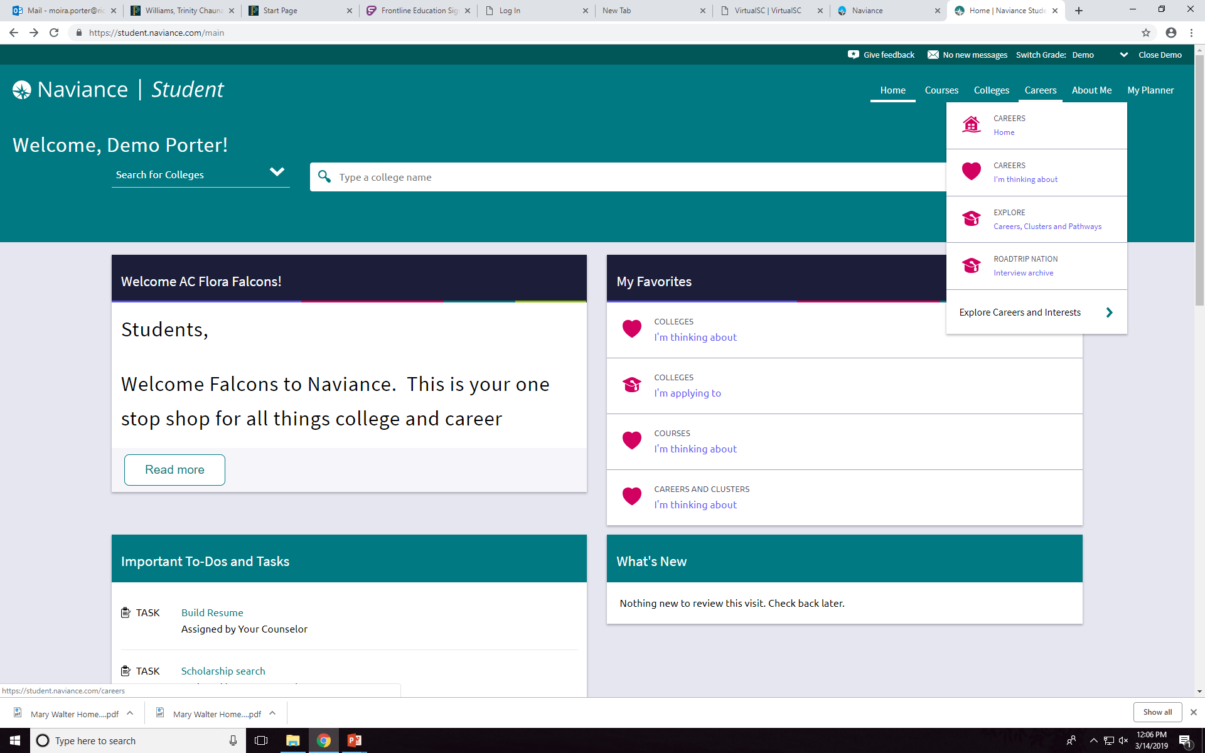
Go to Roadtrip Nation

Slide 9
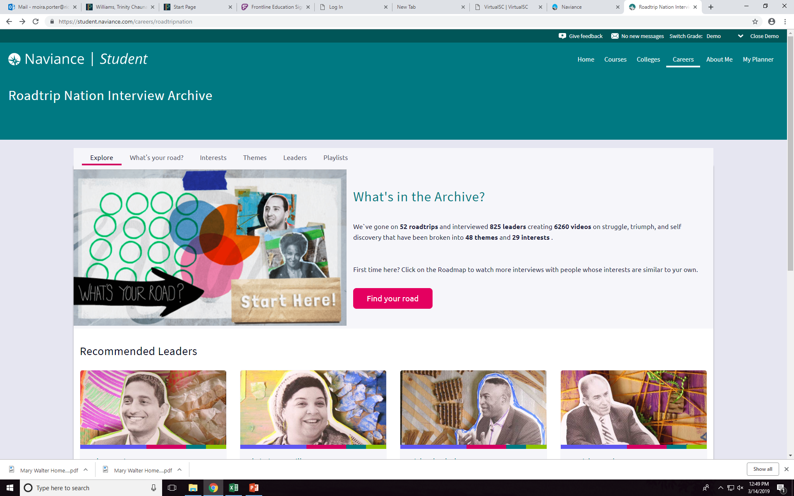
Begin by clicking What’s Your Road?

Slide 10
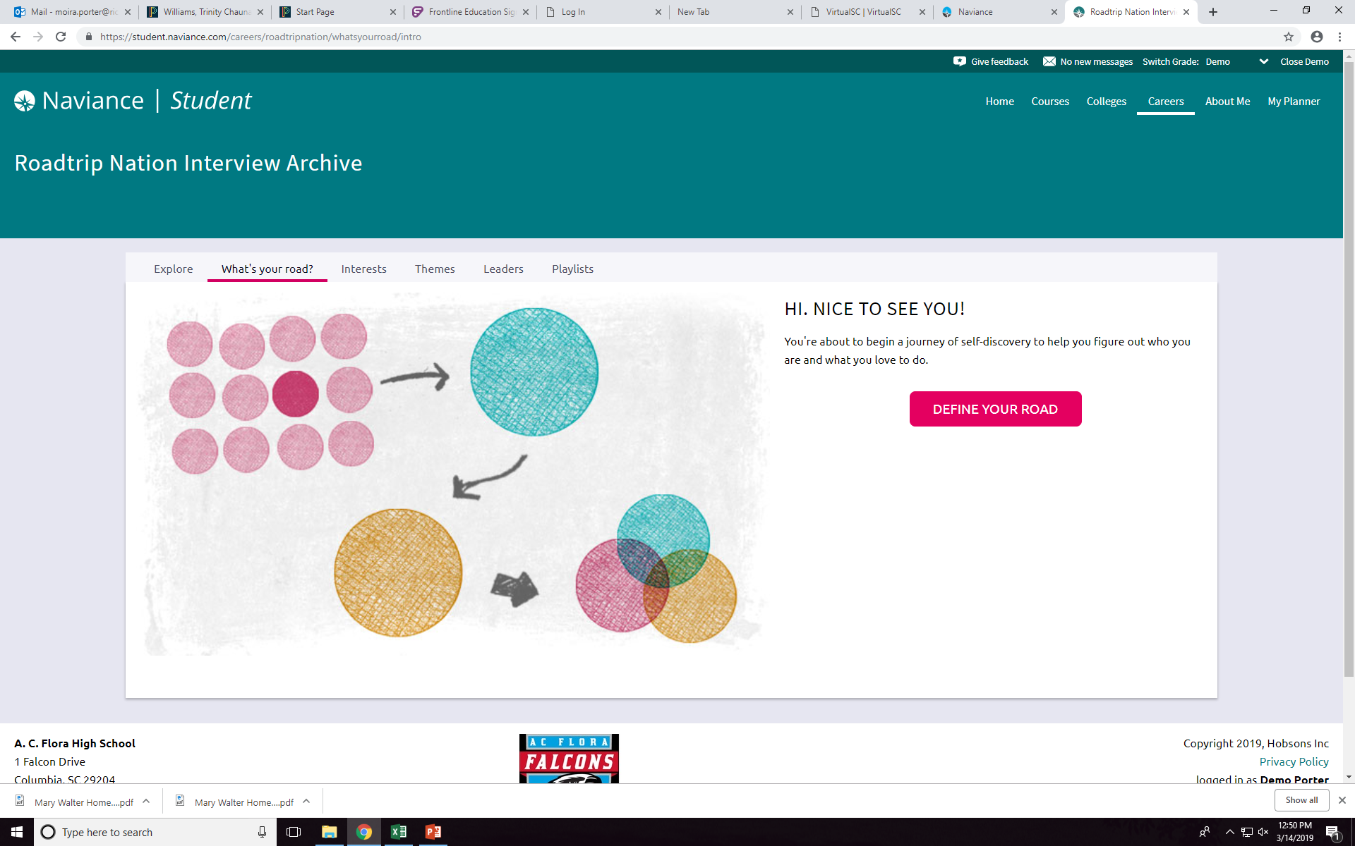
Click on Define Your Road and begin the task.

Slide 11
Once you have completed the task, view one of the videos from the career your choose. (Please use your headphones if you have them.

