Slide 1
Naviance/Clever
Scholarship Search

Slide 2
How do Students Log-in to their account:
Students, please follow the directions given below.
(Screenshots of directions below are in the following 3 screens.)
Students go to :
https://clever.com/
  Go to “Log In As a Student”
  Type in school name as “Flora”, then choose AC Flora from Drop down menu
Username: Student ID, example 11344
Student password: M/D/YYYY Ex: 5/9/200
          MM/DD/YYYY Ex: 12/24/2003

Slide 3
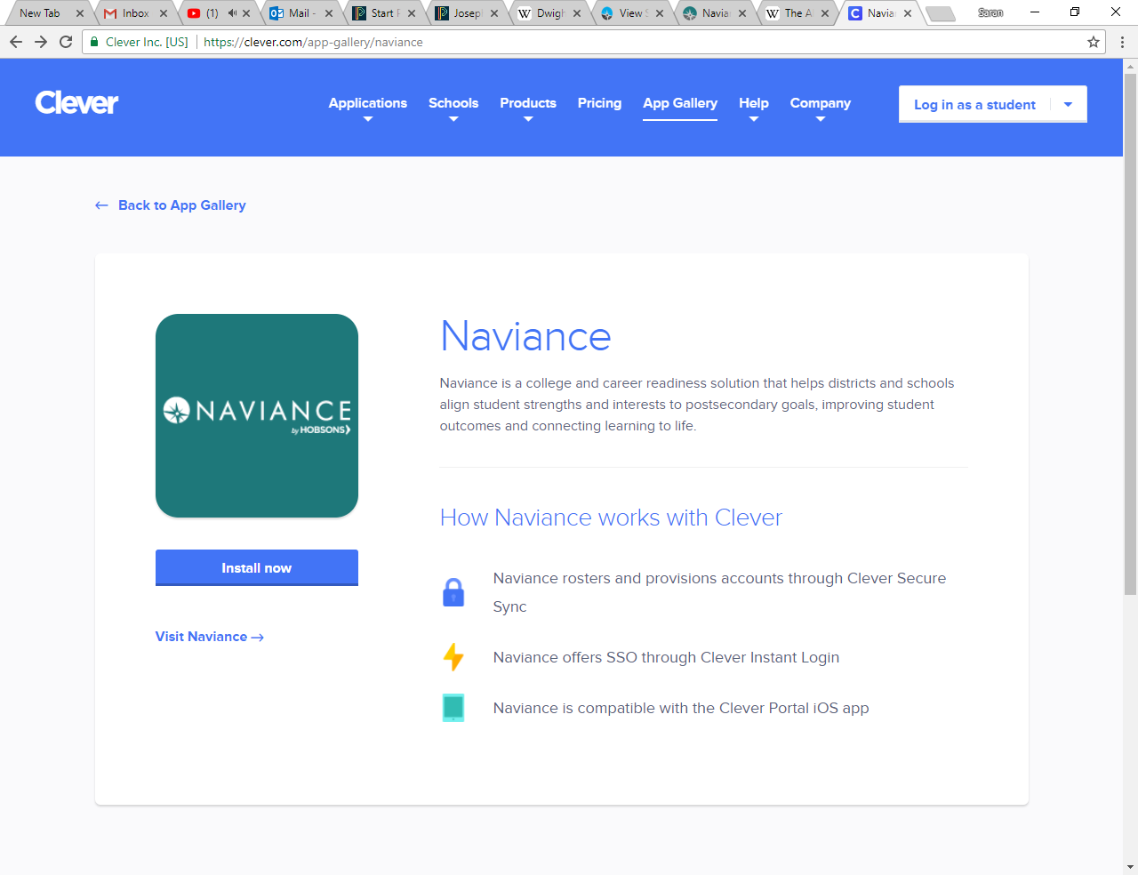
In the upper right hand corner, click on the log in tab

Slide 4
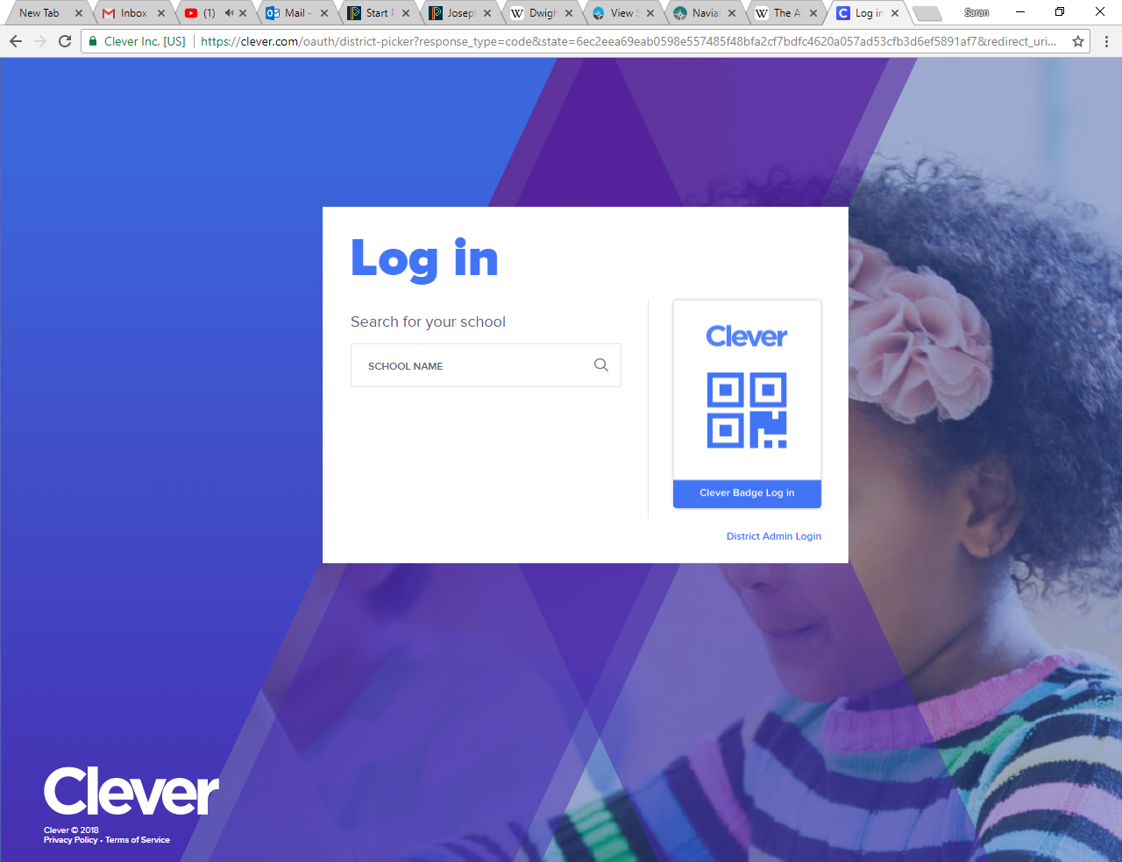
If this screen appears: Type Flora in the school name section; and then select AC Flora High School.

Slide 5
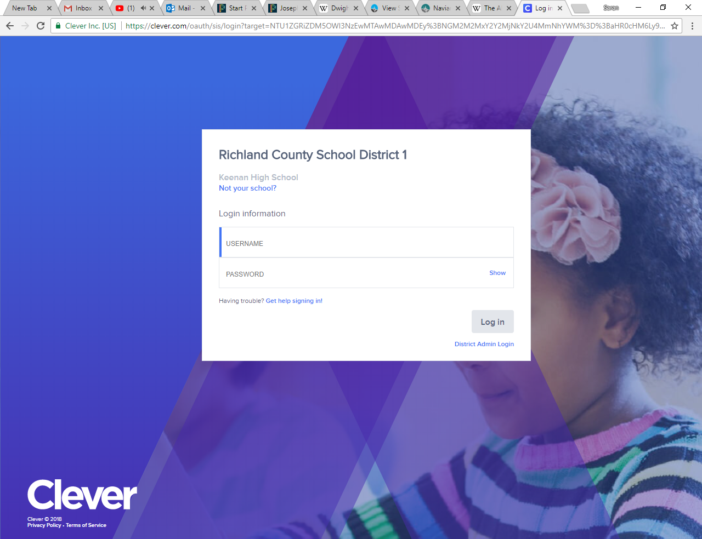
Your username is your school ID (the entire ID number)
Your password is your birthday (if you have a 0 at the beginning of the month or day of your birthday DO NOT TYPE THE ZERO). For example students born in the month of January should write 1/2/2001.

Slide 6
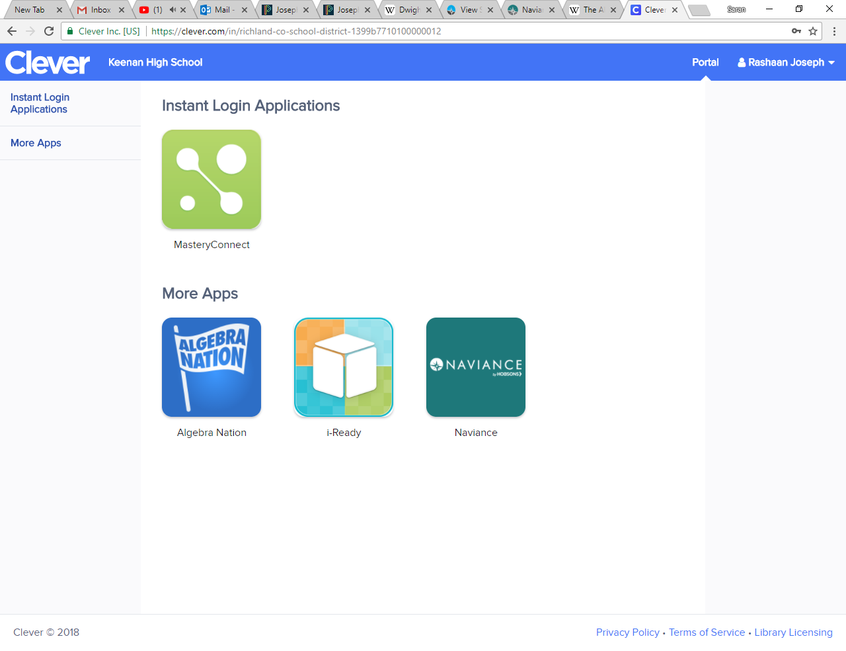
Once in the site, go to the Naviance tab

Slide 7
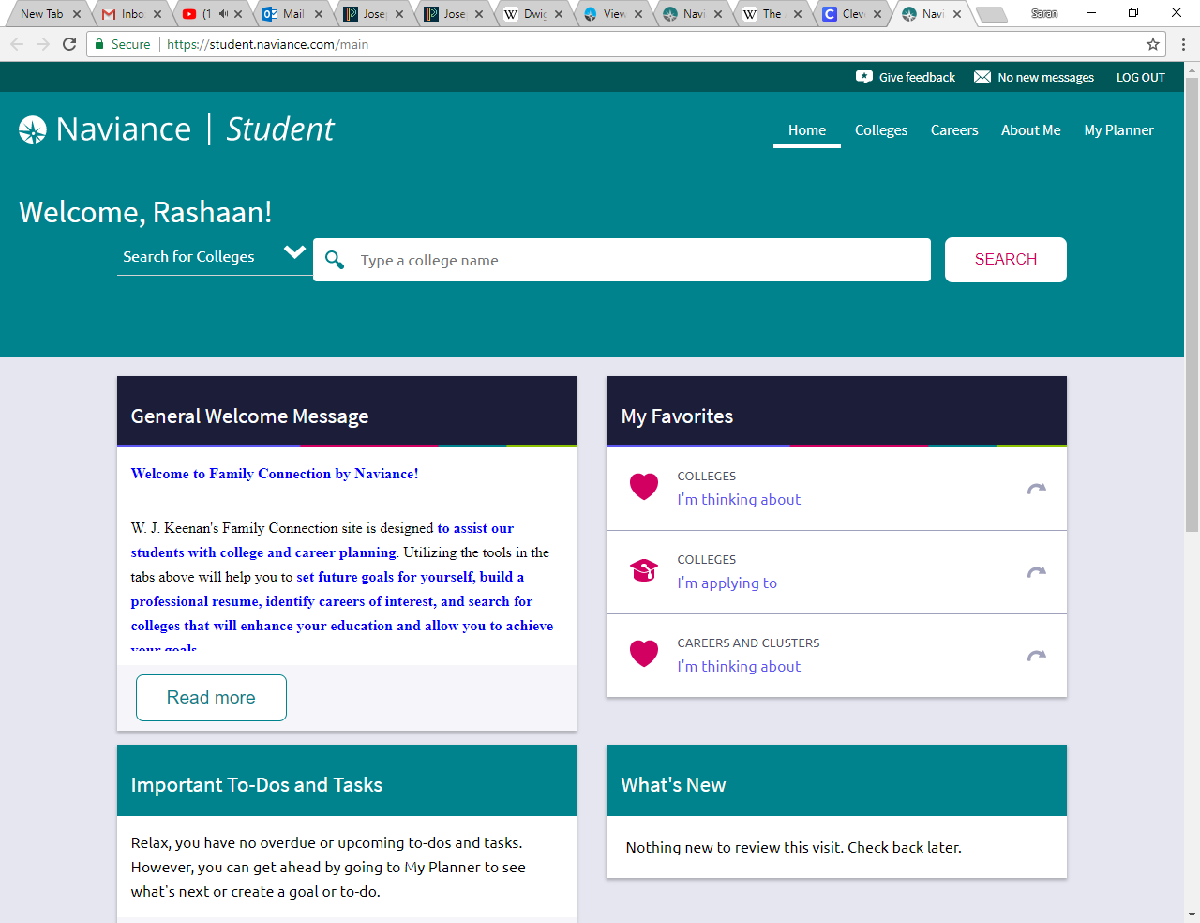
You did it!!!!! This site will be used for various activities, etc.

Slide 8
12th grade students: Now, go to the top RIGHT corner and click on Colleges.

Slide 9
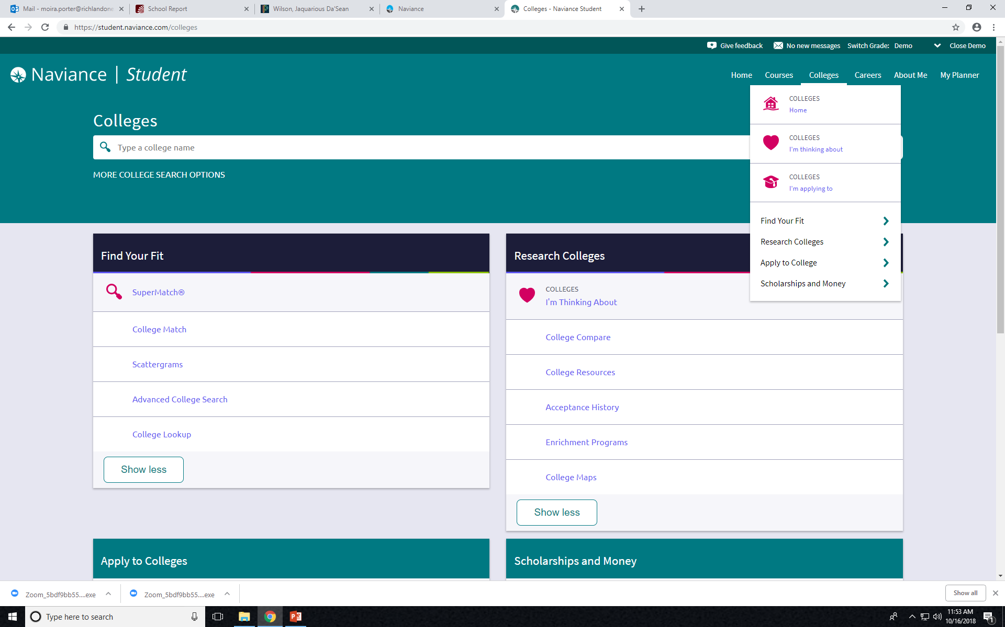
Select Scholarships and Money

Slide 10
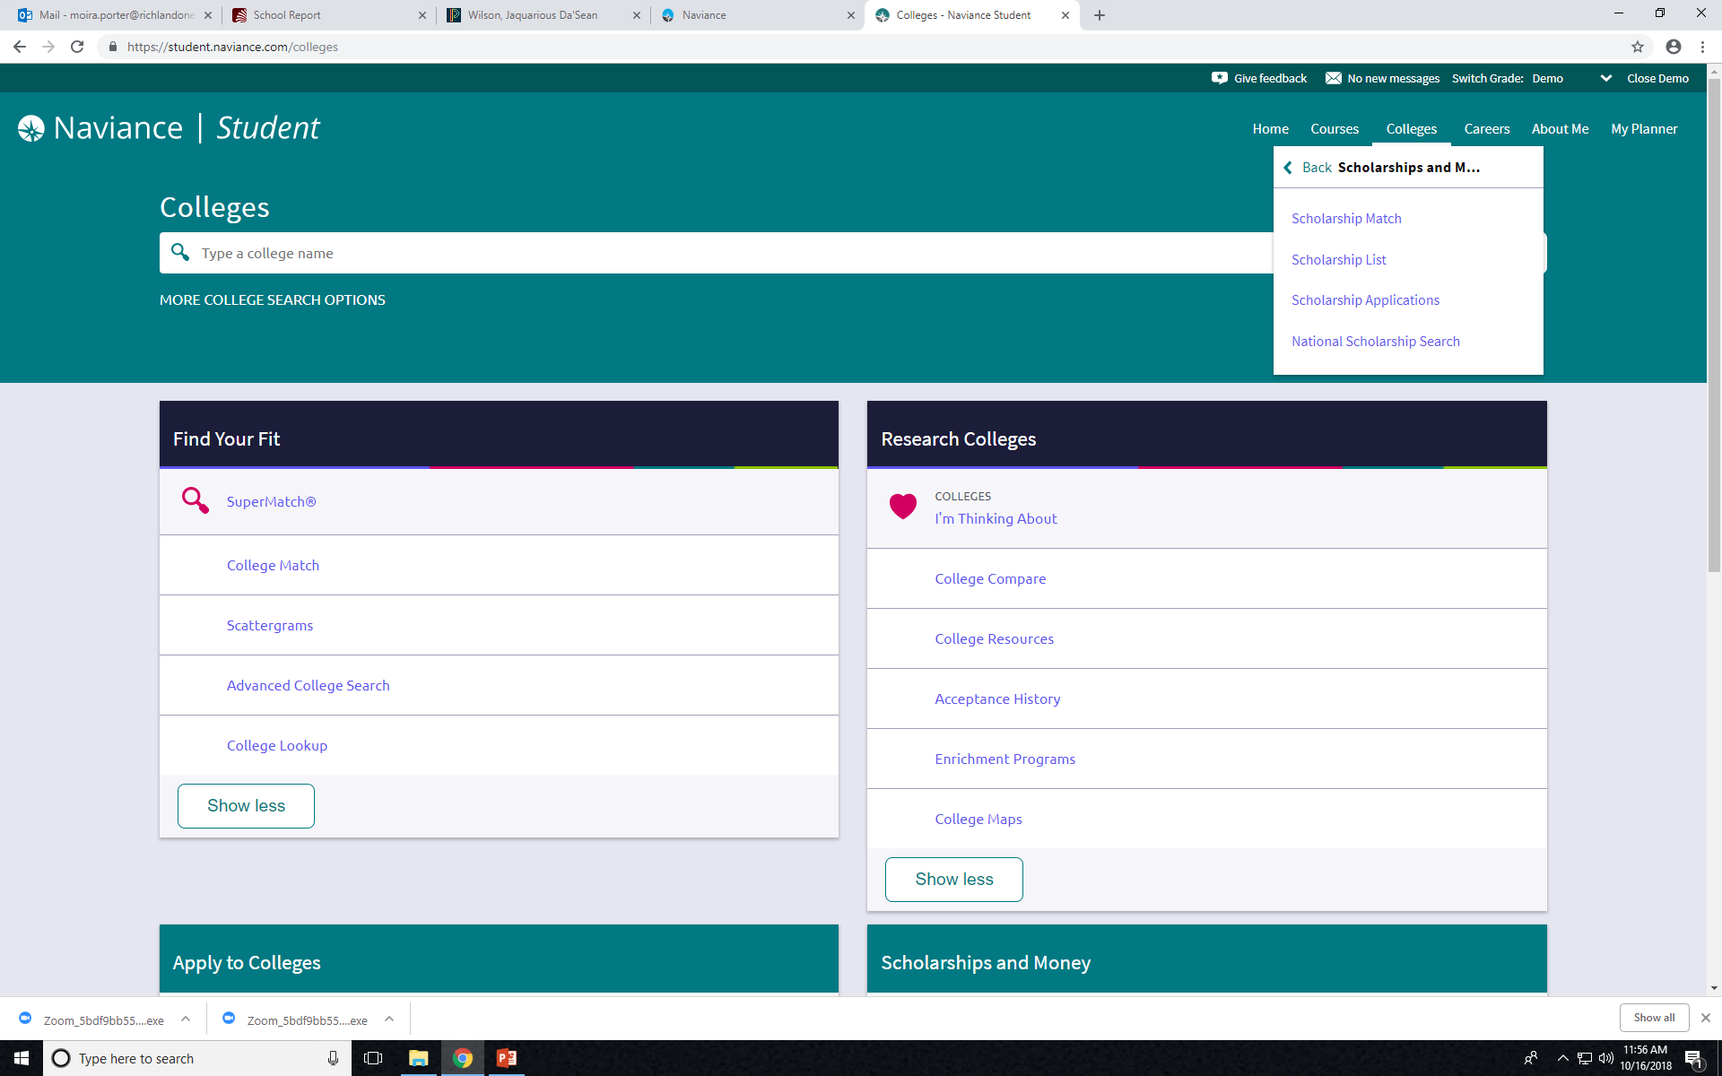
Select Scholarship List and/or National Scholarship Search. Use these searches to begin your scholarship search and begin applying for scholarships.

Slide 11
Scholarship Goal
You need to look at the requirements for 3 scholarships.
Choose one to begin applying to TODAY!!
If you finish early, Go to Build Your Resume and update your resume previously built by reviewing all of the resume questions previously answered.

