Slide 1
Naviance/Clever
College Supermatch Search

Slide 2
How do Students Log-in to their account:
Students, please follow the directions given below.
(Screenshots of directions below are in the following 3 screens.)
Students go to :
https://clever.com/
  Go to “Log In As a Student”
  Type in school name as “Flora”, then choose AC Flora from Drop down menu
Username: Student ID, example 11344
Student password: M/D/YYYY Ex: 5/9/2004
            MM/DD/YYYY Ex: 12/24/2003

Slide 3
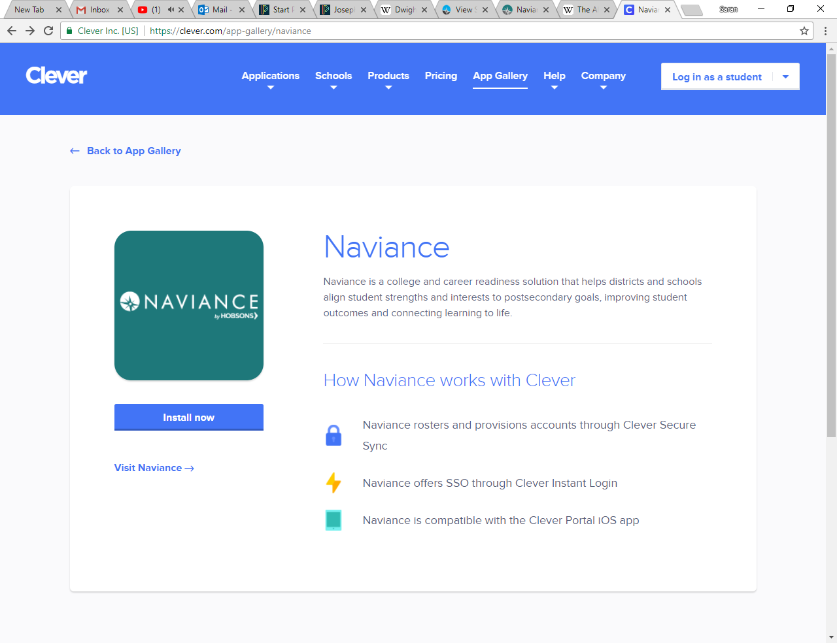
In the upper right hand corner, click on the log in tab

Slide 4
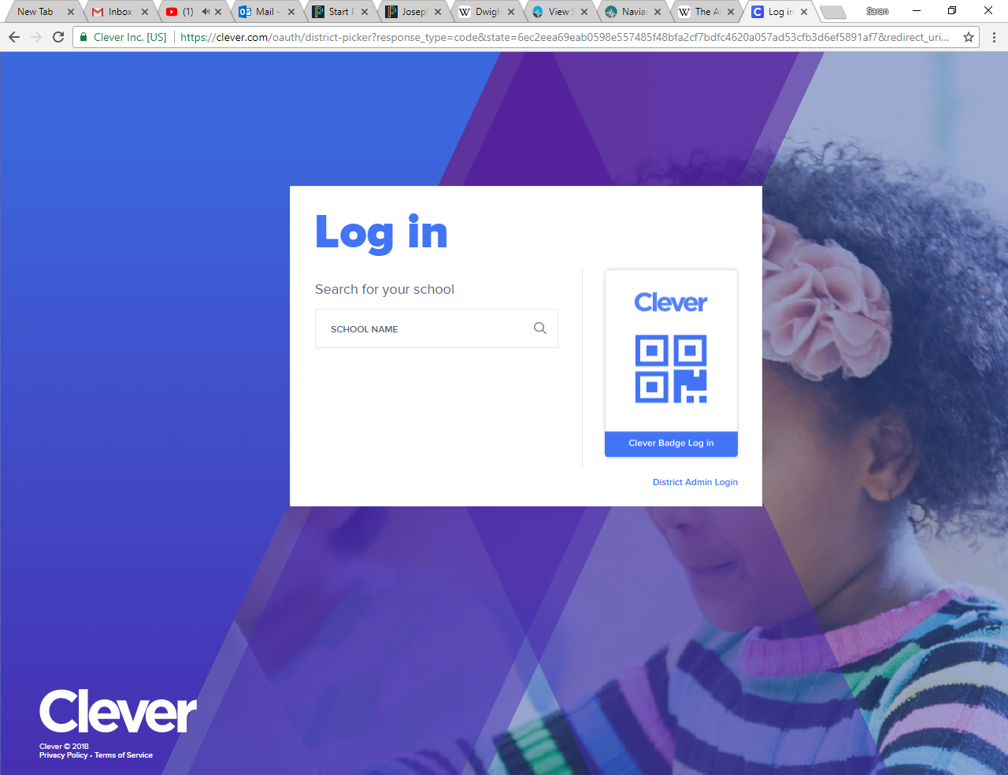
If this screen appears: Type Flora in the school name section; and then select AC Flora High School.

Slide 5
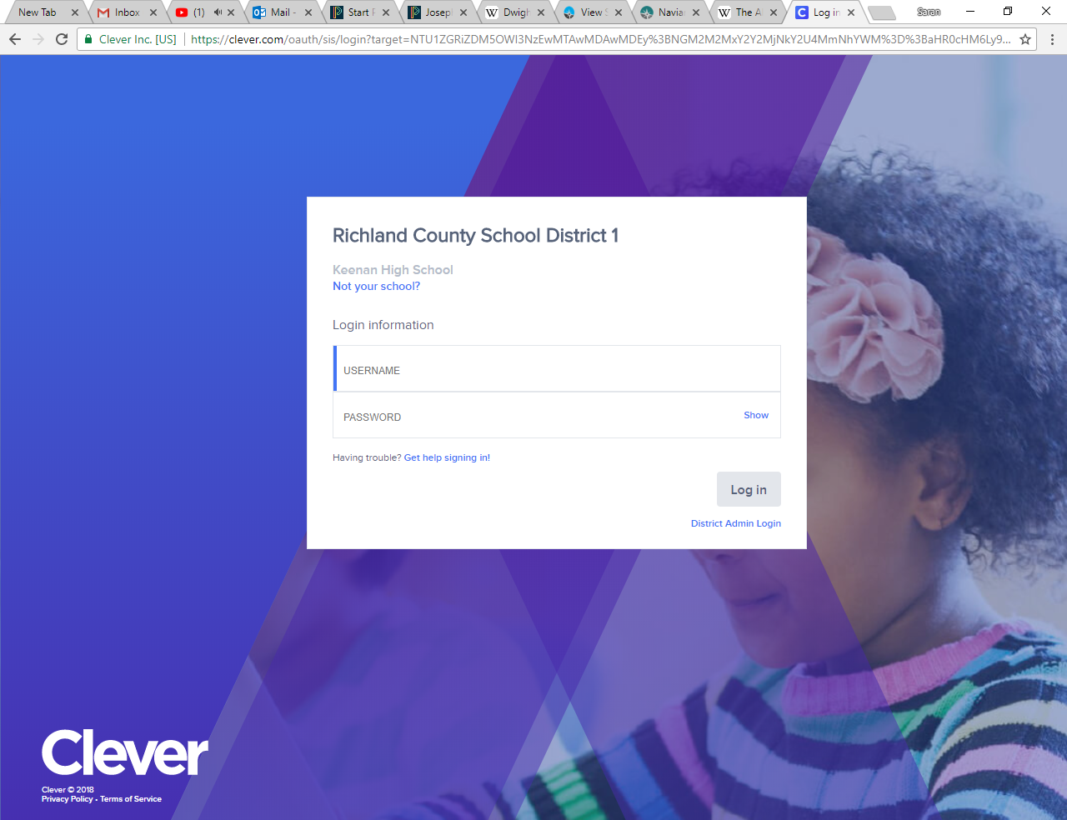
Your username is your school ID (the entire ID number)
Your password is your birthday (if you have a 0 at the beginning of the month or day of your birthday DO NOT TYPE THE ZERO). For example students born in the month of January should write 1/2/2001.

Slide 6
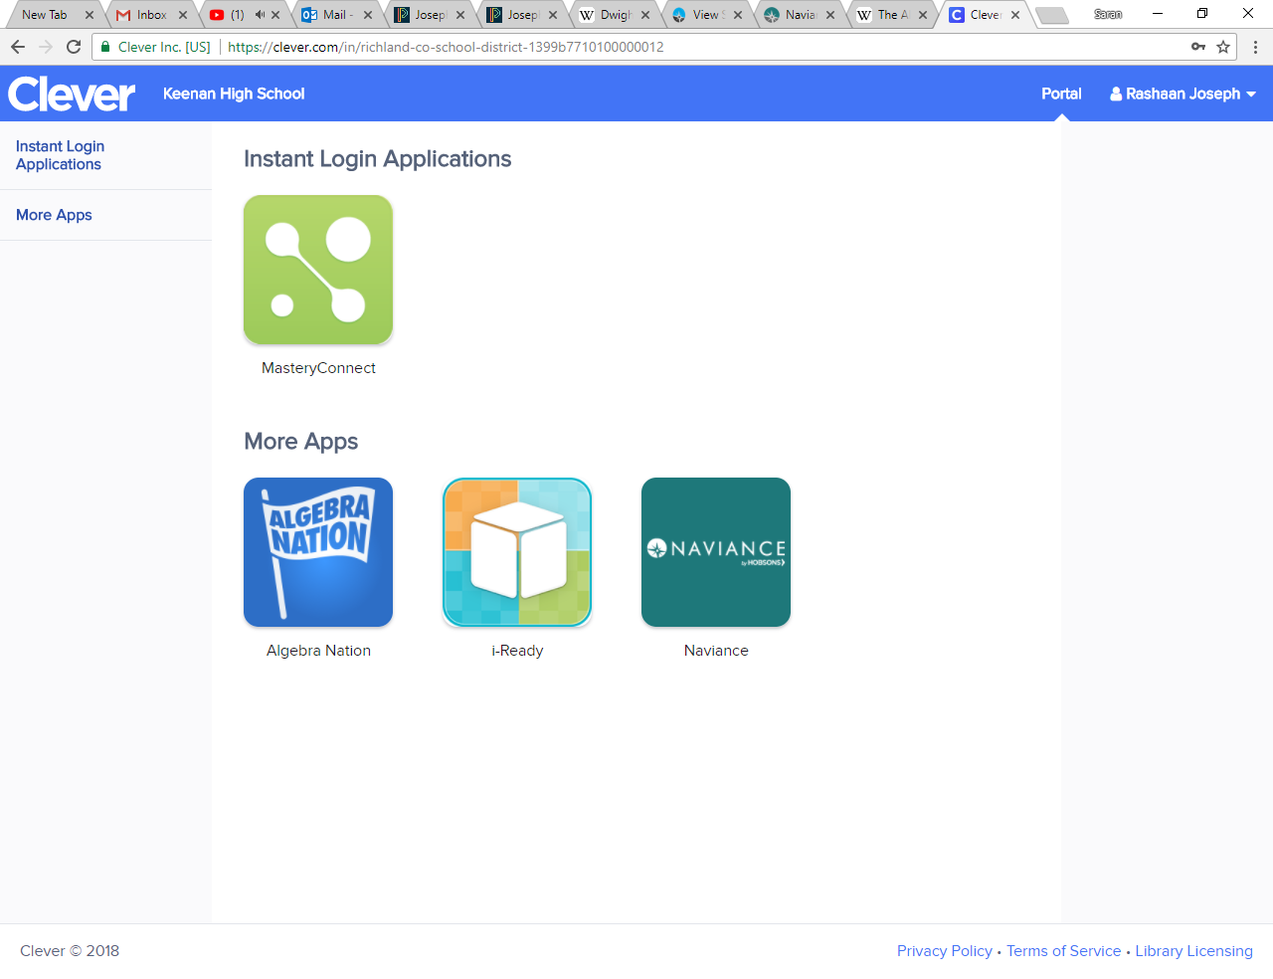
Once in the site, go to the Naviance tab

Slide 7
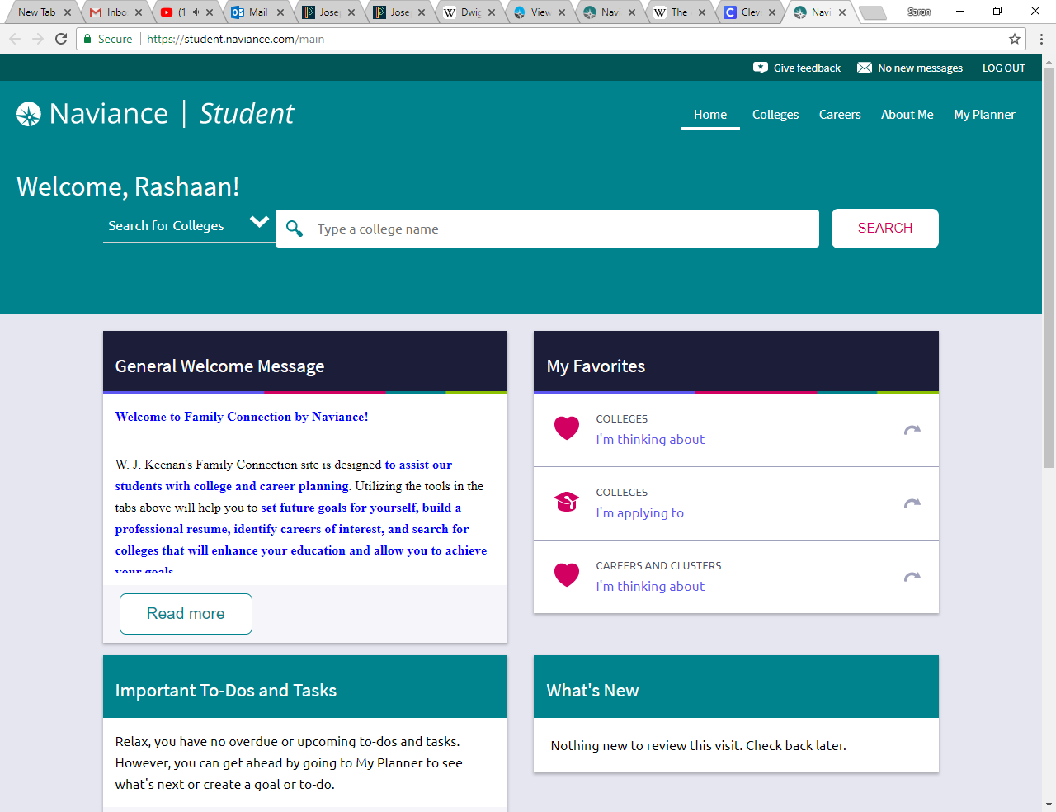
You did it!!!!! This site will be used for various activities, etc.

Slide 8
Now, go to the top RIGHT corner and click on My Planner.

Slide 9
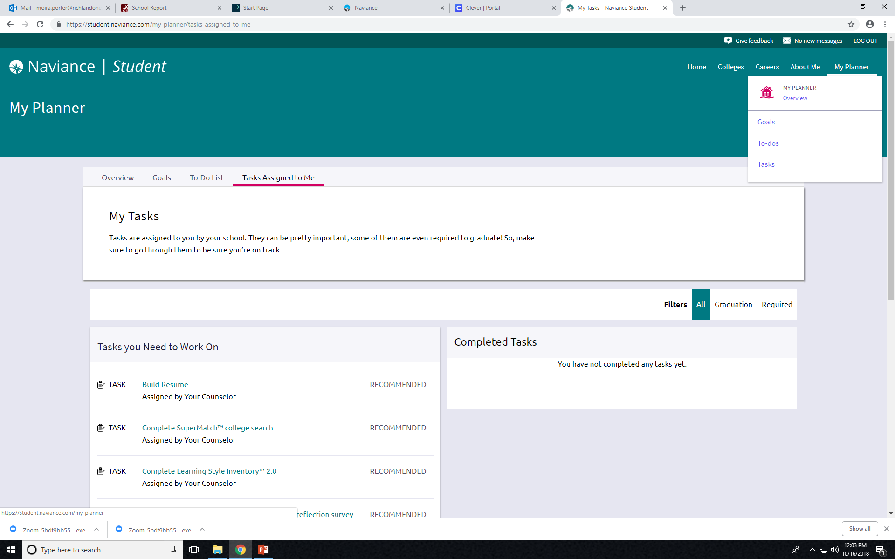
Select Tasks

Slide 10
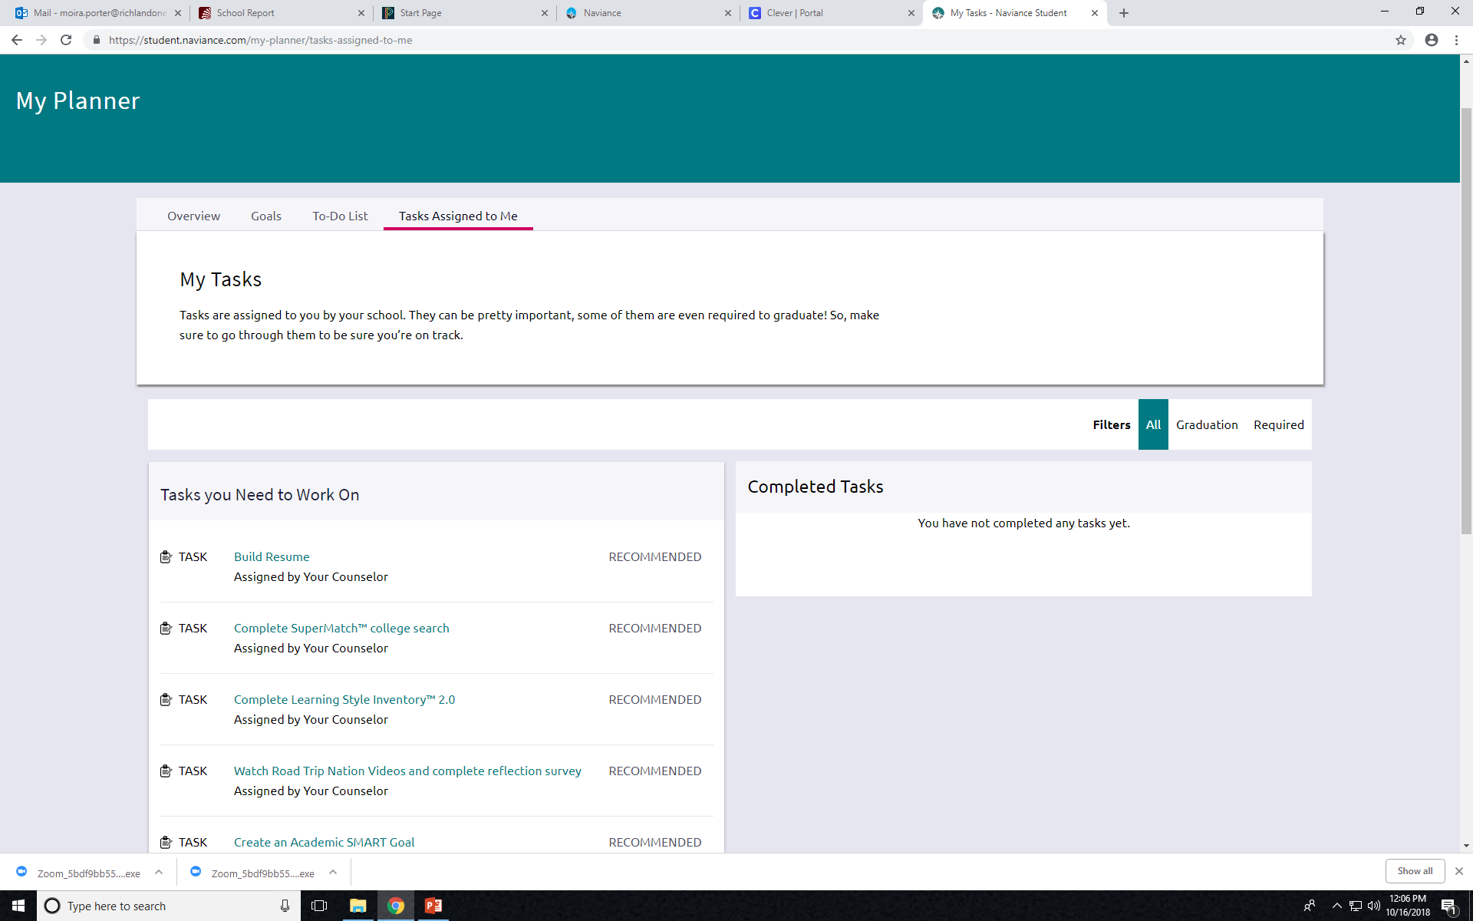
Choose Task- Complete SuperMatch College Search.

Slide 11
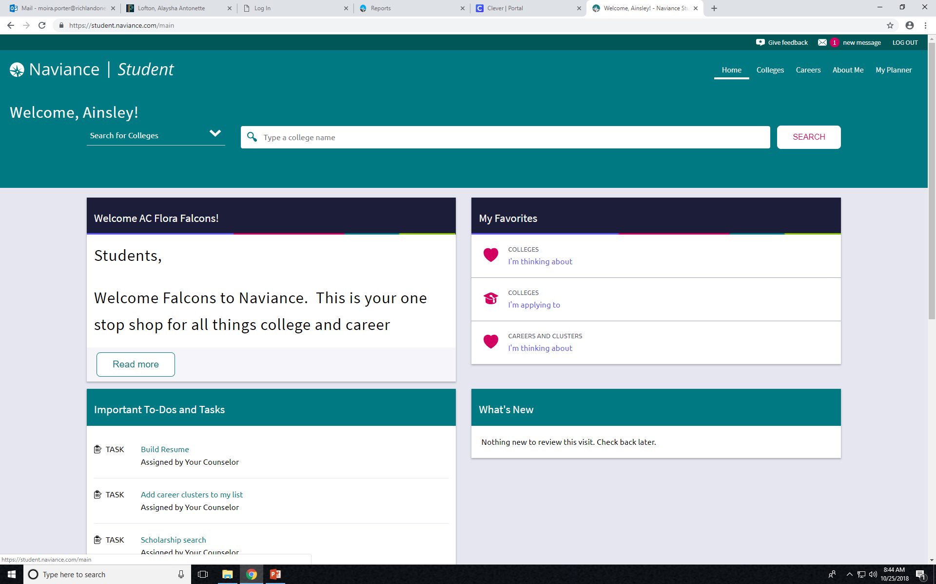
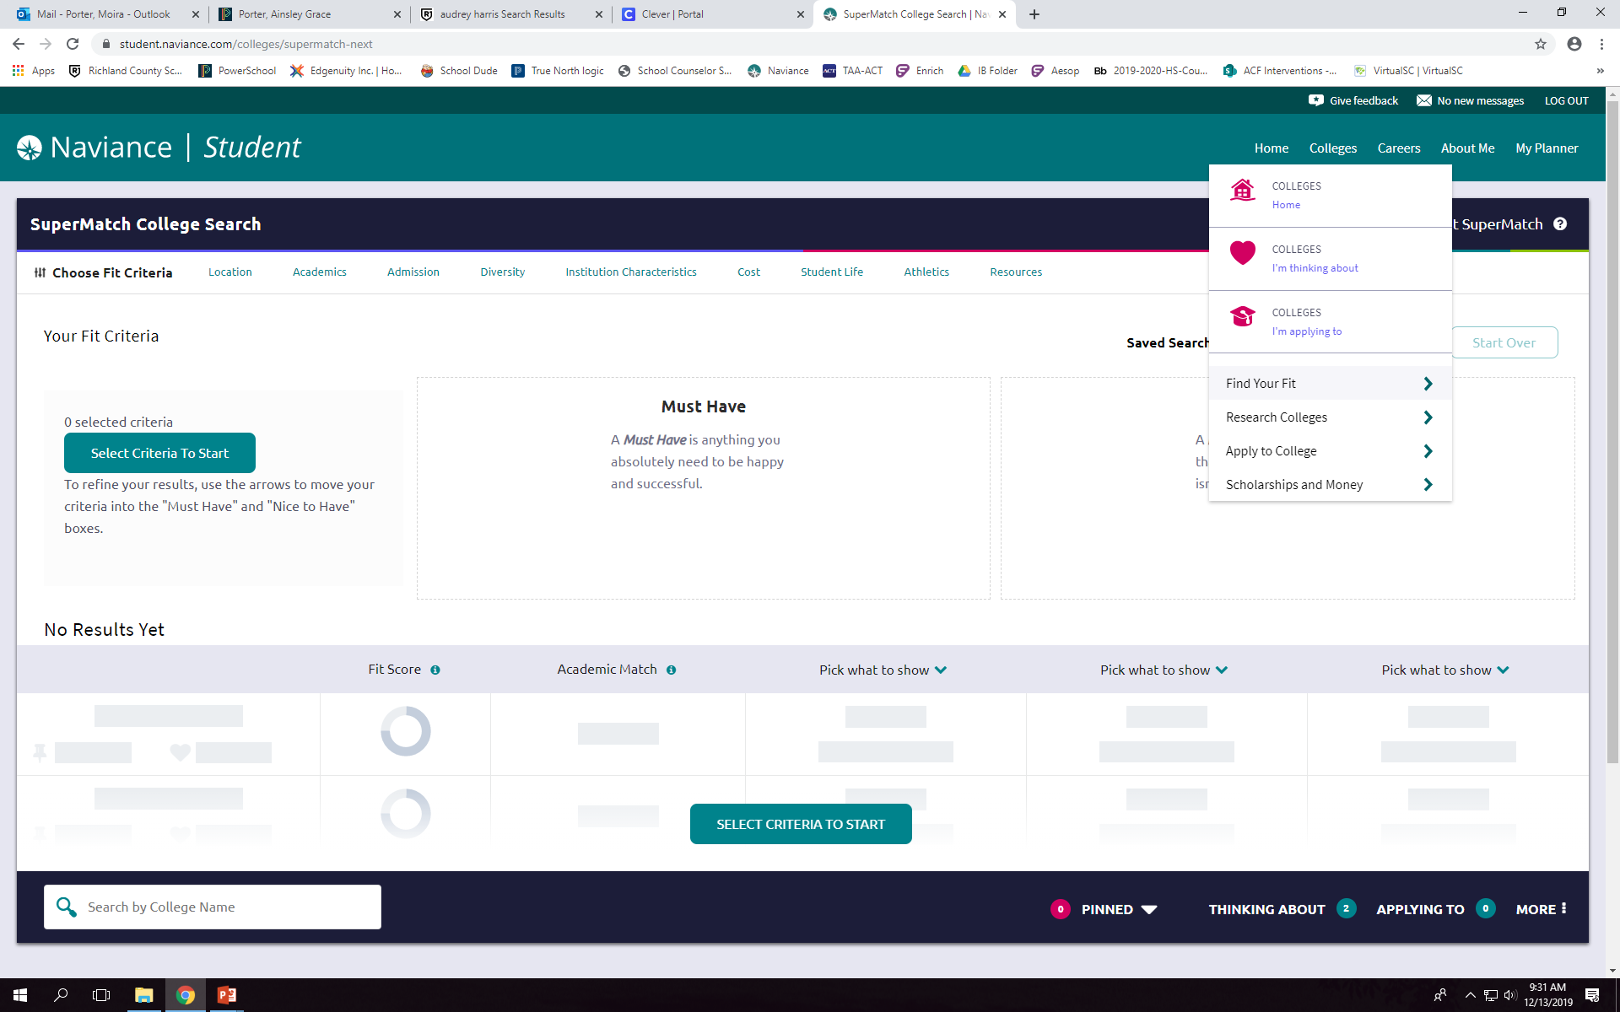
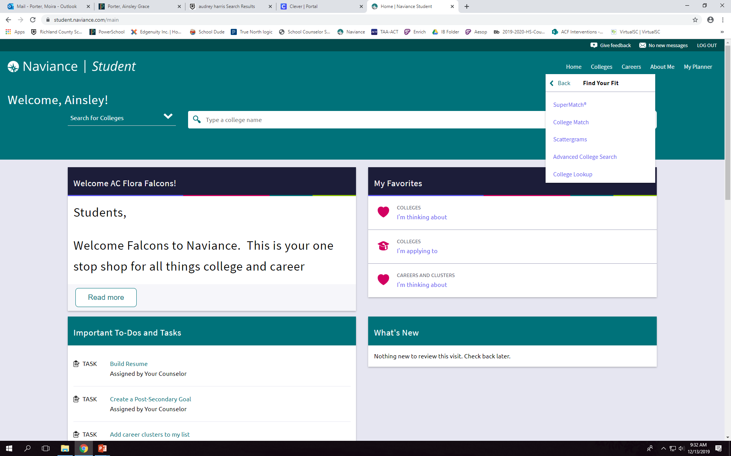
If you DO NOT have a To-Do and Tasks list use the directions below:
Go to COLLEGES
Click FIND YOUR FIT
Click SUPERMATCH

Slide 12
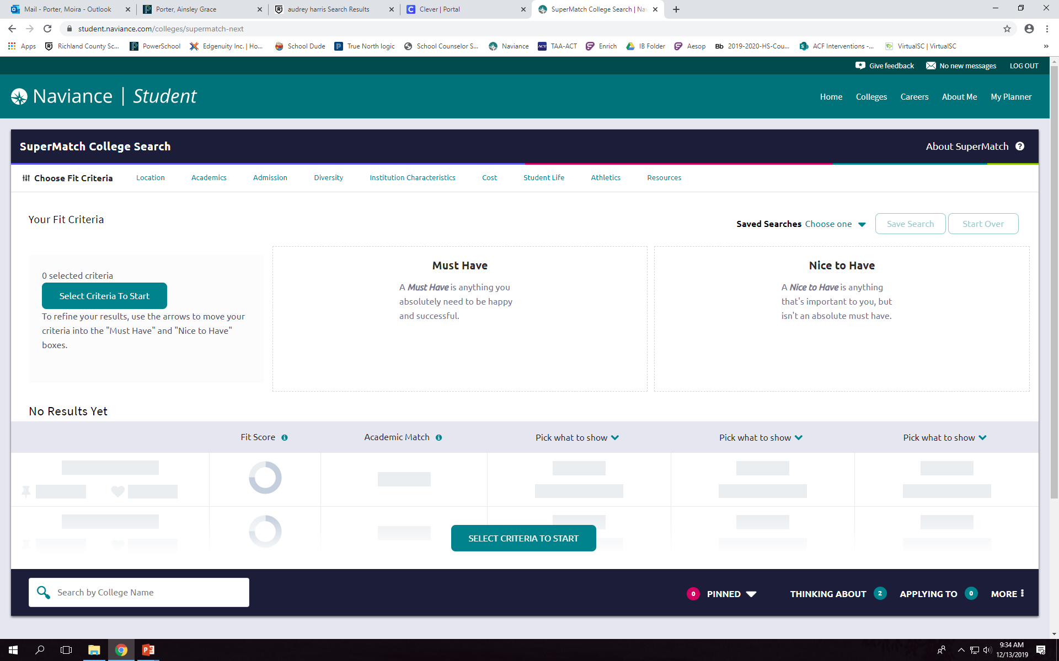
Begin by clicking on Select Criteria to Start.

Slide 13
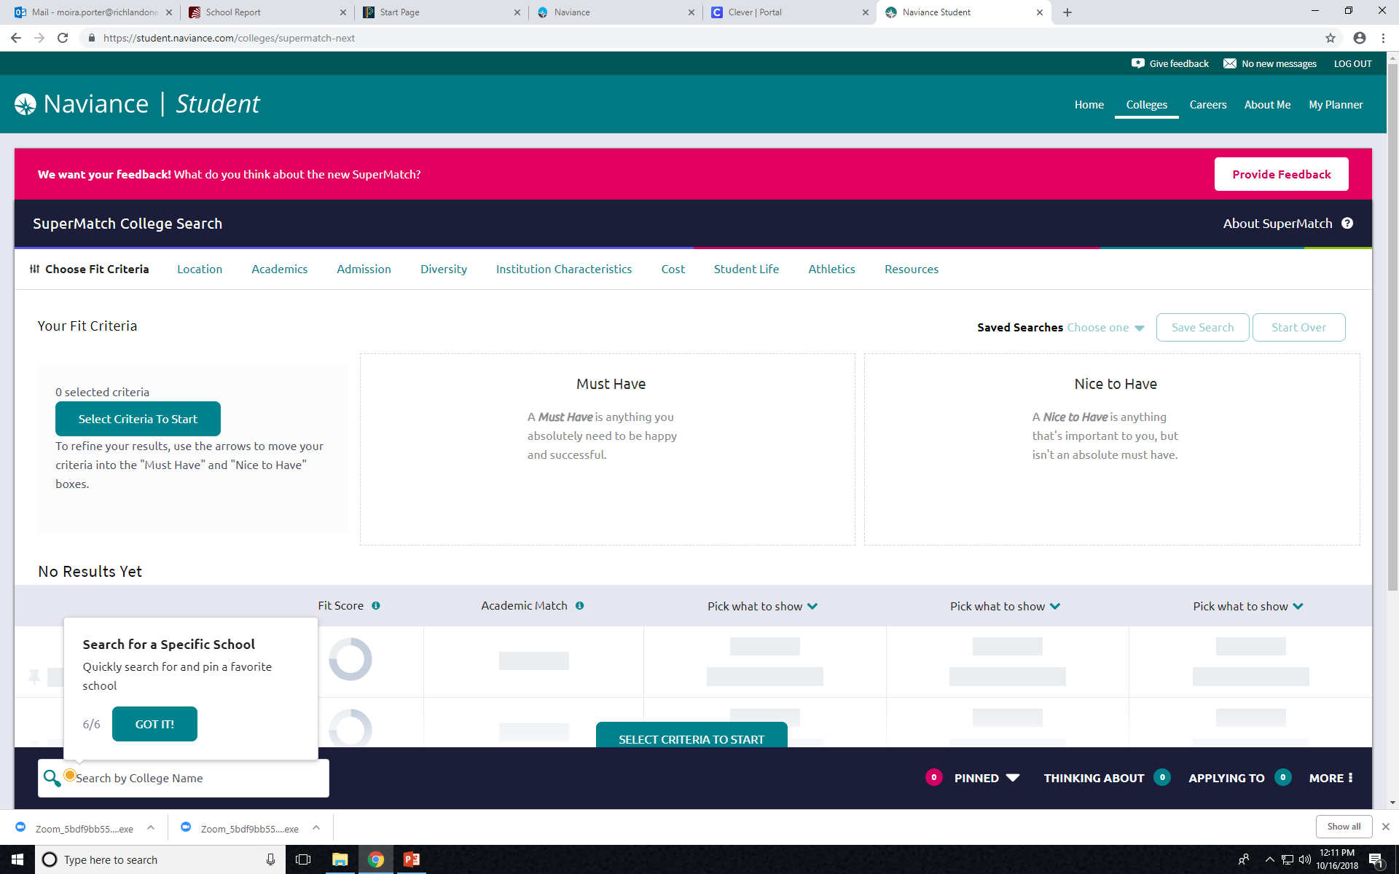
Begin your College Search by completing the tasks on the top toolbar.
Begin Here.

Slide 14
Once you have completed this, you have completed your tasks for this session.

