Slide 1
Naviance/Clever
Building a Resume

Slide 2
How do Students Log-in to their account:
Students, please follow the directions given below.
(Screenshots of directions below are in the following 3 screens.)
Students go to :
https://clever.com/
  Go to “Log In As a Student”
  Type in school name as “Flora”, then choose AC Flora from Drop down menu
Username: Student ID, example 11344
Student password: M/D/YYYY Ex: 5/9/2004
            MM/DD/YYYY Ex: 12/24/2003

Slide 3
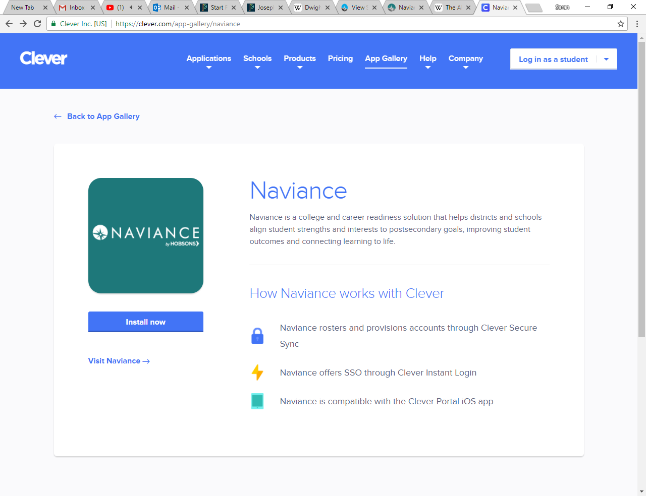
In the upper right hand corner, click on the log in tab

Slide 4
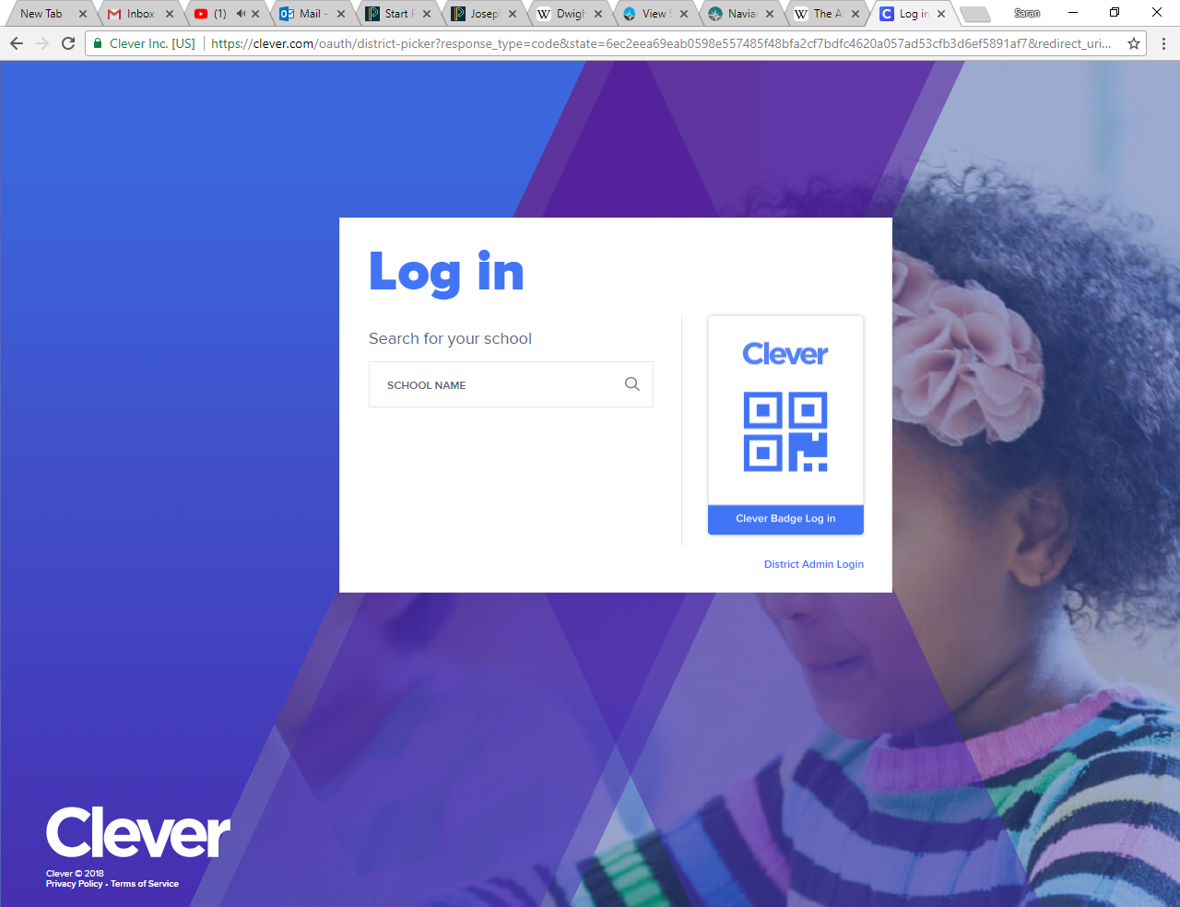
If this screen appears: Type Flora in the school name section; and then select AC Flora High School.

Slide 5
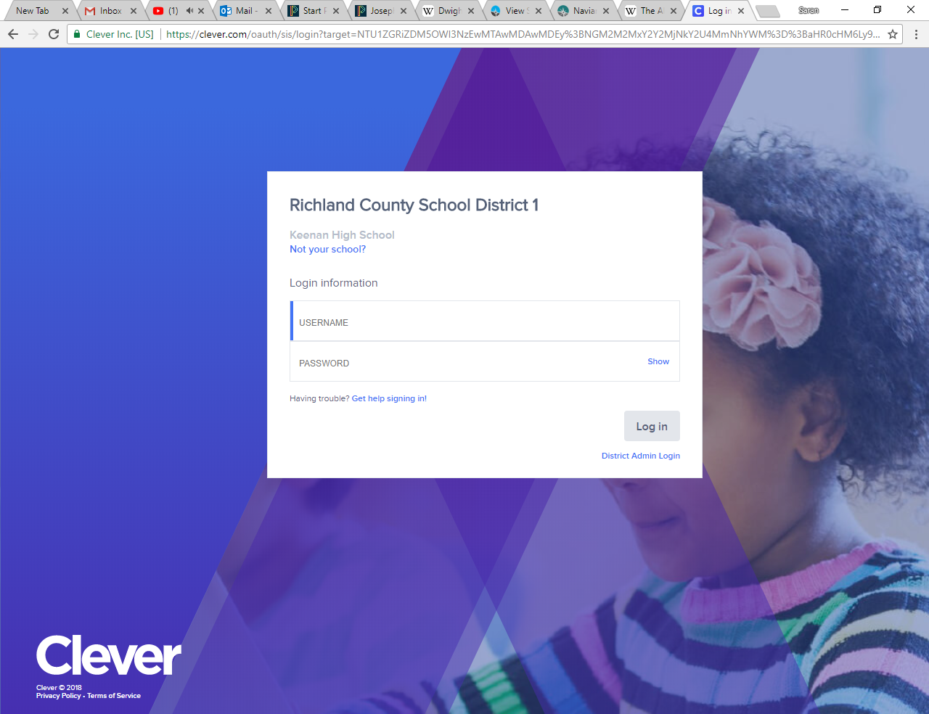
Your username is your school ID (the entire ID number)
Your password is your birthday (if you have a 0 at the beginning of the month or day of your birthday DO NOT TYPE THE ZERO). For example students born in the month of January should write 1/2/2001.

Slide 6
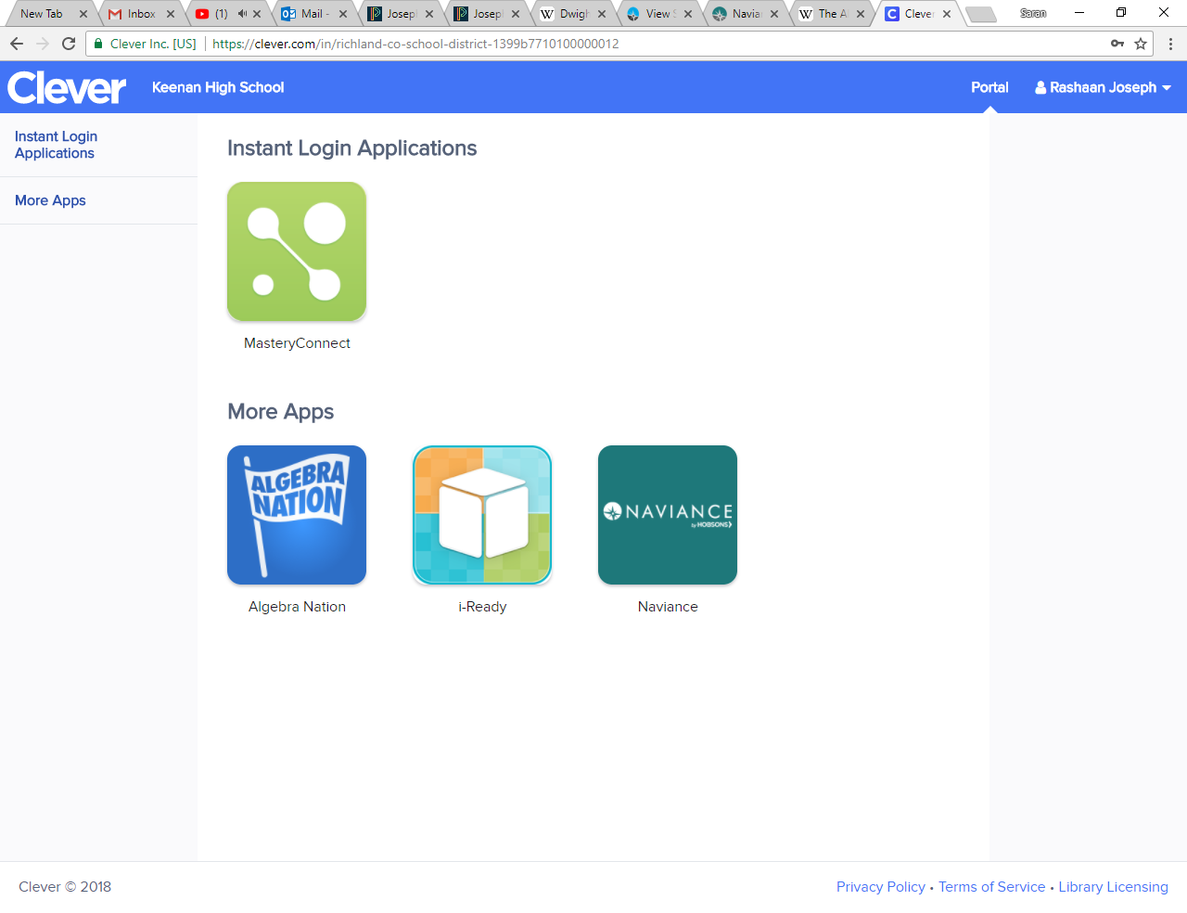
Once in the site, go to the Naviance tab

Slide 7
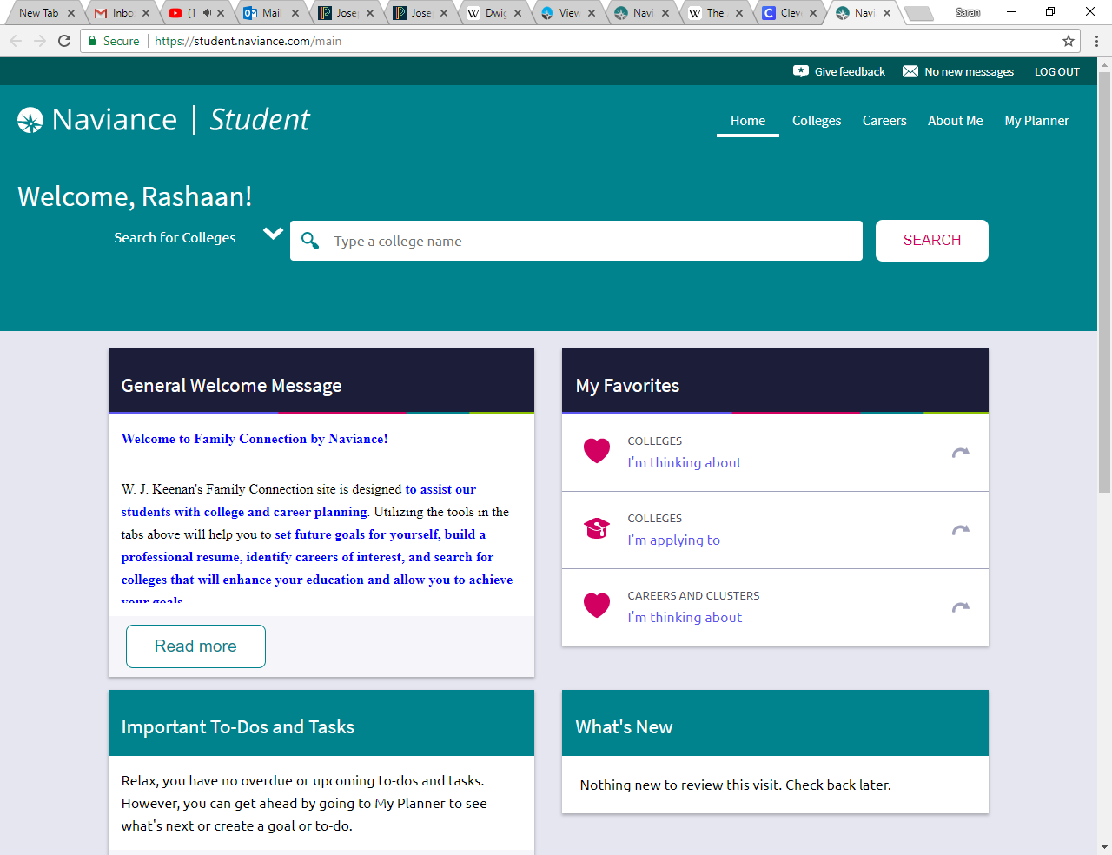
You did it!!!!! This site will be used for various activities, etc.

Slide 8
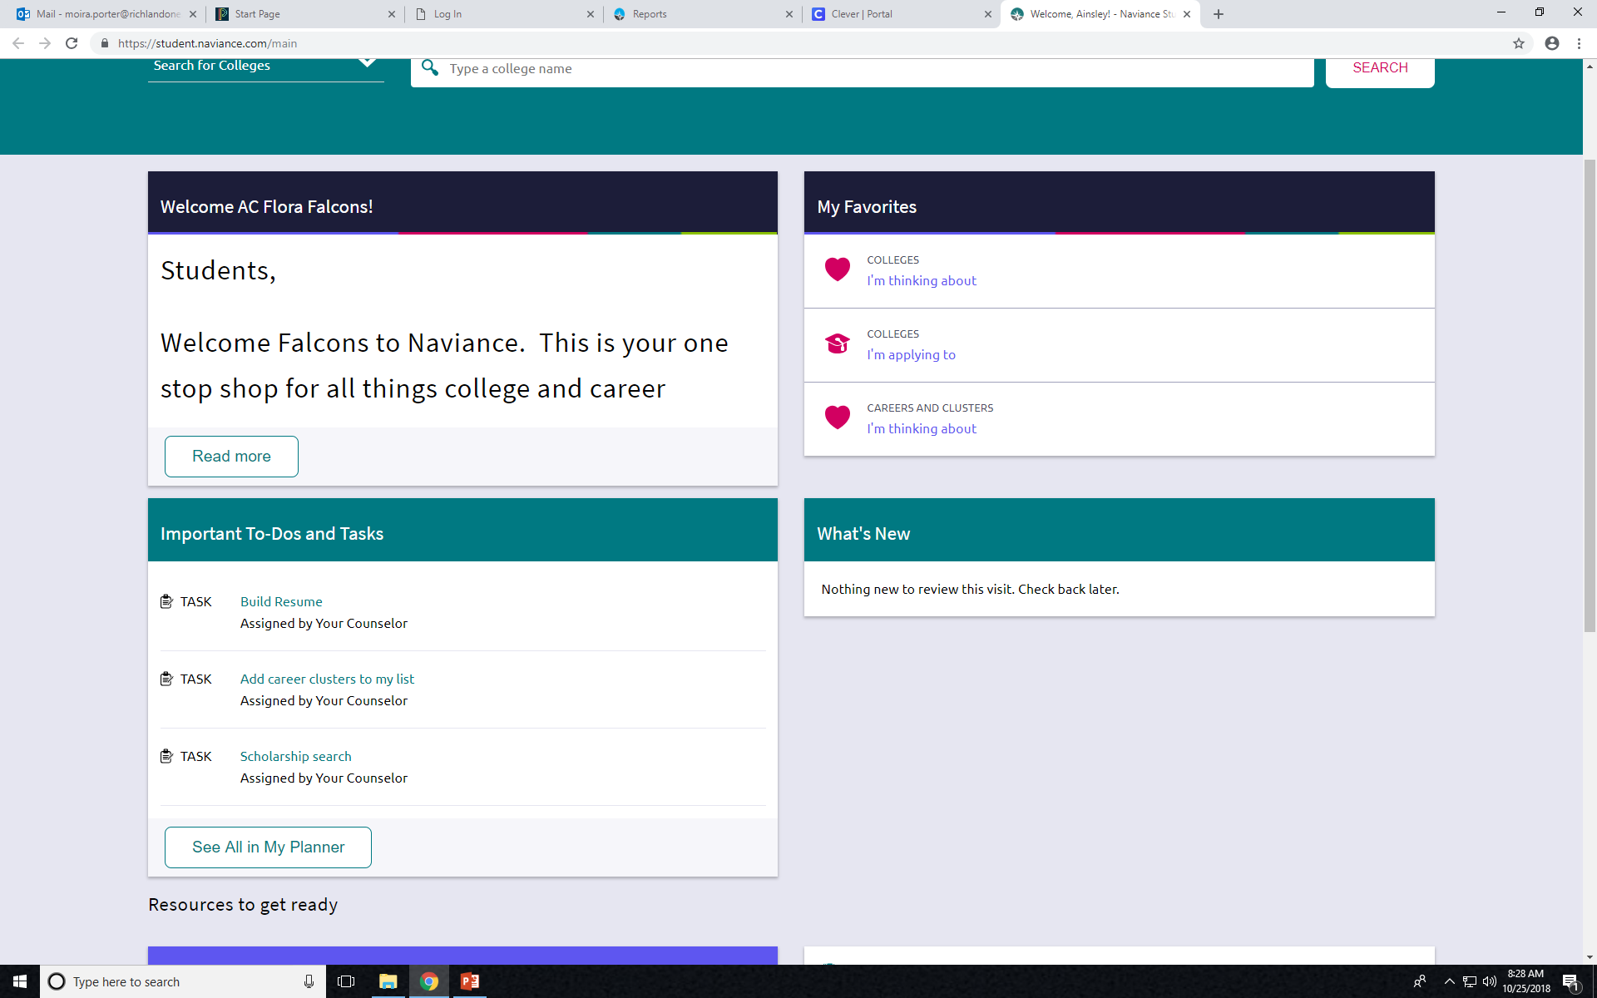
All students: Now, go to the Important To-Do’s and Tasks. Click on Build Resume.

Slide 9
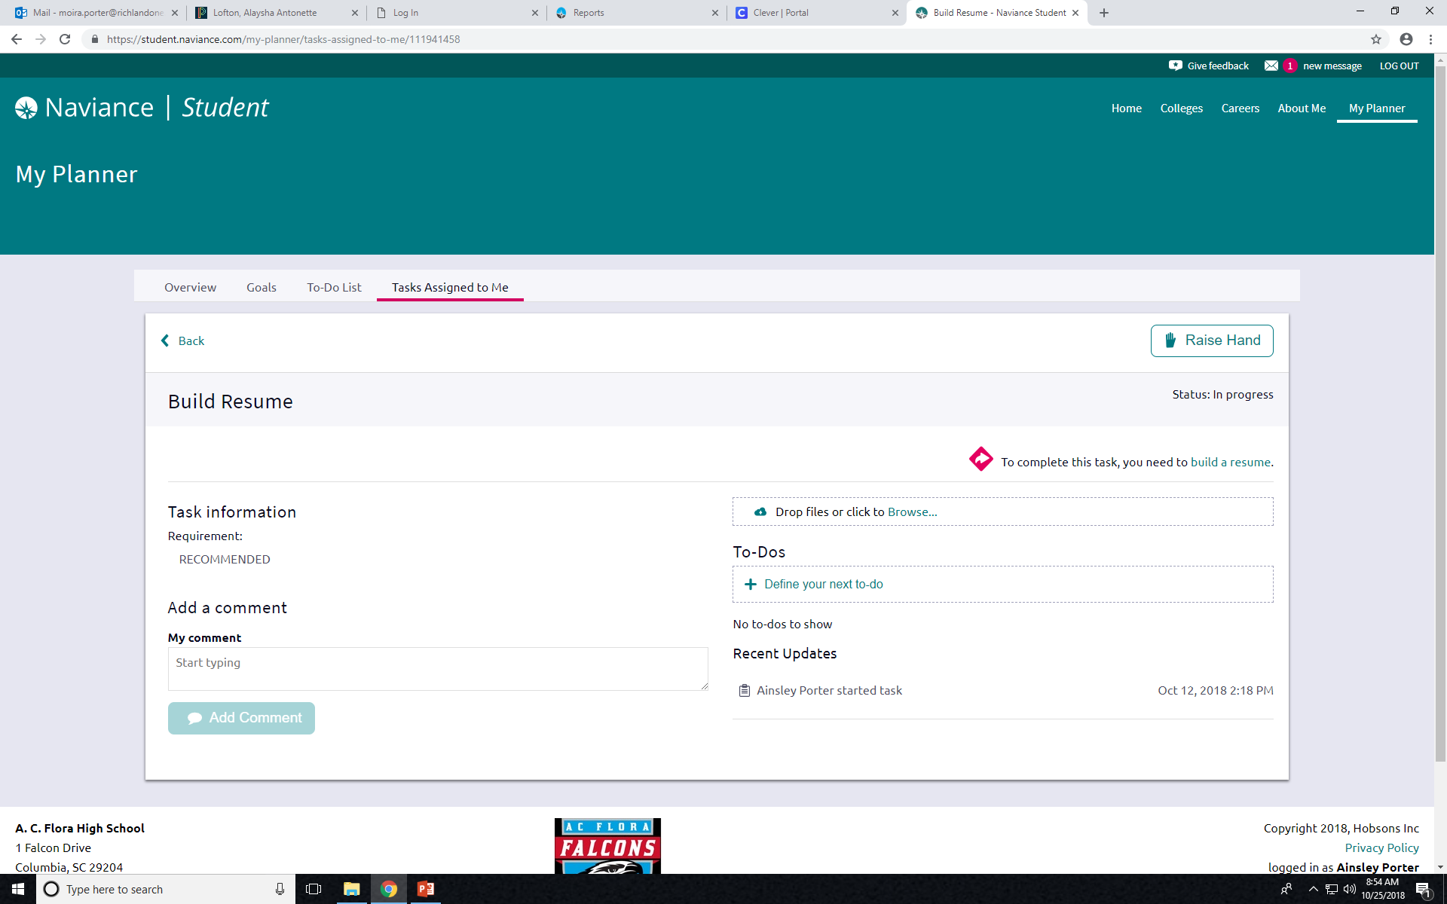
Begin by clicking on Build a Resume.

Slide 10
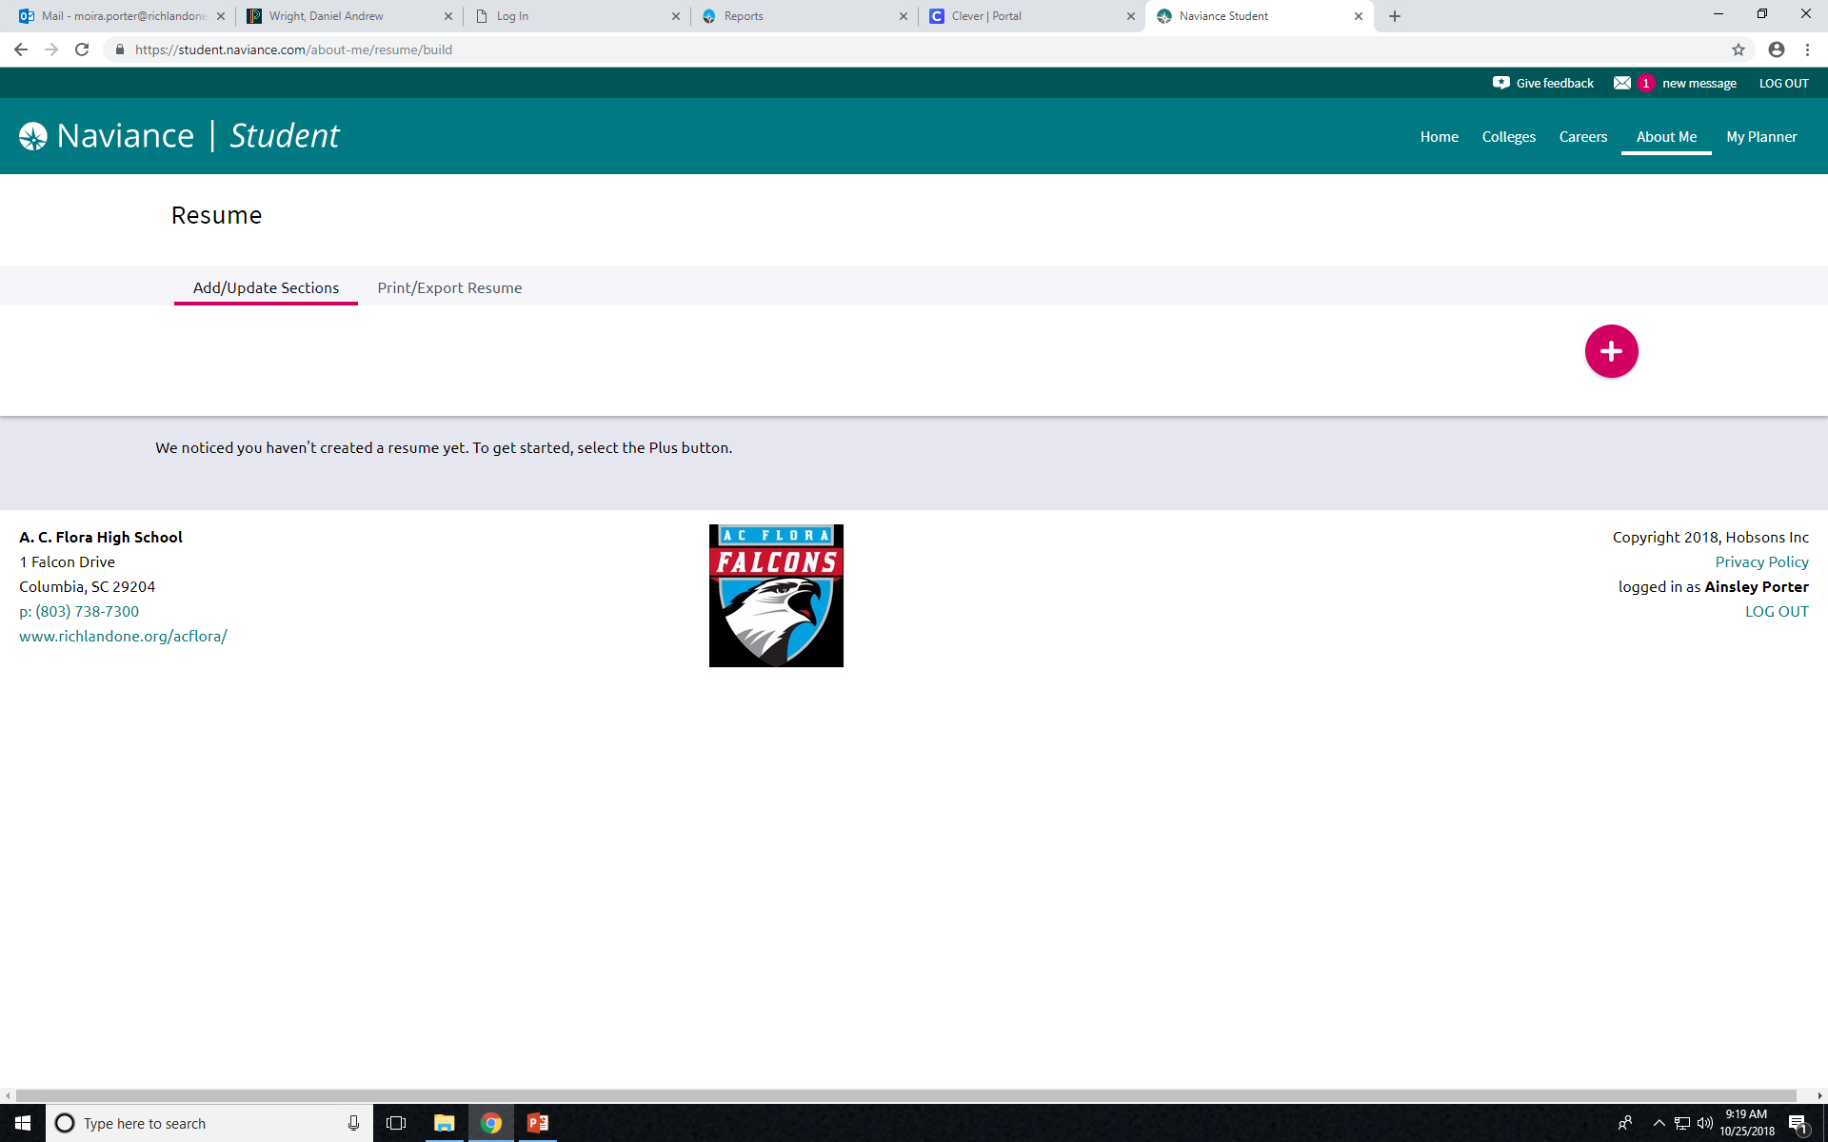
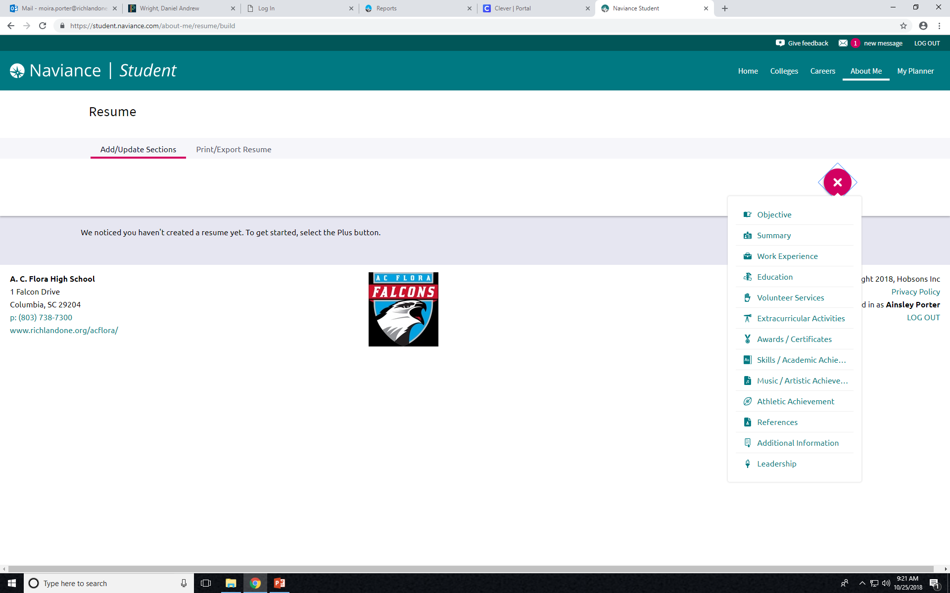
To Add/Update Sections, click on the (+) button; Then click on each category and complete what is asked.

Slide 11
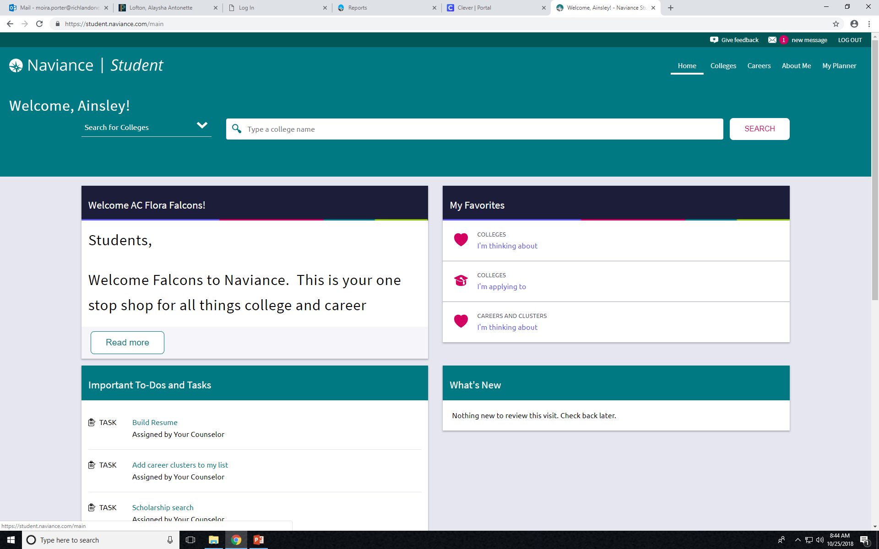
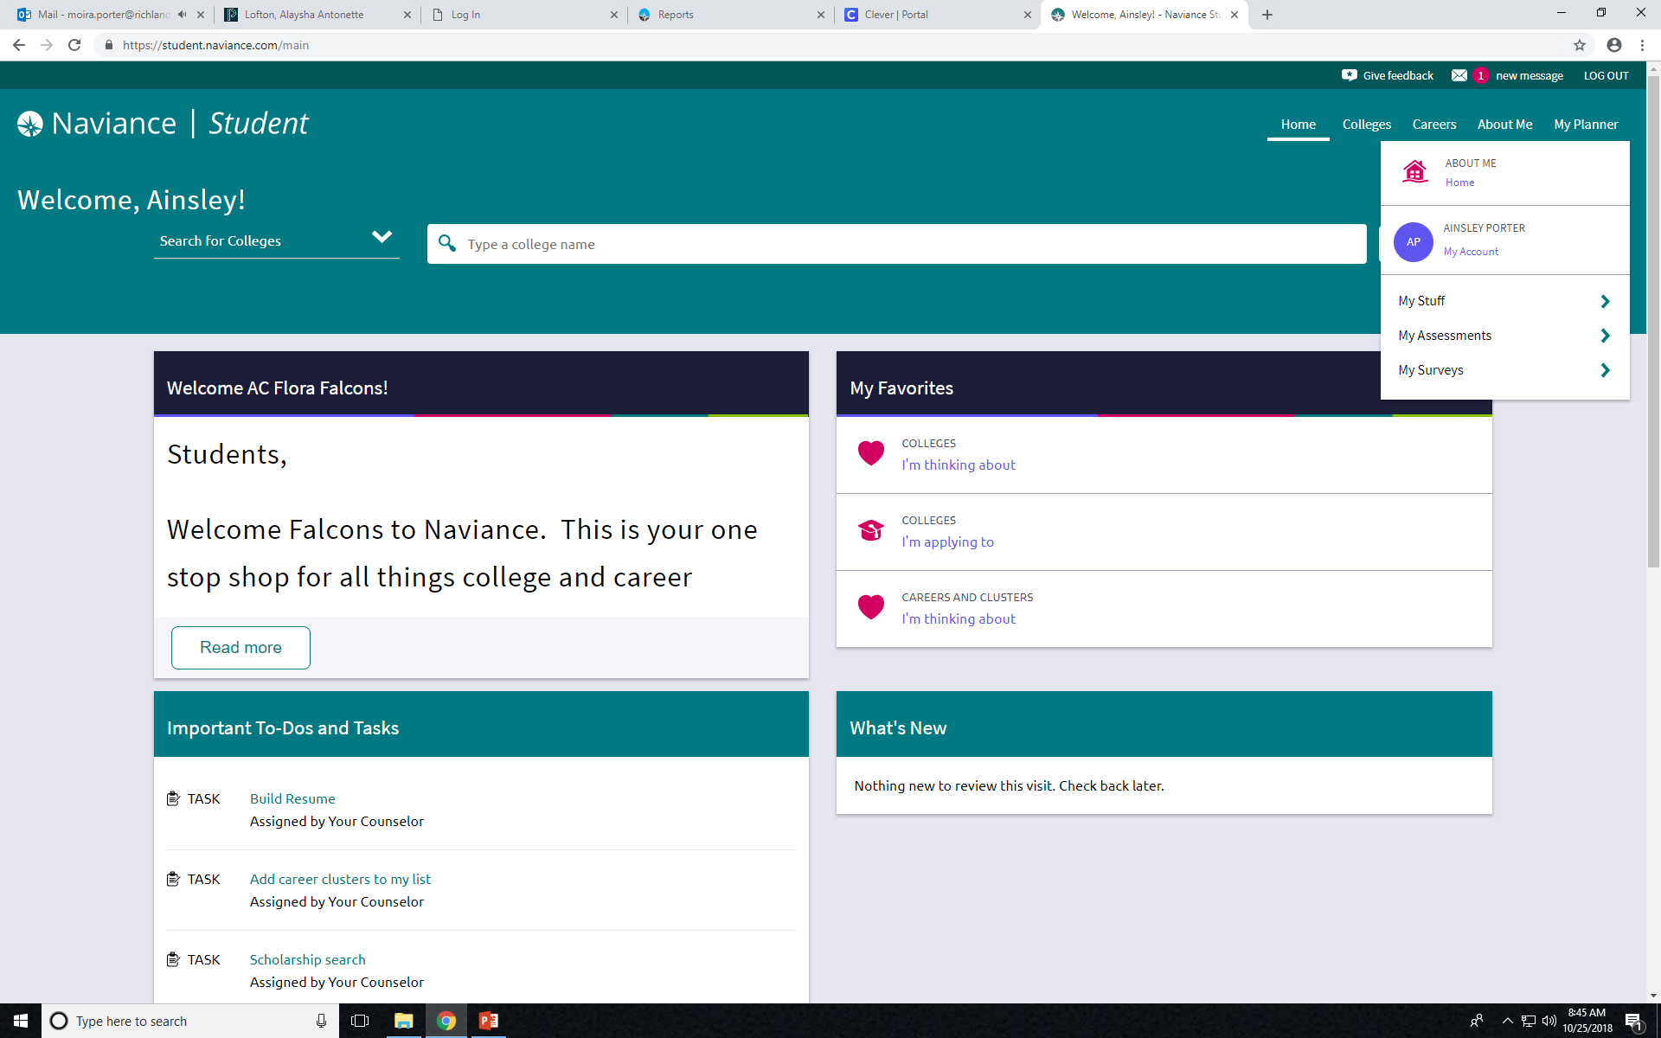
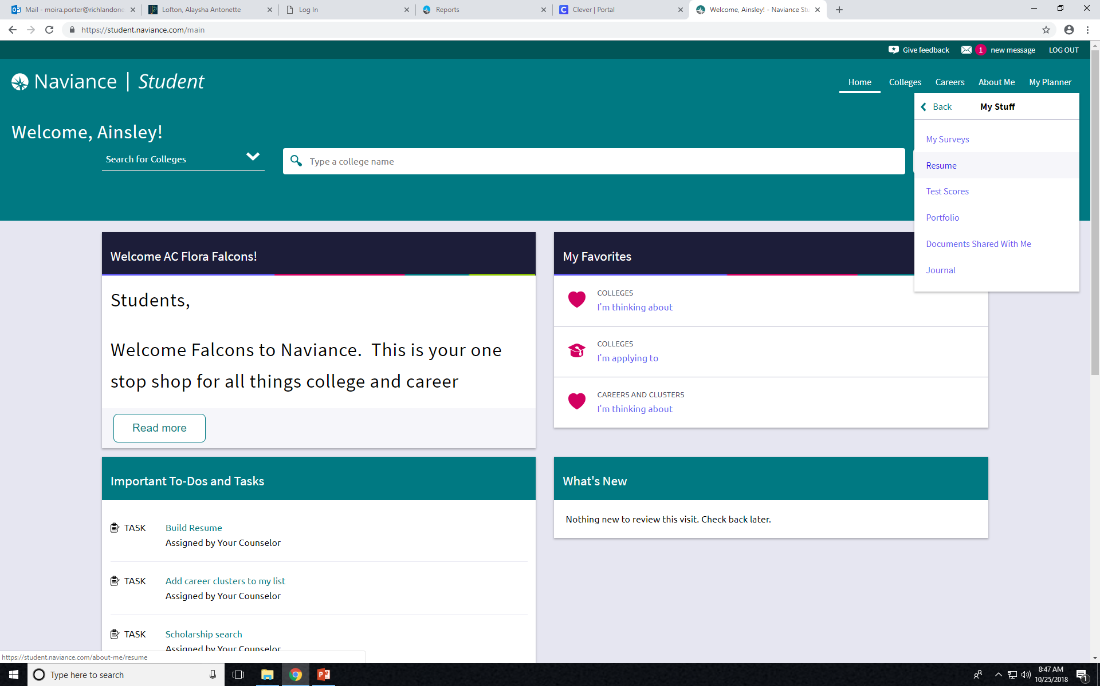
If you DO NOT have a To-Do and Tasks list use the directions below:
Go to ABOUT ME
Click MY STUFF
Click RESUME

Slide 12
To Add/Update Sections, click on the (+) button; Then click on each category and complete what is asked.

Slide 13
If you complete your goals quickly, use the College and Career Resources at the top of the “Welcome” page to do some research on your own.
You can also review your previous activities and make any changes or additions you feel are needed.

