Slide 1

A.C. Flora High School
Welcome, Class of 2027!

Slide 2
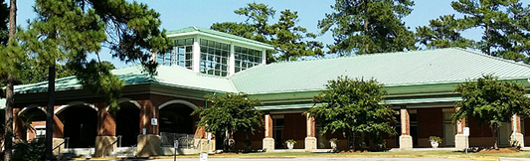
Introductions
AC Flora Administration:
Susan Childs, Principal
Dr.Tori Simmons, API
Fletcher Spigner, AP for Last Names A- C
Virginia Tate, AP for Last Names D- I
Dominique Padgett, AP for Last Names J - O
Brent Davis, AP for Last Names P- S
Dr. Patrick Sellars, Last names T-Z
Crayton Administration:
Ms. Angela Burns, Principal
Ms. Amanda Arflin, 6th grade Asst. Principal
Mr. Prince Brewington, 7th grade Asst. Principal
Ms. Brian Blease, 8th grade Asst. Principal
Mr. Kendrick Cleckley, Asst. Principal
W.G. Sanders Administration:
Ms. Andrenna Smith – Principal
Ms. Harriet Davis Alexander- Asst. Principal
Mr. Barry Charley - Administrator
Ms. Candice Parnell- Administrator
AC Flora School Counseling:
Vierean Bartley, Last Names A-C
James Major, Last Names D-I
Anna Coward, Last Names J-O
Shayla Broadnax, Last Names P-S
Moira Porter, Director, Last Names T-Z and IB Students
Crayton School Counseling:
Dr. Amleht Alston, 7th Grade School Counselor
Ms. Cheryl Nix, 6th Grade School Counselor
Ms. Donna Moultrie, 8th Grade School Counselor
Mr. Austin Coleman, Counselor
W.G. Sanders School Counseling:
Ms. Cooper – 8th grade and 7th grade Last Names M- Z
Ms. Mickens- 6th grade and 7th grade Last Names A-L

Slide 3
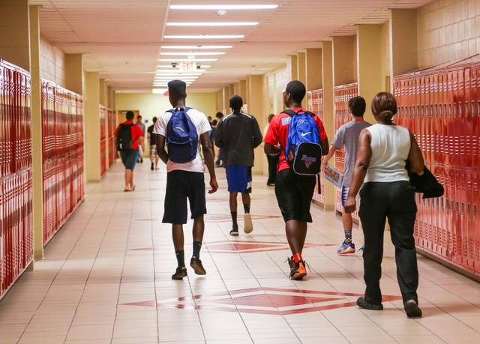
Who: Who is enrolled at AC Flora?
Total Enrollment: 1325-1400 students
Freshmen Class: 359
Sophomore Class: 361
Junior Class: 309
Senior Class: 299
Transfer Season for non-zoned students begins March 1st
  For information about transferring please contact the Registrar’s office located at Lyon Street

Slide 4
What: What do classes look like?
A.C. Flora follows an A/B Block Schedule (alternating A-Day and B-Day classes), Semester long-courses, and year long courses.
Register for 8 classes, that can fit into the schedule in multiple ways.
    “Year-Long Class” : Student attends all year, every other day, earning 1 credit.
    “Semester-Long Class” : Student attends 1 semester, every other day, earning ½ credit.
    “4x4 Class”: Student attends one class every day for Semester 1 and one class everyday for Semester 2, earning 2 credits. (Example Spanish 1/Spanish 2 4x4)
    These options are what are currently in use for the 2022-2023 School Year.
Students can bring unlimited credits from middle school if:
  It was a high school course in World Language, Math, English, or Computer.
  They earned a “C” or higher.
  A student who has taken a course for a unit of high school credit prior to his or her ninth grade year may retake that course regardless of the grade he or she has earned.

Slide 5
When: When does school start and end?
School opens at 7:45am and classes begin at 8:00am.
We currently have 2 lunch periods. The lunch period a student attends is determined by what the location of their 3rd period class is.
1st Block | 8:00 a.m. – 9:38 a.m.
2nd Block | 9:43 a.m. – 11:20 a.m.
3rd Block* | 11:25 a.m. – 1:32 p.m.
1st Lunch | 11:20 a.m. – 11:50 a.m. | 100, 300, 500 Buildings; JROTC, and afternoon Heyward students
2nd Lunch | 1:02 p.m. – 1:32 p.m. | 200, 400, 800, Fine Arts buildings and Gym
4th Block | 1:37 p.m. – 3:15 p.m.

Slide 6
Important things to know about high school
Attendance
  Students can be absent for 10 days in a yearlong course (A/B schedule) and 5 days in a semester course and a 4 x 4 class. ALL ABSENCES count toward these 10 days, no exceptions. If a student misses more then 10 days, they will need to participate in attendance make-up or they will fail the class due to absences.
Course Credit
  Each course is given a credit weighting (yearlong classes are 1 credit; semester classes are ½ credit)
  Students need to earn a total of 24 credits by the end of their senior year; many students will graduate with more than 24 credits.
GPA’s
  Grade Point Averages begin calculating when your student takes a course for high school credit.
  Classes are weighted based on course rigor (College Prep (CP), Honors (H), Advanced Placement (AP), Dual Enrollment (DE), and International Baccalaureate (IB)

Slide 7
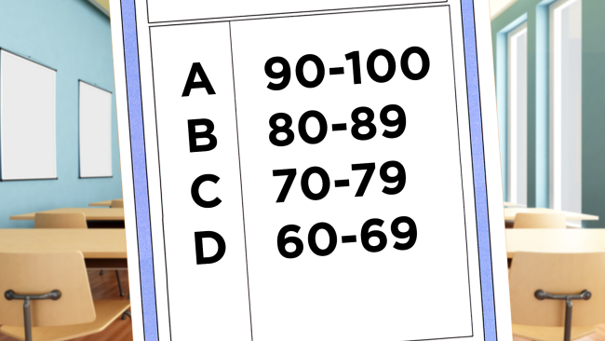
Course Credit Levels
Credit Definitions
Classes are offered at different levels within different programs.
  College Prep (CP)
  Honors (H) – designed for students exhibiting superior abilities in the particular content area
  Advanced Placement (AP)- college level coursework where students can earn college credit by making a qualifying score on the AP exam
  Dual Enrollment (DE) – currently taught through Midlands Technical College; need to complete the MTC application and meet all of their requirements to be accepted into the program
  International Baccalaureate (IB) – Academically rigorous program
  GPA weight increases at each level because the rigor of the coursework increases at each level.
  The South Carolina Uniform Grading Policy is used to calculate GPAs and Class Rank.
    You can view the SC Uniform Grading scale at this link: https://ed.sc.gov/newsroom/news-releases/10-point-uniform-grading-scale-approved-by-state-board-of-education/10-point-grading-scale-conversion-chart/
Placing students in courses
  Counselors will review current grades, test scores, and
  teacher recommendations to help place students in the correct course levels
  Parents will be asked to complete a waiver when placing students in a higher
  level course than the student is currently enrolled.

Slide 8
Additional Course Options
JROTC
  Level 1 can be used as the required credit for PE 1
  Uniforms once a week
Theatre
  To be in Theatre 1, you must have passed a district GT audition. If you are in year long theatre currently there is no need to audition!
  Learn the history of theatre, different aspects of theatre, and perform in school based performances
Dance
  To be in Dance 1 (entry level, 1 credit classes), you must have passed a district GT audition. If you are in year long dance currently there is no need to audition!
  Learn the history of dance, new techniques, create, rehearse, and refine dances (through performance)
.

Slide 9
Additional Course Options
Visual Arts
  Art 1 – Learn different techniques in painting, drawing, photography, etc., the history of art, and the elements and principles of design
  This course is a required course for students to enroll in other visual arts classes.
Chorus
  The Falcon Singers are students in Chorus Classes who give two mass concerts a year. We have over 75 singers. There are select groups who perform throughout the year at Flora and in the community. The singers explore diverse repertoire from classical, pop, gospel, seasonal and Broadway music during the year. Students have the option of auditioning for the musical as well in collaboration with theatre and dance.

Slide 10
Additional Course Options
Orchestra
  Concert Orchestra is offered to students in grades 9-12. These courses are designed for students with previous instruction in Orchestra during middle school, but experience is not required if you are willing and excited to learn. Students are required to participate in all school level performances and are encouraged to participate in auditioned ensembles.
Band
  Concert Band is comprised of students from Band 1 – 4 and percussion classes. Membership is by audition only, however auditions are only for chair placement, not exclusion. All students will be REQUIRED to perform in concert band.
  Marching Band - Membership in the marching band requires strenuous physical exercise and the ability to play the difficult literature encountered in the activity. All students enrolled in the band program HAVE THE OPTION to march, with the exception of students outside of the program who are eligible to audition for the color guard.
  Marching Band with PE - This course also meets the PE graduation requirement for all students enrolled in the Marching Band for PE class. After-school and weekend rehearsals and performances are required.
  Jazz Band - Students may elect to audition for Jazz band, and auditions are for chair placement, not exclusion. The jazz band plays for community events and performs throughout the year.
  If you have further questions regarding the band program, Mr. Sweatt, our director, will be available after the preview concert on February 28th at 6 pm in the Crayton Middle School Auditorium.
  For more information about our Fine Arts courses and programs, please use this link https://www.youtube.com/watch?v=7j0J1J6RWNA

Slide 11
Additional Course Options
CATE (Career and Technology Education)
  Fundamentals of Webpage Design – meets the computer science requirement for graduation
  Introduction to Engineering and Design (Does not meet the computer science requirement for graduation)
  Heyward Career Center – possibility in 9th grade introduction courses
    For more information on Heyward Career Center, use the link attached to view their brochure. https://issuu.com/mitchwyatt/docs/heyward_brochure_2019
Alternates
  2nd choices to electives
  These are classes that will potentially be on your students schedule, so make sure they choose carefully.
  Even if your student is placed in an alternate course, all students will receive the necessary credit requirements for graduation.

Slide 12

International Baccalaureate
The International Baccalaureate Diploma Programme (IB) begins in 11th grade.
Students entering the International Baccalaureate Programme take IB courses in each area of study (English, World Language, History, Sciences, Math, and Arts) over a two year period.
Students who complete the IB Diploma Programme are considered IB Diploma Candidates and will be eligible for the IB Diploma upon successful course completion and having earned 24 diploma points as awarded by the International Baccalaureate Organization.

Slide 13
Preparing for International Baccalaureate
International Baccalaureate
For students who are considering entering the International Baccalaureate Programme in the 11th grade, the following are the prerequisites that should be completed by the end of the 10th grade:
  Success in honors level courses
  Algebra 2 Honors
  Biology 1 and Chemistry 1
  2 Social Studies courses
  World language level 3
All students who meet the prerequisites are eligible to pursue the IB Diploma. Students are encouraged to complete PE, Personal Health, the Computer Science requirement, and an arts course (Chorus, Theatre, Dance, or Visual Arts) by the end of the 10th grade.
For more specific information, please visit the IB site on the AC Flora High School website.
https://www.richlandone.org/Page/5306

Slide 14
Freshmen AP Course Offering in
Social Studies
AP HUMAN GEOGRAPHY: (9TH Grade) The purpose of the AP Human Geography course is to introduce students to the systematic study of patterns and processes that have shaped human understanding, use, and alteration of Earth’s surface. Students employ spatial concepts and landscape analysis to examine human social organization and its environmental consequences. They also learn about the methods and tools geographers use in their science and practice.

Slide 15

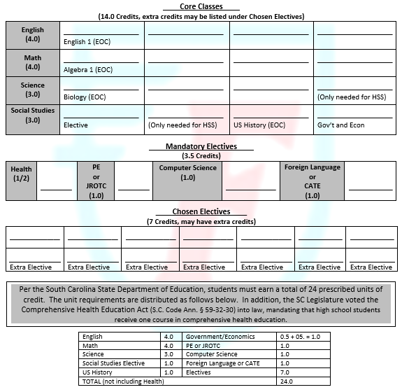
Graduation Requirements
Students planning to attend a college or university should take
2-3 credits of a foreign/world language and at least 1 credit of a visual or performing art class.

Slide 16
IGP Conference Schedule for Crayton Students
All IGP conferences with Crayton students have been scheduled for the Week of February 21st.
IGP Conference Schedule for WG Sanders Students
All IGP conferences with WG Sanders students have been scheduled for the Week of February 6th.
These conferences will be held virtually and both middle school counselors and AC Flora Counselors will be present, unless an in-person conference has been requested.
Each conference is 20 minutes long. We ask that you please adhere to that time frame.
If you have additional questions after the 20 minute meeting, please direct those questions to your student’s school counselor via email.

Slide 17
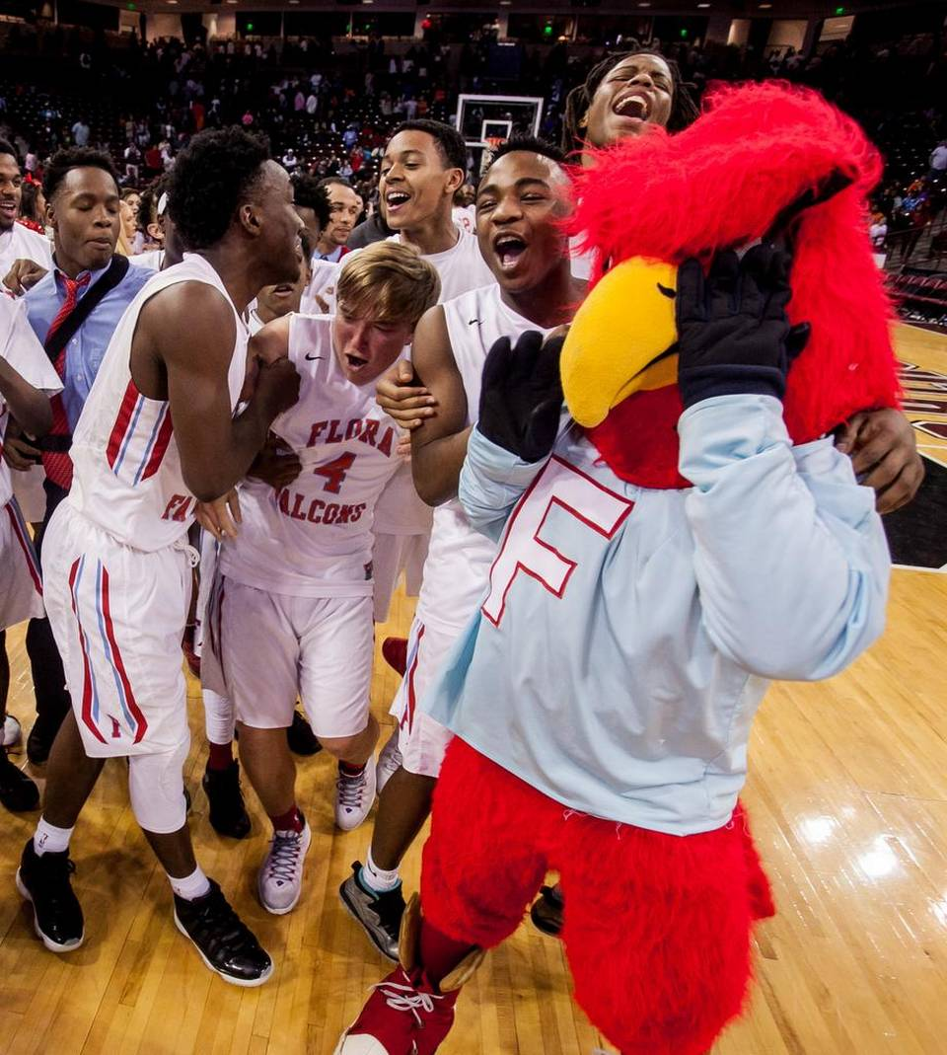
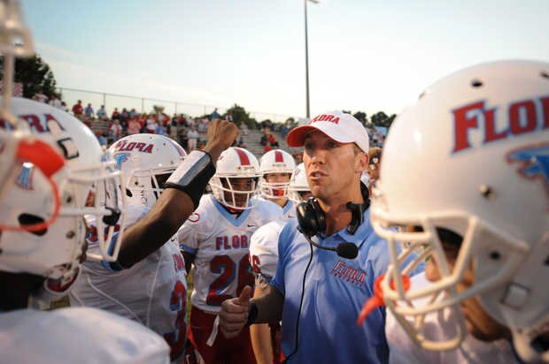
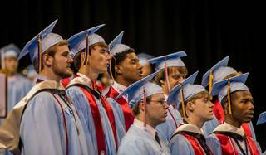
Student Life:
Athletics, Clubs, and Government
24 Varsity Sports Programs, 51 Competitive Sports Teams
30 Student Clubs
Student Government has grown in participation and focus on service leadership
Performing Arts Ensembles showcase students in numerous concerts and performances throughout the year
Various Honor Societies

Slide 18

The Big Picture
School Counseling Program Goals:
AC Flora’s School Counseling Department is dedicated to providing academic, personal, and career counseling through a system designed to assist all students with developing and attaining their educational, career, and personal goals.
The Big Picture: What should your student be thinking about?
Middle school was the step to high school and high school is the step to what?
Career? Military? College?
What do I need to do in order to get there (career, military, college)?
How can I become involved and build my resume? What classes do I need?
What are my academic goals?
What are my strengths and weaknesses, likes and dislikes?
Do I want to take every art class? Join the IB Program my junior year?
What are my personal goals?
Do I want to play a sport? Be in a play? Join a club?

Slide 19
Things to Remember:
All course request changes must be completed by May 1, 2023. Any changes after that date will be considered a schedule request change and will not be reviewed until after final schedules have been issued in August.
Flora Update is our weekly electronic newsletter. Sign-up by going to floraupdate.com and scroll to the bottom of the page and enter your email address to subscribe. This will keep you up to date on the latest AC Flora High School news. Also, follow us on Twitter and Instagram.
Please contact AC Flora High School Counselors with any questions you might have about your child’s future here at Flora.
For a copy of this presentation and more information on particular programs (Heyward Career Center, JROTC, etc.), please visit the link below:
  https://www.richlandone.org/domain/1724
Finally….
  THANK YOU!

Slide 20
Questions??????

