Slide 1
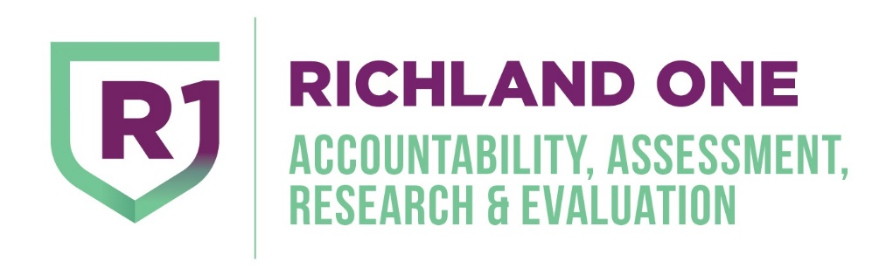
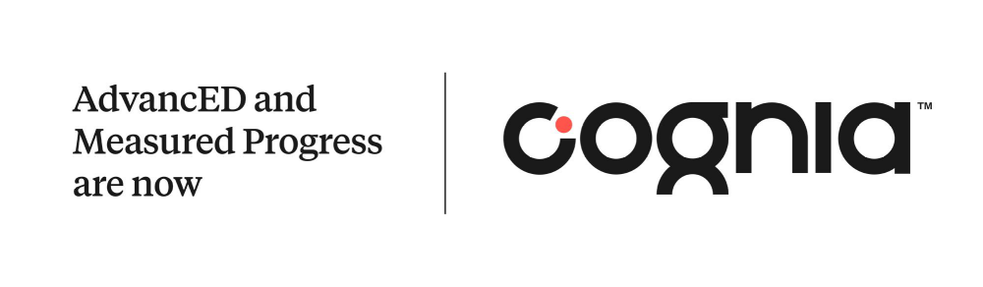
Cognia Accreditation Update
Tuesday, April 26, 2022

Slide 2
Strategic Plan and Superintendent Goal Alignment
The Cognia Review aligns to all goals in the District’s Strategic Plan:
  Student Achievement (Learning Capacity)
  Teacher/Administrator Quality (Leadership Capacity)
  Climate (Resource Capacity)
Board and Superintendent’s Goal #3:
  Complete Cognia Accreditation Review.

Slide 3

What is Accreditation?
An international protocol for institutions committed to systematic and sustainable improvement:
Builds capacity of your institution to improve and sustain student learning
Stimulates and improves effectiveness and
efficiency throughout
your institution

Slide 4
Preparing for the Review Timeline
June 2021
  Executive Team presentation and designation of teams for each standard area (Leadership, Learning, Resources)
June 2021 through January 2022
  Teams rated their respective areas and provided evidence for each standard
October 2021 – December 2021
  Schools rated each standard area and provided evidence
November 2021
  Surveyed staff, parents, and students
January 2022
  Finalized ratings and uploaded evidence by January 7, 2022
January 30 – February 2, 2022
  Hosted engagement review team virtually January 30 – February 2, 2022

Slide 5
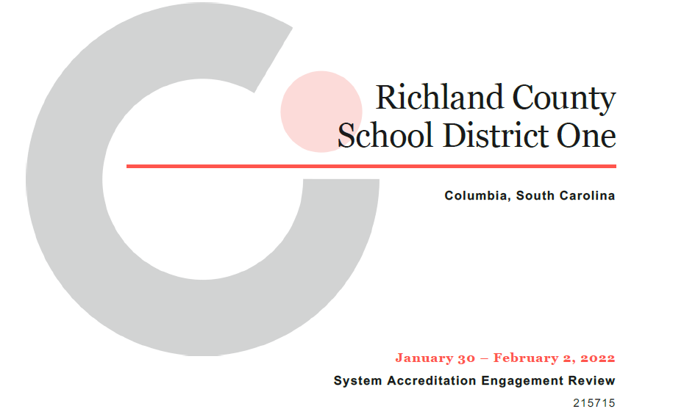
The Role of the Engagement Review Team
Gather first-hand information to evaluate your institution’s performance against the Cognia Performance Standards:
  Interview stakeholder groups
  Review documentation you provided
Provide feedback to your institution that helps to focus and guide your improvement journey

Slide 6

Interviews Conducted by the Cognia Review Team
Stakeholder Groups | Number of Participants
Students (Learners) | 56
Parents/Community | 23
Certified Staff | 43
Supporting Staff | 25
Leaders | 78
Superintendent | 1
Governing Board | 7
Total | 223

Slide 7
Cognia’s Three Main Performance Standards for Systems Accreditation
Leadership Capacity
An institution’s leadership capacity includes the fidelity and commitment to its purpose and direction, the effectiveness of governance and leadership to enable the institution to realize its stated objectives, the ability to engage and involve stakeholders in meaningful and productive ways, and the capacity to implement strategies that improve learner and educator performance.
Learning Capacity
An effective learning culture is characterized by positive teacher/learner relationships, high expectations and standards, a challenging and engaging curriculum, quality instruction and comprehensive support that enable all learners to be successful, and assessment practices (formative and summative) that monitor and measure learner progress and achievement. Moreover, a quality institution evaluates the impact of its learning culture, including all programs and support services, and adjusts accordingly.
Resources Capacity
Institutions ensure that resources are distributed and utilized equitably, so the needs of all learners are adequately and effectively addressed. The utilization of resources includes support for professional learning for all staff. The institution examines the allocation and use of resources to ensure appropriate levels of funding, sustainability, organizational effectiveness, and increased student learning.

Slide 8
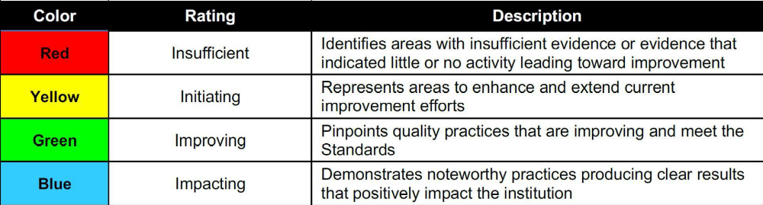
Cognia Ratings
The Cognia Performance Standards Diagnostic is used by the Engagement Review Team to evaluate the institution’s effectiveness based on the Cognia Performance Standards.

Slide 9
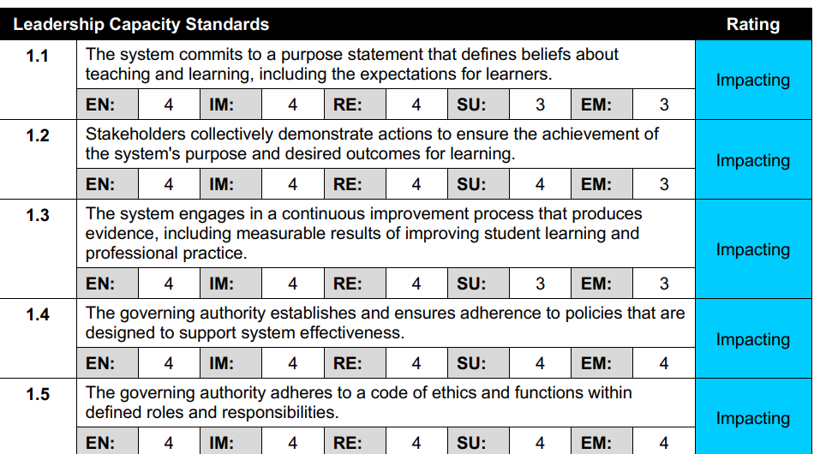
Cognia Ratings Sample

Slide 10
Domain Ratings
 | Impacting | Improving | Initiating | Insufficient
Leadership Capacity | 10 | 1 | 0 | 0
Learning Capacity | 6 | 5 | 1 | 0
Resource Capacity | 2 | 6 | 0 | 0
Total | 18 | 12 | 1 | 0

Slide 11
Index of Educational Quality (IEQ)
The Index of Educational Quality (IEQ) results are reported on a scale of 100 to 400.
  An IEQ score below 250 – institution has several areas in the Initiate level and should focus their efforts on those standards.
  An IEQ score in the range of 225-300 – institution has several standards within the Improve level and is using the results to inform continuous improvement
  An IEQ score of 275 and higher – institution is beginning to reach Impact level and is engaged in practices that are sustained over time and are becoming engrained in the culture of the institution.

Slide 12
Richland School District One IEQ Score
An IEQ score of 275 and higher – institution is beginning to reach Impact level and is engaged in practices that are sustained over time and are becoming engrained in the culture of the institution.
  Impact: where desired practices are deeply entrenched
The CIN (Cognia Improvement Network) IEQ range includes all institutions evaluated during the last five years and their range of IEQs.

Slide 13
Insights from the Review
Richland County School District One enacts its mission, “We are Richland One, a leader in transforming lives through education, empowering all students to achieve their potential and dreams,” through conscientious creation of myriad pathways and multiple levels of support to ensure that options and opportunities are realities for all learners.
Although curricular areas and policies were formally reviewed per published cycles, formal evaluation of all the district’s programs, initiatives, and practices appeared inconsistent.
The district has conscientiously established clear direction and systems of accountability and support that have provided schools with both structure and flexibility to serve the needs of learners, for staff to grow, and for programs to develop as indicated.

Slide 14
Insights from the Review
Strategic and improvement planning across the district is aligned, data-informed, and systematic.
Richland County School District One collects, analyzes, disseminates, and utilizes informative and impressive sets of available trend and comparative data responsibly and systematically.

Slide 15
Next Steps
Review and share findings with Richland One Stakeholders.
Update District and School Strategic Plans to address any identified areas of improvement.
Use findings and data from the Engagement Review to guide and strengthen Richland One’s continuous improvement journey.
Celebrate the successes.
Continue the improvement journey – next visit will be in 2027.

