Slide 1
Study & Learning Strategies
RVGS-D

Slide 2
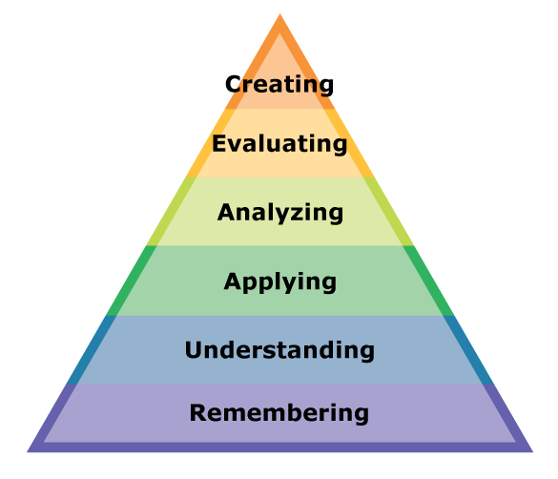
Bloom’s Taxonomy

Slide 3
How do You move from the bottom to the top?
Go to class
Be an active listener
Take notes
Review
Ask questions
Study

Slide 4

Study cycle
Look over the materials/text before class
Go to class and be an active listener
Go over your notes soon after class
Study
Check your learning

Slide 5
Note taking
Research shows that students perform better when using hand-written notes rather than typed notes.
Research also shows that students learn better by reviewing their own notes rather than notes written by the teacher or peer.
Cornell Note-Taking is one technique that many have found helpful.

Slide 6
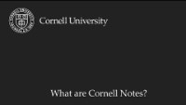
Cornell method

Slide 7

Metacognitive Study tools
Using
Using the study cycle
Taking
Taking notes by hand
Studying
Studying with others
Making
Making tests/quizzes for yourself
Teaching
Teaching the material to someone (real or imagined)

Slide 8
Where are your study skill strengths?
Take the Study Skills Inventory
Review the Score Sheet to see where you might improve
Read over the Study Tips in the areas you want to improve
Talk in your small groups about what you learned

Slide 9
Works cited
Mayjor Edge Resources. (2016). Study Skills. www.teacherspayteachers.com
McGuire, Saundra Yancy. Teach Students How to Learn. Sterling, Stylus Publishing, LLC., 2015.
Think Insights. (2022). Cornell Method – A Method to Take Great Notes. https://thinkinsights.net/consulting/cornell-method-great-notes/
“What are Cornell Notes.” YouTube. Learning Strategies Center Cornell. 2020. https://www.youtube.com/watch?v=HEsBd_Rgzfs.

