Slide 1
Self-Care & Dealing with Stress
RVGS-D

Slide 2
Self-Care
According to Google's English Dictionary, the definition of self-care is "the practice of taking an active role in protecting one's own well-being and happiness, in particular during periods of stress."
  Self-care can be reactive or proactive

Slide 3
Proactive Self-care
Mindfulness/meditation –
Exercise – doesn’t have to be structured or intense
Take care of your physical self – take time to look good and feel good about yourself – get your hair cut/styled, file your nails, etc
Pursue a hobby or activity you enjoy
Start a gratitude journal – even small things matter – make it part of your daily/nightly routine
Make time for family and friends
Create stretches of tech-free time in your day – no phones, social media, etc. – especially during meals and before bed
Consume healthy and nutritious food and drinks
If you need help, get it – it’s okay to talk with a counselor (school or community)

Slide 4
Re-active Self-care
Meditation – use an app or on your own
Practice breathing exercises
Exercise – doesn’t have to be structured or intense
Practice gratitude in the moment
Practice relaxation techniques
Reach out to a support person
Distract yourself with a creative endeavor – coloring/art
Be in the moment with one of your senses
Notes:
– eating or drink something you crave and can savor; light a candle with a scent you enjoy; listen to a beautiful piece of music; look at something beautiful in your surroundings – focus on just one sense

Slide 5
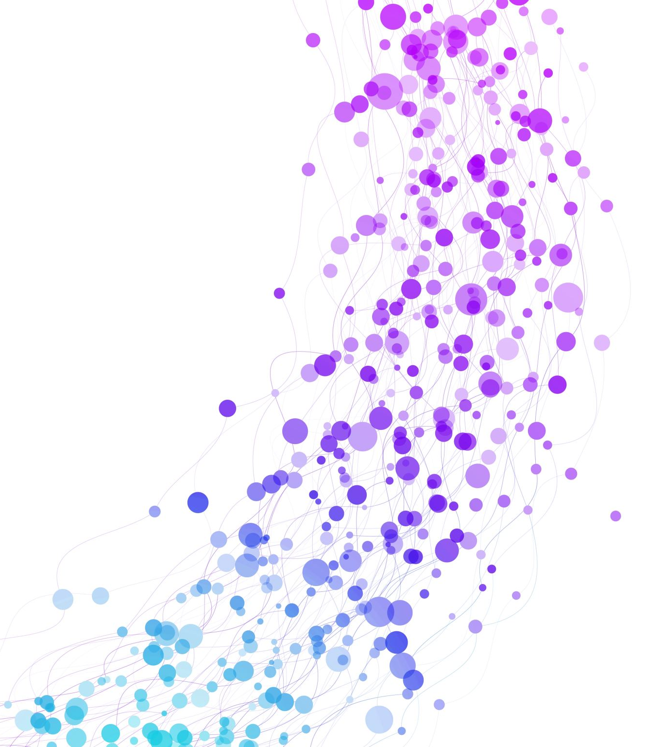
Let’s practice:
Here is a short, guided meditation from “Stop, Breathe, Think”

Slide 6

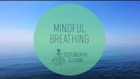

Slide 7
What’s next?
Take a few minutes to fill out the self-care assessment and the self-care plan.
In your small group, discuss what self-care habit you would like to begin practicing.
What have you learned today?

Slide 8
Works Cited
Harvey, Sammi. (2021 August 22). “10 Ways to be Proactive in Your Self-care Routine.“ Good, Good, Good. https://www.goodgoodgood.co/articles/proactive-self-care-help
Saakvitne, Pearlman & staff. “Self-care Assessment Worksheet.” www.brown.edu

