Slide 1

Monthly Financial Report – March 2021

Slide 2

Cash Balance Comparison
$4.5 million more than last March – due to mainly due to phase-in of income tax collections.

Slide 3
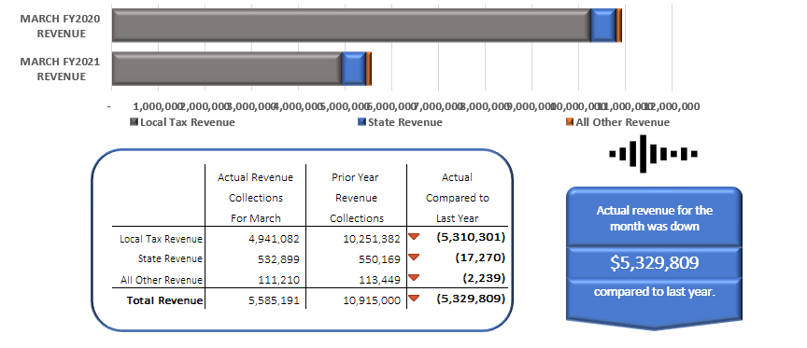
March Revenue Collections Compared to Prior Year
Timing of property tax advance payments (received more in February this year, but March last year)
State funding reductions.

Slide 4
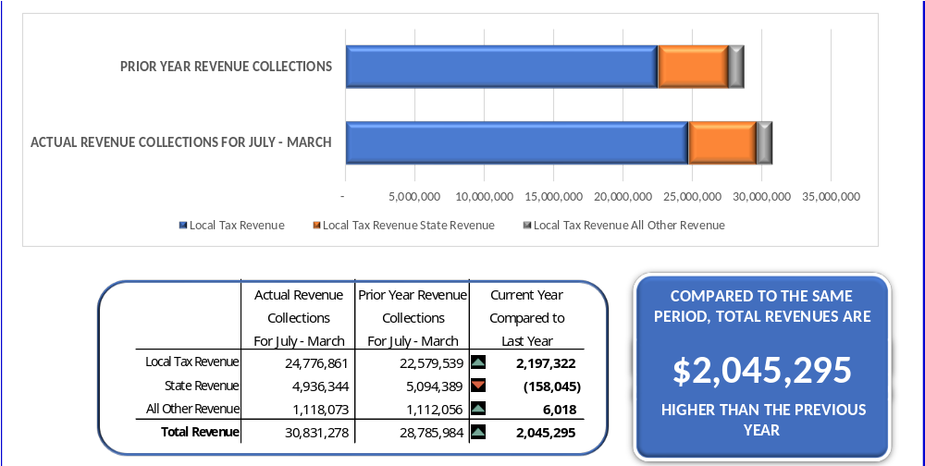
YTD Revenue Collections Compared to Prior Year
Local tax: income tax phase in
State revenue: timing of reductions
All other revenue: lower return of advances, lower interest earnings, BWC refunds

Slide 5
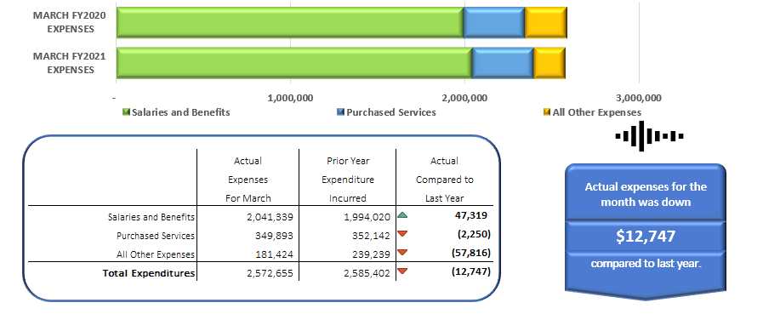
March Expenditures Compared to Prior Year

Slide 6
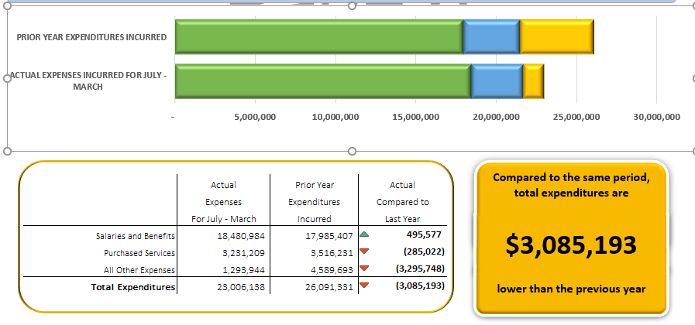
YTD Expenditures Compared to Prior Year
After adjusting for the double insurance payment and athletic complex transfer, expenditures are down $80,458
Salaries & Benefits: duplicate insurance payment in July due to software conversion
Purchased Services: likely to remain below last year and below estimate
All Other Expenditures: no transfer for athletic complex this year

Slide 7
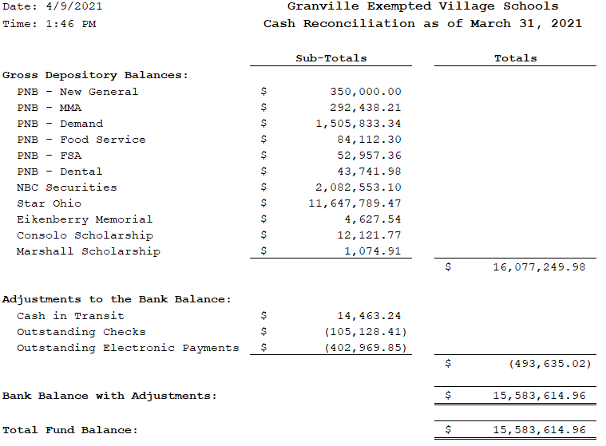
Cash Reconciliation

