Slide 1








HIGH SCHOOL INFORMATION NIGHT
Robert Horn – Principal
Brett Pinckard – Assistant Principal
Whitney Morberg - Counselor
Etowah High School

Slide 2




Classes are divided into two semesters
1st Semester August –December
High
School
Scheduling
2nd Semester January -May
A student will take 6 classes each semester
Each semester course is worth .5 units of credit per class
Credit is issued at the end of each semester (Dec. & May)
Students must earn 23 units to graduate
Lunch is a full 55-minute period

Slide 3



Graduation Requirements
Core Requirements
4 Units of Literature
4 Units of Math
Elective Requirements
  1 Unit of Health (.5) and Personal Fitness (.5)
  3 Units of required electives
    World Language, Fine Arts and/or Career/Technical
  4 Units of miscellaneous electives
  TAA provides a potential .5 credit (each year) Pass or Fail grade.
4 Units of Science
3 Units of Social Studies
23 total units are required for graduation
Honor Graduates: cumulative weighted NGA of 90 or above

Slide 4





Schedule Changes
2400 Students with a 7-period schedule​
1 lunch period
152 Teachers w/ two planning periods
(one must be between 3rd-6th period for a lunch)​
271 different classes offered ​
NO SCHEDULE CHANGES
except for leveling up or down within 15 days.

Slide 5


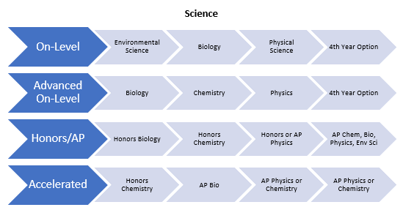
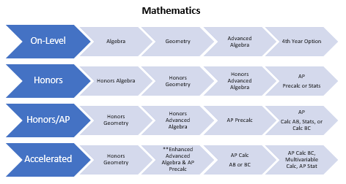
Course Sequencing

Slide 6
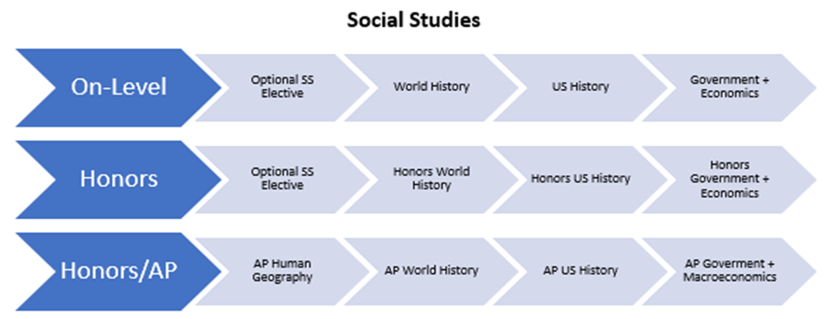
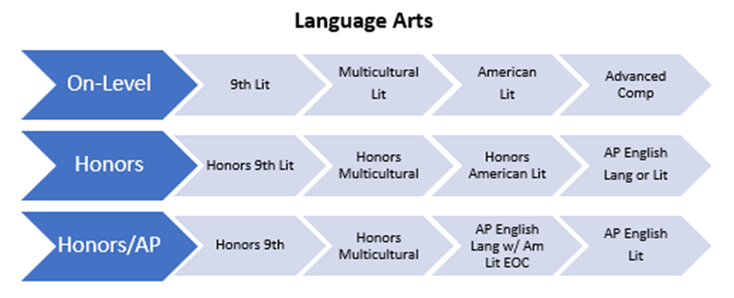
Course
Sequencing

Slide 7




EOC Testing Weights
Algebra 1
Biology
American Literature
US History
Counts for 20% of your overall Semester 2 grade.

Slide 8

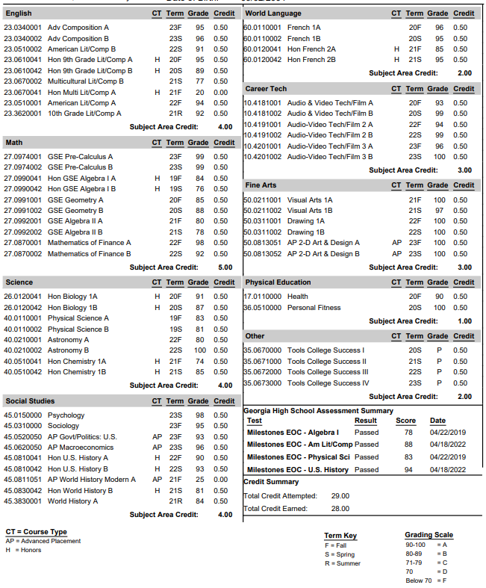
Sample
Transcript
Notes:
8

Slide 9


Career Pathways
Career Pathways
Architectural Drawing & Design
Audio/Video Technology & Film
Carpentry
Collision Repair
Computer Science
Engineering Graphics & Design
Game Design
JROTC – Air Force
Law Enforcement/Criminal Investigations
Nutrition & Food Science
Plant & Floral Design Systems
Therapeutic Services/Allied Health/Sports Med/Exercise Physiology
Veterinary Science/Animal Care

Slide 10


1
4-year colleges require a minimum of
two consecutive years of the same World Language.​
World
Language
2
Technical Colleges currently do not
require a World Language.​
University System of Georgia will accept
Computer Science (Complete pathway
(3 years) in computer science)
3
World Language options at Etowah High School:​
Spanish ​
French​
German​
Computer Science​
4

Slide 11

PSAT
All 9th and 10th grade students will take the PSAT
Tests Critical Reading, Math, and Writing Skills​
Prepares students to take the SAT, shows AP Potential
11th Grade students may opt to take the PSAT for a fee. Students will receive information regarding registration for the PSAT during TAA and it will also be posted to the EHS website.​
In 11th grade, PSAT scores are used to qualify students for the National Merit Scholarship

Slide 12
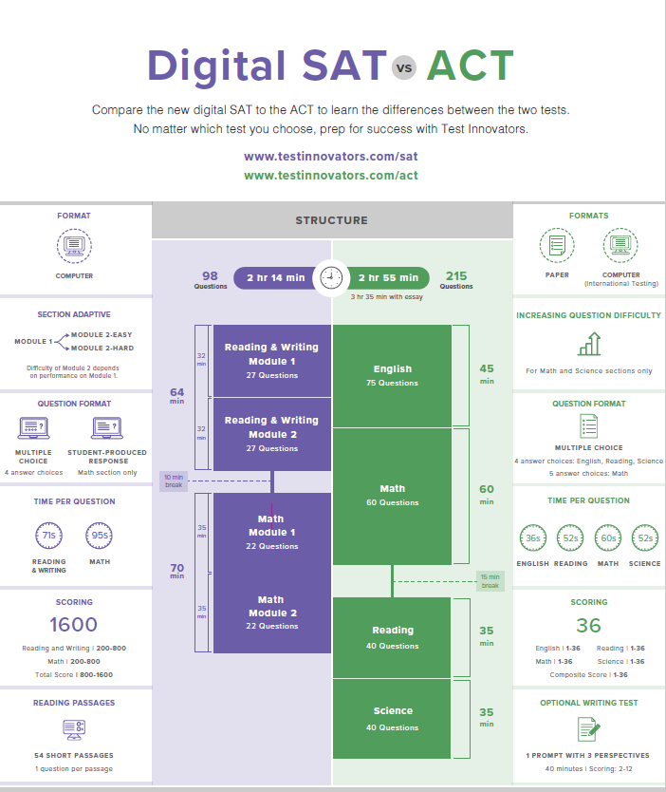
SAT and ACT
SAT/ACT can be taken multiple times ​
​
Usually required to apply to colleges and universities (not required for technical colleges) ​
​
College-bound Seniors should try to take fall semester, if possible, to meet application deadlines ​
​
SAT vs. ACT: both are recognized at MOST colleges and universities ​

Slide 13


What are Colleges Looking For?
What is Rigor?
  Colleges will use 9th grade as a baseline year to assess where a student started. ​
  It is assumed that from 9th – 12th grade classes will increase in difficulty. Grades should show growth as difficulty increases. This is rigor. ​
  Honors and AP offerings do increase rigor, but there are some things to keep in mind when planning for advanced classes. ​
  Student A who maintains an A average from 9th grade on-level math to 10th grade math is keeping up with expected rigor. ​
  Student B who earns an A average in 9th grade math but a C in 10th grade AP math does not show they are keeping up with expected rigor. ​
  Student C who earns an A average in 9th grade math and an A in 10th grade Honors math is showing expected rigor and will also show higher than expected growth by participating in the honors level course.​
  Colleges look for students who are growing throughout their high school careers.​
  Many colleges look at a student’s unweighted GPA. Weighted GPA is primarily used for class rank.​
  Colleges look at SAT and ACT scores. There is no standard preference from one test to the other, but you should look at a few potential colleges and see if they have a preference.​
  Colleges look to see what extracurricular activities a student is involved in and how consistently they show involvement in their community. Colleges are looking for depth, not a laundry list.​

Slide 14
Technical, 2 Year, or 4 Year College?
Technical
College
SAT/ACT not required.
Use the Accuplacer exam for placement​
Qualifies for HOPE Grant​
Chattahoochee Tech is nearby
4 Year College:
Each college determines their minimum entrance requirements.​
  Minimum GPA​
  ACT or SAT scores​
Georgia 4-year colleges require:​
  College Preparatory Curriculum requirements (2 years world language)​
  Freshman Index requirement​
  Minimum results on Test Scores ​
2 Year
Community
College
SAT/ACT may not be required:
Could use Accuplacer exam for placement​
School determines minimum GPA​
Nearby 2-year schools:
Georgia Highlands & GSU Perimeter College​

Slide 15


2023
Freshman
Admission
UGA Calculated Grade Point Average mid-range/average: 4.06 – 4.33, with a 4.19 average
  Please remember this is not the GPA students see on their high school transcript, but rather the GPA that UGA recalculates for everyone based on the core academic courses taken in high school and looking at the actual grades posted on the transcripts. Roughly 91% of the HS core grades were A’s, and 8+% were B’s, thus showing the academic strength of the accepted group.
AP/IB/Dual Enrollment course mid-range/average: 8-13 courses, average of 10+
  We determine academic rigor based on all core classes a student has taken (CP, Honors, Advanced, AP, IB, DE, etc.) as compared to what is offered in the school/community. This is not based simply on the number of AP/IB/DE courses, but instead we look at the overall coursework over four years in the core areas and the progression of rigor over the years. The AP/IB/DE information is the most specific data I can give on it, but the numbers do not cover all of our curriculum review.
SAT Total mid-range for students: 1270-1470
  This data is based on admitted students where the SAT was the strongest score if both SAT and ACT were submitted or if the SAT was the only test taken and sent.
ACT Composite mid-range for students: 29-34
  Remember, UGA focuses on ACT E and M. For reporting purposes, we give out the best score overall ACT score, but the ACT E and M are very similar to the overall score.
This data is based on admitted students where the ACT was the strongest score if both SAT and ACT were submitted or if the ACT was the only test taken and sent.

Slide 16
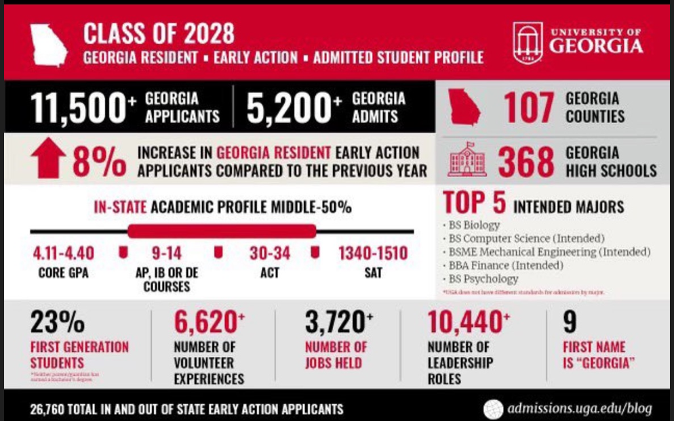

Slide 17




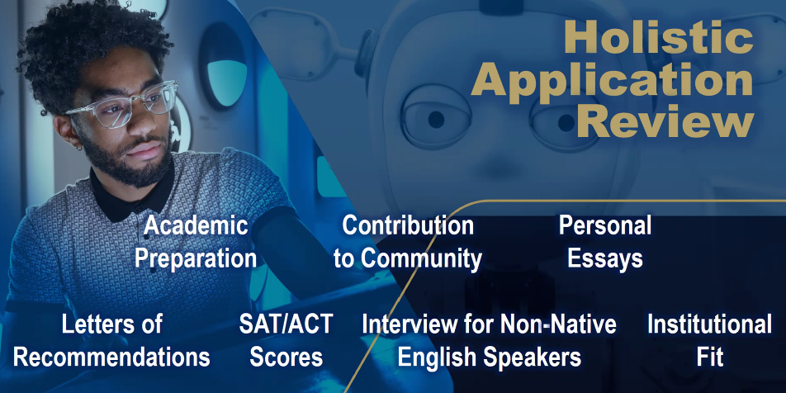
Application
Review
Georgia Southern University Admissions Info
Georgia State University Admissions Info
Albany State University Admissions Info
Georgia Military College Admissions Info
Click here to find Georgia's College and University Admissions Requirements

Slide 18
HOPE and Zell Miller Scholarships
SSN Verification
Rigor Requirement
Social Security numbers are required to be in ASPEN for a student to be HOPE eligible.
4 courses complete prior to graduation (examples: Algebra 2 or higher, Chemistry, Physics, 2ⁿᵈ year of Foreign Language or higher, AP Courses)
Zell Miller Scholarship
HOPE Scholarship
3.7 academic GPA—covers 100% of tuition
SAT 1200 combined CR and Math or 26 ACT composite
3.0 academic GPA, covers The new rule states that HOPE will cover “100%” of tuition, but there are caveats.
This is the information that was shared with us:
HOPE will cover the current year at 100% of the prior year tuition amount. Example: the 2024 year of college gets covered at 2023 tuition rate under HOPE, the 2025 year gets covered at the 2024 rate. If the rates are the same from one year to the next, HOPE funds at 100%; if the rates change from one year to the next then HOPE only covers the amount equal to the prior year.

Slide 19

HOPE and Zell Miller Scholarships
HOPE SCHOLARSHIP
  3.0 Core GPA (AP classes weighted +.5 up to 4.0)​
  Students must maintain a 3.0 GPA in college​
  HOPE GPA IS NOT ROUNDED! 2.9999 is ineligible!!!​
  To apply for HOPE/Zell, FAFSA or GSFAPP​
ZELL MILLER SCHOLARSHIP
  3.7 Core GPA (add .5 weighting for AP courses up to 4.0)
  Students must maintain a 3.3 GPA in college
  Students who drop below the college 3.3 GPA can earn Regular HOPE if their college GPA remains above 3.0
  NOT ROUNDED: 3.6999 will receive HOPE, not Zell Miller
  You must submit your SAT or ACT scores to the GA Student Finance Commission for Zell

Slide 20

HOPE Scholarship Rigor Requirements
Four of these couress requried prior to graduation.
REQUIREMENT | EXAMPLES
Advanced Math | Algebra 2, College Readiness Math, Statistical Reasoning, Pre-Calc, Calculus, Honors Multi Variable Calculus
Advanced Science | Chemistry, Physics, Forensics, Anatomy, Zoology, Astronomy
AP Core Courses | AP English, AP Math, AP Science, AP Social Studies, AP Computer Science, AP Psychology
Dual Core Courses | Various Courses
Advanced World Language | Spanish, French, German, (2,3,4 and AP)

Slide 21
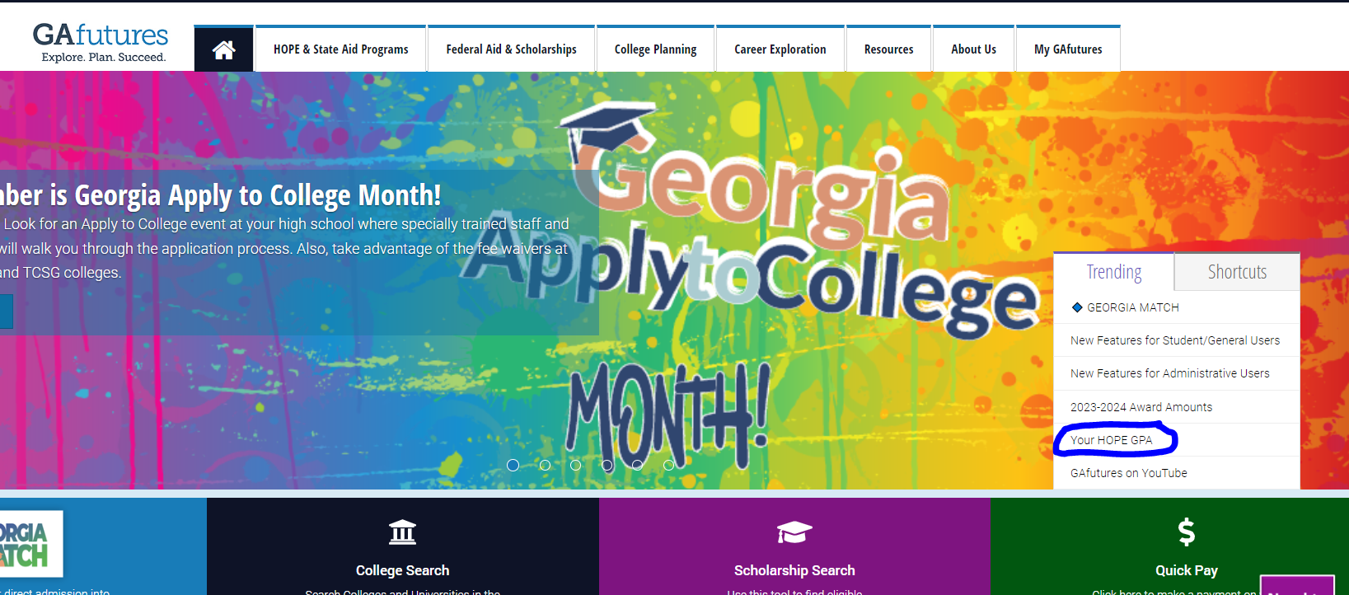
HOPE GPA
https://www.gafutures.org/

Slide 22
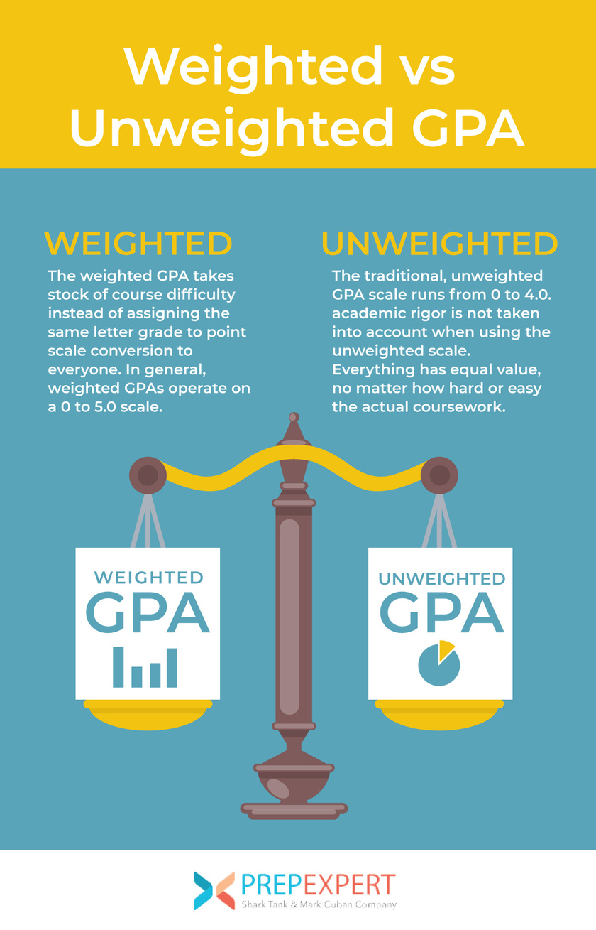
How to Convert (Calculate) Your GPA to a 4.0 Scale
NGA= Numeric Grade Average; 100-pt scale
GPA= Grade Point Average; 4-pt scale
  Cherokee County Schools report NGA weighted and unweighted located in the top right corner of student transcripts.
  Actual unweighted grades are posted to the transcript.
*Honors earns an additional 5 points
*AP earns an additional 10 points
Class rank is determined by the weighted NGA

Slide 23
Academic Letter & Honors Graduate
Academic Letter
Honors Graduate
Letter
Two consecutive years of 90 or above weighted NGA​
Lamp of Knowledge
Three consecutive years of 90 or above weighted NGA​
To earn an honor's cord at graduation, students must have an overall weighted NGA of 90 or above. ​
*weighted NGAs are not rounded

Slide 24

Traditional Dual Enrollment
  Dual Enrollment allows high school students to take college courses for both college and high school credit.
  Up to 30 credit hours, beyond 30 credit hours students will pay out of pocket for any remaining DE courses.
https://www.usg.edu/student_affairs/prospective_students/opportunities
https://www.usg.edu/student_affairs/prospective_students/dual_enrollment_applications
https://www.cherokeek12.net/divisions/curriculum-instruction/dual-enrollment

Slide 25
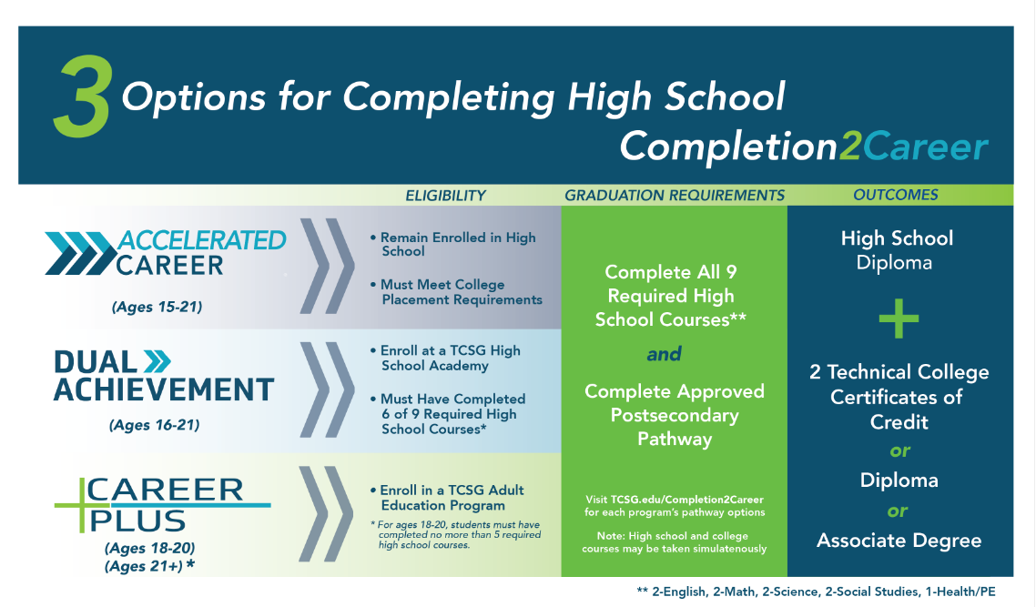



Slide 26
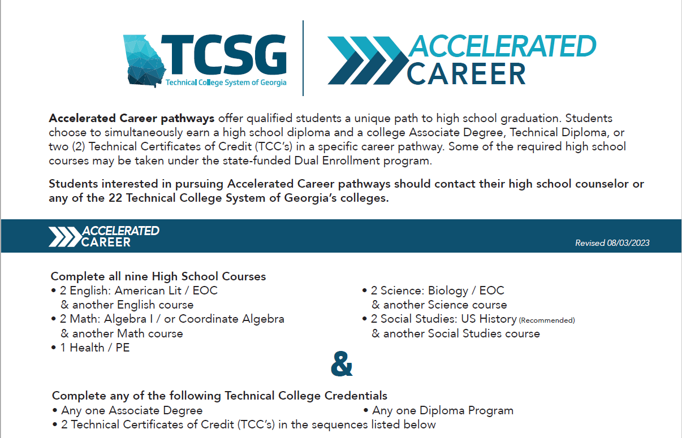
Dual
Enrollment
Accelerated
Career
Accelerated Career Pathways

Slide 27

Dual
Achievement
https://www.chattahoocheetech.edu/chatt-tech-academy/

Slide 28




C3 Academy
Cherokee College & Career (C3) Academy Video
Cherokee College & Career (C3) Academy Overview

Slide 29
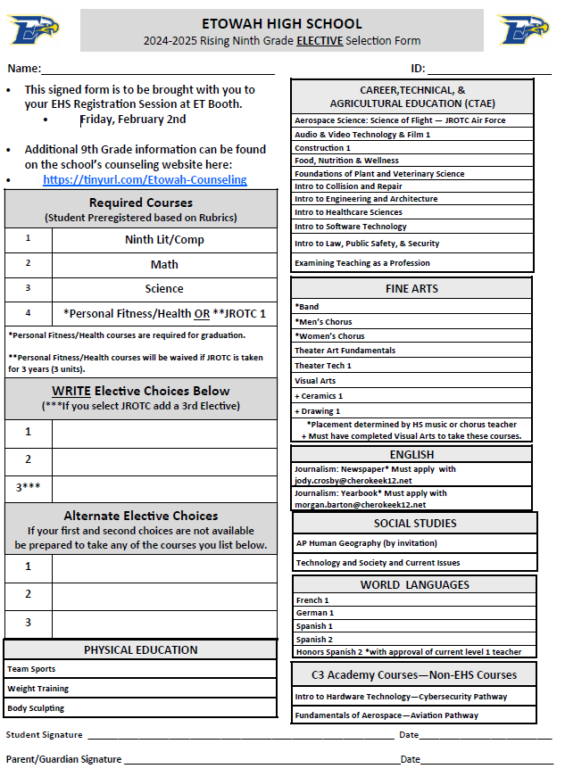
Registration Form
Bring to ET Booth on Feb 2nd

