Slide 1



Communications with Students And educator Misconduct
Presented By: Robert David

Slide 2
Social Media Can Be Used:
In Education:
In the classroom
Connecting with students, parents, and the school community
Sharing ideas and information with coworkers
Promoting the school district
In Your Personal Life:
To connect with friends and family
Networking in your profession
Getting and sharing news and information
Marketplace
Entertainment
Remote Learning

Slide 3
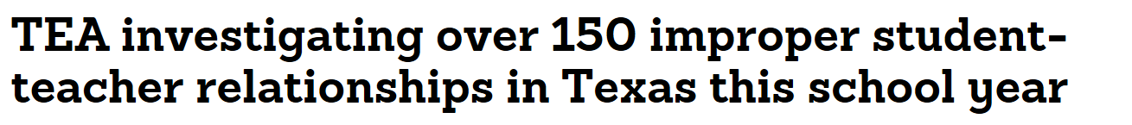
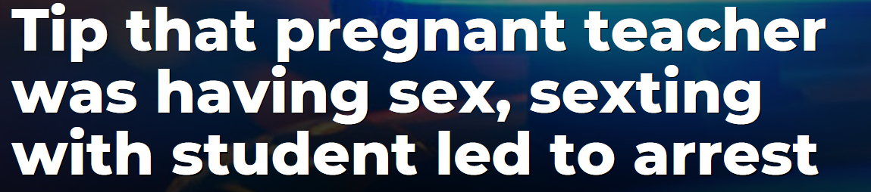
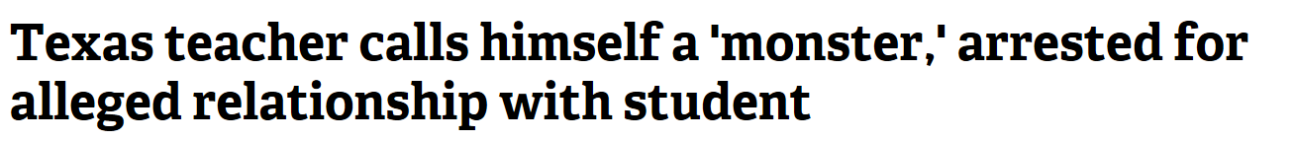
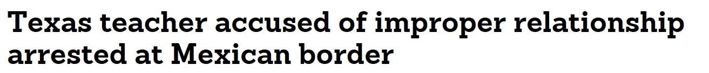
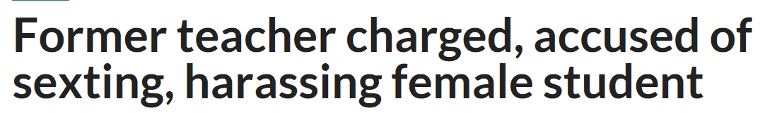

Slide 4

Rules and Guidelines

Slide 5
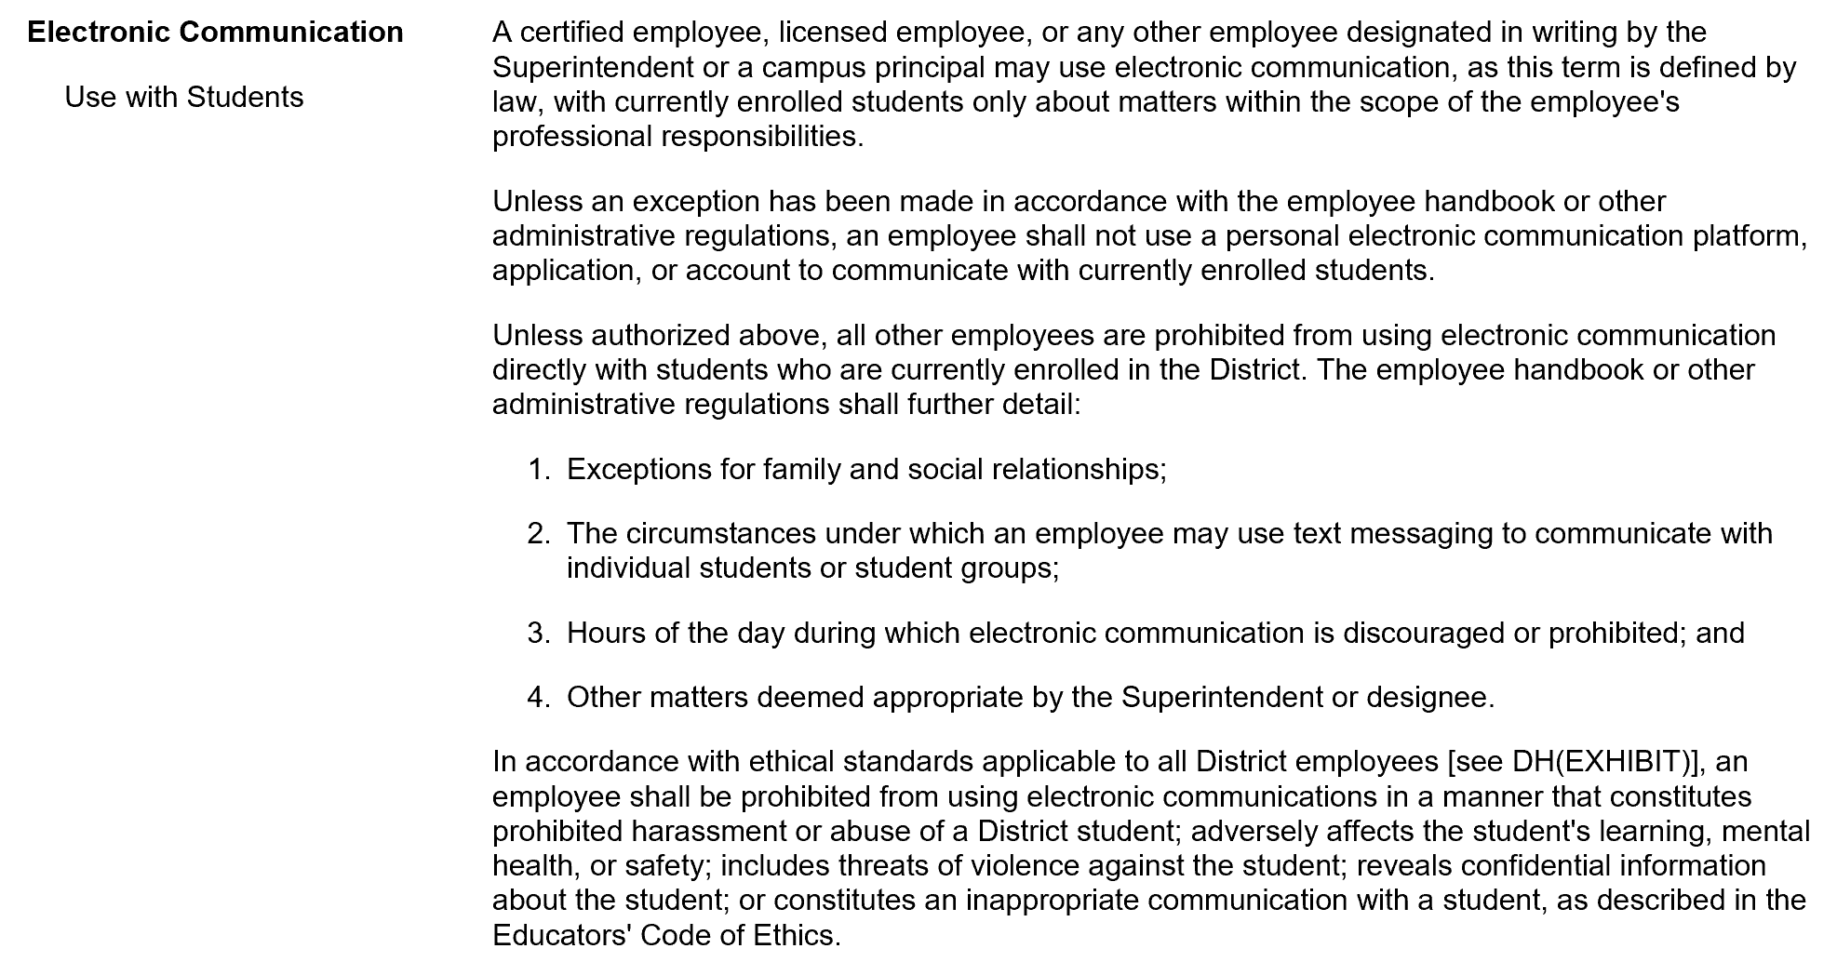
Board Policy DH (LOCAL)
Board Policy DH (Local)

Slide 6
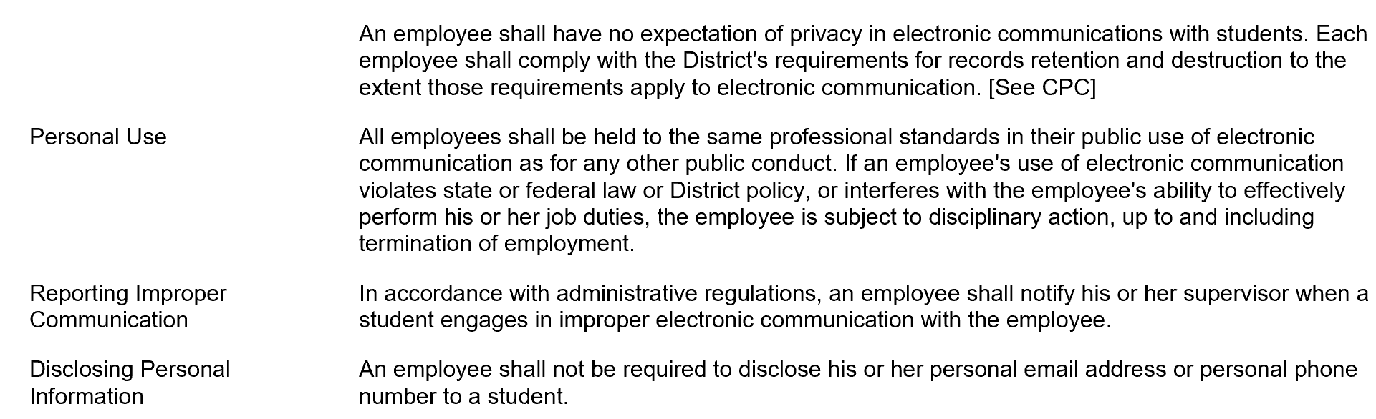
Board Policy DH (LOCAL), Cont.

Slide 7
The Educators’ Code of Ethics
Standard 3.6. The educator shall not solicit or engage in sexual conduct or a romantic relationship with a student or minor.
Standard 3.8. The educator shall maintain appropriate professional educator-student relationships and boundaries based on a reasonably prudent educator standard.
Standard 3.9. The educator shall refrain from communication with a student or minor, including, but not limited to, electronic communications such as cell phone, text messaging, email, instant messaging, blogging, or other social network communication.

Slide 8
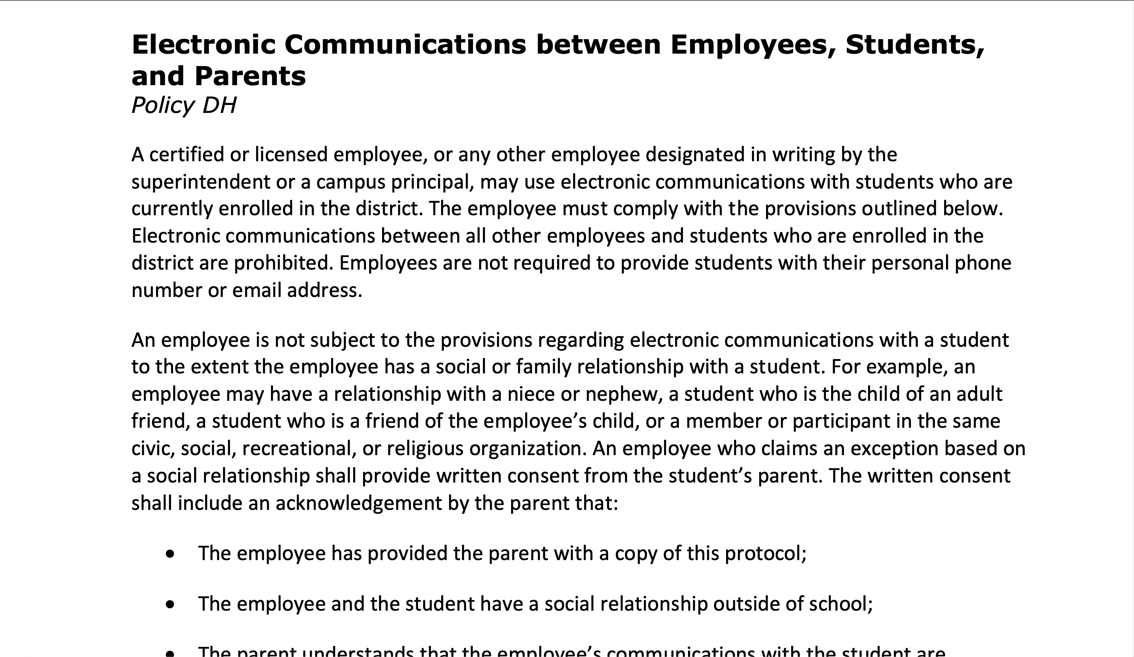
Board Policy DH (LOCAL)
Santa Maria ISD Employee Handbook, Pages 42-46

Slide 9
Application

Slide 10
Who may Communicate with Students
Only certified or licensed employees, or those designated in writing by the Superintendent, may communicate with currently-enrolled students through electronic media.
These employees may include teachers, counselors, principals, librarians, paraprofessionals, nurses, educational diagnosticians, licensed therapists, and athletic trainers.

Slide 11
When employees may communicate with students
Certified, licensed, or designated employees may communicate with students when:
  The communication is pursuant to the employee’s official duties, and
  It occurs between the hours of 7:00 AM and 8:00 PM.

Slide 12
How employees may communicate with students
When communicating with students, employees must use an official District communication platform (ex. email) unless otherwise permitted. Personal communication platforms, applications, and accounts are expressly prohibited.
Text messaging may only be used by a teacher, athletic trainer, or coach with an extracurricular duty, to communicate with students in that extracurricular activity regarding related matters.
  On any after-hours work-related communications, the employee’s supervisor must be included.
We also recommend, but the District does not require, including a parent/guardian and a supervisor on any communications. This will avoid the appearance of any illicit contact by providing constant supervision, while also updating parents on their student’s school matters.

Slide 13
Group chats / team social media pages
District employees such as coaches may create group chats or group social media pages for the purpose of communicating with students, with administrative approval. Any social media groups or pages must be made distinct from the employee’s personal accounts.
Students, parents, and school administration must be granted access to the group communication page.
While communications generally must occur only between 7:00 AM - 8:00 PM, this restriction does not apply to public posts, such as on a group page, which may be sent at any time.

Slide 14
EXCEPTION For Related Students
An employee may communicate with a currently-enrolled student who the employee has a social or family relationship with.
An employee who claims an exception based on a social relationship must provide written consent from the student’s parent and acknowledgment from the parent that:
  The employee has provided the parent with a copy of the electronic media protocol in the employee handbook;
  The employee has a social relationship with the student outside of school;
  The parent understands that the employee’s communications with the student are excepted from district regulation; and
  The parent is solely responsible for monitoring electronic communications between the employee and the student.

Slide 15
Defining Inappropriate Communications
Whether communication with a student is inappropriate is determined by considering multiple factors, including:
The nature, purpose, and amount of the communication;
The subject matter;
Whether the communication was open or private;
Whether the communication could be reasonably interpreted as soliciting sexual contact or a romantic relationship;
Whether the communication was sexually explicit; and
Whether the communications discussed physical/sexual attractiveness or sexual history, activities, preferences, or fantasies, of either the educator or the student.

Slide 16
Grooming Behavior
Engaging in increasingly inappropriate boundary violations to gain the trust of a student and prepare him or her for a future sexual relationship.

Slide 17
Preventing Social Media Problems
Follow these common-sense guidelines to avoid social media mishaps that can damage a career:
THINK before you post.
Do not friend any minors on social media who you supervise directly or indirectly. Period.
Separate personal and professional at all times.
Don’t give out your personal email address to students or parents. Use district email.
Maintain STRICT privacy settings.
Do not leave your personal electronic devices and/or computers unlocked or accessible.

Slide 18
Questions?
Robert David
O’HANLON, DEMERATH & CASTILLO
808 West Ave
Austin, TX 78701
512-494-9949
rdavid@808west.com

