Slide 1

Welcome to
Camp Read Aloud
Literacy Night
Curriculum, Instruction, and Assessment
Vineville Academy of the Arts Magnet School
Principal: Mrs. Kristy Graham
November 3, 2022

Slide 2





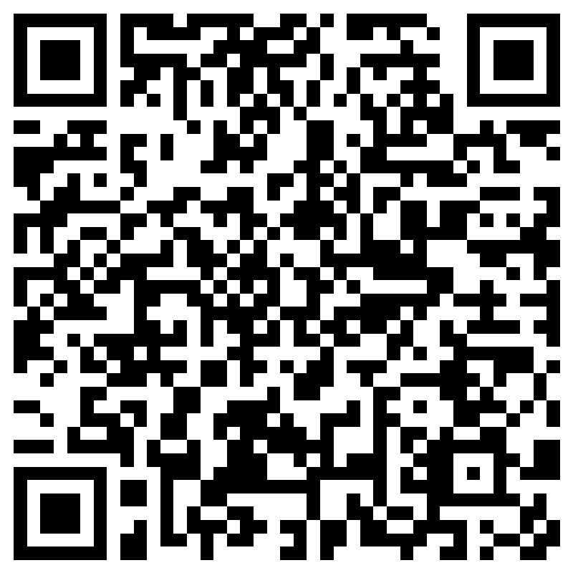

Sign-In

Slide 3



WHAT WE BELIEVE
VALUES
Competence
Loyalty
Open Communication
Defined Autonomy
Honor
VISION
Each student will demonstrate
strength of character and will be college or career ready.
MISSION
The Bibb County School District develops a highly trained staff and an engaged community dedicated to educating each student for a 21st century global society.

Slide 4

VICTORY IN OUR SCHOOLS
Overriding Objective = CCRPI > 70
STRATEGIC PRIORITIES
Priority 1: Get students reading on grade level.
Priority 2: Be successful on the Georgia Milestones.
Priority 3: Increase the number of students in school every day.
Priority 4: Close the knowing-doing gap.
Priority 5: Work hard to support schools.
Priority 6: Establish a culture of accountability for everyone.
STUDENT ACHIEVEMENT
Increase
Content Mastery
Increase Post School
Readiness
Increase Grad Rate and Post Secondary Options
STUDENT AND STAKEHOLDER ENGAGEMENT
Partner
with Students
Partner
with Parents
Partner
with the Community
LEADER AND TEACHER EFFECTIVENESS
Be
A PLC
Know
Technology
Do
Standards-Based Classrooms
INTERNAL PROCESSES
RELIABLE ORGANIZATION
Manage
Processes and Projects
Manage
Finances and Personnel
Manage
Perceptions
Maintain a Safe Learning Environment
LEARNING AND GROWTH
Recruit and Retain
The Right People
Respect
BCSD Values and Culture
Grow
From Evaluations
Notes:
Partnering with students, parents and the community is a key part of achieving Victory in Our Schools. The work we do collectively leads us to every student achieving and being ready to move to the next level in their lives.

Slide 5
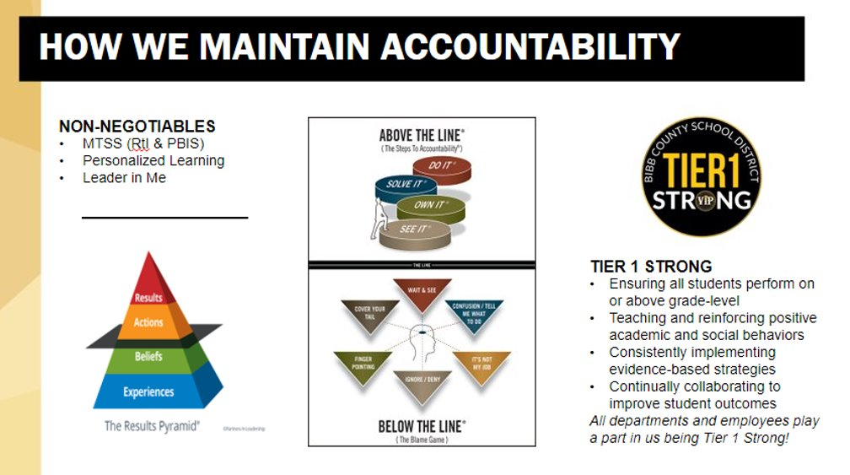
Overriding Objective = CCRPI > 70
Notes:
Partnering with students, parents and the community is a key part of achieving Victory in Our Schools. The work we do collectively leads us to every student achieving and being ready to move to the next level in their lives.

Slide 6
Agenda for 11.3.22
Welcome
- Mrs. Kristy Graham, Principal
Presentation of GSE standards, BCSD Curriculum, and Assessments
- Mrs. Benton & Mrs. Sawyer
Special Guest & Performance
- Mrs. Redding
- VA CheerLEADERS
Hotdog Dinner
- Grill Master Cote
Read Alouds and Literacy Activities
- Vineville Teachers and Staff

Slide 7




Vineville Academy of the Arts
Family Engagement Facilitators
Mrs. Benton & Mrs. Sawyer​
As Vineville Academy's Family Engagement Facilitators we establish two-way-communication between home and school. We share information, surveys, and workshops with our community and families. Partnering together with our families will ensure that students achieve their maximum potential in our school. ​

Slide 8
Welcome to Fine Arts!
Mrs. Baser - Strings
Mrs. Crisp - Dance
Mrs. Gay - Music
Mrs. Siebenmorgan – Art
Participation is key to success in the fine arts. Attendance, Attitude and Effort are important!

Slide 9
-Georgia Fine Arts Standards of Excellence
Art
Music
Strings
Dance
ELA
Math
Creating – engage in the creative process
Presenting – exhibit work and identify as an artist
Responding – discuss artwork and enhance visual literacy
Connecting – discover the relationships with other disciplines, with communities, and develop life skills
Creating-Improvise melodies and composing music.
Performing-sing and/or play instruments alone and with others.
Responding-listen to and describe music. Move to music alone and with others.
Connecting-connect music to history and culture. Connect with all subjects.
Creating- Collaborate with others to create and perform movement.
Performing- Demonstrate focus and concentration in performance skills.
Responding- Explain basic features that distinguish one dance from another. Discuss the performance experience.
Connecting- Participate in a dance from another culture. Compare and contrast dance to other art forms and subject areas.

Slide 10
Fine Arts Assessments
Performances, contests, and displays are typical assessments.
More importantly, developing life skills such as collaboration, creativity, critical thinking, and communication over time as a life-long learner.

Slide 11
Welcome to Violin
Grades K-2 and Strings Grades 3-5!
Connect to Ms. Baser via Remind or email: patricia.baser@bcsdk12.net
K violin: Be on time. Student needs to arrive BY
7:45 a.m. Violins stay at school.
1st-2nd Violin and Strings Grades 3-5:
Class meets twice a week. Bring instrument and music (grades 3-5) on the day of class. Students are required to practice at least 3 times a week at home.
***Fingernails cannot extend past the
fingertips and NO fake nails.

Slide 12
-Georgia Standards of Excellence
*
Math
Creating: improvise, play variations; make arrangements.
Performing: play your instrument correctly, alone and with others.
Responding: listen and evaluate yourself and others.
Connecting: learn how string playing connects to other subjects and your community.

Slide 13
Performance Opportunities
All K-5 String students will perform at their awards ceremonies in May.
On March 9, 2023, members of the Panda Philharmonic will perform 3 pieces and be evaluated by 3 judges as part of Large Group Performance Evaluation (LGPE).
Additional school performances occur at various times during the year.

Slide 14
Pre-K
Welcome to Pre-K
Ms. Collins
Ms. Lowe
Ms. Hall
Ms. Hayslip
Class of 2036

Slide 15



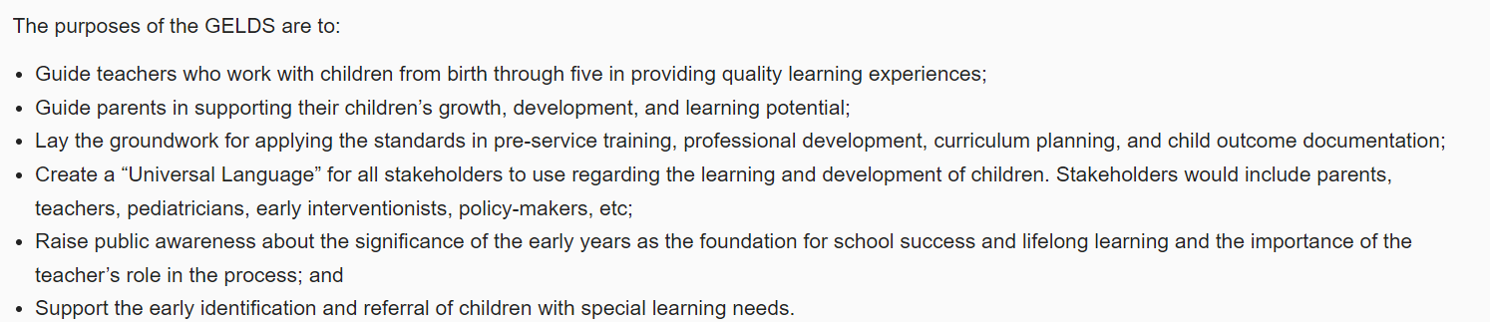


Slide 16
K
Welcome to Kindergarten
Ms. Clark & Ms. Hughes
Ms. Davidson & Ms. Davis
Ms. Hodor & Ms. Alston
Ms. Hollis & Ms. Bozeman
Class of 2035

Slide 17
-Kindergarten Georgia Standards of Excellence
Math
Social Studies
ELA
Science
ELA
Identify national holidays and American symbols
Use words and phrases related to chronology and time
Demonstrate and understand good citizenship
Describe the work that people do, and that people earn income by working
Explain how money is used to purchase goods and services
Explain wants and needs
Explain that a map is a drawing of a place and a globe is a model of the Earth
State the street address, city, state, and country in which a student lives
Blend and segment onset and rime
Identify and write all letters
Produce letter sounds
Decode single syllable words
Fluently read decodable text
Identifies sight words
Spell simple words phonetically
Isolates initial, medial ,and final sounds in words
Ask and answer questions about key details, word meaning main topic, character, and setting.
Use a combination of drawing, dictating, and writing to compose a piece of writing
Identify rhyming words
Count to 100 by ones and tens
Number cardinality
Count to answer, “How many?”
Quantities of 1-20
Write numbers 0-20
Two- & Three-dimensional shapes
Composing numbers with addition
Decomposing numbers with subtraction
Greater than & less than with comparing
Fluently add and subtract within 5
Measurement
Recognize day and night skies (sun, moon, stars)
Identify living and non-living things
Explain motion – push and pull
Identify different materials (clay, cloth, plastic, wood, paper, and metal)
Identify earth materials (soil, rocks, water, and air)
Identify different features of animals and plants

Slide 18

Grade Level Assessments
Individual Sight word assessments
Decodable reader formative assessments
Written and verbal assessments corresponding to report card / GKIDS

Slide 19
1st
Welcome to 1st Grade
Ms. Cannady
Ms. Daughdrill
Ms. Douglas
Ms. Forehand
Class of 2034

Slide 20
-1st Grade Georgia Standards of Excellence
Math
Social Studies
ELA
Science
ELA
Math
Characters, setting, and events
Key Details
Types of Text
Main Idea
Reading Fluency
Nonsense words
Decodable Passages
Addition
Subtraction
Number Sense
Shapes
Time
Measurement
Weather
Plants and animals
Magnets
Light
Sound
Historical Figures
Continents
Landforms
Economics
Patriotism

Slide 21
1st Grade Assessments
Weekly
Spelling and Phonics Assessment
Comprehension Assessment
Math Assessment
Unit
Math Assessment
Reading Assessment
Writing Assessment
3 Class Projects

Slide 22
2nd
Welcome to 2nd Grade
Ms. Miller
Ms. Moore
Ms. Palmer
Ms. Power
Class of 2033

Slide 23
-2nd Grade Georgia Standards of Excellence
Math
Social Studies
Science
ELA
Ask and answer such questions as who, what, where, when, why, and how
Main idea
Retelling stories
Elements of a Story
Visit 2nd Grade English Language Arts Georgia Standards of Excellence (ELAGSE) for more reading and English standards.
Math
Stars and our Sun
Seasons and changes
The moon
Matter
(solid, Liquid, and gas)
Forces
Life Cycles of Animals and plants
Government
Maps
Regions of GA
GA Rivers
Good Citizenship
Sequoyah
Creek and Cherokee
Mary Musgrove
Jackie Robinson
Martin Luther King, Jr.
Jimmy Carter
Even and ODD
Addition and Subtraction up to 1,000
Comparing numbers to 1,000
Measurement (length)
Interpreting graphs
Money
Shapes

Slide 24
2nd Grade Assessments
Fluency Tests
Freckle Assignments
Quizzes & Tests
Unit Writing Assignments
Projects

Slide 25
3rd
Welcome to 3rd Grade
Mrs. Benton
Mrs. Kerns
Mrs. Hanon
Mrs. Sawyer
Class of 2032

Slide 26
-3rd Grade Standards of Excellence
Math
Social Studies
ELA
Science
ELA
Math
Texts – Informational, Reading, and Literary​​
Skills covered- Compare & Contrast, Story Structure, Text Features, Author’s Point of View, Character Traits, Literal and Nonliteral Meanings, Theme, Main Idea​
Writing Pieces- Informational, Narrative, and Opinion​
​
We will be using Wonder's ELA series this year​
Lexile Level- 520L-820L​
Numbers and operations ​
relationships between multiplication and division​
Patterns in addition and multiplication​
Geometry​
Representing and comparing fractions​
Measurement
Unit 1: Heat Energy
Unit 2: Rocks and Soil
Unit 3: Fossils
Unit 4: Habitats of Georgia
Unit 5: Pollution
Unit 1: Rituals and Routines, Virtual Access and Studies Weekly​
Unit 2: United States Geography​
Unit 3: American Indians: Past and Present​
Unit 4: Let’s Go Exploring​
Unit 5: British Colonial America​
Unit 6: American Government Basics​
Unit 7: Economics 101​

Slide 27
3rd Grade Assessments
Weekly
Spelling
Freckle Fact Practices
Freckle Target Practices
Big Ideas
Vocabulary
Unit
Math Assessment
Reading Assessment
Writing Assessment
3 Class Projects
Social Studies
Science

Slide 28
4th
Welcome to 4th Grade
Mrs. Barton
Ms. Burns
Ms. McCoy
Class of 2031

Slide 29
-4th Grade Georgia Standards of Excellence
ELA
Social Studies
Math
Science
Math
Writing: narrative, expository, argumentative
Reading Genres: Nonfiction, Drama, Realistic fiction, science fiction, historical fiction, biography
Reading Strategies: main idea, key details, inferencing, text structures, text features
Place Value
Multiplication and division
Fraction equivalents and operations with fractions
Fractions and decimals
Measurement and geometry
Energy in ecosystems
Astronomy
Earth moon and sun (seasons/ day and night)
Water cycle
Weather and climate
Light and sound
Forces and motion/ simple machines
American Revolution
US Government
Westward Expansion
Slavery
Civil War
Reconstruction

Slide 30
4th Grade Assessments
Weekly
Weekly Comprehension Assessment
Oral Reading Fluency
Math Fact Fluency
Unit
Math Assessment
Reading Assessment
Social Studies and Science Assessments
Writing Assessment
3 Class Projects
Science Fair
Simple Machine Project
Book Report

Slide 31
5th
Welcome to 5th Grade
Mrs. Bradley – Math
Mr. Doud – Science & Social Studies
Mrs. Sargent – ELA
Class of 2030

Slide 32
-5th Grade Georgia Standards of Excellence
ELA
Social Studies
Math
Science
Non-fiction: Main Idea and Text Structures-compare and contrast, cause and effect, problem and solution, sequence, and chronological order
Fiction: Themes, Summaries, and Inferencing
Writing: Narrative, Informational, and Opinion
Grammar: Sentence Structure and Parts of Speech
Vocabulary: Non-literal Language (similes, metaphors, idioms, hyperboles, and personification), Context Clues, Greek and Latin Roots, and Prefixes and Suffixes
Math
Earth Science
  Earth and Changes Over Time: Surface Features
Life Science
  Classification of Organisms
  Learned Behaviors and Inherited Traits
  Cells and Microorganisms
Physical Science
  Natural vs Human Harnessed Electricity
  Circuits, Conductors, and Insulators
  Types of Magnets
  Physical and chemical Changes
Order of Operations and Whole Numbers
Place Value and Adding and Subtracting with Decimals
Multiplying and Dividing with Decimals
Adding, Subtracting, Multiplying, and Dividing Fractions
2D Figures, Volume & Measurement, Geometry and The Coordinate Plane
Citizenship, Business and the Government
Bigger, Better, Faster: The Changing Nation
War and Prosperity: World War I and the 1920’s
The Great Depression and the New Deal
Another World War [WW2]
War Turns Cold
Civil Rights Address Civil Wrongs
United States from 1975 to the Digital Age
Building A Budget/Economic Lessons

Slide 33
5th Grade Assessments
ELA:
Weekly comprehension and grammar quizzes, bi-weekly writing assessments, and district unit assessments taken in School City
Math:
Chapter practice
Spiral Review quiz
Fact Fluency
School City Unit Assessments
Science & Social Studies:
School City Unit Assessments
Benchmarks:
Star CBM Fluency assessments, Star Reading and Math assessments, and Reading Plus diagnostics

Slide 34
District Assessments
Renaissance-
Star Early Literacy (K-1)
Star Reading
Star Math
Star Oral Reading Fluency
School City –
Unit Assessments (3-5)
GMAS – Georgia Milestone Assessment System(3-5)

Slide 35
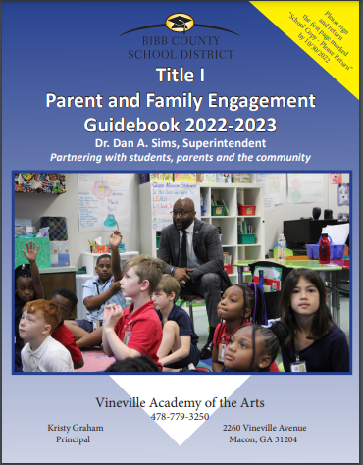

National School-Parent Compact Signing Day

Slide 36



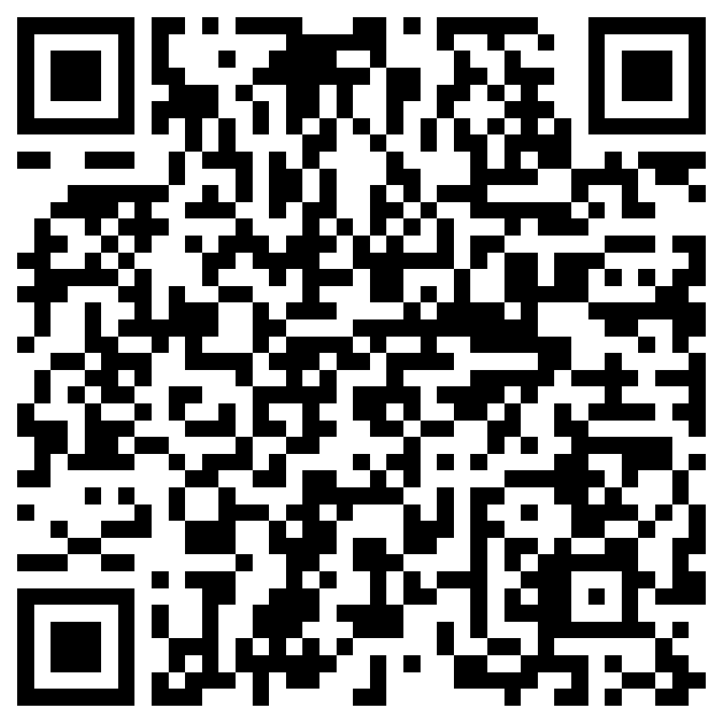




Evaluation

Slide 37


Thank you!
Vineville Academy of the Arts
Family Engagement Facilitators
Mrs. Heather Benton
Heather.Barnes@bcsdk12.net
Mrs. Jessica Sawyer
Jessica.Sawyer@bcsdk12.net

Slide 38
Please join us for a Hot Dog Dinner and Literacy Activities
Vineville Academy of the Arts Magnet School
GSE Standards, Curriculum, & Assessment Workshop

