Slide 1

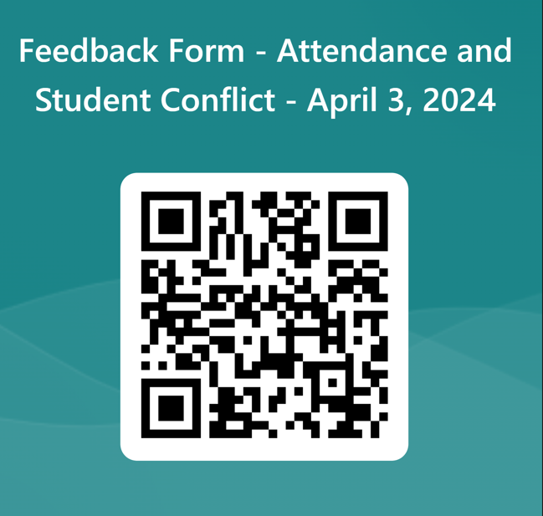
Welcome Families!
Session will be recorded.
Session will be posted on the ISD website after spring break.
Please mute your microphone.
Please turn off your audio.
Ask questions in the chat.
Chats will be addressed during the presentation if applicable or addressed at end of session.
Parents can ask questions at the end of the session.
Please complete the feedback form at the end of the session.

Slide 2

Attendance and
Reporting Student Conflict
Issaquah School District
Stacy Cho – Assistant Director of Compliance
Lorna Gilmour – Family Partnership Specialist, Equity
Notes:
Stacy – define what is Compliance

Slide 3
Purpose of tonight’s event:
Provide guidance for families on procedures around reporting student conflict.
Provide information regarding Attendance policies, provide definitions around truancy, chronic absenteeism and laws
Provide tips on partnering with the school around attendance issues or student conflicts.
Notes:
Lorna

Slide 4
Mean Behavior at School
Mean behavior may not always be bullying.
Many kids experience or participate in mean behavior.
Students' “othering” kids or questioning their sense of belonging. Can be same race or gender, find way or difference to pick on others
Needs to be addressed and reported to an adult at school
Parents need to be aware of their children’s behavior so we can partner together.
  Listen to the feedback from the school
  Refrain from blaming the school or staff
  Consistent expectations for student behavior
  It takes both the school and home partnership to help change behavior
Notes:
Lorna and Stacy

Slide 5
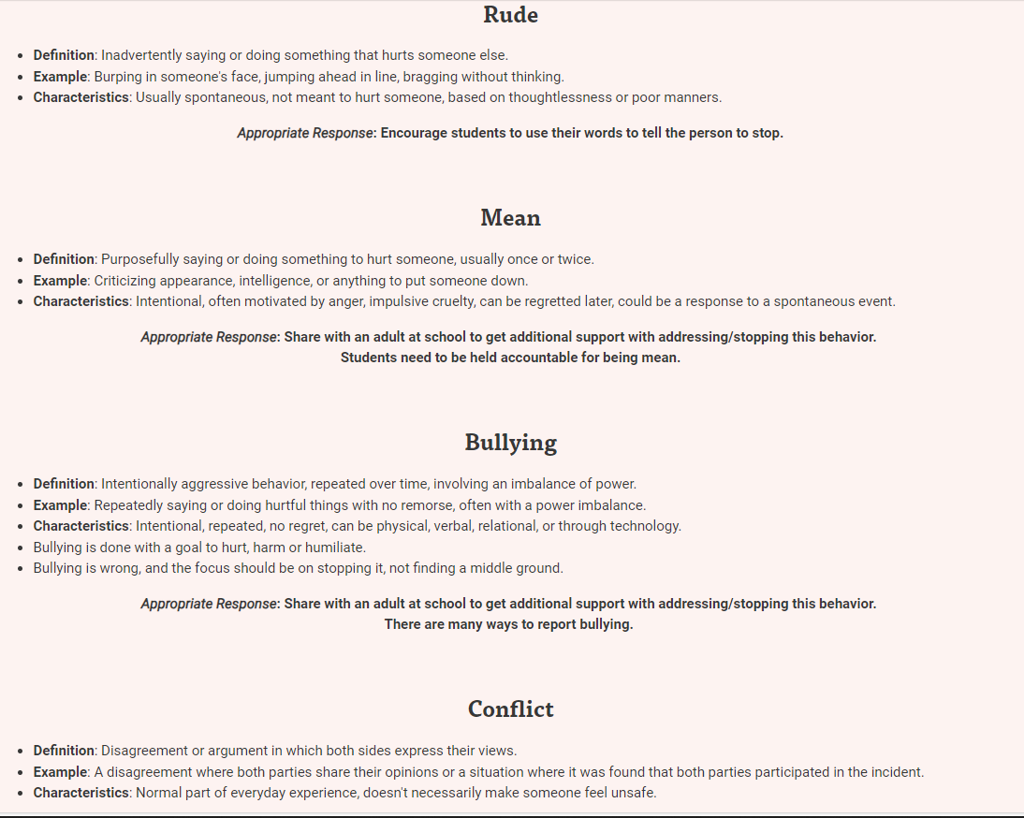
Definitions of Mean, Bullying, Rude and Conflicts
Notes:
Lorna
Rude – unthinking
Conflict – if you have more that one child, chances you have experienced your child having a conflict with another. Or at the playground. Conflict resolution skill part of growing up

Slide 6
What can parents do to support students?
(Mean, rude or conflicts)
Identify if behavior is mean, rude, conflict or bullying so you can help your child appropriately work on solutions
Listen for understanding
For conflicts – you can counsel your child or have them get support of school counselor to help mediate or work out the disagreement (some students need to learn how to problem solve or do conflict resolution)
For Rude behaviors – provide students ideas or tools to use to ask student to stop. Coach them on how to involve staff as needed to intervene.
For Mean behaviors - work with student on problem solving step, identify who is a trusted adult to get support
  If student has used all tools in their tool belt, and other student behavior is still ongoing, it needs to be reported.
For incidents when your child is the witness, you can still report the incident.
You/your child can report anonymously – Supportive measures will be offered in response to all reports; however, disciplinary actions on the alleged aggressor can only be imposed based on non-confidential reports.
District have policy to prevent Retaliation behavior.
If problem not resolved, continue to report new allegations to the principal and complete a non-confidential HIB form to initiate a full investigation.
Notes:
Lorna

Slide 7
Examples of mean/unkind behaviors
Students teasing or commenting about
Weight
Teeth
Hair
Skin color
Religion
Ableism – physical or learning disabled
Sexual identity – homophobic slurs,
Accent – students from same race or country may pick on others
Talk to your child or get guidance if needed – is the action a mean behavior or does it rise to the level of HIB
Even if it happens once, depending on the action, it can be HIB or needs to be formally reported.
The impact of the act on the student is key as school administrators address the incident.
Every incident is unique, many circumstances or factors involved.
Notes:
Lorna

Slide 8
HIB defined
Harassment - refers to any malicious act, which causes harm to any person's physical well-being. It can be discriminatory harassment, malicious harassment, or sexual harassment.
Bullying - refers to unwanted aggressive behavior(s) by another student or group of students that involves an observed or perceived power imbalance and is repeated multiple times or is highly likely to be repeated. Bullying may inflict harm on the targeted student, including physical harm, or educational harm. Bullying can also occur through technology and is called electronic bullying or cyberbullying.
Intimidation - refers to implied or overt threats of physical violence.
Notes:
Stacy

Slide 9
Washington State Legal Definition
Harassment, intimidation, or bullying means any intentional electronic, written, verbal, or physical act when the intentional electronic, written, verbal, or physical act:
Physically harms a student or damages the student's property; or
Has the effect of substantially interfering with a student's education; or
Is so severe, persistent, or pervasive that it creates an intimidating or threatening educational environment; or
Has the effect of substantially disrupting the orderly operation of the school.
Notes:
Stacy

Slide 10
When and Why to Report Incidents - HIB
Pattern - Student has used tools and strategies provided by school and the behavior is ongoing.
Power - Student has asked the student to stop or fears saying anything to student(s) due to imbalance of power.
Intentional – behavior targeted at an individual or group of students.
Goal of aggressor – to hurt, harm or humiliate student
*If you are unsure, you should always report anyway and let your school administrator decide.
School focus is to stop the behavior of concern. Goal is to keep students safe.
Notes:
Stacy

Slide 11
Who and How to Report incidents – For Parents
Focus on the actions, report facts and details. Work with the school to identify the problem and solution.
ISD Webpage – Safety Concern on top of any ISD webpage - Safety Concern - Issaquah School District 411 (isd411.org)
t is very important to always document in writing about incidents of mean or hateful behavior.
When incidents of hate and mean behavior is not addressed or reported – students suffer, school cannot address the issue, problem builds and escalates
For first time incidents – an email with details should be sent to the school staff.
  If incident happened in class, send to the teacher and cc a school administrator* if needed.
  If incident happened in lunch, hallway, recess, send the email to the school administrator*
If problem does not stop, send another email to all staff involved. Parent is documenting a pattern of behavior.
Students may report directly to any district staff member when harassment, intimidation, or bullying is taking place.
For parent – written documentation is key to reporting incidents. (In parent's preferred language)
*School Administrator – principal, assistant principal or dean of students
Notes:
Lorna

Slide 12
Reports
Anonymous report – no discipline can be assigned based only on an anonymous report. An investigation may or may not occur. Administrators may use the report as informational to gather more data or to watch for that behavior of students involved.
  Usually done by student witnesses or parents who have heard of incidents
  Name of reporter not stated but provide enough details to help school look into the situation.
Informal Reporting
  You can complete the informal reporting form or email school staff.
  Key to reporting: provide details on when and where the behavior occurred, other student witnesses, all details you can provide.
  A follow up conversation will happen with school administrators to gather more information and to talk about what supportive measures might be needed.
Formal Report – HIB Form (online or complete paper) – email or give to school principal
Be sure to include previous documentation/emails and screen shots if applicable.
Notes:
Stacy

Slide 13
What happens after reporting:
School administrator or school staff will contact you within 2 school days to confirm receipt.
If additional information is needed, a time to meet (virtual or in person) will be scheduled (parent, school and student).
A non-confidential formal complaint will result in an investigation
  Interview both parties separately
  Interview witnesses
  Discussion with family. Let school know what supportive measures would benefit your student.
  Review of prior complaints involving both complainant and alleged aggressor
  Review any available video footage (parents can request to see the video footage)
Parent will be updated every 5 days regarding the investigation.
After the investigation, a written response will be given to the parent/guardian of both the complainant (person who reported) and the alleged aggressor.
*The parents of the students involved are NOT connected. School will not meet with parents of both parties at the same time.
Notes:
Stacy

Slide 14
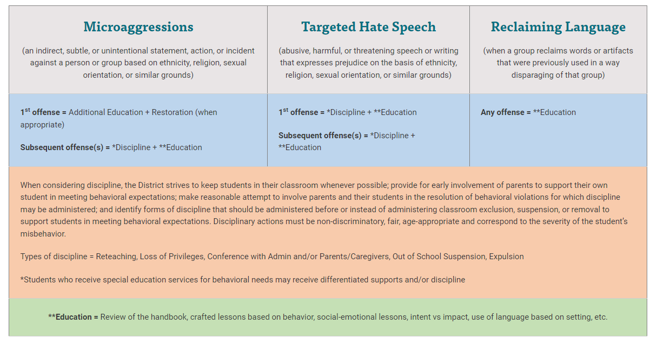
Behaviors and Disciplinary Actions
Notes:
Lorna

Slide 15
Progressive Discipline plan
The discipline of another student is not shared families or other students.
Our goal is to have a consequence that will help change a student's misbehavior and address that student's need.
Factors in the type of consequence or discipline
1st offense
Type of offense
Severity of offense
Developmental age of the student
Notes:
Stacy

Slide 16
Discipline Response to Reports
Unique – based on the specific student doing that specific behavior
  Education – conversation, teaching, counseling
  Resources may include mental health referral
  Social emotional supports,
  Student safety plan such as “No contact”, Recess time play area, lunch time plan
  Different walking paths
  Afterschool or Saturday detention (High school)
  Other consequences
Elementary grades may have Circles or class discussions, work with school counselor or administrator, sit in office to do activity as reflection on behavior
Washington State discipline laws have changed.
Goal of school is to TEACH
Removing students from school is not part of the plan unless extreme situation/circumstances.
Notes:
Stacy

Slide 17
Communication with school in person
Important to call school and make an appointment with an administrator.
Follow up with any conversations with an email so you have the information discussed in writing.
Important to keep calm and to work cooperatively with the school.
Recognize that there may be a different side to the story then what is being shared with you at home.
Collaborate to keep your child safe.
Notes:
Lorna

Slide 18
What can be shared about incidents?
The student and family that reported the incident is not notified about the consequences of the other student's involved in the incident. (no names shared, no details given, parents not connected with each other)
Notes:
Stacy

Slide 19
Follow up after an incident – Tips for parents
Parents need to have ongoing conversations with their child. Check in with your child – Not to continually remind them or traumatize them but a check in
Families should focus on the outcome and the well-being of their child.
If issue is still a concern, send an email to the administrator with details of the incident.
Ask for a weekly check in with the student by school personnel (school counselor, AP, trusted staff) as a supportive measure to help move forward from the incident.
Notes:
Lorna

Slide 20
Cyberbulling/Online incidents
Mean and Bullying often happens on Social Media such as Snapchat, Instagram, Discord, TikTok and other apps
These apps have instructions for how to report accounts that are concerning
Take screenshots to document incidents to you can share with the school – documentation
Talk to your students about how to block users and about group chats.
Have a family plan for turning in technology at night so students can focus on sleep.
Inappropriate photos (child pornography) should be shared with police only. Inform the school but DON'T send the photo to the school administrator/school.
Cyberbullying
  Report the incident to school
  Should be reported to the police also since it violates Federal Law
  School will investigate if it is impacting school environment
  Block number and report user's account to the app
  Make sure your children know who is a part of the group chat
Notes:
Stacy and Lorna

Slide 21
Incidents off campus
Fights or incidents between students often happen outside the school boundaries in neighborhoods or in the community.
  Students can still request support from school if there is a known conflict between students that might include alternate passing times, different walking paths, or no contact agreements
  Families can report such incidents to the police – school cannot address problem off campus
Notes:
Stacy

Slide 22
Problem solving is part of learning process
Our students are learning and growing
They will make mistakes
We will partner together to help them navigate these situations
We want all our students to feel safe and supported at school
We have partnered with Care Solace to help our students, parents and community to connect to mental health professionals
Notes:
Stacy
Welcome parents to reach out to Stacy or FPL if they questions

Slide 23
Attendance

Slide 24


Attendance Matters!
Research has shown that it usually takes students three days to catch up with school work for every day they’ve missed.
Develop social and emotional skills including self-regulation and problem solving.
Establish an environment that promotes a sense of safety and belonging. ​
Prioritizing respect and creating a space where students feel connected to adults in the building and the school culture. ​
When students feel connected to and supported by their teachers, they are more motivated to attend and have better academic outcomes.
Notes:
Lorna

Slide 25

Attendance Law
Why does the law exist?
State Law requires children from the age of 8 to 17 to attend a public ​school, private school, or homeschooling. ​
Children who are 6 or 7 years old are not required to be enrolled in school.​
However, if parents enroll their 6- or 7-year-old, the student ​must attend full-time.
The law requires many things of schools, but only requires one thing ​of students:
attend school.
If a student does not attend school the law ​requires the school district to take action.
Notes:
not only for academic success, but because school offers an opportunity to develop social and emotional skills such as listening, paying attention, problem-solving and self-regulation, all which are needed to grow and learn.
Stacy

Slide 26
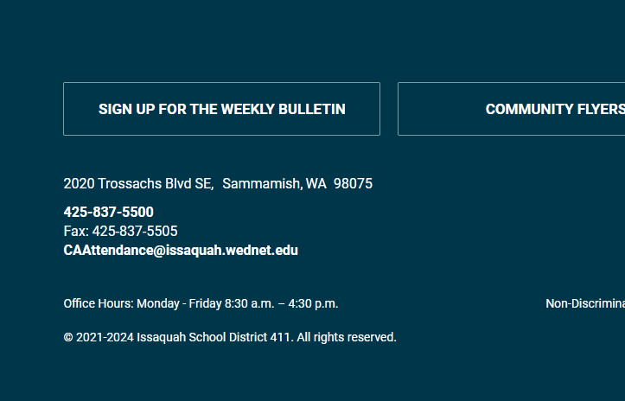
Reporting Absences
Call the school attendance office using the email or phone number listed above to excuse the absence each day.
  Provide student name, grade level, date of absence and reason for absence
  You can call at night and leave a message as well if you forget to call during the day.
Any absence is marked unexcused if the office is not notified.
A student arriving 2 or more hours after the start of the day is considered absent for the morning. (Elementary)
A student who leaves 2 or more hours before dismissal is considered absent for the afternoon. (Elementary)
If you take your child to the doctor for illness causing absences, please request a doctors note for the school.
Attendance information can be found at the bottom of ALL ISD SCHOOL WEBSITES! Please scroll to the bottom of the page for quick access.
Notes:
Lorna

Slide 27

School phone call (Robo call) when student is absent
School computer system that automatically makes the calls when the student is marked absent. Safety measure built in to keep students safe.
If you receive a phone message that your child is absent and you believe your child to be at school, please email your child's teacher and the attendance office. (All students K-12)
  Email teacher in class period missed for secondary (grades 6-12) students to ensure it was not teacher or school error for call.
  Contact school ASAP to check and verify absence so that the attendance can be updated.
  Only the teacher can verify and change the attendance record using an attendance correction form (signed and turned in by teacher)
Notes:
Lorna

Slide 28
Pre-arranged Absences
For Pre-Planned absences of 1-2 days, simply call or email the office in advance with the dates of absence and reason. Please also inform your child's teacher (for elementary school).
For Pre-Planned absences of 3 or more days, complete Pre-Approved Absence form at least one week prior to absences.
  Elementary Form
    The student is responsible for completing missed work.
    Make-up assignments following the student’s return, along with a reasonable timeline for completion
  Secondary Form – Needs teacher signatures
    Student’s responsibility to make up all assigned work according to his/her teachers’ classroom guidelines
    Students should be checking Canvas for assignments and work.
Teachers do not provide make up work in advance of the absences. Students get work when they return.
The principal or designee may only grant permission for a student’s absence providing such absence does not adversely affect the student’s educational process
Notes:
Stacy

Slide 29

For Absences Greater than 20 days
Meeting/conversation designed to help school and family partner around the absence since it could adversely impact student learning.
Your student's school will be contacting you to schedule a conference at a mutually agreeable, reasonable time with at least one District employee.
Discussion to identify the barriers and supports available to you and your student related to this absence prior to your departure.
Signed agreement between parent/guardian and school principal that the absence will not cause a serious adverse effect upon the student's educational progress.
If you don't return that same school year, your child may be withdrawn.
Notes:
Stacy

Slide 30
Responses to schools for Unexcused absences
3-7 unexcused absences in a month – school will send letter home and may ask to have a parent meeting
  Respond to the school when they call or email.
  Student and parent share the barriers preventing attendance
  Student and parent partner with school to create an attendance agreement.
  For students with an IEP or 504 plan, school team will meet at this time.
11 unexcused absences in a year
  Attendance Office sends 11 unexcused absence warning letter.
  School (principal, AP or Dean) meets with family to review/modify attendance success plan.
  Work with school to update the attendance agreement
15 unexcused absences in a year
  Attendance Office sends 15 unexcused absence letter
  Student and parents should continue talking and working with school on plans to address attendance concerns
  Assistant Principal files BECCA petition
    If a petition is filed, you will receive additional letters outlining the next steps.
Letters, call homes and meetings are all legal steps required by state law. School document these steps and present them at truancy court if attendance continues to be a concern (15+ unexcused absences)
Notes:
Stacy

Slide 31
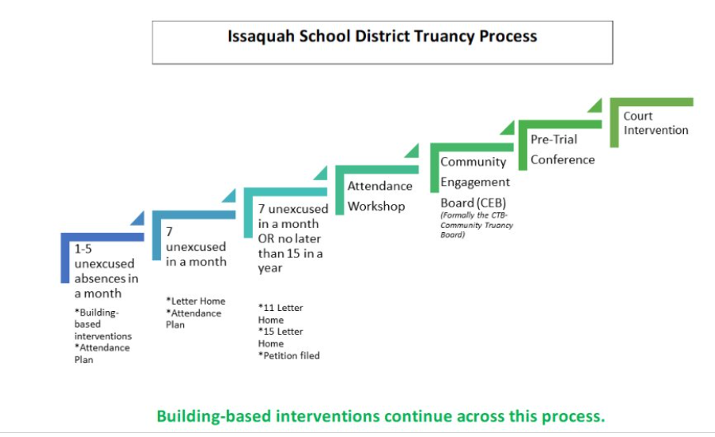
Steps of the Truancy Process
Notes:
Stacy

Slide 32

How can parents' partner with schools?
Communicate with school – attendance secretary or school administrator. School's goal is to keep students safe.
Respond to the school’s outreach​
Be an active part in the conversations around barriers to attendance​
Problem solve with the team to identify interventions to try​
Help create routines at home to reduce stress in the morning​
Establish an expectation at home around the use of technology at night​
Talk about alternate ways to get to school if the bus is missed​
We would prefer students arrive late rather than not attending at all
Notes:
Lorna

Slide 33
Interventions offered by schools
Create an attendance plan with goals
Create an incentive/recognition of meeting goals
Offer to adjust student schedule
Provide structured break time in an alternate location
Discuss concerns or alternative if transportation is concern
Offer an automatic wake-up call each morning
Offer an alarm clock for family
Offer academic support/tutoring, VOICE mentor, etc
Conduct home visits/well-child checks
Offer to arrange counseling with Swedish Mental Health counselor at school
Many other options – based on unique need of child and family
*School team meets to discuss next steps and concerns to support child and family.
Notes:
Stacy

Slide 34
Chronic Absenteeism vs Truancy
Chronic absenteeism is defined as missing 10% of class, which is equal to 18 days over the academic year. (Excused or unexcused)
Truancy is defined as when students miss school without a valid excuse.
  Washington State Law – school must respond when students are truant.
    The school district may file truancy petitions with the juvenile court after seven unexcused absences in a month, or fifteen unexcused absences in an academic year.
  Truancy Board at ISD is called the Community Engagement Board (CEB)
    Board meets with student and families after a petition has been filed.
    Goal is to support student and family prevent unexcused absences.
Notes:
Stacy

Slide 35
Excessive Excused Absences
A meeting may be called if students have more than 15 excused absences in a year and there is an academic concern
Under state law, elementary schools are required to conference with parents/guardians when an elementary student has five absences for any reason in a month or ten absences over the course of the year.
The meeting is an opportunity to address barriers and concerns regarding absences between the school administrator and family.
A discussion with the principal (school administrator) will occur about what will be excused or unexcused moving forward.
A doctor's note may be required to excused future absences with the hope that a professional can address the medical concern if any.
Suggestion to schedule family vacations and trips during school scheduled breaks.
Notes:
Stacy

Slide 36
Questions?
Please contact a Family Partnership Liaison if you have additional questions!
Feedback form: https://forms.office.com/r/EJKNi2Hvag
Student handbook - Student Conduct - Issaquah School District 411 (isd411.org)
Stacy Cho – Assistant Director of Compliance (HIB and Attendance)
ChoS@issaquah.wednet.edu
Lorna Gilmour – Family Partnership Specialist – gilmourl@issaquah.wednet.edu
Liliana Medina Family Partnership Liaison 📞: 425-837-7141 🗨️: 425-331-9555 |  | Wenli Mithal Family Partnership Liaison📞: 425-837-7106 🗨️: 978-252-3686 |  | Ina Ghangurde Family Partnership Liaison📞: 425-837-7008 🗨️: 252-563-3498
Notes:
Lorna

