Slide 1
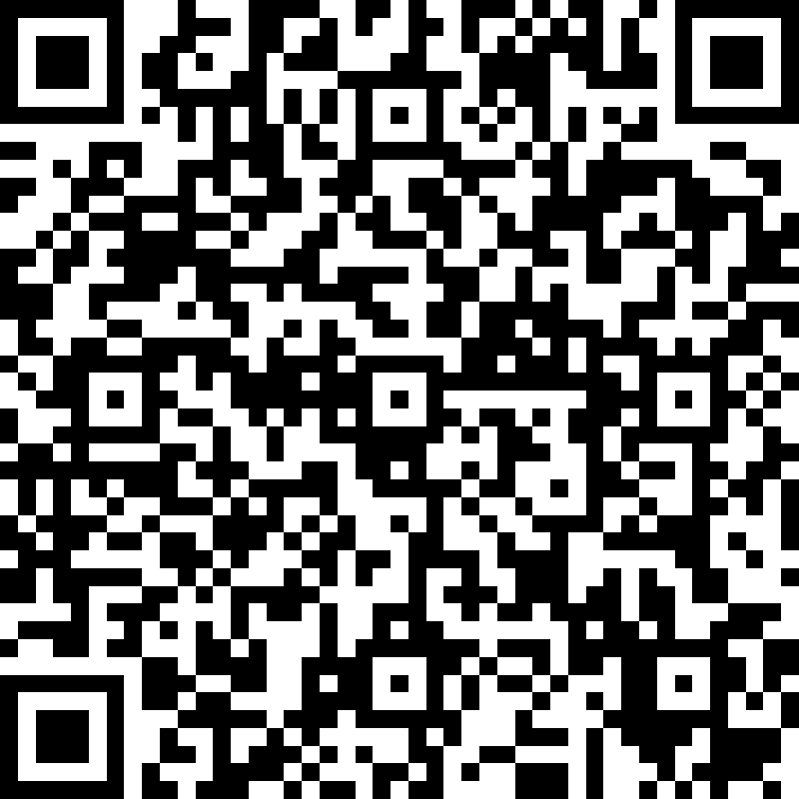

Georgia Milestones Parent forum
Bernd Elementary Leadership Academy
Please Sign-In
Thank You for Joining Us!

Slide 2




WHAT WE BELIEVE
VISION
Each student will demonstrate
strength of character and will be college or career ready.
MISSION
The Bibb County School District develops a highly trained staff and an engaged community dedicated to educating each student for a 21st century global society.
VALUES
Competence
Loyalty
Open Communication
Defined Autonomy
Honor

Slide 3

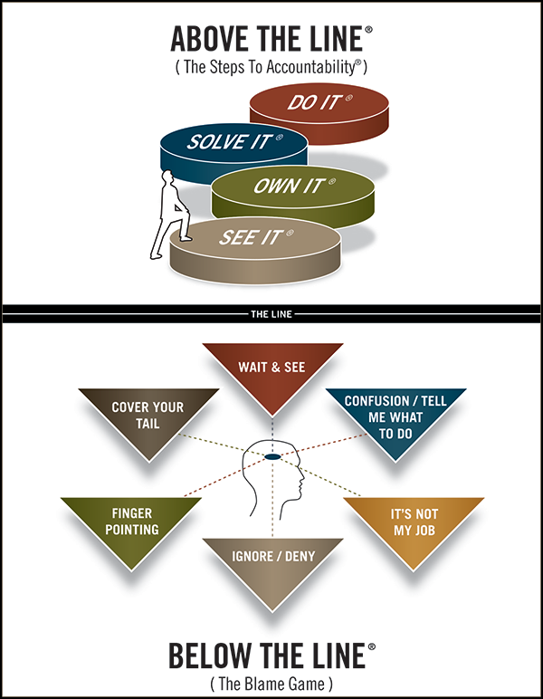
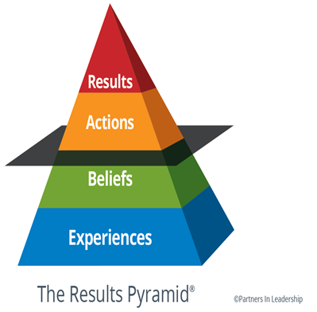
HOW WE MAINTAIN ACCOUNTABILITY
NON-NEGOTIABLES
MTSS (RtI & PBIS)
Personalized Learning
Leader in Me
TIER 1 STRONG
Ensuring all students perform on or above grade-level
Teaching and reinforcing positive academic and social behaviors
Consistently implementing evidence-based strategies
Continually collaborating to improve student outcomes
All departments and employees play a part in us being Tier 1 Strong!

Slide 4

VICTORY IN OUR SCHOOLS
Overriding Objective = CCRPI > 70
STRATEGIC PRIORITIES
Priority 1: Get students reading on grade level.
Priority 2: Be successful on the Georgia Milestones.
Priority 3: Increase the number of students in school every day.
Priority 4: Close the knowing-doing gap.
Priority 5: Work hard to support schools.
Priority 6: Establish a culture of accountability for everyone.
STUDENT ACHIEVEMENT
Increase
Content Mastery
Increase Post School
Readiness
Increase Grad Rate and Post Secondary Options
STUDENT AND STAKEHOLDER ENGAGEMENT
Partner
with Students
Partner
with Parents
Partner
with the Community
LEADER AND TEACHER EFFECTIVENESS
Be
A PLC
Know
Technology
Do
Standards-Based Classrooms
INTERNAL PROCESSES
RELIABLE ORGANIZATION
Manage
Processes and Projects
Manage
Finances and Personnel
Manage
Perceptions
Maintain a Safe Learning Environment
LEARNING AND GROWTH
Recruit and Retain
The Right People
Respect
BCSD Values and Culture
Grow
From Evaluations

Slide 5


Slide 6
Essential Outcomes
What is the purpose of the Georgia Milestones?
What do the achievement levels and domains mean?
How can I help my student?
What are our grading guidelines?

Slide 7


Slide 8


Slide 9
EOG PURPOSE
Provide a valid measure of student achievement of the state content standards across the full achievement continuum CONTENT MASTERY
Provide a clear signal of each student’s preparedness for the next educational level (grade) READINESS
Allow for the detection of the academic progress made by each student from one assessed grade to the next PROGRESS
Be suitable for use in promotion and retention decisions at grades 3(reading), 5 (reading and math), and 8 (reading and math)
Support and inform educator effectiveness measures
Inform state and federal accountability measures at the school, district, and state levels.

Slide 10
Achievement vs. Growth
Achievement MASTERY
  How well students are meeting state expectations
  Snapshot look at student performance
Growth PROGRESS
  How students are progressing from year to year
  Takes students’ starting points into consideration
Growth is independent of proficiency cuts

Slide 11
Achievement Levels
Beginning Learners do not yet demonstrate proficiency in the knowledge and skills necessary at this grade level/course of learning, as specified in Georgia’s content standards. The students need substantial academic support to be prepared for the next grade level or course and to be on track for college and career readiness.
Developing Learners demonstrate partial proficiency in the knowledge and skills necessary at this grade level/course of learning, as specified by in Georgia’s content standards. The students need additional academic support to ensure success in the next grade level or course and to be on track for college and career readiness.
Proficient Learners demonstrate proficiency in the knowledge and skills necessary at this grade level/course of learning, as specified in Georgia’s content standards. The students are prepared for the next grade level or course and are on track for college and career readiness.
Distinguished Learners demonstrate advanced proficiency in the knowledge and skills necessary at this grade level/course of learning, as specified in Georgia’s content standards. The students are well prepared for the next grade level or course and are well prepared for college and career readiness.

Slide 12
Developing Learners
Developing Learners demonstrate partial proficiency in the knowledge and skills necessary at this grade level/course of learning, as specified by in Georgia’s content standards. The students need additional academic support to ensure success in the next grade level or course and to be on track for college and career readiness.
The Developing Learner achievement level consists of students who have demonstrated partial proficiency; they have a partial command of the knowledge and skills inherent in their grade level or course content standards. These students can be successful in future learning but will likely need some type of focused remediation in their weaker areas; they do not, necessarily, need a support class. Their learning should be monitored to ensure their success and to increase their opportunity to reach proficiency.
In short, this achievement level allows for the recognition of those students who have demonstrated some command, albeit partial, of the grade-level expectations but have not yet reached the full command necessary to signal proficiency. Proficient students demonstrate a strong, solid command of the grade-level or course content and skills.

Slide 13
Achievement Level Descriptors
Achievement Level Descriptors:
are critical to test score interpretation, helping to give meaning to the scale scores and achievement classifications;
represent the progression of understanding, thinking, and reasoning in each content area; and
can be viewed as stages of thinking and learning, providing insight into not only the content, but also the cognitive demand and context within which students are able to demonstrate mastery.

Slide 14
Types of Scores
Scale Scores
  Range varies depending on grade level and content area
Achievement Levels
  Achievement Level Cuts
    Developing Learner: 475
    Proficient Learner: 525
    Distinguished Learner: varies from 555 to 610

Slide 15
Domain Signals
English Language Arts
Reading Status
  Below Grade Level
  On Grade Level or Above
  Lexile Score- is a standard score that matches a student’s reading ability with difficulty of text material. A Lexile score can be interpreted as the level of book that a student can read with 75% comprehension.
Writing Scores
  Extended Writing Task – rubric score by trait
    Ideas, Organization & Coherence [number of points earned out of 4]
    Language Usage and Conventions [number of points earned out of 3]
  Narrative Writing [number of points earned out of 4 possible]

Slide 16
Domain Signals
Mathematics (3rd-5th), Science (5th)
Remediate Learning
Monitor Learning
Accelerate Learning
Domain Performance:
What is the likelihood the student would achieve proficiency on the test given his/her performance in the domain?

Slide 17
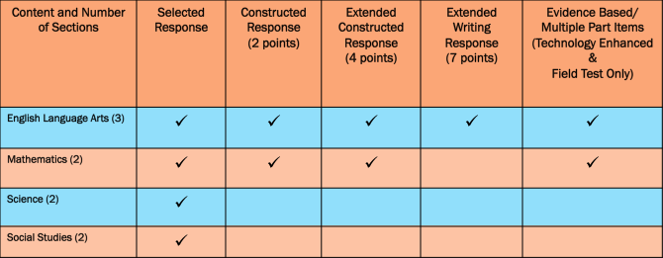

Slide 18
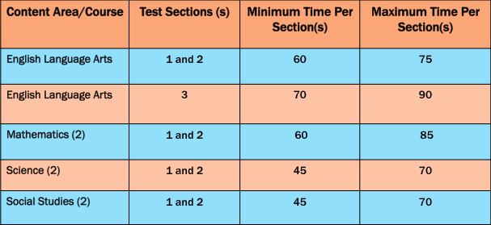

Slide 19
Item Types
  Multiple-Part Items
  Field test slots (Sections 2 & 3 in ELA)
  Evidence-Based Selected-Response (EBSR) Items for English Language Arts – a two-part multiple-choice item that requires students to complete both parts
    First part answers inferential or key concept question related to text. Includes one correct response
    Second part is evidence from the text used to support the inference or idea. May include one or more correct response(s)
    2-point score value with opportunity for partial credit. Part One and Two must be correct to receive 2-Points. 1-Point if only Part One is correct

Slide 20
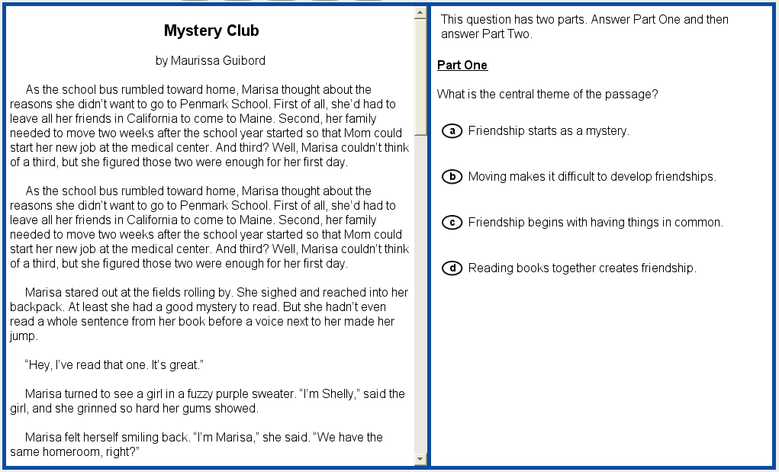
Evidence-Based Selected Response- part 1 online

Slide 21
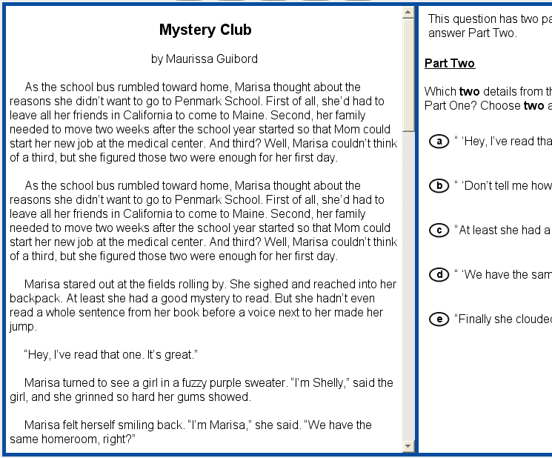
Evidence-based selected response- part 2 online

Slide 22
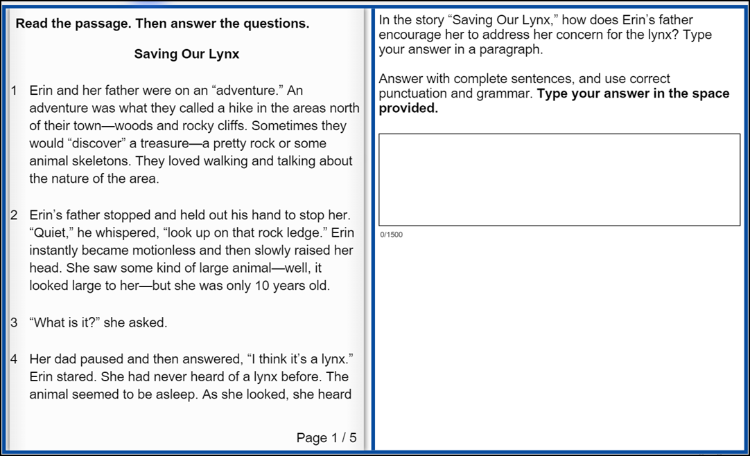
ELA Section 3: Online Test Takers
ELA Section 3 Online Item 59
Constructed Response
The left side of the screen- the Reading Passage
The right side of the screen- the test items and the Writing Task function independently .
Students can refer to either passage or Writing Task while typing a response.
Short cut keys for Text Entry Boxes
Ctrl + C = Copy
Ctrl + X = Cut
Ctrl = V = Paste

Slide 23
item types
  Multiple-Select Items
  Field test slots
  Allows for more than one correct answer
  There are five or six options listed
  Number of selections are limited to the number of correct responses
  Provides students with the opportunity to show fluency and/or multiple representations
  2 points for all correct or 1 point for a specific combination(s).

Slide 24
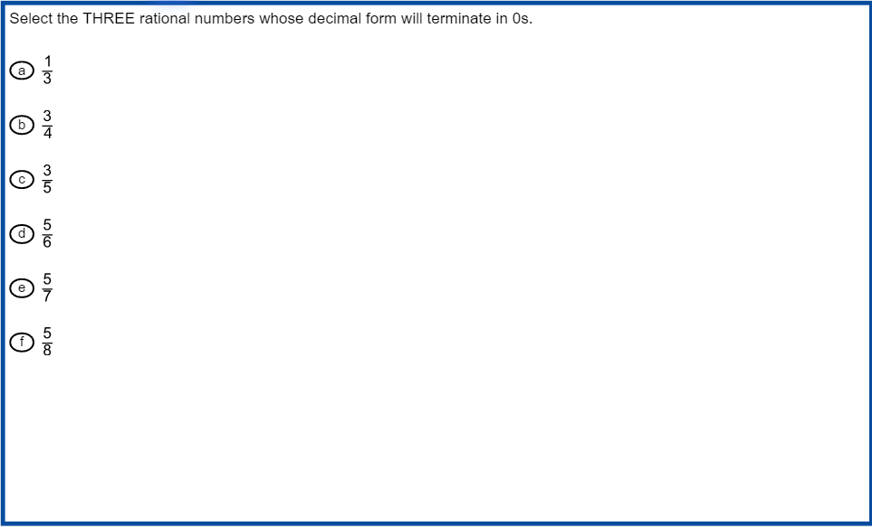
Multi-Select Item Online

Slide 25
Promotion & Retention
2022-2023 School Year
Reading – Grades 3, 5, and 8
Student performance on the reading portion of the ELA test will be used to provide a grade level reading determination:
Below Grade Level or On/Above Grade Level
The determination is based on the linkage of the Lexile scale to Georgia Milestones. To be eligible for promotion, students must demonstrate reading skill at the beginning of the grade-level stretch-band.

Slide 26
Promotion & Retention
2022-2023 School Year
Math – Grades 5 and 8
Student performance on the math portion of the Milestones test will be used to provide a grade level math determination:
Developing or On/Above Grade Level
The determination is based on the linkage of the Math scale to Georgia Milestones. To be eligible for promotion, students must be at the Developing Learner achievement level or above in mathematics to be promoted to the next grade.

Slide 27
Lexile Stretch Bands
Grade Band Current Lexile Band "Stretch”Lexile Band*
K–1 N/A N/A
2–3 450L–730L 420L–820L
4–5 640L–850L 740L–1010L

Slide 28
Grading Guidelines
Receive Progress Reports at the End of Each 6-Weeks
Receive Report Card at the End of the Year
Access Grades Through Parent Portal
Kindergarten
Used to Report Progress on Essential Skills in Content Areas and Social Development:
EXC – Exceeding
DEM – Demonstrating
DEV – Developing
EM – Emerging
ND – Not Demonstrated
Grades 1-5
Numerical Grades Assigned to Core Subjects of ELA & Math(1-5), and Science & Social Studies (3-5):
90-100 – A (Excellent Progress)
80-89 – B (Satisfactory Progress)
70-79 – C (Needs Improvement)
Below 70 – F (Unsatisfactory Progress, Failing)
**Letter Grades Are Assigned to Fine Arts Courses and PE (1-5) and Science/Social Studies (1-2):
E – Exceeds
M – Meets
N – Does Not Meet

Slide 29

The Days Before…..
Go to bed on time
Pack any school supplies you will need for the test (pencils, scratch paper)
Solve any friend/family issues before the testing date
The Days of Testing……….
Eat a balanced breakfast
Get to school on time
Think positive
During the Test……..
Pace yourself
Listen to all directions the first time
On multiple choice questions, use the process of elimination
Find key words and phrases to help you choose the correct answer
Don’t get frustrated if some of the questions are difficult for you

Slide 30
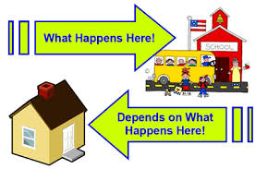

Slide 31

Remember…..

Slide 32
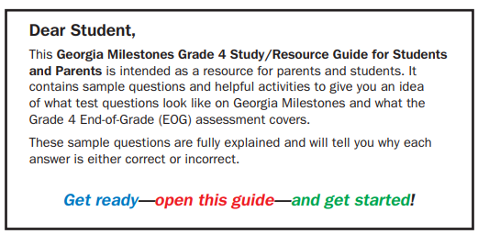
Some things to think about
As a parent, what can I do at home?
What will I do differently?

Slide 33
STUDENT/PARENT RESOURCES
The Experience GA Online Testing http://www.gaexperienceonline.com/ site is open. This site provides students with familiarity with testing online in the state of GA. Please see the information below regarding the site.
"This practice site lets students see what testing online is like. Parents and educators are welcome to try it too. The items on the demonstration tests are general and are organized into three grade bands: Grades 3 – 5, Grades 6 – 8, and High School in the content areas of English Language Arts, Mathematics, Science, and Social Studies. The items do not necessarily represent the specific grade-level content that students learn daily in their classrooms. The primary purpose is to let students experience, firsthand, the functionality of the online testing platform. The sample tests are not graded."
Students MUST use Google Chrome to access the site. If another browser is used, students will need to follow the link at the bottom of the page to adequately access the features of DRC INSIGHT.
When using the Test Practice link,
  Grades 3-8 will click on END-OF-GRADE (EOG) Spring Main Online Tools Training
    Username and Password are provided on the screen
https://www.gadoe.org/Curriculum-Instruction-and-Assessment/Assessment/Pages/Georgia-Milestones-End-of-Grade-Assessment-Guides.aspx

Slide 34
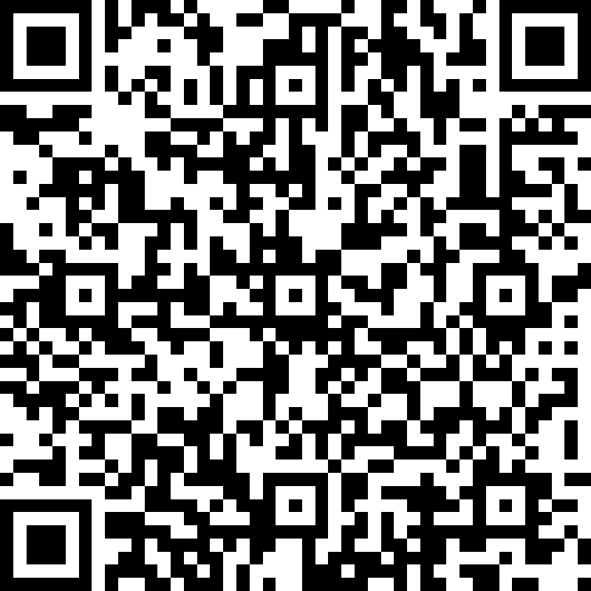
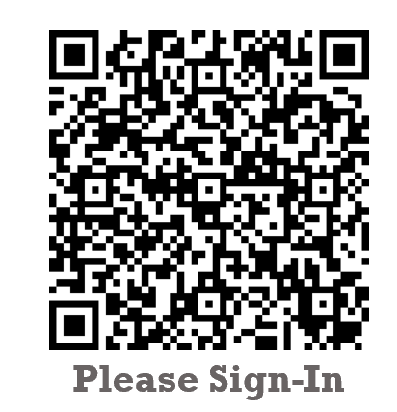
Georgia Milestones Parent forum
Bernd Elementary Leadership Academy
Please Provide Feedback
Thank You for Joining Us!

