Slide 1
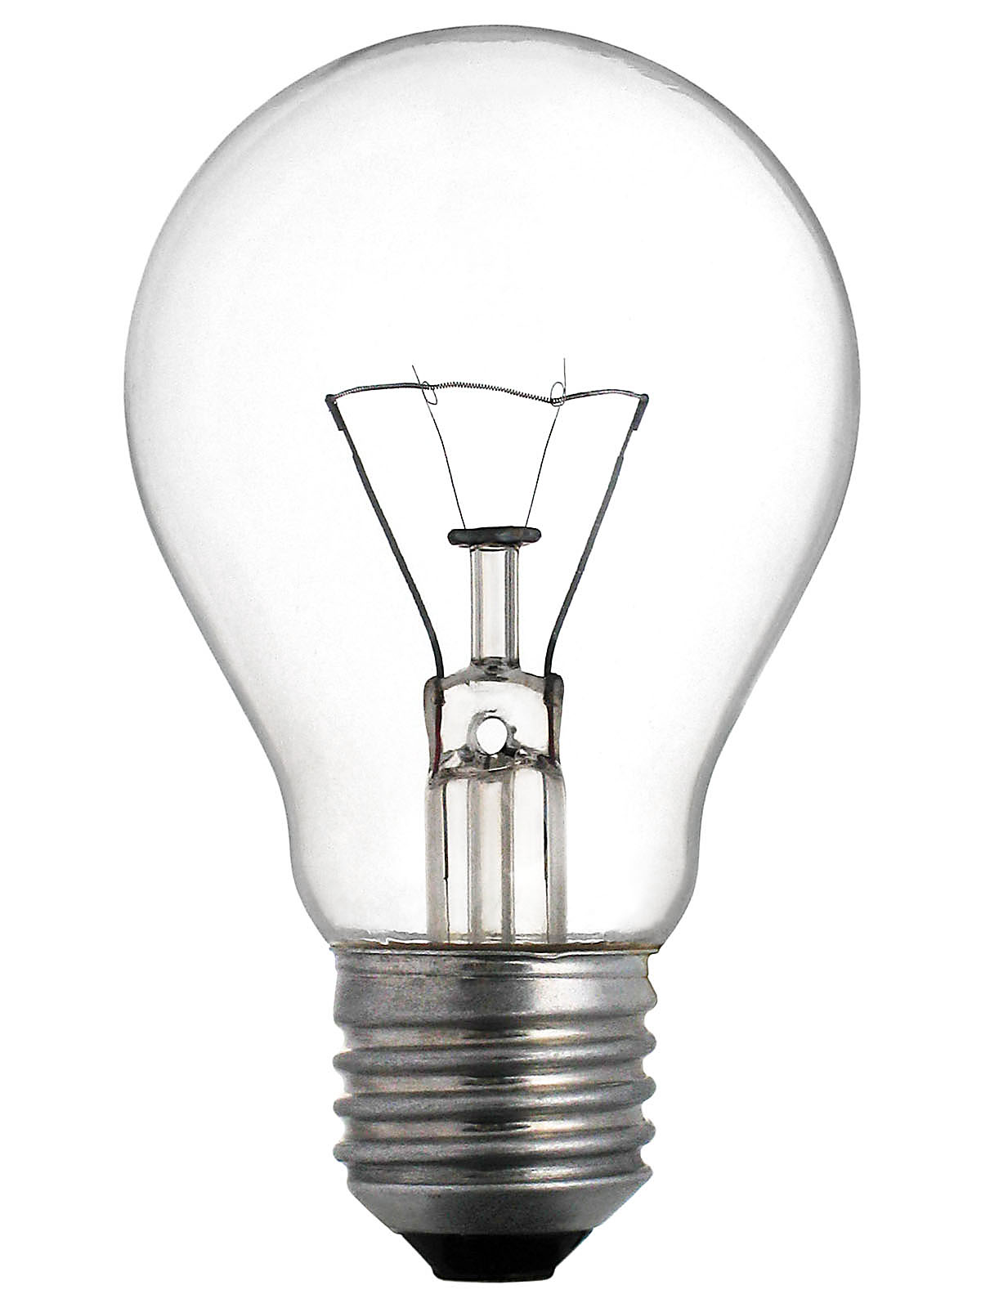
Engineering Design Process
4) Generate Ideas
3) Gather Information
5) Select Solution
Reflect
6) Make Item and
Test Solution
2) Identify Requirements
1) Define the Problem
7) Evaluate Item
BIG IDEAS:
The process is used to solve problems.
The process is a method to turn ideas into finished products and systems.
The process can be used in any order to produce the best results.
It is important to gather as much information as possible, be creative and consider all ideas.

