Slide 1
Planning for Your Child’s College Education
Notes:
Welcome to the New York State Higher Education Services Corporation’s presentation on “Student Financial Aid: Helping You Pay for College!”
The Higher Education Services Corporation, or HESC, is New York State’s higher education student financial aid agency.
At HESC we administer New York State’s Tuition Assistance Program (TAP) along with 20 different state-sponsored scholarship and student loan forgiveness programs. In addition we conduct outreach programs for students and families to inform them about student financial aid opportunities.
During this presentation we will review how the financial aid system works, what programs are available and the application process.

Slide 2
Planning for College Education
There are lots of things to think about and many questions you need to ask.
  How much will it cost?
  What kind of colleges can we afford?
  Will we receive financial aid?
  What should we be saving?
Notes:
Now that you’re planning to go to college, you and your family may have questions such as: How much will it cost? Can I afford it? and Where do I go for help? To assist you in finding the answers to these questions, you first need to learn some of the basics.

Slide 3
College Costs Continue to Rise
In the last ten years published in-state tuition and fees at public four-year institutions increased at an average rate of 3.2% per year beyond inflation
  2.4% at private nonprofit four-year institutions during the same timeframe
Notes:
In recent years, increases in college tuition costs have far out-paced the rate of inflation. And, besides paying for college, you need to account for other costs…

Slide 4
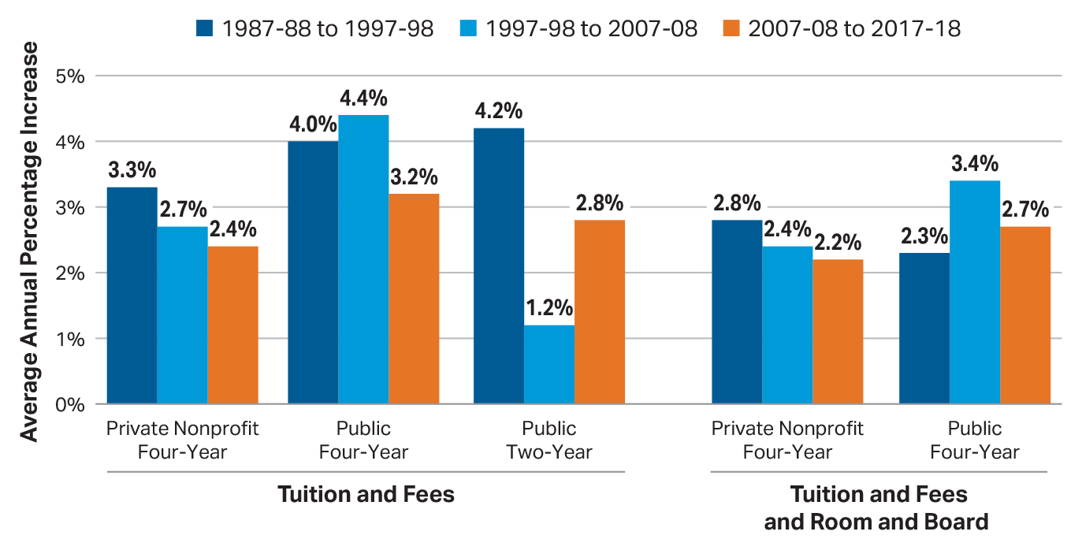
Average Annual Percentage Increase in Published Prices 1987-88 to 2017-18
Source: The College Board, Trends in College Pricing 2017, Figure 4A.

Slide 5
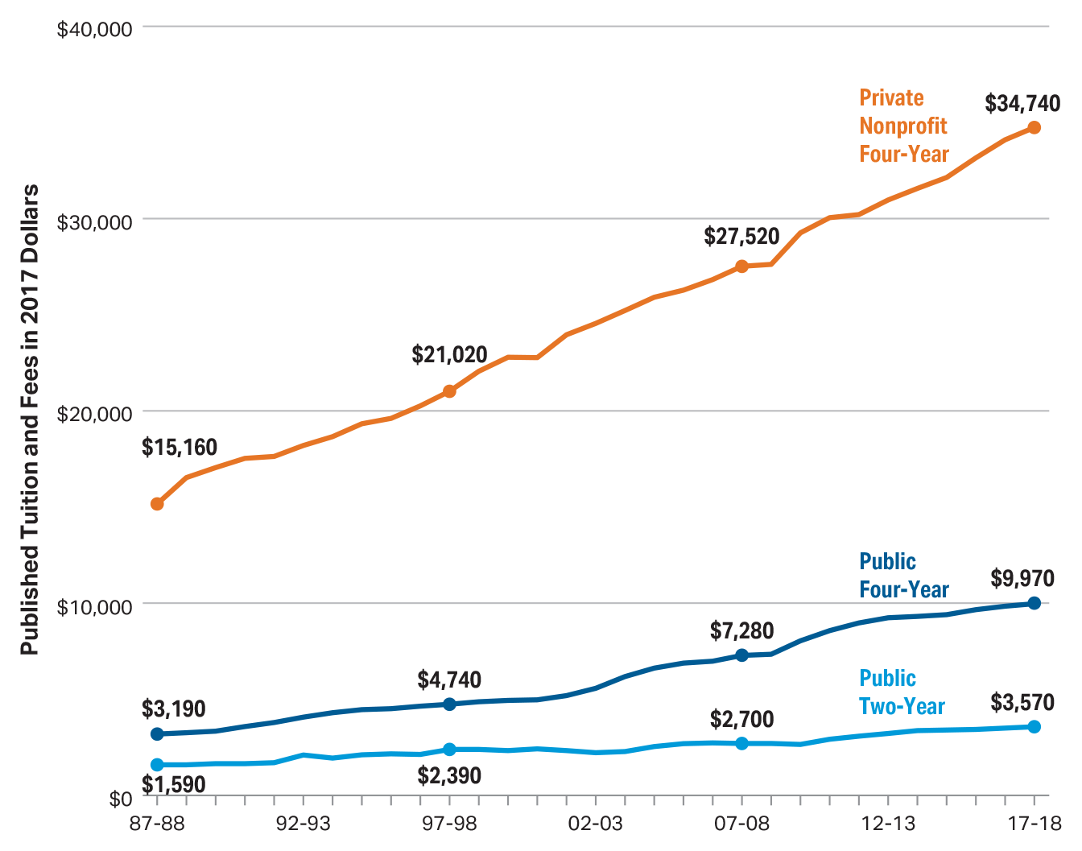
Average Tuition & Fees by Sector 1987-2018
Source: The College Board, Trends in College Pricing 2017, Figure 3.

Slide 6
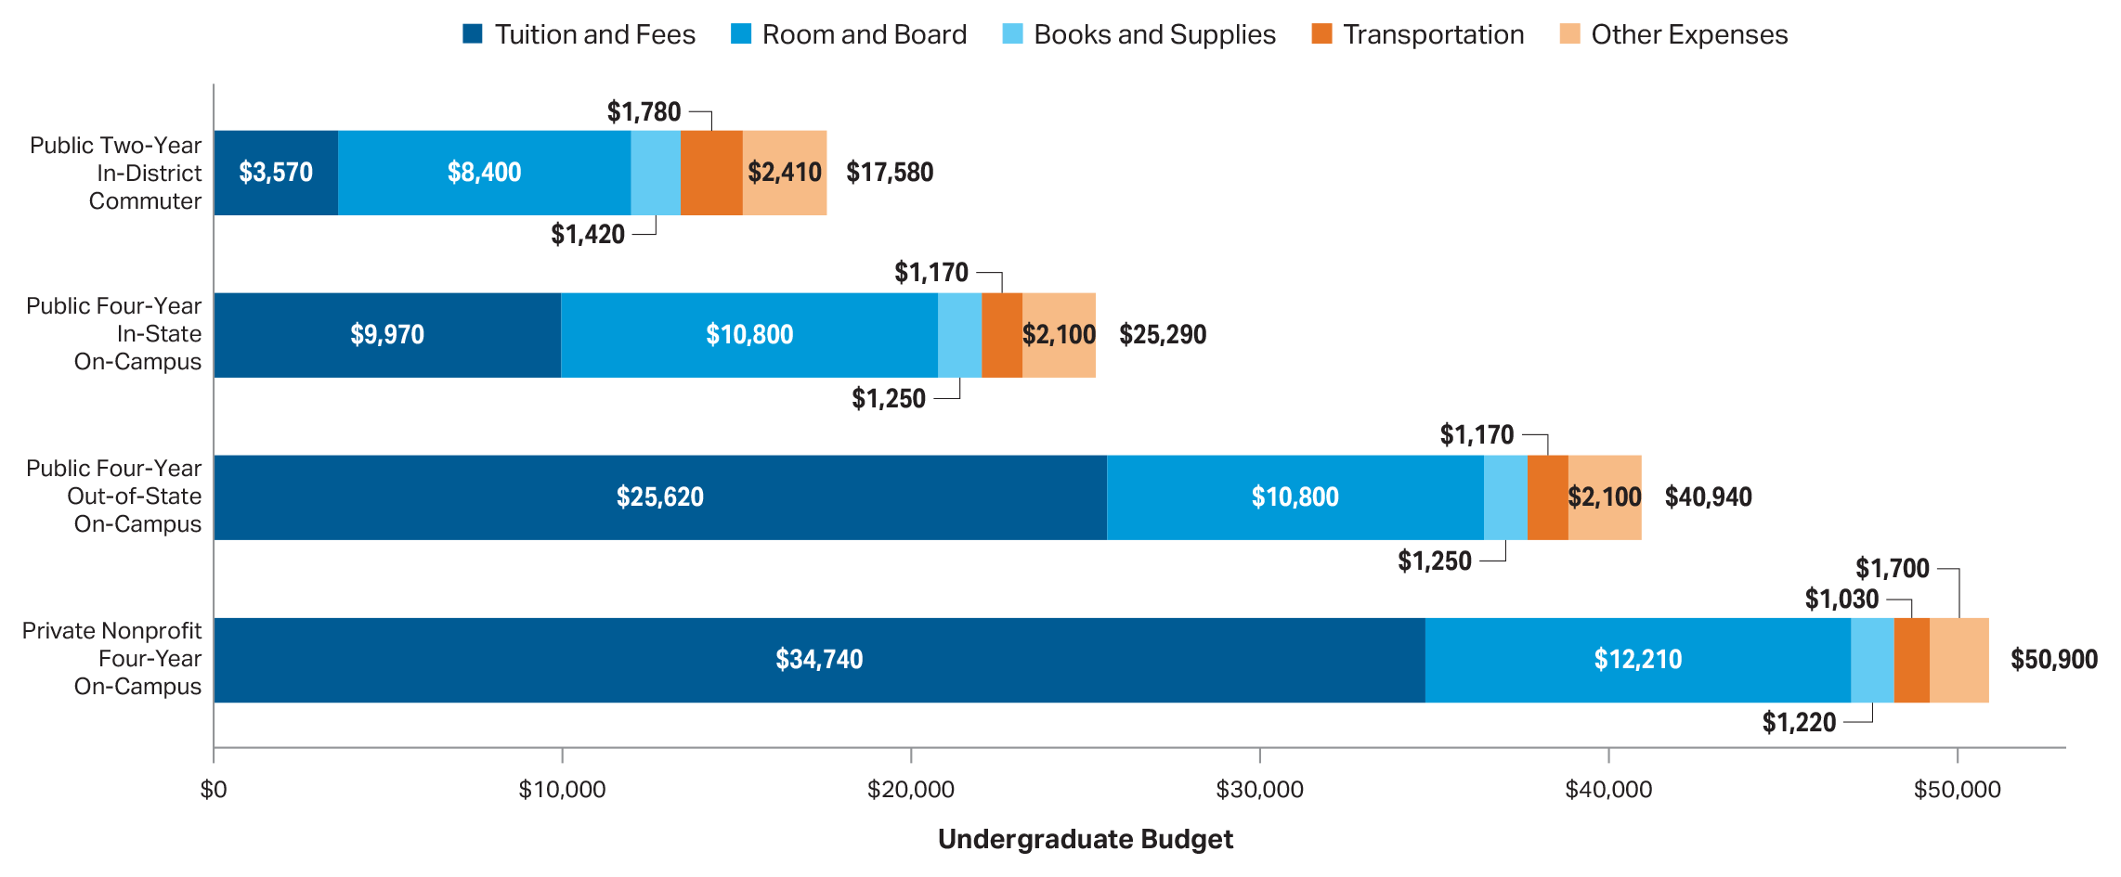
Average Cost of Attendance, 2017-18
Source: The College Board, Trends in College Pricing 2017, Figure 1.

Slide 7
Start Planning
Notes:
You know that your goal is to save for college but where do you start and how do you get there? Develop a plan.

Slide 8
Information to Consider in Your Plan
Estimated cost for college (public vs. private)
Number of years until child is college age
Amount of household income available NOW for college
Amount of household income available during college years
Student contribution/working before, during college
Eligibility for loans/Willingness for debt
Notes:
Here is some of the information you need to consider in developing your plan.

Slide 9
Savings Options
529 College Savings Plans
Pre-paid Tuition Plans (State or Private)
Coverdell Education Savings Account (Education IRA)
Custodial Account (UGMA/UTMA)
Notes:
Here are some of the most typical vehicles that people use in saving for college.

Slide 10
529 College Savings Plan
Self or professionally managed college savings investment
Contributions are made with after-tax dollars with tax-deferred earnings
Distributions are tax-free if used to pay for qualified education expenses
  Tuition, fees, books, supplies, equipment, expenses for special needs services, and room and board.
State tax benefits if using your own state’s plan
Notes:
Let me start with a brief overview of what a 529 college savings plan is…
It’s a program designed to help families meet the rising cost of higher education that we were just discussing.
It gets its name, “529”, from section 529 of the Internal Revenue Code, which established this type of plan.
It’s a flexible and convenient way to save for college:
- A 529 plan is easy to start and to maintain
- It offers federal and state tax advantages
- In addition, the investments in a 529 plan are professionally managed by leading investment management firms
A 529 plan can also help assist your estate planning
Let’s look at some of these features…

Slide 11
Pre-paid Tuition Plans (State or Private)
Investors purchase a percentage of a future year’s tuition at the same rate as today’s tuition, plus a premium
Contributions are made with after-tax dollars with tax-deferred earnings
Distributions are tax-free if used to pay for qualified education expenses

Slide 12
Coverdell Education Savings Account (ESA)
College savings investment with a broader range of investment options than 529 plans
  Open to individuals earning up to $110,000 ($220,000 for married couples)
Contributions capped at $2,000 per year and are made with after-tax dollars
  Contributions allowed up to age 18
Distributions are tax-free if used to pay for qualified education expenses

Slide 13
Custodial Account (UGMA/UTMA)
Financial account (such as a bank account, a trust fund or a brokerage account) set up for the benefit of a beneficiary
Administered by a responsible person, known as a custodian, who has a fiduciary obligation to the beneficiary
  an adult may control for a minor until the age of 18, depending on state laws

Slide 14
What About the Impact on Financial Aid?
Parent/Student owned 529, Prepaid Tuition, Coverdell ESA
  Parent asset with minimal to moderate impact, depending on parent income
Non-parent or non-custodial parent owned 529, Prepaid Tuition or Coverdell ESA
  When distributions are made it becomes student’s “other untaxed income” on future FAFSA filing
  Counted on the CSS Profile
Custodial Account (UGMA/UTMA)
  Student asset with significant financial aid impact

Slide 15
Help With Setting Savings Goal
Online tools and resources can help you estimate your Expected Family Contribution (EFC) or the “net price” of schools to help set your savings goal
  FAFSA4caster, Net Price Calculators on school websites
  College Savings Plan Network, SavingforCollege.com
Professional financial advisor
Notes:
To get you started on your journey, I’ve listed a few resources here that provide a wealth of information about planning and saving for college.

Slide 16
Important to Know: The EFC
The Expected Family Contribution, or EFC, provides a guideline for schools to determine a student’s need-based aid eligibility
  Calculated using a federal formula based on the answers to questions on the FAFSA
  Stays the same regardless of college selected
Notes:
Your EFC is a special number that college financial aid staff will use to determine how much financial aid you can receive if you attend their school. It is not the amount of money your family will have to pay for college. The EFC is calculated according to a formula within the FAFSA application and is based on federal law.
The EFC is calculated using the Federal government’s formula with the data provided on the FAFSA for both the parent and the student.
It is important to note that a family’s federal EFC always remains the same regardless of the college the student attends.

Slide 17

The FAFSA4Caster on FAFSA.gov
Get an estimate of your federal student aid eligibility
See the kind of questions you will be asked on the actual FAFSA
Notes:
If you’re not ready to apply for federal student aid, but you’d like to estimate your aid, try the FAFSA4caster on the FAFSA.gov webpage.
The FAFSA4caster can be used to receive early federal student aid estimates, create scenarios based on future earnings, and help establish college funding strategies. It also gives you an idea of the types of questions you will be asked when you complete the actual FAFSA application.

Slide 18

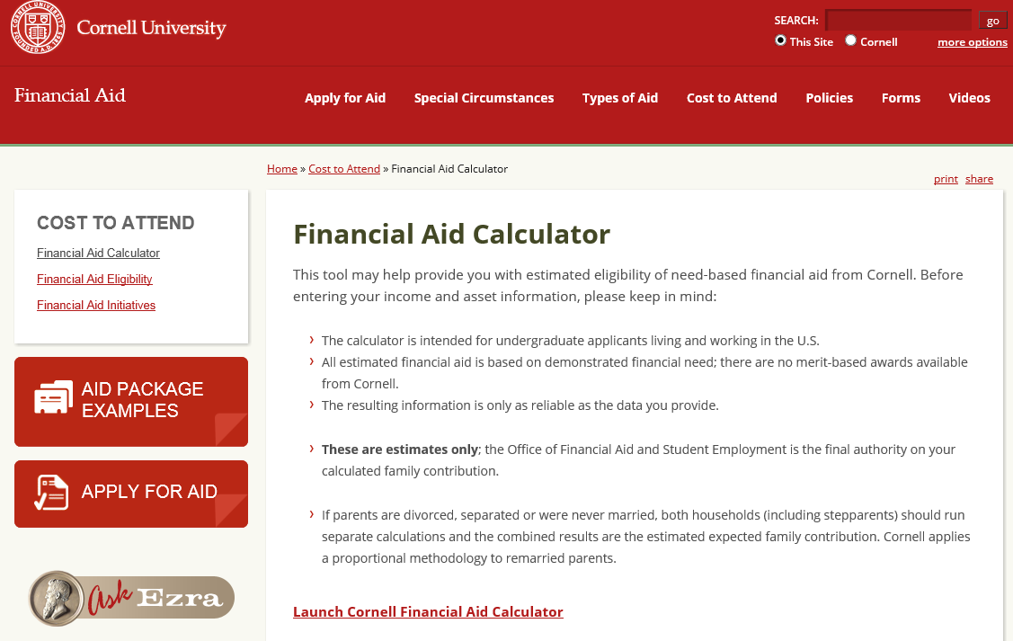

Use Net Price Calculators
Notes:
When researching a college’s financial aid website, it may be helpful to utilize their Net Price Calculator.
Net price calculators allow you to enter your information, such as your household size and income, to generate an estimate of a specific college’s cost of attendance, average aid package (based on what families with similar demographics have received), out-of-pocket costs, average indebtedness, and average net price – which is the result of subtracting cost of attendance from grant aid.
Net price calculators vary in format from school to school. The results are estimates and averages to be used as a planning tool only, as schools cannot be held liable to meet the figures presented within the calculation.
Be sure to check out the websites of all the colleges you are considering for more information!

Slide 19
College Savings Plan Network
Provides information about saving for college and 529 plans, including:
  Why saving for college is important
  What is a 529 plan
  A college cost calculator
  Links to state 529 plans
  A 529 plan comparison tool
Collegesavings.org

Slide 20
SavingforCollege.com
Commercially sponsored site with some free college cost, savings calculators and tools
529 Savings Plan comparison tool
“Pro” content is available at a cost

Slide 21
Other Ways to Finance College
Financial aid
Cash-flow, Tuition payment plan
Relatives contributing to college fund
Tax credits and deductions
Home equity line of credit
Withdrawals from Roth or Traditional IRA
Notes:
Here are some other ways to finance or help reduce the cost of college. In many cases you can use a combination of these to achieve you goal.
Note that with many of these items there are potential tax benefits and tax consequences, or impact financial aid eligibility.
For instance, if you cash flow part of the college expenses you may be eligible for the American Opportunity Tax Credit (due to expire in 2017) of up to $2500 per year.
If a grandparent sets up a college savings account, it will not show up as a parent or student asset when initially assessing need-based financial aid, however, distributions from the account are deemed as untaxed income to the student and will impact future year eligibility for need-based financial aid.
While the equity in your home is not considered in determining need-based financial aid, taking out a mortgage/refinancing will negatively affect eligibility for need-based financial aid. As said before, it is recommended you work with a CPA or financial planner to understand the impact of various choices.

Slide 22
What is Financial Aid?
Financial aid programs help pay the cost of attending college
Financial aid may awarded based on
  Financial need (need-based)
  Other criteria, such as academic or athletic ability (merit-based)
Notes:
So to begin, let’s discuss what financial aid is.
Financial aid programs are intended to provide funding to students to help them pay for the cost of attending college.
Financial aid programs are awarded from several different sources and qualifications may be based on either financial need or other non-need-based criteria, such as academic excellence or athletic ability.
With need-based aid your family’s ability to pay for college costs is evaluated using income and asset information collected from financial aid applications such as the FAFSA (the Free Application for Federal Student Aid).
Non-need-based financial aid is more commonly referred to as merit-based aid.

Slide 23
Sources of Financial Aid
Federal government
New York State
Colleges – Institutional aid
Other sources
  Businesses
  Foundations
  Clubs/Organizations
Notes:
The federal government, New York State, colleges and other organizations are all sources of financial aid. We will discuss the different types of aid each of these sources offer in a moment.

Slide 24
Different Types of Aid
Scholarships
Grants
Work Study
Loans
Free Money
Self-help aid
Notes:
It is important that you understand that there are different types of financial aid awards available for students.
Scholarships and grants are “free money” or gift aid – meaning you do not have to pay any of the money back. Many scholarships and grants are awarded through the financial aid application process and may be either need-based or merit-based.
Work-study and student loans are called self-help aid because they require the recipient to either work to earn their assistance or pay them back plus interest.
Remember, when you are applying for financial aid -- always go for the “free money” first!

Slide 25
What is the FAFSA?
Free Application for Federal Student Aid
Opens October 1st of senior year
Reviews income, asset info to determine need-based aid eligibility
Qualifies the student to receive federal student aid programs
Notes:
If you’re not ready to apply for federal student aid, but you’d like to estimate your aid, try the FAFSA4caster on the FAFSA.gov webpage.
The FAFSA4caster can be used to receive early federal student aid estimates, create scenarios based on future earnings, and help establish college funding strategies. It also gives you an idea of the types of questions you will be asked when you complete the actual FAFSA application.

Slide 26

What is the CSS Profile?
Form used by colleges to determine institutional aid
Asks more detailed questions than FAFSA
Collects asset values excluded by FAFSA, e.g. home value, retirement accounts
Non-Custodial Parent Supplement
Notes:
What is the CSS Profile?
The CSS Profile is a financial aid application administered by the College Scholarship Service (CSS), the financial aid division of the College Board. The CSS Profile is required by many private colleges and universities to determine your eligibility for non-government financial aid, such as the institution's own grants, loans and scholarships.
The CSS has many differences from the FAFSA application. For example, the application asks more detailed questions about your income and assets. It also collects asset values that were excluded by FAFSA, such as the value of your family home and tax deferred retirement accounts. The CSS Profile also requires the Non-Custodial Parent Supplement to be completed for students with divorced or separated parents.
If you have questions or concerns about how this information is used to determine you eligibility for institutional aid, you should speak with the financial aid offices at your prospective colleges.

Slide 27
How Financial Need is Determined
Cost of Attendance (COA)
– Expected Family Contribution (EFC)
= Financial Need
Notes:
First, let’s talk more about how students qualify for need-based financial aid.
This is the formula colleges use to calculate a student’s financial need. Cost of Attendance minus Expected Family Contribution equals financial need.
The Expect Family Contribution is calculated using the Federal government’s formula based on student and parent information entered on the student’s FAFSA application. We will discuss the type of information FAFSA requests from applicants a bit later.
Let’s talk more about the Cost of Attendance component of this formula.

Slide 28
What is the Excelsior Scholarship?
Provides aid for eligible students to attend SUNY or CUNY tuition free
  Less any other aid that already covers tuition
Applicants for the 2019-20 school year must have a combined federal adjusted gross income of $125,000 or less for tax year 2017 to qualify
Requires on-time degree complete and in-state residency during post-award period
Notes:
The Excelsior Scholarship provides for full in-state tuition coverage for students attending SUNY or CUNY. The scholarship is deducted by any Pell, TAP, or other aid that covers tuition.
2019-20 school year applicants must have a household federal adjusted gross income (AGI) at or under $125,000 to qualify based on the 2017 federal income tax returns.
You can apply for Excelsior after filing the FAFSA and TAP applications on hesc.ny.gov. The application period for the 2019-20 school year will be announced some time during this year.

Slide 29
Tuition Payment Plans
Tuition payment plans are short-term (12 months or less) installment plans which split your college bills into equal monthly payments
  Automatic debit or credit card payments
Many such plans are essentially interest-free, but some have fees or finance charges
  In most cases the fees are less than $100.

Slide 30
Tax Benefits
Credits (reduces the amount of income tax you may have to pay)
  American Opportunity Credit
  Lifetime Learning Credit
Deductions (reduces the amount of your income that is subject to tax)
  Tuition and Fees Deduction
  Student Loan Interest Deduction
Notes:
American Opportunity Credit
Under the American Recovery and Reinvestment Act (ARRA), more parents and students qualify for a tax credit, the American opportunity credit, to pay for college expenses.
The American opportunity credit originally modified the existing Hope credit for tax years 2009 and 2010, and was later extended for an additional two years – 2011 and 2012, making the benefit available to a broader range of taxpayers, including many with higher incomes and those who owe no tax. It also adds required course materials to the list of qualifying expenses and allows the credit to be claimed for four post-secondary education years instead of two. Many of those eligible qualify for the maximum annual credit of $2,500 per student.
The full credit is available to individuals whose modified adjusted gross income is $80,000 or less, or $160,000 or less for married couples filing a joint return. The credit is phased out for taxpayers with incomes above these levels. These income limits are higher than under the existing Hope and lifetime learning credits.
Special rules applied to students attending college in a Midwestern disaster area for tax-year 2009, only, when taxpayers could choose to claim either a special expanded Hope credit of up to $3,600 for the student or the regular American opportunity credit.
If you have questions about the American opportunity credit, these questions and answersmight help. For more information, see American opportunity credit.
Lifetime Learning Credit
The lifetime learning credit helps parents and students pay for post-secondary education.
For the tax year, you may be able to claim a lifetime learning credit of up to $2,000 for qualified education expenses paid for all students enrolled in eligible educational institutions. There is no limit on the number of years the lifetime learning credit can be claimed for each student. However, a taxpayer cannot claim both the Hope or American opportunity credit and lifetime learning credits for the same student in one year. Thus, the lifetime learning credit may be particularly helpful to graduate students, students who are only taking one course and those who are not pursuing a degree.
Generally, you can claim the lifetime learning credit if all three of the following requirements are met:
You pay qualified education expenses of higher education.
You pay the education expenses for an eligible student.
The eligible student is either yourself, your spouse or a dependent for whom you claim an exemption on your tax return.
If you’re eligible to claim the lifetime learning credit and are also eligible to claim the Hope or American opportunity credit for the same student in the same year, you can choose to claim either credit, but not both.
If you pay qualified education expenses for more than one student in the same year, you can choose to take credits on a per-student, per-year basis. This means that, for example, you can claim the Hope or American opportunity credit for one student and the lifetime learning credit for another student in the same year.

Slide 31
Should You Withdraw From Retirement?
Most financial advisors do not recommend this
Check with your retirement plan administrator for details on tax penalties and how distributions will be taxed
Remember, there is financial aid for college, but not for retirement

Slide 32
Questions?
NYS Higher Education Services Corporation
99 Washington Avenue
Albany, NY 12255
www.hesc.ny.gov
1-888-NYSHESC (1-888-697-4372)
Notes:
Thank you for attending HESC’s presentation “Student Financial Aid: What Every High School Students and Parents Should Know.” We hope you found the information useful in your quest to learn more about student financial aid opportunities and the application process.
Our agency website and customer call center number is listed here for future reference. Please feel free to reach out to us should you have any questions about New York State student financial aid programs.
Does anyone have any questions?

