Slide 1
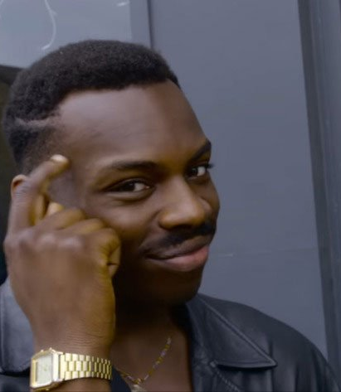
Introduction to wise mind
Where reason and emotion meet

Slide 2
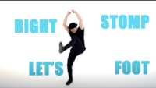
Cha-cha Slide!

Slide 3

Quick questions about cha-cha
Did you judge yourself?
Did you judge others?
Did you hold back?
DID YOU REALIZE YOU WERE HAVING THESE THOUGHTS IN THE MOMENT OR ONLY WHEN REFLECTING AFTER?
DID YOU FEEL IN CONTROL OF THOSE THOUGHTS?

Slide 4
What is mindfulness?
Learning to be in control of our own thoughts instead of our thoughts controlling us.
Putting our minds where we want them to be – being present and not worrying about the future or regrets about the past.
  Chat in your groups about what might be some examples
CAN YOU THINK OF A TIME WHEN YOU PRACTICED MINDFULNESS IN A SITUATION? (Aka … thinking before doing)
  Did a positive outcome occur?
  What could have been different if you acted impulsively?

Slide 5
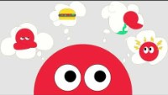
WHAT IS WISE MIND?

Slide 6
THREE STATES OF MIND
Emotion Mind, Reasonable Mind, WISE Mind
Summary of Three States – Circle with words already pre-populated
Reason
Wise
Emotions

Slide 7
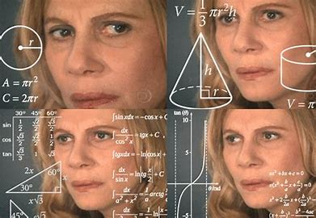
How do we Know which state of mind we used in decision making?
If…_________ is emotional mind and
If…_________ is rational mind,
Wise mind would be…?

Slide 8
CLASSMATE CONVERSATIONS
Have students work in their class groups
Pick substitute teacher, mom’s birthday, arguing with SO for 3 months,

Slide 9
NOW WHAT?!

