Slide 1
What & How Skills
DBT-STEPS A
Ms. Rivero & Mrs. Rigaglia

Slide 2
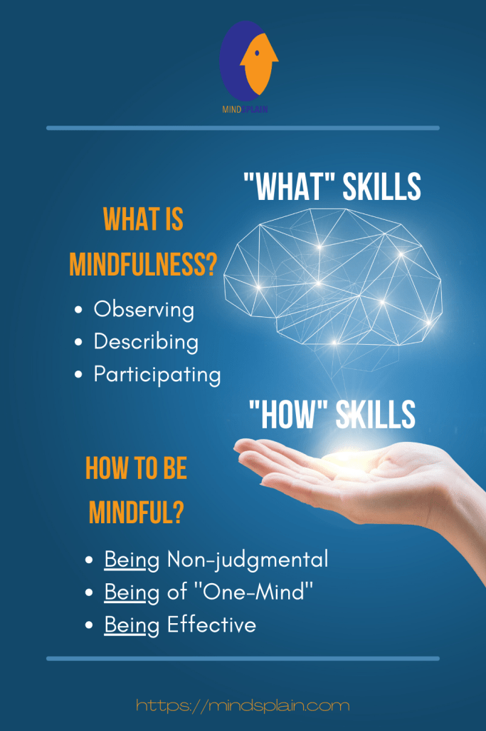
What and How (Lesson 4 & 5)
There are 3 mindfulness "what skills," which are what we do and 3mindfulness "how skills," which are how we do them

Slide 3
Quick Review....
Emotion Mind: What I feel to be
Reasonable Mind: What I think to be
Wisemind: What I know to be
*The what & how skills = get us to wisemind*

Slide 4
What Skills
The 3 mindfulness What skills are: observe, describe, and participate. You can only do one of these at a time. These are what we do in order to reach wise mind and be mindful.
Paying attention on purpose, without reacting
Noticing without labeling
Process of focusing the mind on one thing – what you sense or experience
Wordless watching - just watching
Being able to control your attention, means that you can control your mind. Most important, it is about observing what reality is, not what we think about reality.
Handout 4.1

Slide 5
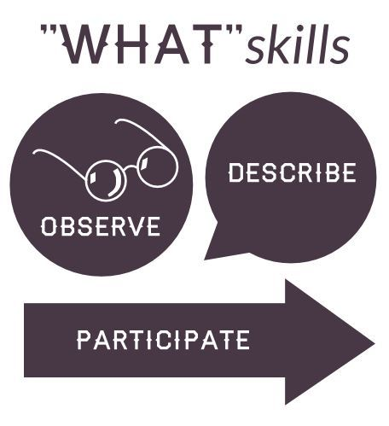
Mindfulness: What Skills
https://youtu.be/JUSaQL1_zXE

Slide 6

Observing Inside vs. Observing Outside
Observing Outside
We can only observe the outside world through our five senses: seeing, hearing, smelling, tasting, and touching.
Observing inside
Observe our inside worlds through sensing our thoughts, emotions, and internal bodily sensations
We notice & watch them pass even when they are painful
We don’t want to avoid or suppress the thoughts & emotions we are observing

Slide 7

Observing Without Describing
It can be hard to observe something without describing it
The same way we hear "meow" and think of a cat
You cannot observe & describe at the same time

Slide 8
Describing
Describing
  - Putting what you have observed into words. Describing is labeling what is observed; it is wordful watching
  - Mindfulness is about slowing down and doing just one thing at a time.
  Describing is labeling what we have observed, as if explaining it to a blind person or to an artist who is going to draw on the basis of our description. We can ONLY describe something if we observed it. We cannot observe the thoughts, feelings, or intentions that are inside other people. This is a key point that we often forget.
  *Activity of hands on desk
Notes:
Pg. 85

Slide 9
Participating
Participating is being fully present to our own lives, without self-consciousness, effortlessly in flow – forgetting ourselves and becoming what we are doing. Watch young children. Whether they are running through a park, splashing in puddles, or dancing to music, children are great examples of participating. (handout 4.1)
Participating is not thinking about yesterday or tomorrow. It is not worrying about what other people are thinking or feeling about us right now.
It is about jumping in the current activity 100%.

Slide 10
How Skills
Now that we have gone over "What Skills" we are going to learn "How Skills": are for balancing emotional mind and reasonable mind to achieve wise mind.
Just as there are 3 "What skills" there are 3 "How Skills"
* nonjudgementally, one-mindfully, and effectively.
Unlike what skills which can only be done one at a time the how skills can all be done at the same time.

Slide 11

Mindfulness: How Skills
https://youtu.be/oYdrMpnE93s
Handout 5.1

Slide 12
NONJUDGEMENTALLY
The way to observe, describe, or participate mindfully is to take a nonjudgemental stance. In other words do not judge anything as good or bad, as valuable or not valuable, as worthwhile or worthless, as how things should or should not be.
Judgements can act as fuel for our emotions

Slide 13
ONE-MINDFULLY
(handout 5.1)
One-mindfully means doing only one thing at a time, in the moment, with awareness and alertness. It is about the quality of awareness.
Focusing attention on only one thing helps bring the whole person to the activity without expectations. It means focusing on what is immediately present, and not the past or the future.
Ways it can be harmful
Some behaviors can function together as a set (notes & class time)

Slide 14
EFFECTIVELY
(handout 5.1)
When do throw yourself 100% into an activity. Doing something effectively means knowing your goals, objectives, and actual situation. Giving your all to the best of your ability
Asking yourself, "Is this aligned with my long-term goals?"
Not letting emotions drive behavior
** To be effective is to do what works to reach our goals. Once we can identify our objectives, then we can begin to determine the most effective route to obtaining them

Slide 15
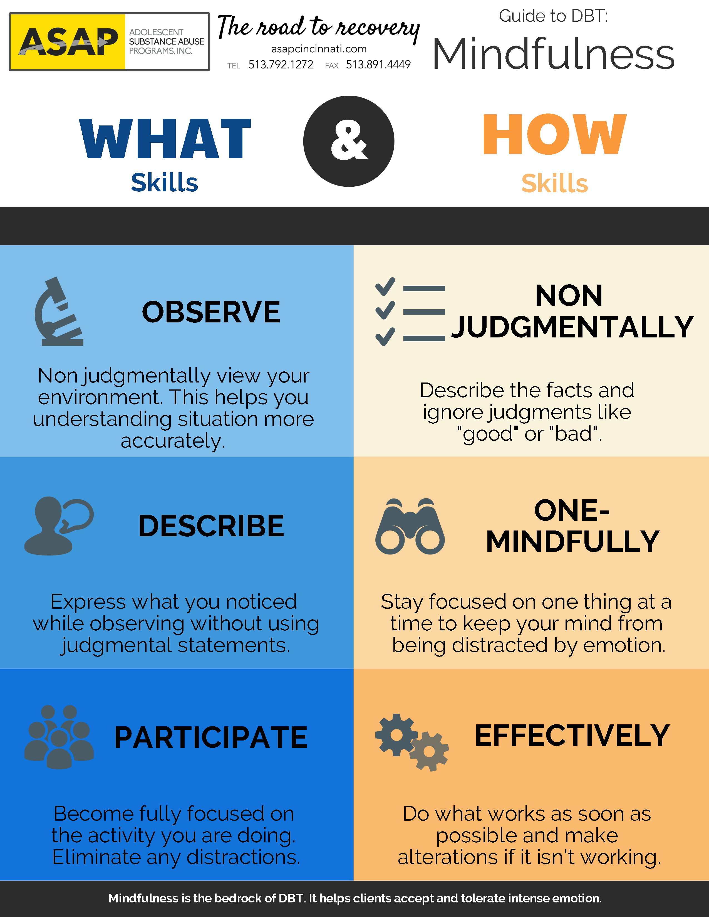
Questions

