Slide 1
Wise mind
Mindfulness: what it is, why bother with it & states of mind

Slide 2
Last Lesson Review
What did we learn last time about dialectics and thinking dialectically?
Talk with your group about your homework assignment
  Pick one example from a group members homework to share out
  Each group pick a person to tell the class your example
  What steps were used? If you were to try again, what might do you differently?
  Turn in homework

Slide 3
Mindfulness Elements
Opened Mind:
Being present and participating fully in the moment (being ‘in the zone’)
Focused Mind:
Intentionally focusing your attention on one thing in the moment.
Mindfulness
Taking Hold of Your Mind

Slide 4
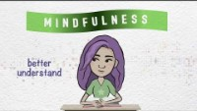
What Mindfulness Really is…
Learning to be in control of your own thoughts, emotions, and behaviors instead of them being in control of you!
Putting your mind where you want it to be – freeing you from worries about the future or regrets from the past.
If you can’t focus on the present, why could that become a problem?

Slide 5
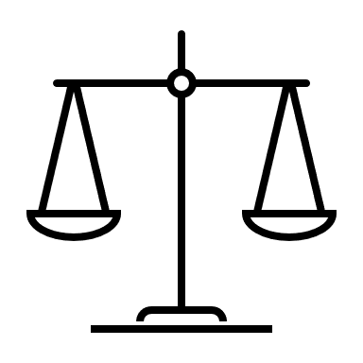
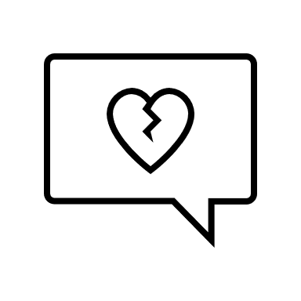
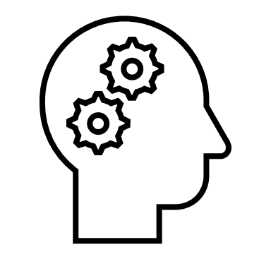



Recap of Handout
Points 1 & 4 – being mindful can help us to be in control of our minds, rather than our emotions running the show or being so unaware that we won’t realize what we’re doing or where we are. More control = more choices.
Point 2 – when being more mindful, we can decrease the amount of time we spend with our emotions in control and can then lessen our emotional suffering.
Point 3 – as learn more these skills, we’ll learn how to make our decisions mindfully (aka thinking things through).
Point 5 – the more mindful we are, the less judgmental we’ll be meaning we’ll be more compassionate instead of judging ourselves and others.
Point 6 – being mindful also means focusing on the present and not the past or future. Even this alone can help reduce stress which leads to better overall health.

Slide 6
Have you ever noticed times…
… you arrive at your next class or home from school, and don’t remember how you got there?
… you don’t remember turning down the hallway or down the street?
… you finished your meal but don’t remember actually eating it?
These are all examples of ‘mindlessness’ – not being aware of the present moment - doing things on autopilot and it’s the opposite of our goal and skills to be mindful.
Can anyone give examples of when or how this could be problematic?

Slide 7
These skills take practice, the more you work at it – the better you’ll be and the easier it’ll become.
Just don’t be hard on yourself while you’re working at it ☺

Slide 8
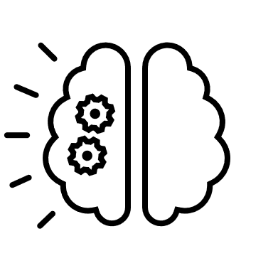
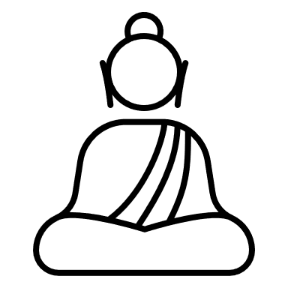

Three States of Mind
Reasonable
Mind
Emotional
Mind
Wise
Mind

Slide 9
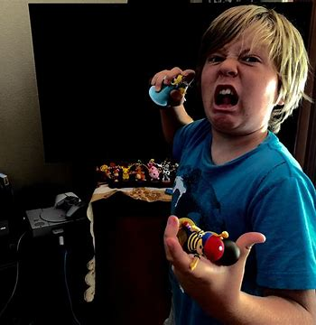
Emotional Mind
State of mind when emotions are in control; they influence and control your thinking, behavior and urges to act or say things. Facts, logic, and reason are not important and ultimately dismissed.
Work in your group:
Make a list of emotions (4 minutes)
Wait for next instructions…

Slide 10
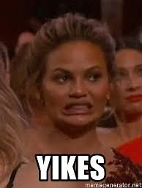
REPEAT AFTER ME:
Emotions are not the enemy!
Being emotional is not what we mean by emotion mind!
Emotion mind is what happens when all reason vanishes, and emotions are in TOTAL control.
  Example: After a game, your mom or dad comes up to you and says, “Good game. If you could have just blocked a few more passes, we would have had a chance.” This makes you feel even angrier, and you start yelling at them in the middle of the parking lot then throw your water bottle.
  What are some other examples where being in emotion mind would not be good?
State of mind is problematic when emotions take control of us and we start acting on the urges that go along with emotions. Every emotion has an ‘action urge’.
  When you are angry, what do you have the urge to do?
  When you are sad, what do you have the urge to do?
  When you are anxious, what do you have the urge to do?

Slide 11

Reasonable Mind
Described as ‘cool, rational, logical, calculated, and task-focused’.
When you are in reasonable mind – feelings, desires, and needs are not important.
Why is reasonable mind important?
  What are some examples?
What professionals do you think require someone to be in reasonable mind?
Is there anything wrong with being in reasonable mind ALL THE TIME? Are there times it’s not good to be in reasonable mind? *Reasonable mind does not take emotions into account*
  What are some examples?

Slide 12

Wise mind
Because emotional and rational states of mind both have their benefits on their own, but they’re better when they’re together

Slide 13
Wise Mind Decisions
When a person knows something in a centered way and experience reality as it is here and now. Can help with big decisions like after high school planning, getting married, ending a relationship or smaller decisions like going to a house party, sneaking out, staying up late on your phone, studying for a test or starting to write a paper.
Scenario
Questions
It’s the homecoming football game (Go Tuskers!) and the whole school is excited for a big win! Players are on the field - very excited and motivated to win. The team is down by 10 points. The QB has been sacked 4 times and has 1 interception.
What happens if the QB is ONLY in emotion mind?
What happens if the QB is ONLY in reasonable mind?
What do we want from our QB in this big game?
What do you think he would do if he’s in his wise mind?

Slide 14
Try it out.
Trust yourself.
Take control.

