Slide 1
Wave Skills
(Lesson 21)
Mrs. Rigaglia

Slide 2
Week 7: Wave Skill (Lesson 21)
Mindfulness Exercise (5 minutes)
  Observe your action urge- for example thinking if you have an itch that you have to scratch it.
  Noticing thoughts/behaviors without acting on it.
  When I say, "one" that’s the sign to sit in the mindful awake position.
  If you notice your urge other than blinking or swallowing notice your urge without acting on it. When I say, "two" that’s the sign to take your deep breath.
  When I say, "three" begin practicing noticing your urges. Then I'll say, "Stop" to end.
  Now let's practice for 2 minutes
  Share observations from class

Slide 3
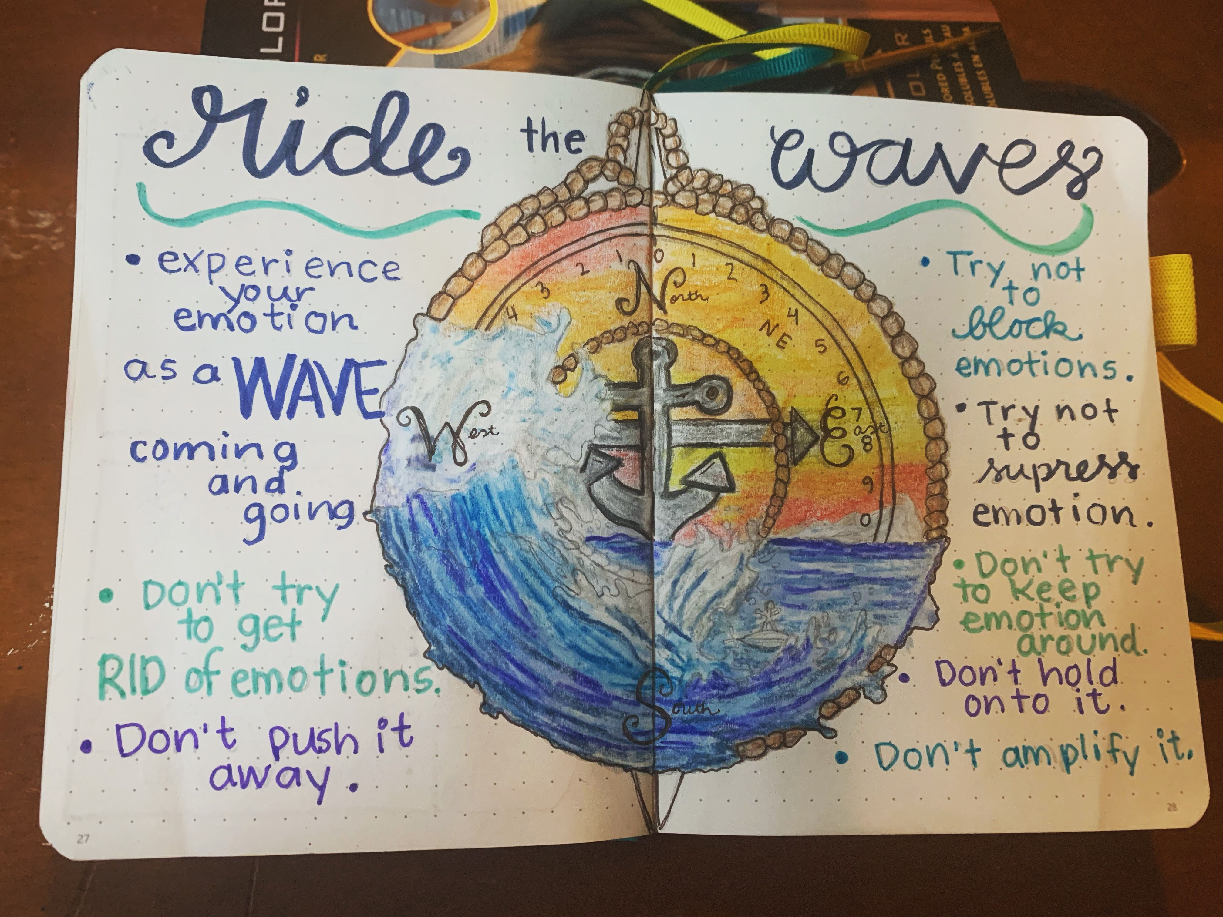
Main Ideas:
Allow selves to experience emotions like a wave being mindful of how they begin, build to a peak and go down, without trying to control them
Why should we also pay attention to our emotions rather than push them away?
It is important to tolerate emotions. The focus is on how to tolerate and experience emotions by focusing on them. A moderate amount of anxiety for example can be beneficial in motivating us and increase tolerance of emotion.

Slide 4
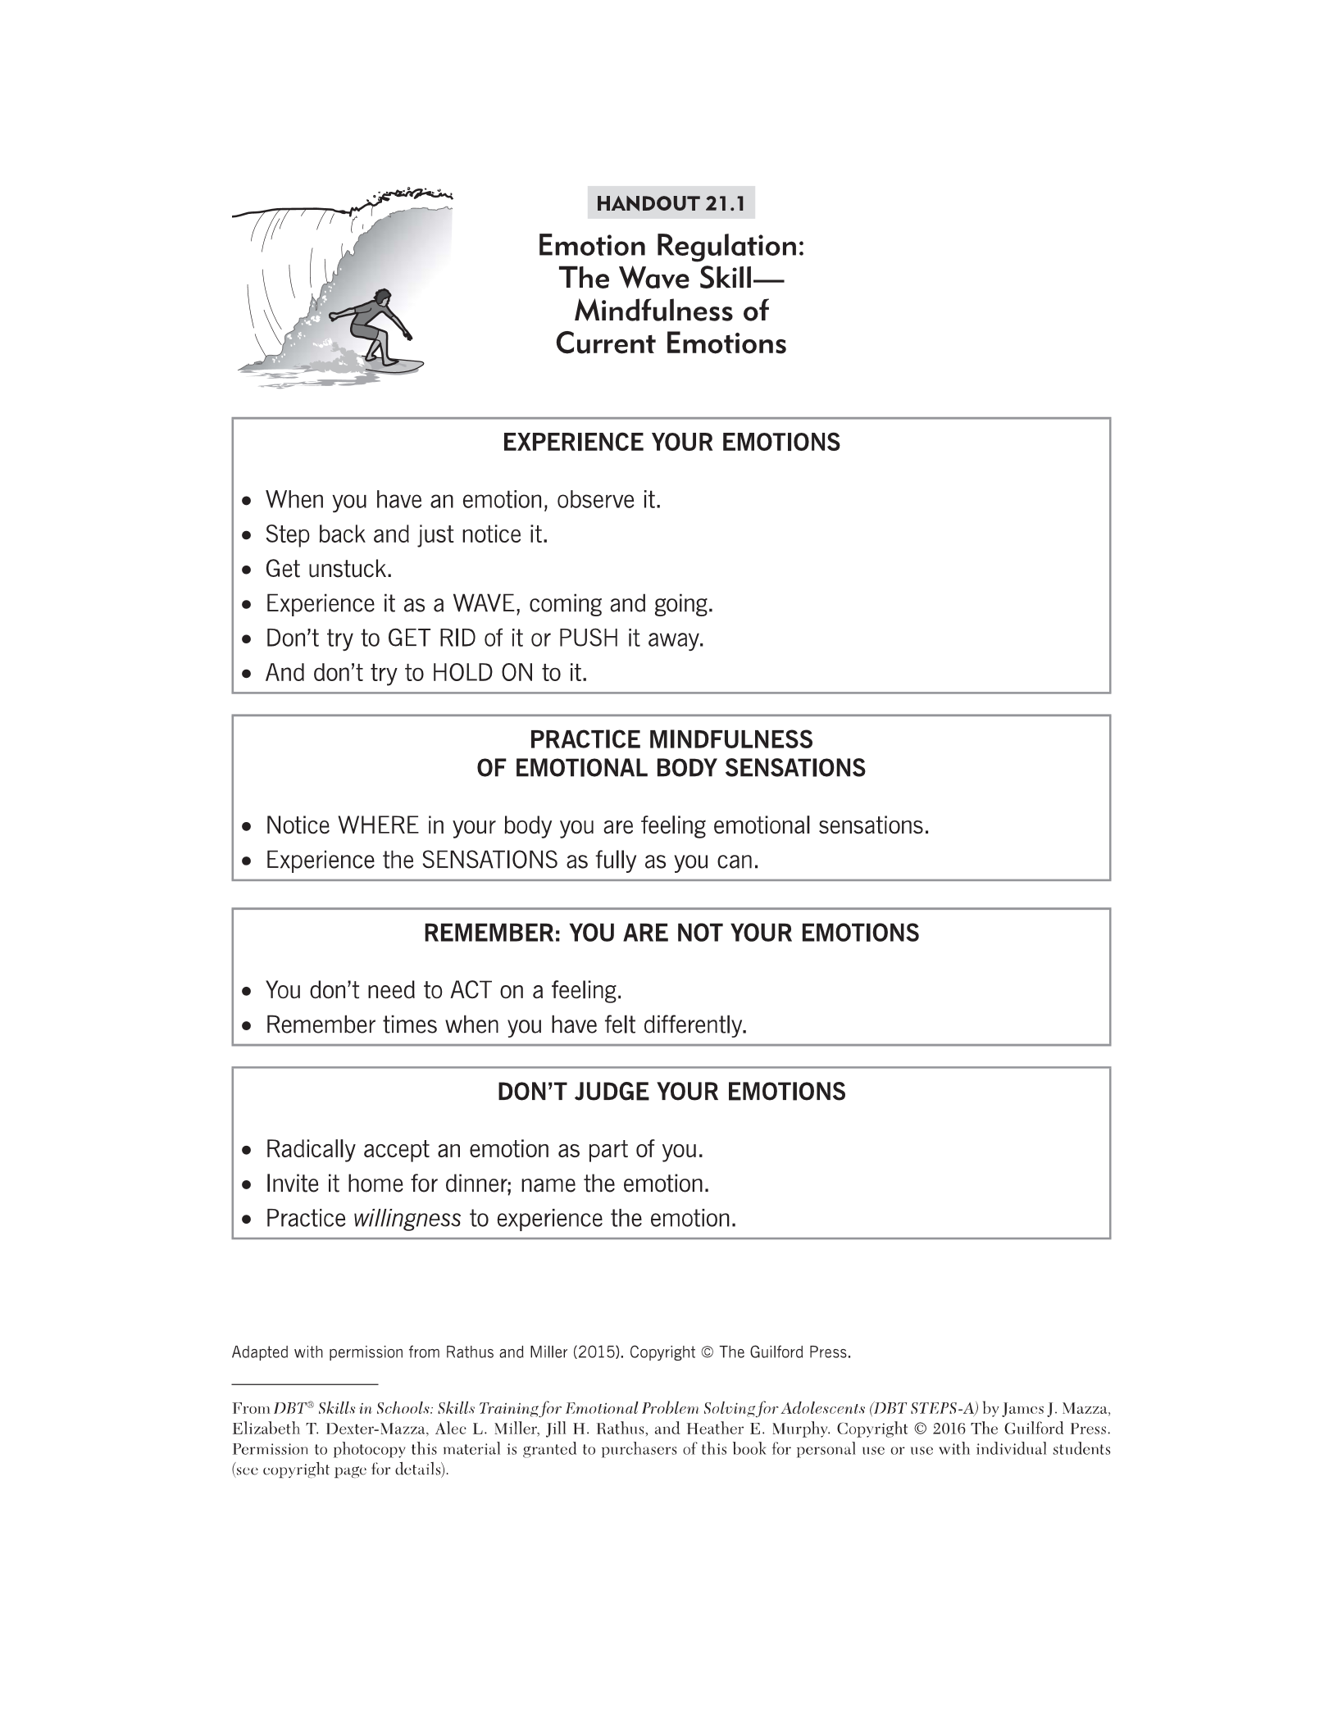
Review handout 21.1
Video

Slide 5
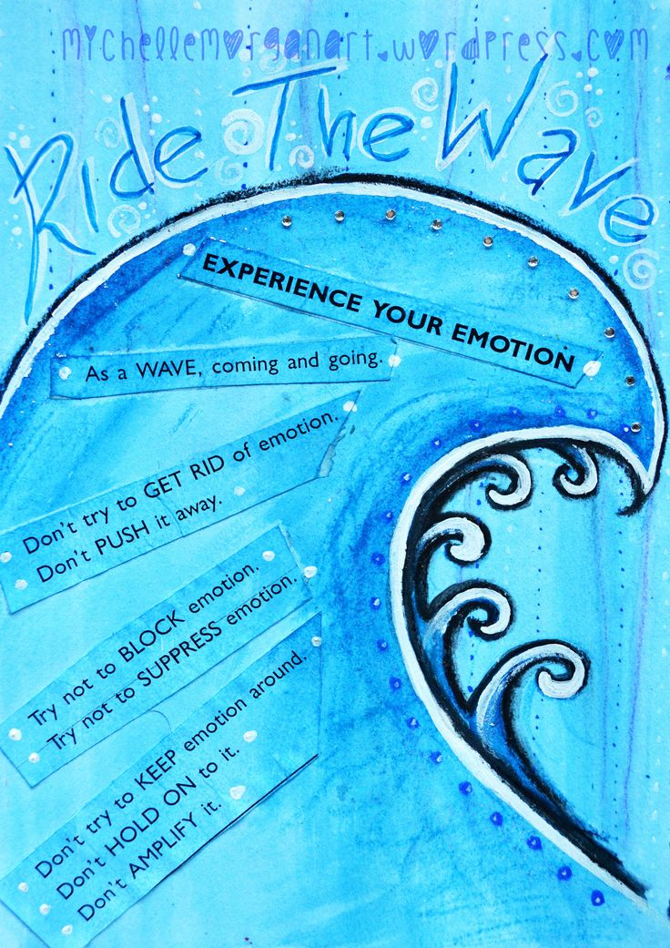

Slide 6
Experience Emotions
Have students read the first box of handout 21.1 and ask:
Have you ever experienced an intense emotion and first reaction was to push it away or distract? (Gather answers)
What happened when you tried to push it away? What is helpful in short-term? Long-term? (Gather answers)
At times, its useful to distract from emotions but not ALL the time.
Think of emotions like waves, let them flow. You will find most of the time these emotions are manageable. The key is to allow yourself to experience them when appropriate (ex: taking test and breakup)

Slide 7
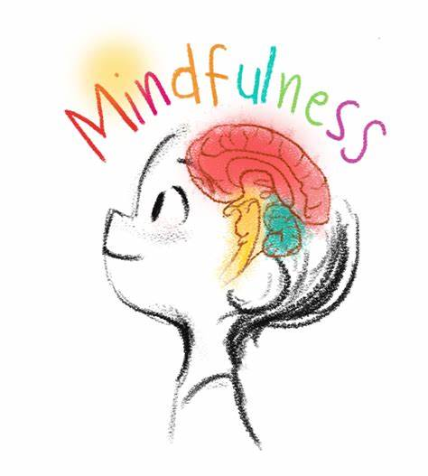
Handout 21.1
Which two mindfulness skills do you think we want to use if we are going to be mindful of our emotions?
Mindfulness to current emotions is about learning to allow the pain.
If you are going to practice observing and describing your emotions, what will you be observing? By being able to describe these emotions we can have an easier time problem solving. The more we allow to experience the emotions we train our brain to not fear them.
How many of you ever thought: Emotions are for the weak? I can't stand feeling sad....
Being mindful can begin to challenge some of these myths

Slide 8
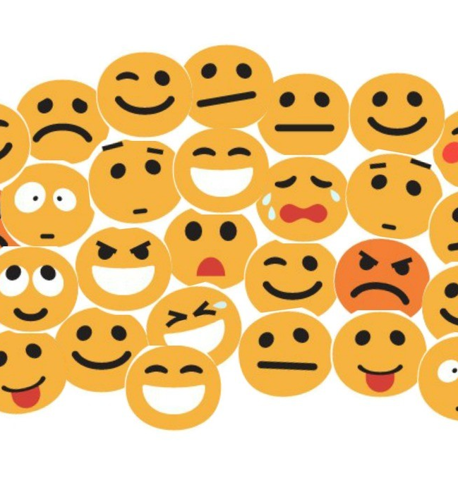
Mindfulness of Emotion Sensations
Read second box in handout 21.1
Have students answer following questions by writing it down:
1. When you are anxious, where do you feel it in your body?
2. When you are sad, where do you feel it in your body?
3. When you are excited, where do you feel in your body?
4. When you are angry, where do you feel in your body?
Share out answers
Do you always like those sensations? Most of the time it's the physical sensations that make us uncomfortable. Learning to experience those symptoms it builds our tolerance like a wave.

Slide 9

ACCEPTANCE
Remember: You are not your emotions
Read third box in handout 21.1
You can have an emotion and tolerate the urge to act on it.
Read fourth box in handout 21.1
Allowing yourself to accept your emotions you decrease emotional suffering. We can embrace these emotions and not be afraid of them. Emotions are inevitable so we must learn to experience them not push them away.

Slide 10
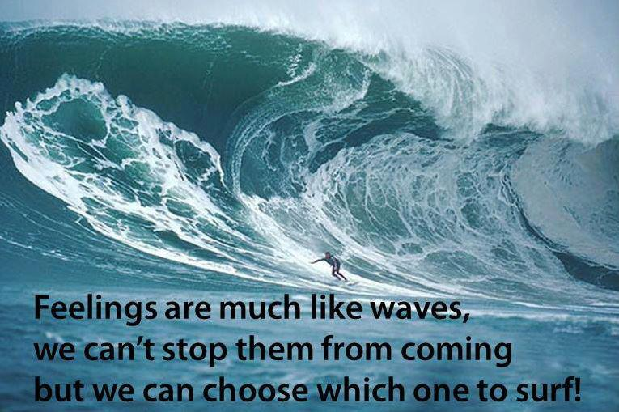

Slide 11
Class exercise: Eye contact with a partner
I want each of you to notice physical sensations in your body, notice urges and do not act on them.
Stand up 6-12 inches of space between you and partner. Hold eye contact throughout the exercise.
Observe the emotions that arise, notice urges to smile laugh and tolerate without acting on them.
Have students maintain eye contact 1-2 minutes
When finished have students share their experience/observations

Slide 12
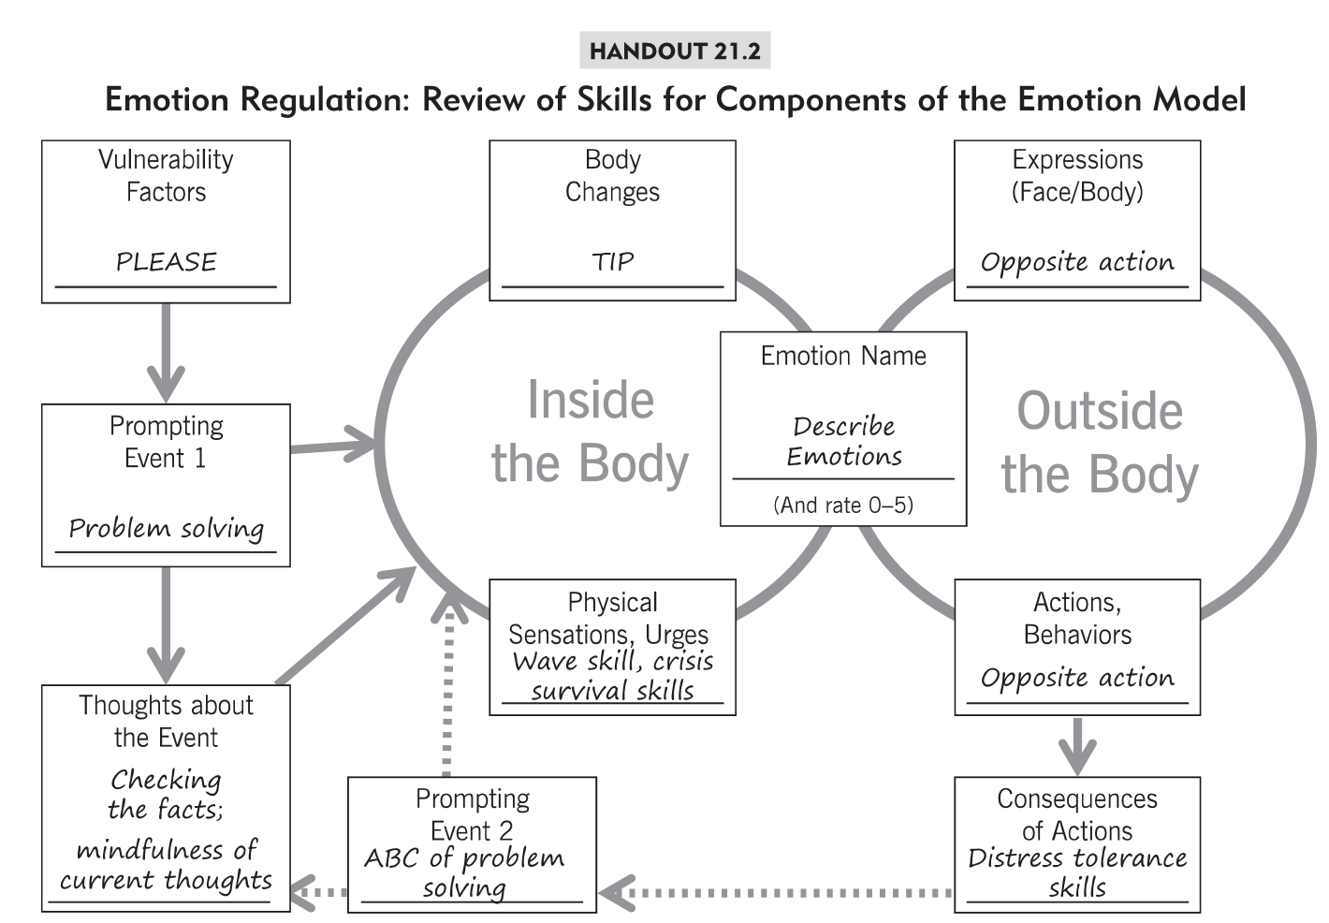
Examples to discuss on page 261
Refers to ACCEPTS
SKILLS WE DID
NOT TEACH?

Slide 13
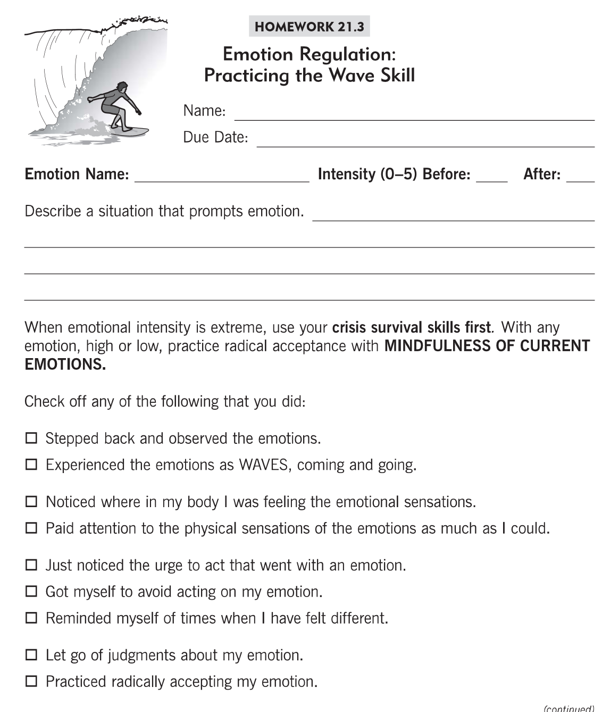

Slide 14
