Slide 1
She-Hulk: Attorney Of Law (2022) - Smart Hulk And Jen Yoga Scene (4K UHD) - YouTube
Watch the video – even the Hulk is talking about it!!
Have you heard about DBT?
In school there's Steps A to learn strategies.....

Slide 2

What is dialectics?

Slide 3

Dialectics: is more than one way to look at something.
Ex: How many legs do you see?

Slide 4
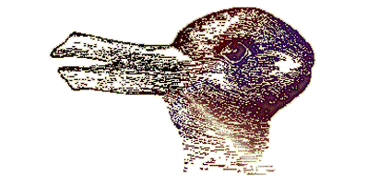
How many animals do you see?

Slide 5
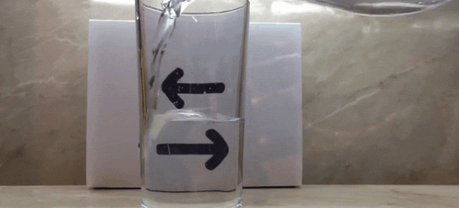
What’s your perception…

Slide 6
Why is it Important?
Helps you to be more flexible and approachable
Expands your thoughts and ways of handling life situations
Wisdom to accept that different points of view can be valid
Practice: *Look at all sides of a situation all points of view
* Look at Handout 2:2

Slide 7
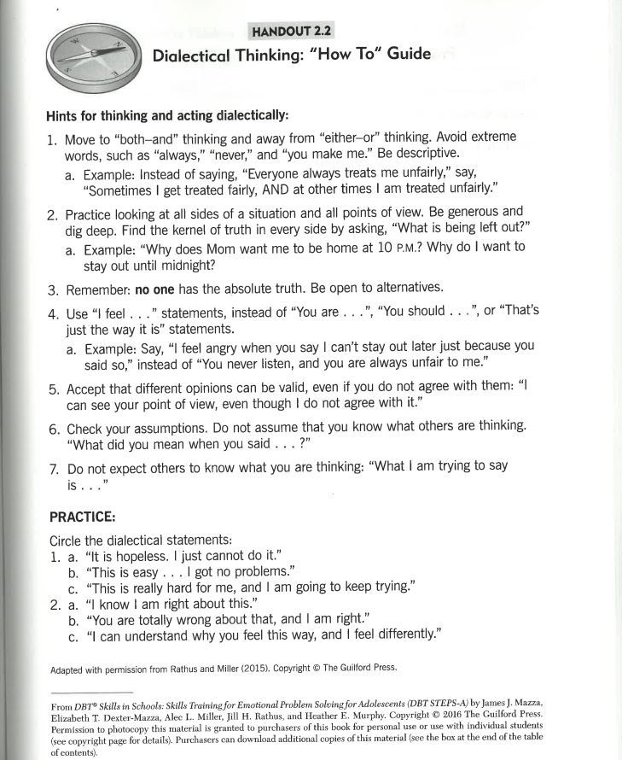
Handout 2.2

Slide 8

Wise Mind - YouTube
Watch the video to learn about Wise Mind
Notes:
Seeing both sides of a situation gives us clarity, helps us to understand that others have their own perceptions, and that it’s helpful to stay open minded.
Sometimes when we see things in only one way, it can make you stuck and increase your stress.

Slide 9

3 STATES OF MIND
Goal of mindfulness is to learn how to access and use our WISE MIND
WISE MIND is a balance between rational mind and emotional mind – What do I know to be true
Rational Mind is the state of mind when logical, calculated and task focused – What do I think to be true
Emotional Mind is the state of mind when emotions are in control influences thinking and behaviors – What do I feel to be true

Slide 10
Rational or Reasonable Mind:
(What I THINK)
Emotion Mind:
(What I FEEL)
Wise
Mind:
What I KNOW

Slide 11

Middle Path
All people have unique qualities and different points of view.
Two things that seem like opposites can both be true.
Honoring and being open to both sides of a situation is the best approach. Middle Path doesn’t mean compromise, but means that you're open to acceptance and change.

Slide 12
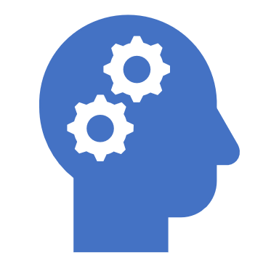
MINDFULNESS
Focusing on the present moment
Alert on what is happening in the moment without judgment
Leads to control of thoughts, emotions and behaviors instead of those being in control of you
This allows you to be in control of yourself in the moment – not in the past or in future

Slide 13
PRACTICING WISE MIND
BREATHING IN WISE
BREATHING OUT MIND
OBSERVE, DESCRIBE and PARTICIPATE

Slide 14
DBT Steps A....
There will be 2 more lessons about this that will provide skills for you to learn about and practice.

