Slide 1
Check The Facts (Lesson 17)
Dr. M.
Mindfulness – directions (5 min)
  Zen Counting (counting to 20 as a group with random people calling #s)
  Letting go of judgements
Discussion (2 min)
  What were your observations (of yourself and other people in the group)?
  How can we be nonjudgemental in this activity?
  Share out examples:
    I noticed...

Slide 2
Homework Review – TIP
How did HW go?
Was it helpful to use TIP skill to help with distress tolerance?
  Did it help you to resist acting on a crisis or negative urge?
Can we share some examples?
How can we incorporate this skill moving forward?

Slide 3
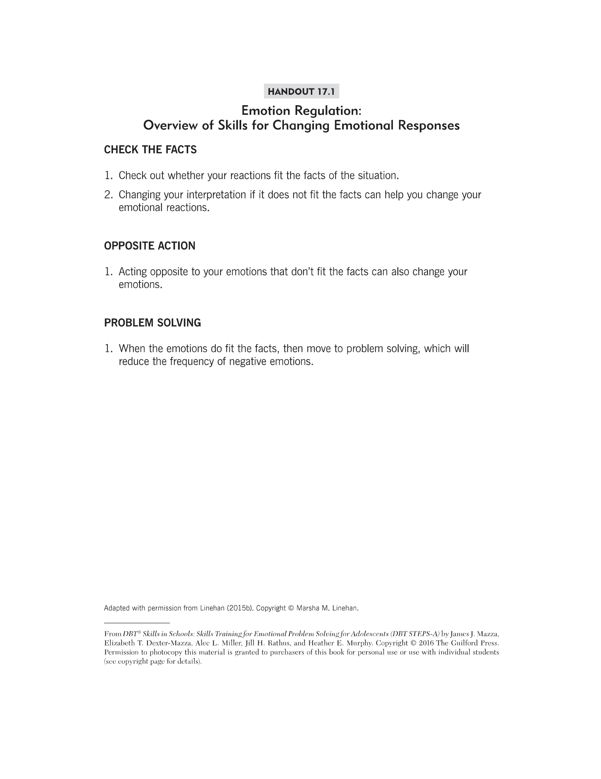

Slide 4
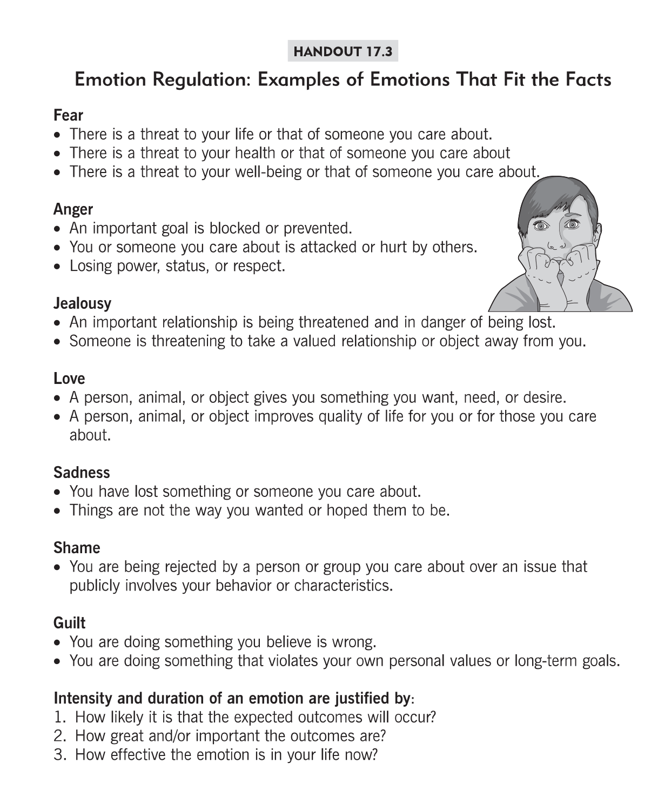

Slide 5
Intro to 1st Main Idea (15 min):
CHECK THE FACTS
Many emotions and actions are set off by our thoughts and interpretations of events, not by the events themselves
For example, getting mad at someone or feeling sad when a person ignores you as you walked down the hall wouldn't "fit the facts" if the person did not see you
Or your mother asks you to wait a minute to share some great news you have with her because she has to speak with your brother. Then she does not come back...
  Can lead to anger, sadness, etc if interpret 1 way
  Can lead to anxiety if interpret another
  Discuss these different examples

Slide 6
Treat Your Thought as A Hypothesis NOT a FACT!
What is a hypothesis?
How do we prove or disprove a hypothesis?
Just because I think it does not make it so!

Slide 7
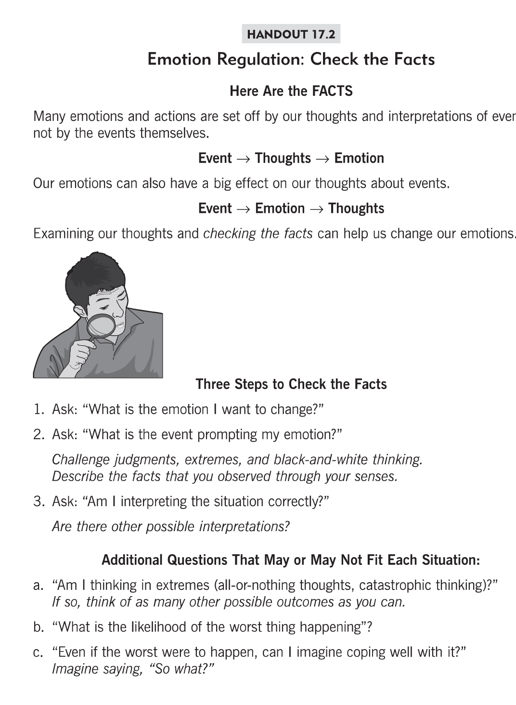

Slide 8
Example for discussion
I say hello to Jen in the hallway and she does not say hello back.
Questions to ask yourself to check the facts:
What is the emotion I want to change?
What is the event prompting my emotion?
Am I interpreting the situation correctly?
Am I thinking in extremes? (all or nothing thinking, catastrophic thinking, mind reading, fortune telling, etc)
What is the worst thing that could happen? How likely is that to happen?
Even if the worst thing were to happen, can I imagine coping well with it?

Slide 9
Emotions react in a variety of way …
https://www.youtube.com/watch?v=t4okAfKCwRk
Inside out link to a variety of emotions and their viewpoints.

Slide 10
Intro to 2nd Main Idea (15 min):
OPPOSITE ACTION
Every emotion has an action urge and by changing the action/behvaior, we can also change the emotion
Typically, emotions lead to behavior (action urge)
  Anger ---> Attack
  Sad ---> Withdraw
  Scared ----> Avoid
Can others share examples of when you have had these emotions and accompanying action urge?

Slide 11
Emotion ---> Opposite Action
We know that if our emotion has an impact on our behavior, then the reverse also may be true: Our behavior can have an impact on our emotion?
  So we can change the emotion by changing how we act!
What is the opposite action?
Examples:
  If I feel sad and want to withdraw...what is the opposte action?
  If I feel scared and want to avoid...what is the opposite action?

Slide 12
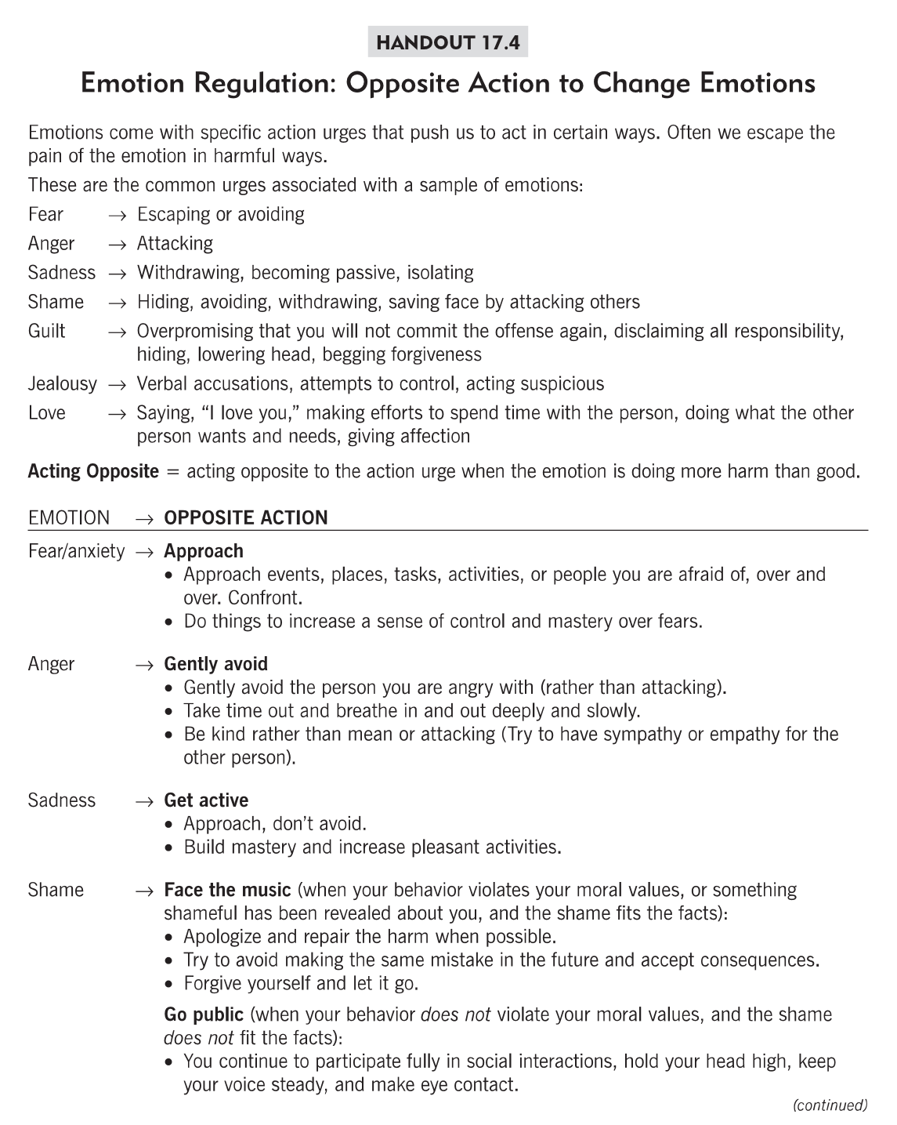

Slide 13
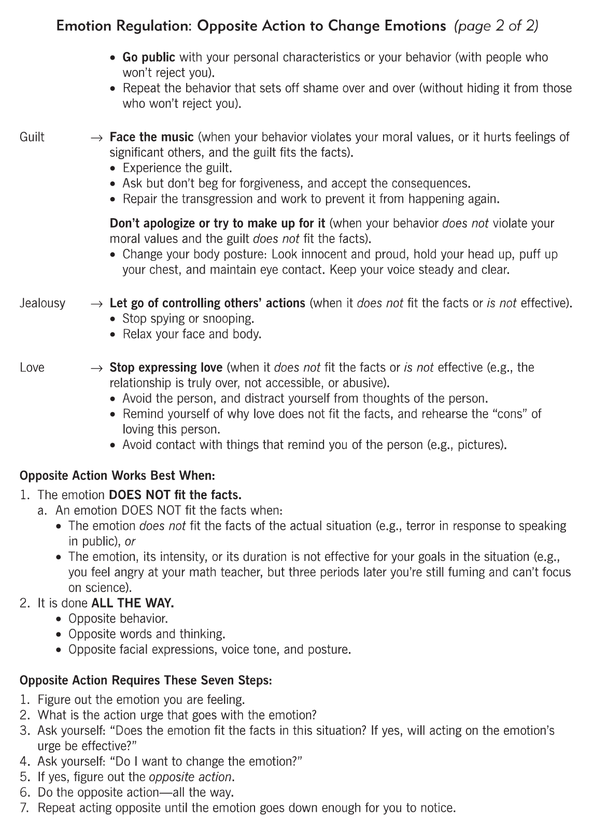

Slide 14
Lesson Summary (3 min)
Check the Facts and Opposite Action are two very helpful strategies for helping to "regulate" or change negative emotions!
It is important to determine whether our interpretations of situations "fit the facts" and how to change our emotions by changing our behaviors
HW practice these two skills during the upcoming using the worksheets provided in workbook (17.5 and 17.6)

Slide 15
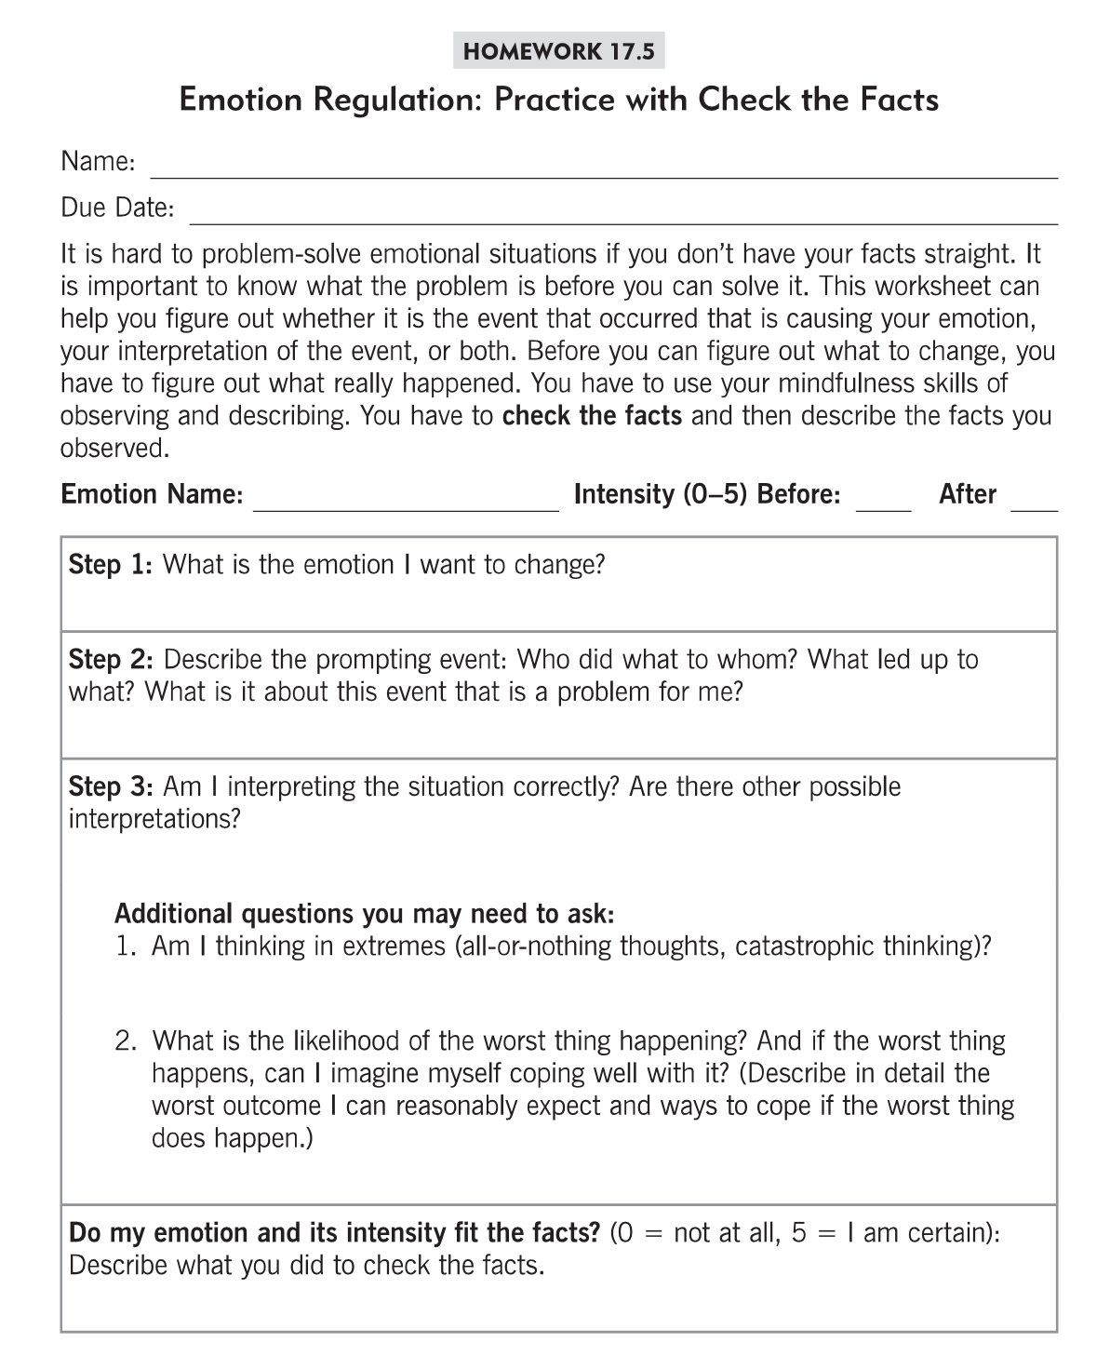

Slide 16
