Slide 1
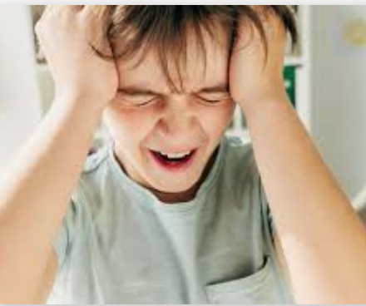

TIPP Skills for Managing Extreme Emotions
First, let’s take a minute to be here:
Brief tense and release exercise
Brief breathing exercise
Picture what you look like when you are totally listening and engaged
Be your best engaged self

Slide 2
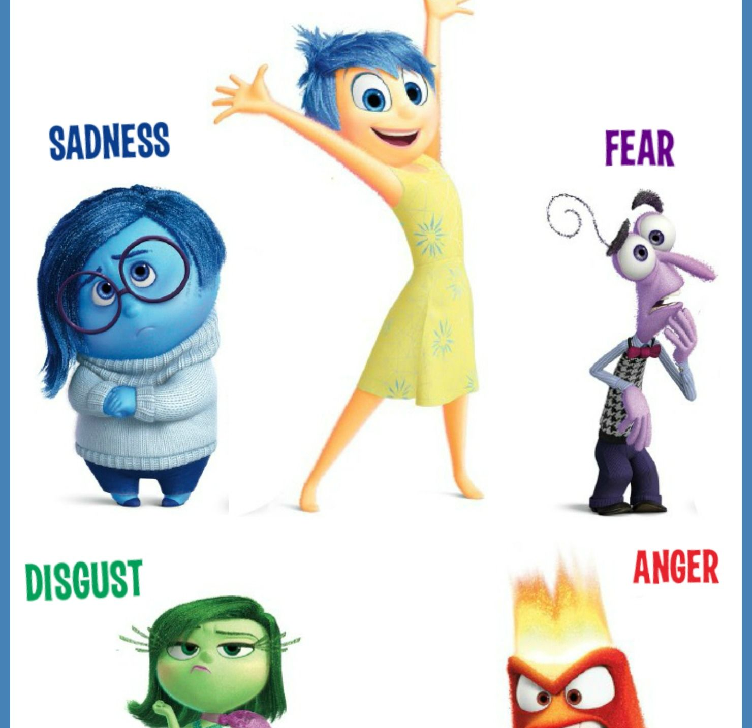
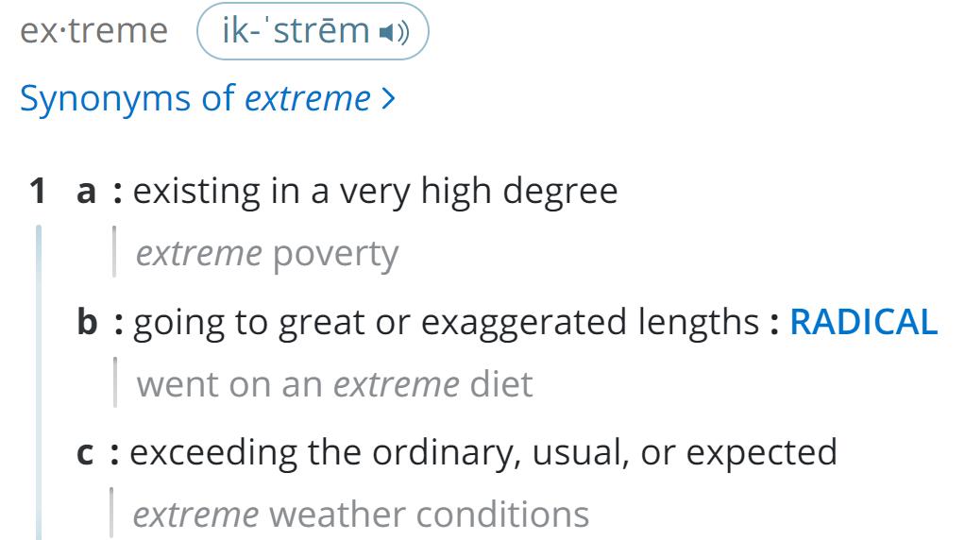
“Extreme” Emotions???
What does this mean?
We’re focusing on extreme emotions that are unwanted and block us from feeling the way we want to feel, and doing the things we want to and need to do.
+! +! +! …….

Slide 3
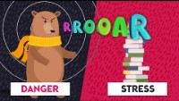
Extreme Emotions Put Us in
Fight, Flight or Freeze Mode
https://www.youtube.com/watch?v=8do0Jiscgsk
There are times when our emotions are so intense that they block our ability to think clearly about what we’re actually experiencing and how we’re responding.

Slide 4
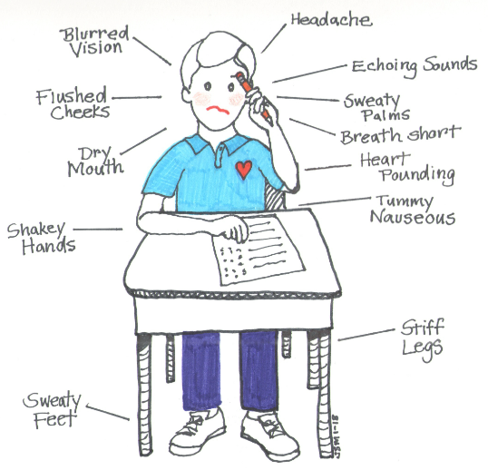

Turn and talk:
What does someone experiencing extreme emotion look like?
What does it feel like?
Who experiences extreme emotion?

Slide 5
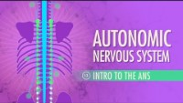
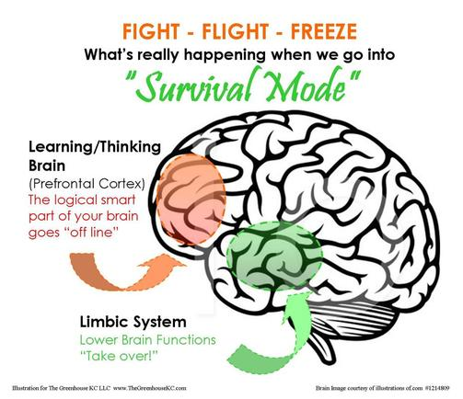
Our Goal: Interrupt Emotion Mind
When emotions get really intense and we can't even focus enough to problem solve, it’s time to reboot our body chemistry and nervous system. https://www.youtube.com/watch?v=71pCilo8k4M
Stop at 3:08 (we’re not exploring anatomy today!)
Notes:
The limbic system controls the autonomic nervous system.
Sympathetic – from Greek, “feeling together”
Parasympathetic – “beside the sympathetic”

Slide 6
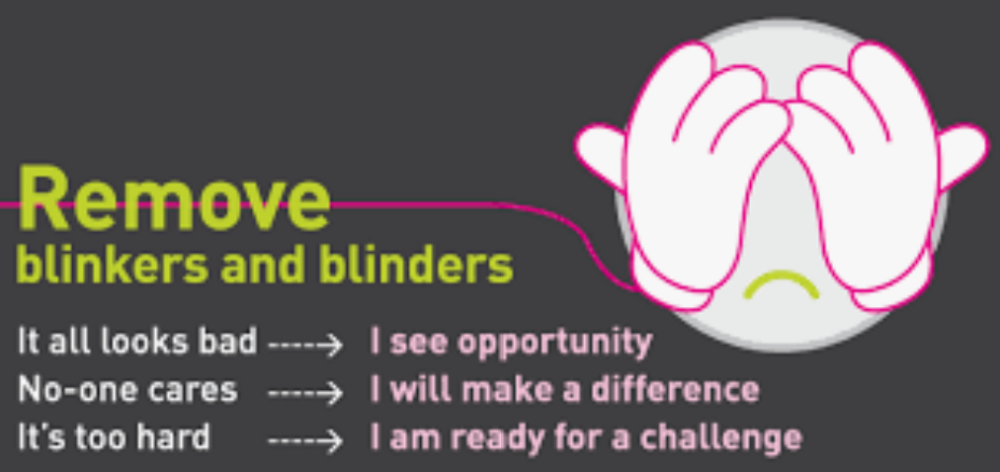

Turning on Our Parasympathetic Nervous System
We can quickly change our body chemistry and activate the parasympathetic (PNS) nervous system (the body's natural calming system), by using the TIPP Skills.
The key to remember here is that the effects of these skills only last about 5-20 minutes. They are not a long-term solution or answer, but they will just buy enough time, in a more calmed state, to mindfully determine what additional skills you need to use to see more clearly.
Notes:
This is like removing blinders so we can see more clearly, or rebooting a computer that’s frozen.

Slide 7
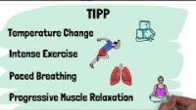
Let’s Learn About TIPP! https://www.youtube.com/watch?v=cqPcOCpJOXw

Slide 8
Temperature
Cold water will calm us down fast by activating our PNS. This comes from the dive reflex, which is what happens when we dive into a body of cold water.
The body has an automatic reaction to keep us alive – that’s where the PNS comes in, so that arousal will decrease so that we can stay afloat.
We use this in order to prevent us from acting impulsively in response to extreme emotions. The key components here are that we have to apply something cold and wet to the face, while bent over and holding our breath.
Students should try this at home.

Slide 9
Intense Exercise
One thing that emotions communicate to us is the need for action. When we are experiencing intense emotions, one way to get in control of our behavior and feeling is to engage in intense exercise, rather than acting on what our emotions are telling us to do.
If you are angry, you may want to attack (or write a mean post); if you're scared, you may want to run and hide. So the goal here is to engage in 20 minutes of intense exercise (run, power walking, jumping jacks) as long as you are doing it intensely.
The key is that when the exercise stops, your body will also slow down for about 20 minutes because the PNS becomes activated.
Practice quick fast-paced umping jacks or running in place for 20 seconds

Slide 10
Paced Breathing
Paced breathing is another method we can use to activate the PNS. This strategy can be used anywhere because we always have access to our breath.
Naturally, our heart increases when we inhale and slows down slightly when we exhale.
The goal is to make our exhales longer than our inhales and decrease our heart rate. We are going to take two inhales, one longer for 3 seconds and one shorter for one second, then exhale for 6-8 seconds. Remember, our PNS is activated during the exhale.
Practice breathing exercise. (How does someone who is sobbing breathe?) We did this exercise in the opening. Now you know why!

Slide 11
Progressive Muscle Relaxation
Muscles can become tense in response to signals from the sympathetic system.
PMR can relax those muscles, draw our attention away from an unhealthy focus, and engage the PNS.
PMR involves tensing and then relaxing different muscle groups of the body while focusing on the feelings and sensations associated with the tensing and relaxing of those muscles. It’s best to engage in this with eyes closed.
Can be practiced again, depending on time. (Remember we did this at the start and now you know why!)

Slide 12
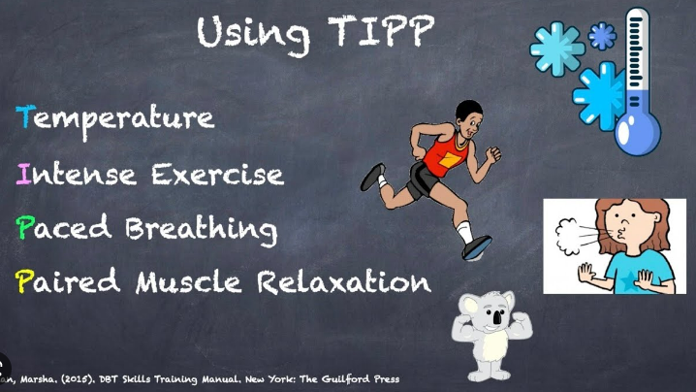
KEY: Practice TIPP Skills when you are NOT experiencing extreme emotions so you know how to use them when you do!

