Slide 1
Understanding Financial Aid

Slide 2
Free Application for Federal Student Aid (FAFSA)
Financial Need
Sources of Financial Aid
The CSS Profile

Slide 3

What is Financial Aid?
Financial aid is funding used to assist students and families to pay for postsecondary educational expenses.

Slide 4

Completing the FAFSA
Each contributor must create an FSA ID and password at https://studentaid.gov/fsa-id/create-account/launch
The FSA ID will provide access to certain U.S. Department of Education websites.
  Every contributor to the FAFSA will need an FSA ID and password to provide consent and to electronically sign the FAFSA
Provide a valid email address for the FAFSA Submission Summary (FSS) to be emailed in 3-5 days.
https://studentaid.gov/

Slide 5
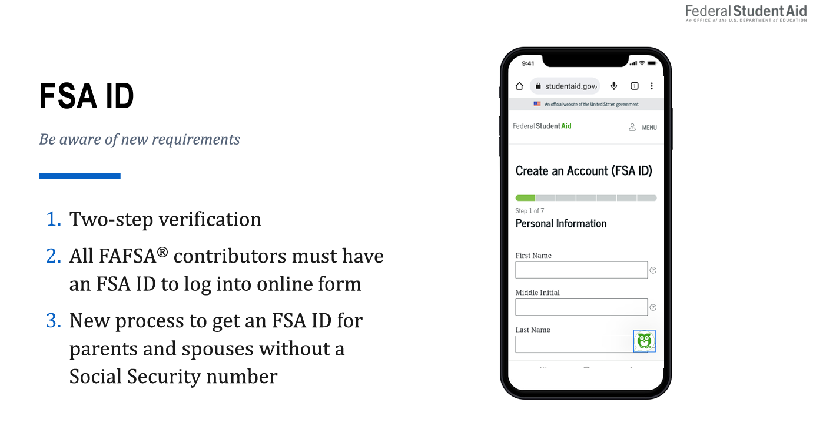
Please note: Within the FAFSA form, the contributor can verify that their personal information is correct. If they need to update any of their personal information, the contributor must access their Account Settings on StudentAid.gov.

Slide 6
Prior-Prior Year FAFSA
The 2024-2025 FAFSA is expected to be available in December 2023*
IF YOU PLAN TO ATTEND COLLEGE FROM | YOU WILL SUBMIT THIS FAFSA | YOU CAN SUBMIT THE FAFSA FROM | USING TAX INFORMATION FROM
JULY 1, 2024 – JUNE 30, 2025 | 2024-2025 | DECEMBER 2023*- JUNE 30, 2025 | 2022
*Please note this is subject to change based on the Federal Government’s Timeline

Slide 7

Documents Used to Complete FAFSA
2022 Federal Income Tax Returns
Child support received
  During last full calendar year
Current balances of cash, savings, and checking accounts
  Education savings accounts will only be counted as a parental asset if the account is designated for the student.
Net worth of investments, businesses, and farms
  Net worth is the value of the business minus the debts owed against it

Slide 8
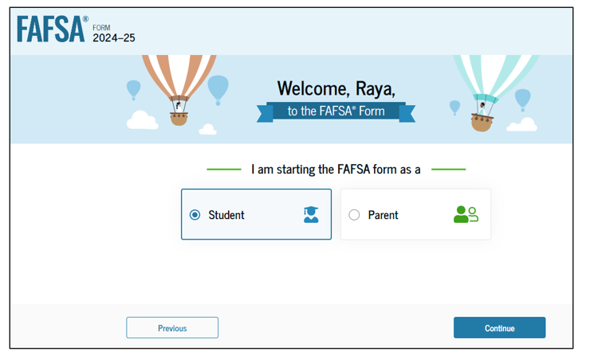
Who can file the FAFSA?
Either the parent or the student can start the FAFSA.
If the student starts the FAFSA, they answer the student questions and invite the parent to the FAFSA form to complete their section, provide consent for their Federal Tax Information (FTI), and sign the FAFSA form.
If the parent starts the FAFSA, they will answer questions about the student as well as questions about the parent. The student will then have to login to provide consent for their FTI and sign the FAFSA form.
Notes:
Consent is required to be eligible for Title IV aid; no consent means no need-based aid!

Slide 9
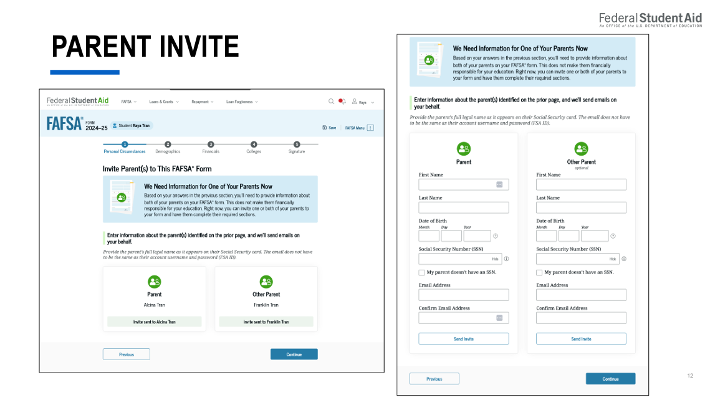

Slide 10
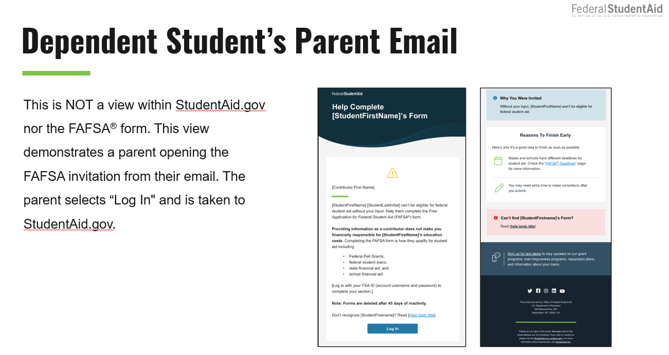

Slide 11
Which contributors are needed to complete the FAFSA?
  For Married Parents:
  Both parents should be contributors on the FAFSA.
  For Remarried Parents:
  If the parent is remarried as of the day that they are filing the FAFSA, the stepparent’s information must also be provided.
  For Unmarried and Both Legal Parents Living Together:
  Both parents should be contributors on the FAFSA.
  For Divorced or Separated Parents:
  The parent that provided the greater portion of the student’s financial support during the last 12 months should be the contributor on the FAFSA.
    If both parents provide exactly equal financial support to the student, the parent with the greater income should be the contributor on the FAFSA.

Slide 12

Notes:
*If you are unsure of the number listed on your 2022 taxes, then enter your household size manually.

Slide 13
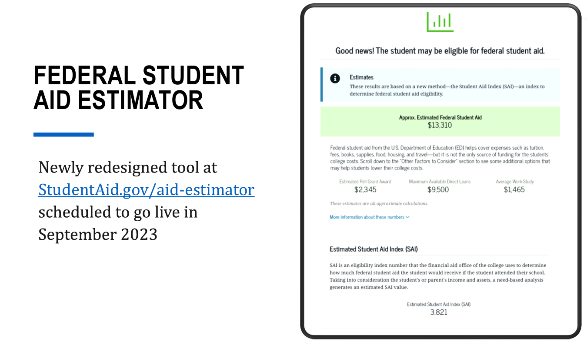
Newly redesigned tool coming soon: https://studentaid.gov/aid-estimator/

Slide 14


Slide 15
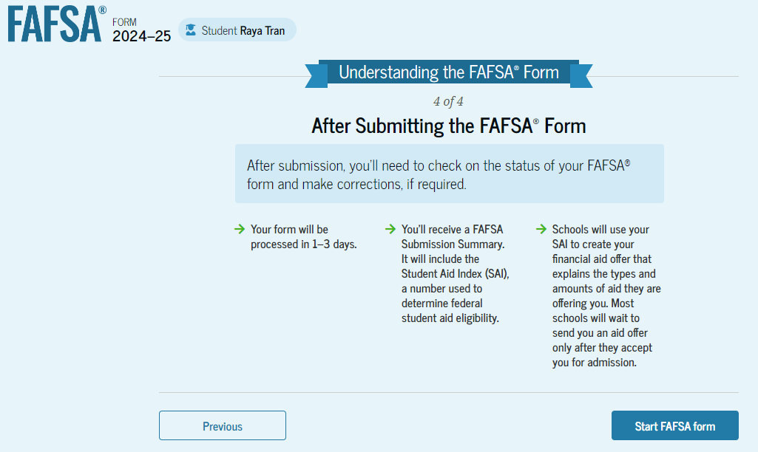

Slide 16
What is the Student Aid Index (SAI)?
(formerly known as Expected Family Contribution (EFC))
The Student Aid Index (SAI) is a number that determines each student’s eligibility for certain types of federal student aid.
Calculated using data from the federal application form (FAFSA) and a federal formula.
Factors Considered in Calculating the SAI:
Income
Assets
Family size
Federal poverty guidelines

Slide 17

What is Cost of Attendance (COA)?
Billable Costs
Non-Billable Costs
Varies from college to college
Includes:
  Tuition and fees, housing and food, books, travel, miscellaneous expenses.

Slide 18
What is Financial Need?
Cost of Attendance
Student Aid Index(SAI)
Other Financial Assistance(OFA)
= Financial Need

Slide 19
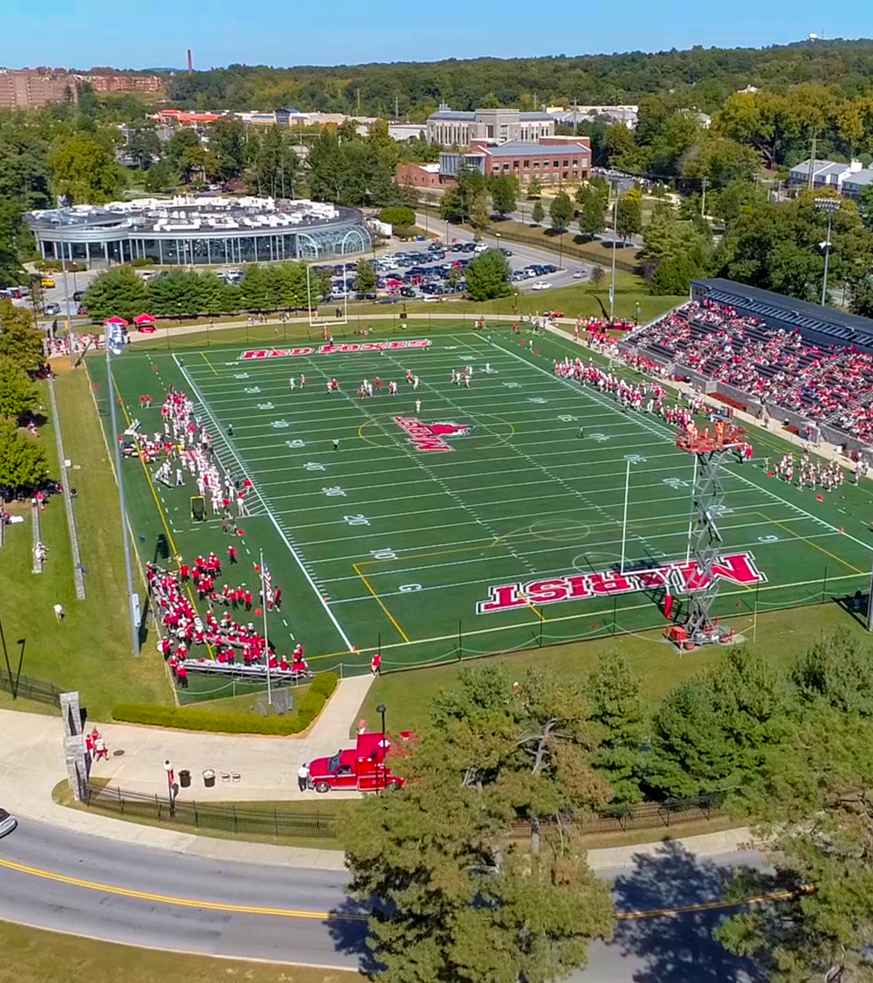
Types of Financial Aid
Gift Aid
  Scholarships
    Merit/Academic
  Grants
    Need-based
Self-Help Aid
  Need-based
    Federal College Work Study
  Non-need based
    Campus Employment
  Loans

Slide 20
Gift Aid: Scholarships
Institutional:
  Academic Scholarship
  Alumni/Legacy Scholarship
  Athletic Scholarship
  Music Scholarship
  Theatre Scholarship
  ROTC Scholarship
Private:
  Endowed Scholarships
  Outside Scholarships

Slide 21
Gift Aid: Grants
Federal:
    Federal Pell Grant: $767 - $7,395 (2023-2024 Pell Amounts)
    Supplemental Educational Opportunity Grant (SEOG)
    TEACH Grant: up to $4,000/year ($16,000 over four years)
State:
    New York State TAP: $500 - $5,665
Institutional:
    Need-Based Grant in Aid

Slide 22
Student Employment
Allows student to earn money to help pay educational costs and learn “real life” work skills
Awarded as Campus Work Study or Campus Employment
Earnings not applied toward the bill
Student receives a paycheck

Slide 23
Federal Direct Loans:
(Subsidized and Unsubsidized)
Subsidized Direct Loan:
Need-based
  Government pays interest earned while in school
Unsubsidized Direct Loan:
Financial need is not a consideration
Interest accrues
Interest payments can be made or deferred
Effective 7/1/23-7/1/24
Fixed interest rate
of 5.50%
Origination Fee of 1.057%
Freshman base annual
loan limit $5,500

Slide 24
Federal Direct PLUS Loan
Borrowers are parents of dependent undergraduate students
FAFSA must be filed to receive a Federal PLUS Loan
Annual loan limit: cost of attendance minus all other financial aid
Repayment begins after final disbursement for the year unless granted a deferment
Federal PLUS Loan:
Effective 7/1/23-7/1/24
Fixed Interest Rate of 8.05%
Origination Fee of 4.228%

Slide 25
Private Loans
Loan in the student’s name
Credit-based
Can borrow up to the cost of attendance minus all other financial aid
Interest rates (fixed or variable), terms, and fees vary with lender

Slide 26
Monthly Payment Plan
Convenient alternative to lump-sum, semester payments
Payments can be made over specified time period
Enrollment fee per semester
No credit review

Slide 27
The College Scholarship Service (CSS) Financial Aid PROFILE
Used by some colleges and universities to award their own institutional financial aid funds. This form is in addition to completing the FAFSA.
Review the colleges’ websites to determine if the PROFILE is required or for priority filing dates.
$25 for the initial application; $16 charged for each additional college you request.
Students register and complete the PROFILE online at http://student.collegeboard.org/profile
PROFILE is not required for federal financial aid
Notes:
Profile takes a deeper dive into your financial situation.

Slide 28
Points to Remember
Read the FAFSA and PROFILE instructions carefully
Financial aid and state requirements and deadlines may vary with institutions
The FAFSA must be completed or renewed every year the student is in college in order to be eligible for financial aid

Slide 29
Online Resources
Federal Student Aid Downloadable Resources: https://studentaid.ed.gov/sa/resources
FAFSA on the Web: studentaid.gov/h/apply-for-aid/fafsa
Department of Education Student Information: http://studentaid.gov
New York State TAP: www.hesc.ny.gov
Net Price Calculator: A tool used to estimate net cost of a specific institution
www.marist.edu/financialaid/freshman/netpricecalculator.html
Marist College Office of Student Financial Services: https://www.marist.edu/sfs

Slide 30

Connect With Us
Contact Student Financial Services if you have any questions along the way.
We are dedicated to helping you understand your costs, your payment options, and your financial responsibilities as a student.
Marist.edu/sfs
Scan the QR code below to schedule a one-on-one appointment

Slide 31


Slide 33


Slide 34


