Slide 1
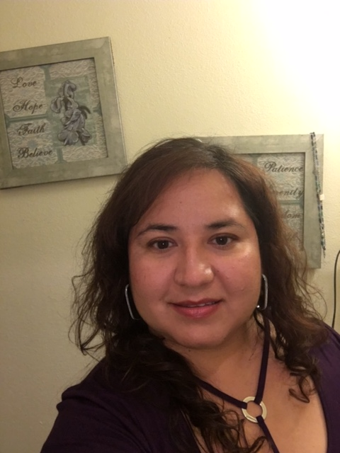
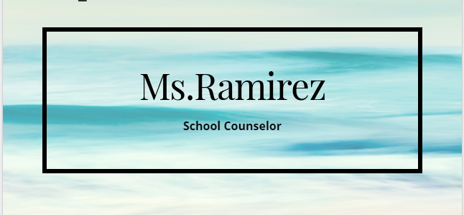

Ms. Ramirez
School Counselor
Zavala Magnet Elementary
432-456-1239
delores.ramirez@ectorcountyisd.org
forms.gle/RGKE2mLuYUkucacR8

Slide 2

Services Provided
Student Counseling (individual & Group)
Response to Intervention (RTI) program
Testing Referrals
Food 2 Kids
Student of the Month program
Guidance Lessons
  Teaching Coping Skilling, self-regulation, social skills
  Social Emotional Skills (SEL)
  Character Education
  Just say “No,” Bully Prevention, & Etc…

Slide 3

Contacting the Counselor
You may contact me via email or phone.
If I do not answer, please leave a voice mail and I will return your call. You can also leave me a message in the office.
CONTACT INFORMATION
Email: delores.Ramirez@ectorcountyisd.org
Phone: (432) 456-1239

Slide 4

Lets have a safe & successful year!!
“Success is about being your best self”
- Carol S. Dweck

