Slide 1


STEM Academy
Choice School Orientation

Slide 2
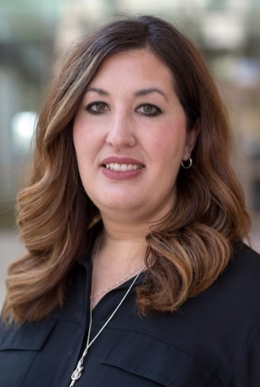
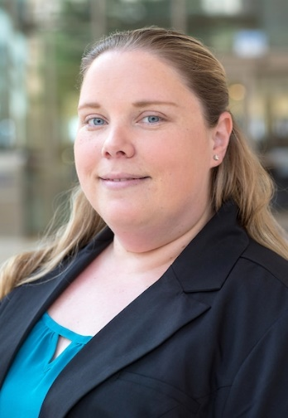
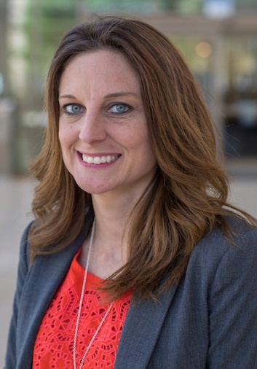
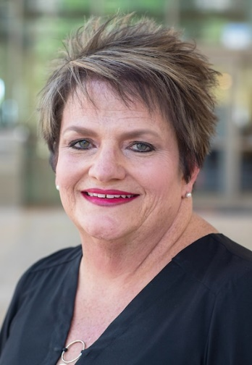
Meet Our Team
Shannon Davidson
Superintendent,
UTPB STEM Academy
Kathleen Halford
Business Manager,
UTPB STEM Academy
Candice Sikes
Instructional Coach,
UTPB STEM Academy
Lucinda Hurlbut
Special Populations Coordinator,
UTPB STEM Academy
Dr. Cody Griffin
Secondary Principal,
STEM Academy
Monica Elizondo
Elementary Principal,
STEM Academy

Slide 3

About Us - Video
AboutUTPBSTEM

Slide 4
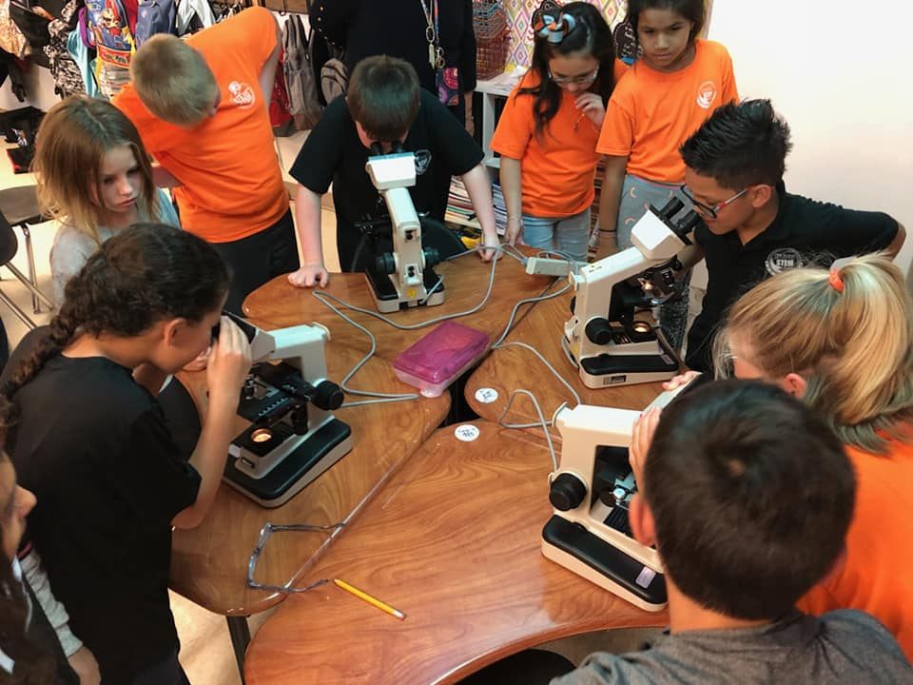
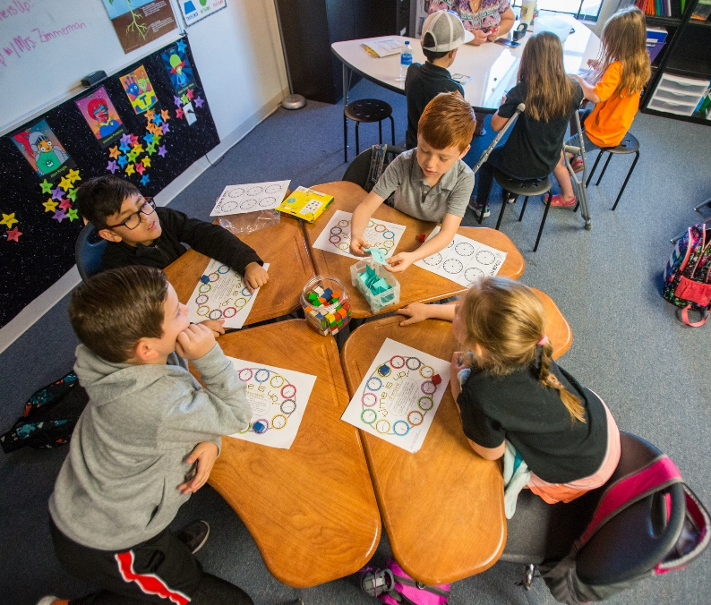
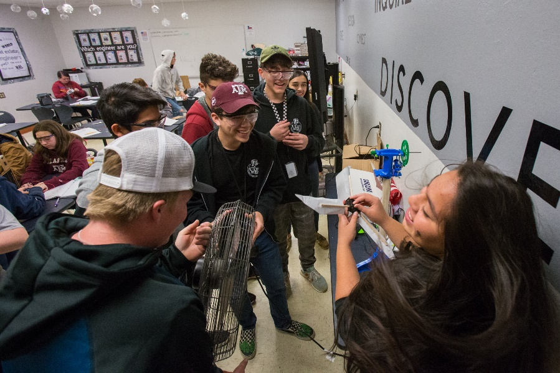
Mission Statement
The UTPB STEM Academy prepares students to be STEM college and career ready, with a shared focus on collaboration, creativity, communication, and critical thinking.

Slide 5

Student Enrollment History
2015-2016
K-7th
352 students 16 teachers
2017-2018
K-9th
654 students 30 teachers
2019-2020
K-11th
769 students 36 teachers
Current
K-12th
770 students 39 teachers
2014-2015
K-6th
308 students 14 teachers
2016-2017
*significant expansion
K-8th
594 students 27 teachers
2018-2019
K-10th
721 students 33 teachers
2020-2021
K-12th
792 students 39 teachers

Slide 6
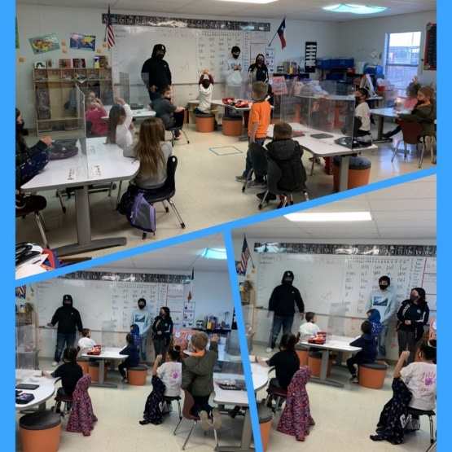
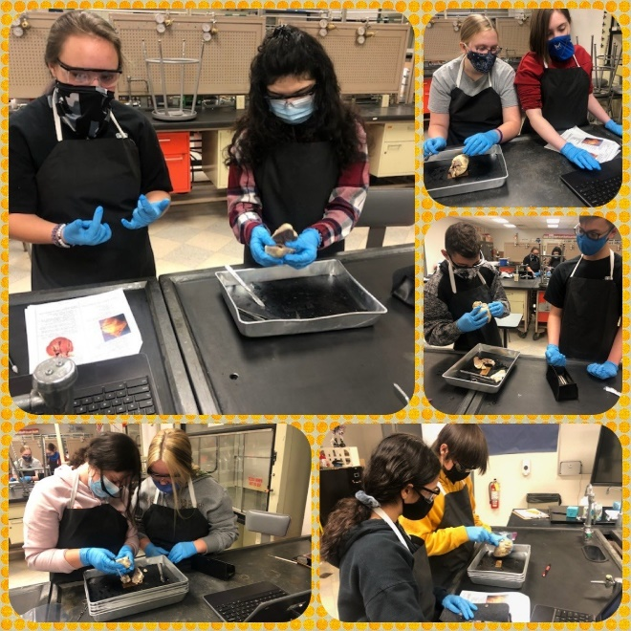
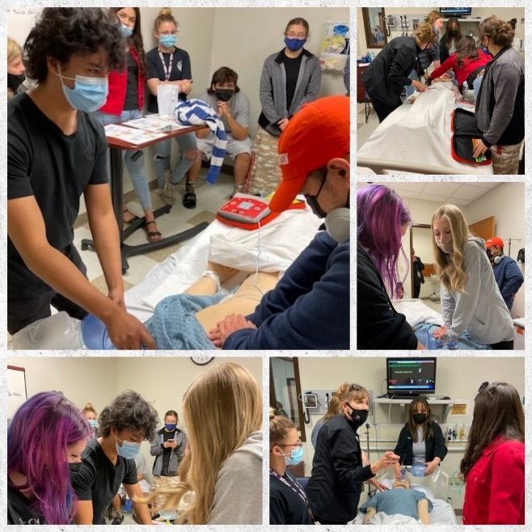
Student Demographics
Kinder- 12th Grade
Average class sizes - 22 students
3 Classes Per Grade Level

Slide 7

Admission and Enrollment
ECISD Schools of Choice
Application Period
  December 1- January 15
Parent Orientations
  Must attend 1 parent orientation
  December 1
  December 7
  January 18
Lottery
  February 15, 2023
  Parent Notification- February 20, 2023, parents must accept or decline by February 22, 2023

Slide 8

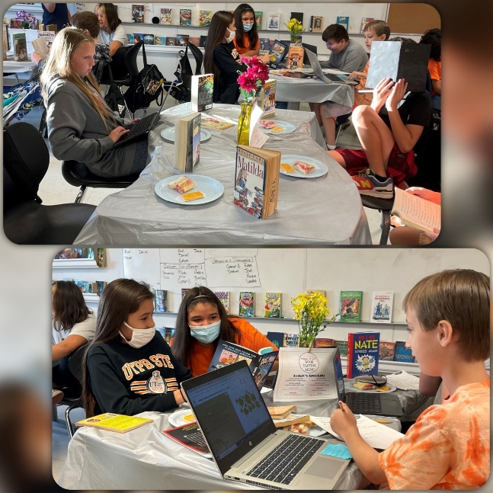


Schedule
Calendar = 180 days
Monday-Friday 7:50am – 3pm
8 Half Day Fridays throughout the year

Slide 9
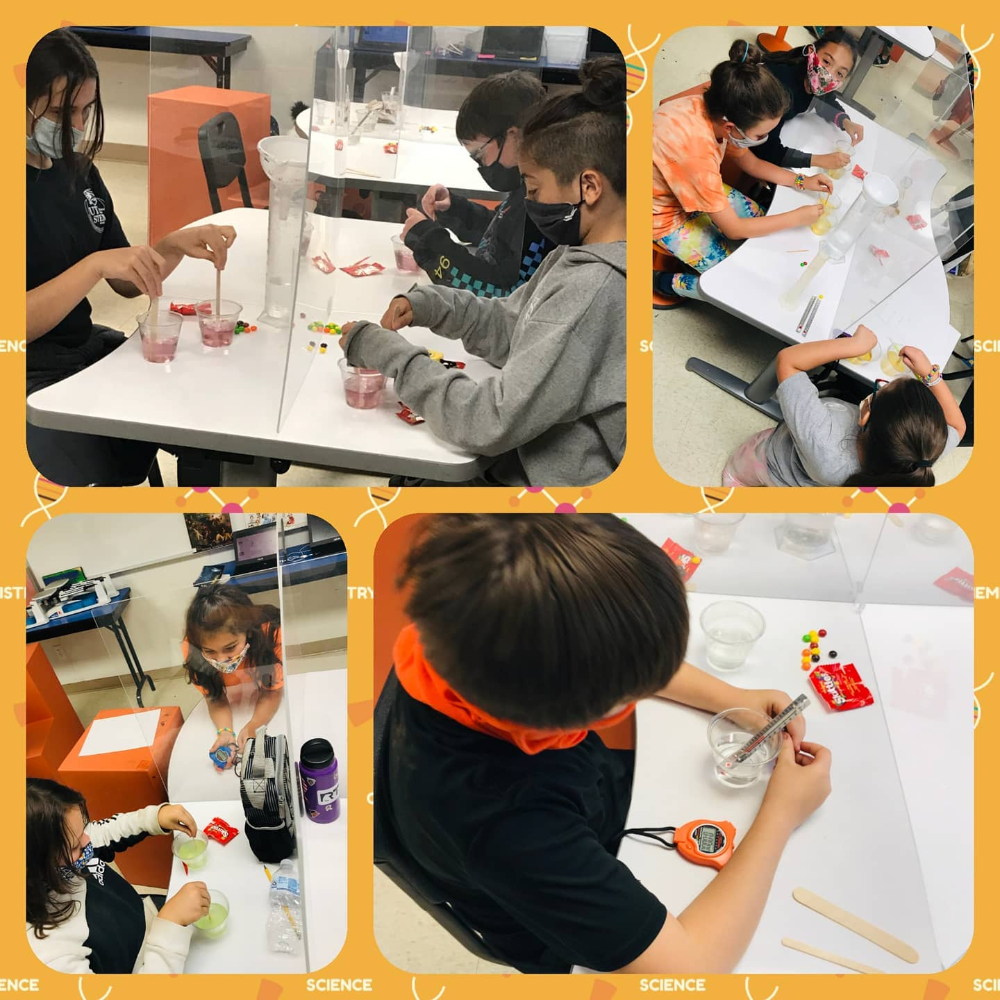
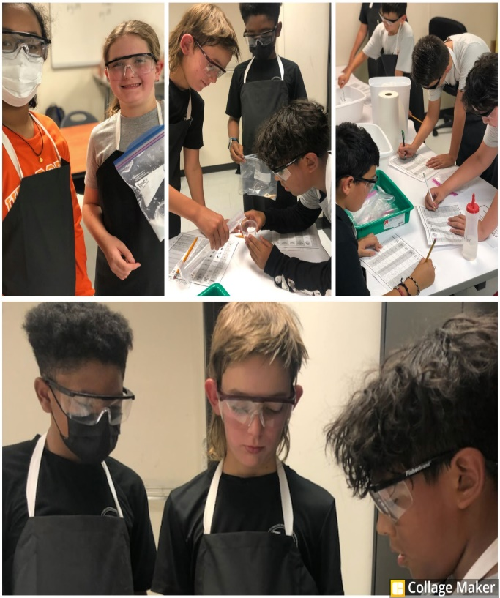
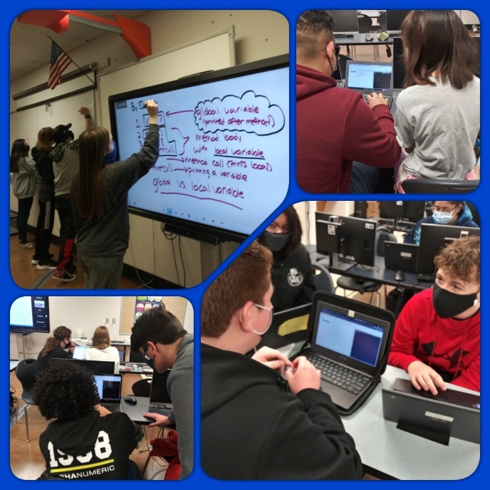
Academic Model
Texas Essential Knowledge and Skills
Project Based Learning
STEM Based Learning
  Pathways
    Biomedical
    Engineering
    Computer Programming

Slide 10

What is PBL
The STEM Academy’s PBL model includes the following progression:
  Entry Event
  Driving Question
  Need to Knows
  Student Voice and Choice
  Research and Sustained Inquiry
  Student Critique and Revision
  Culminating Event

Slide 11

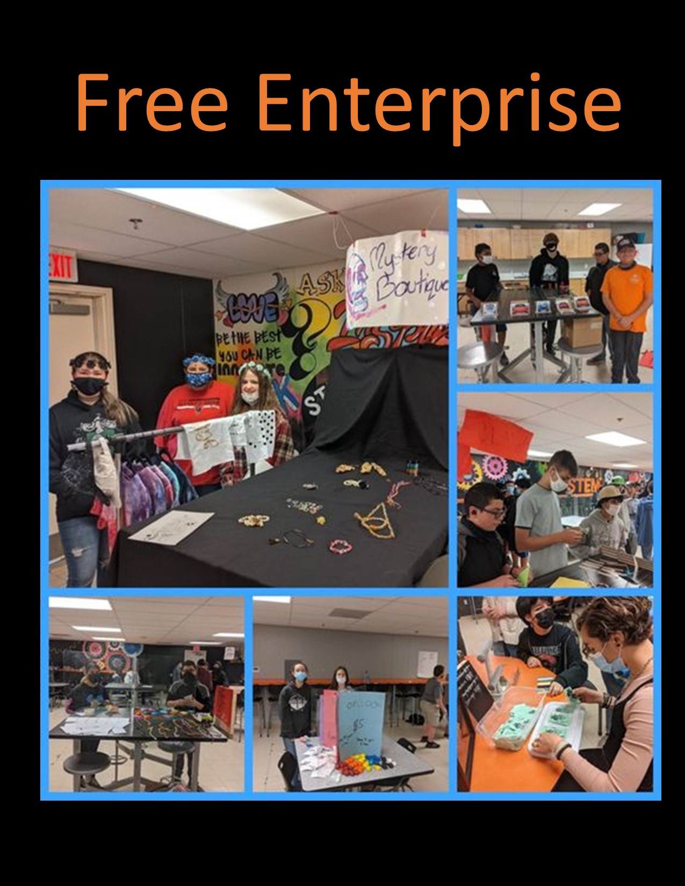
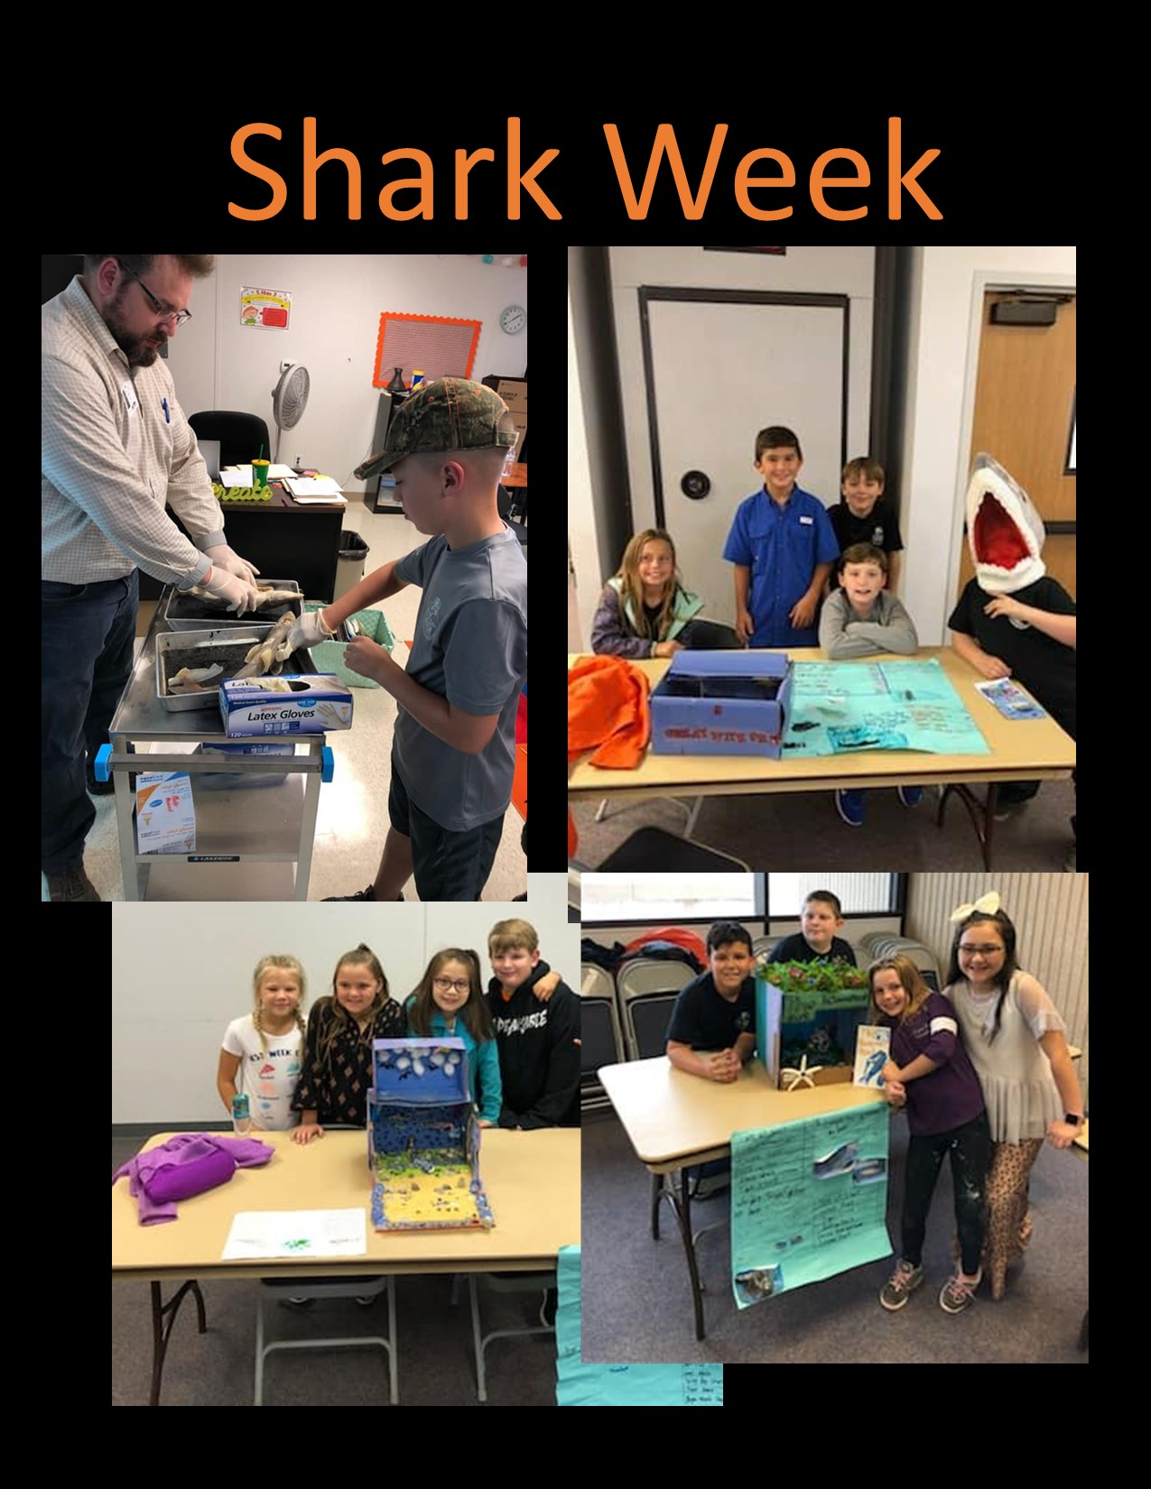
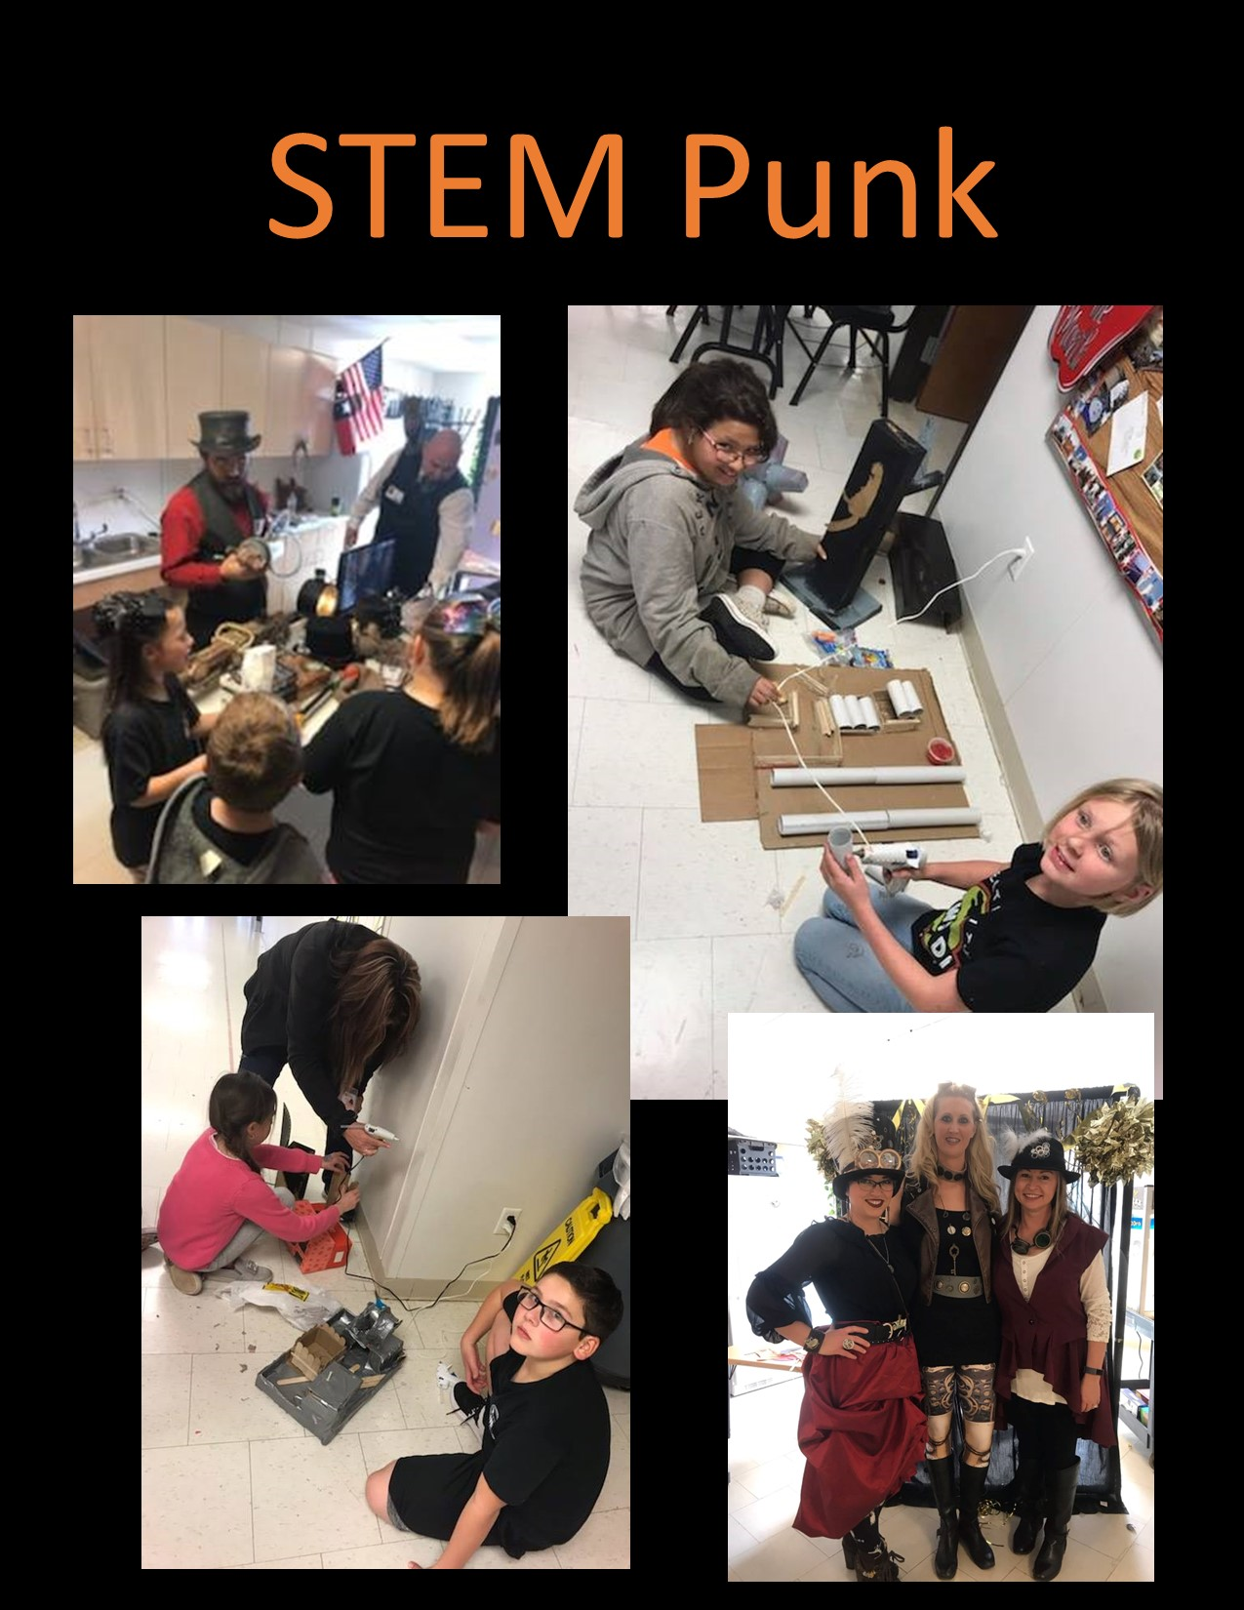
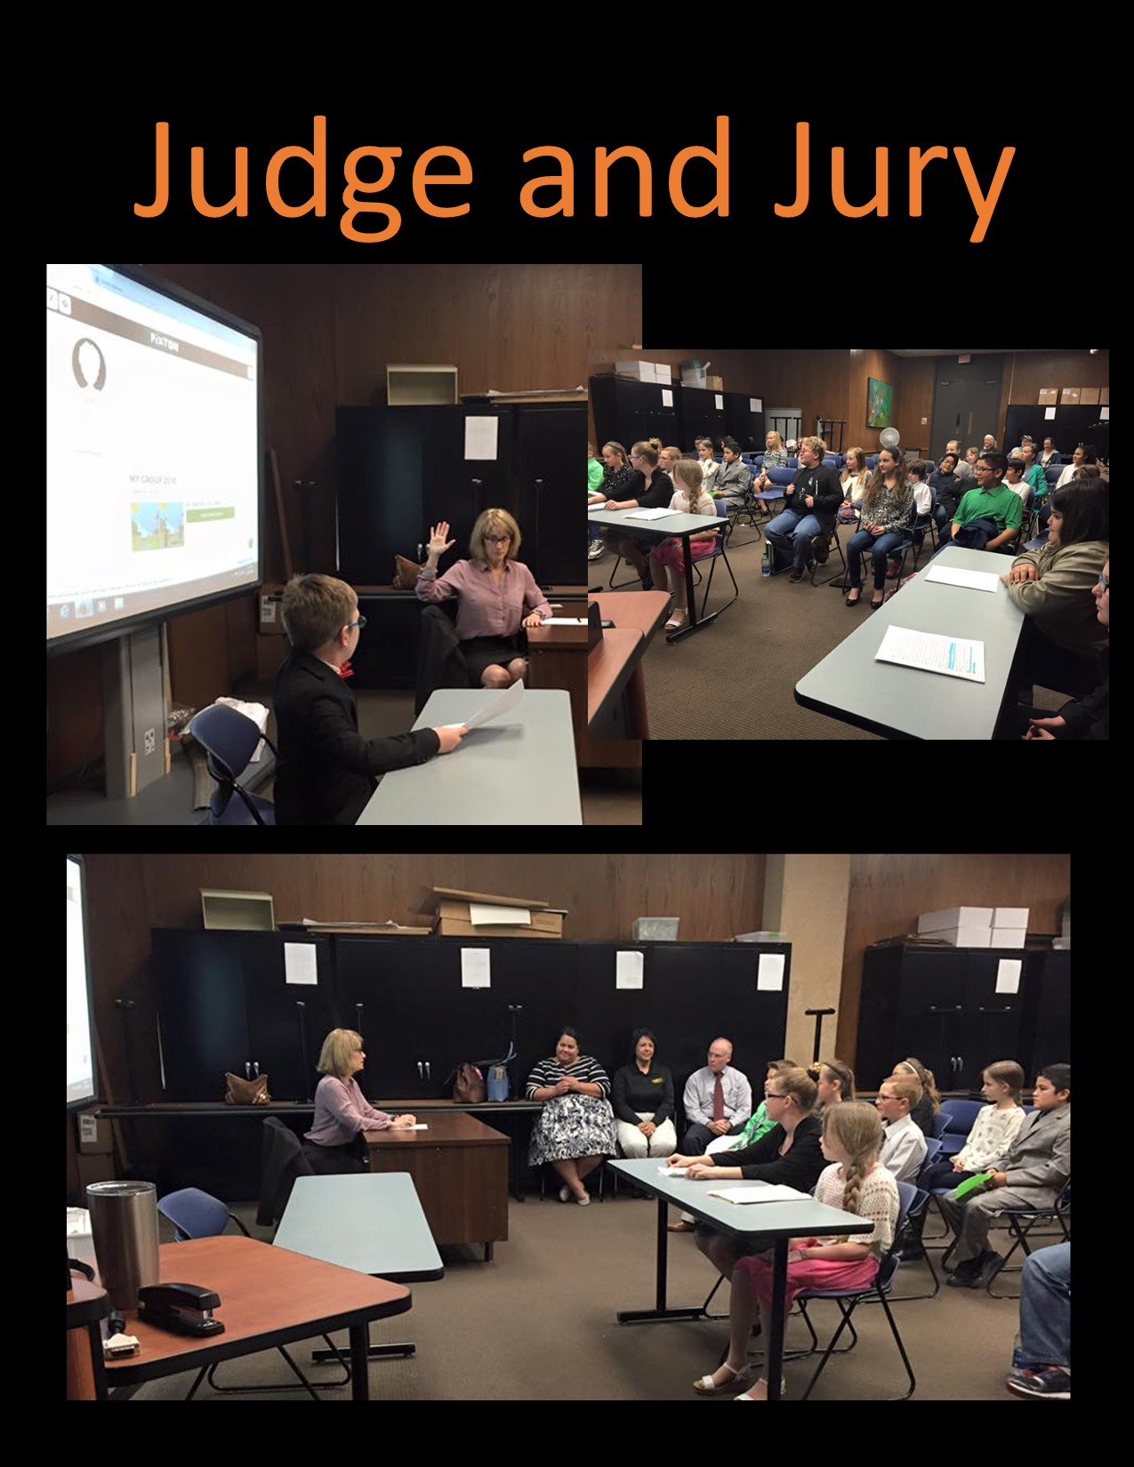
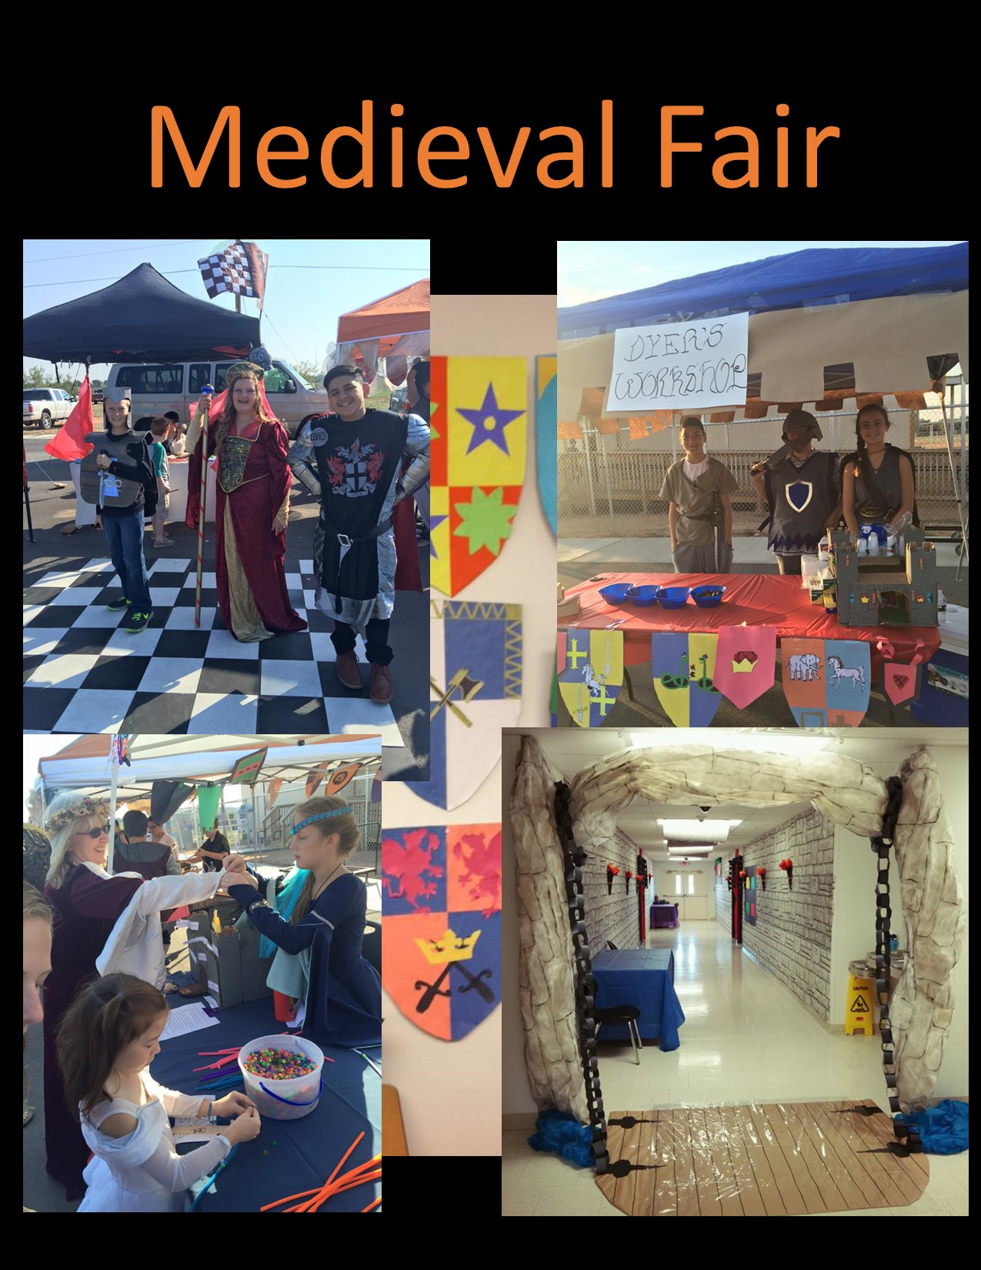
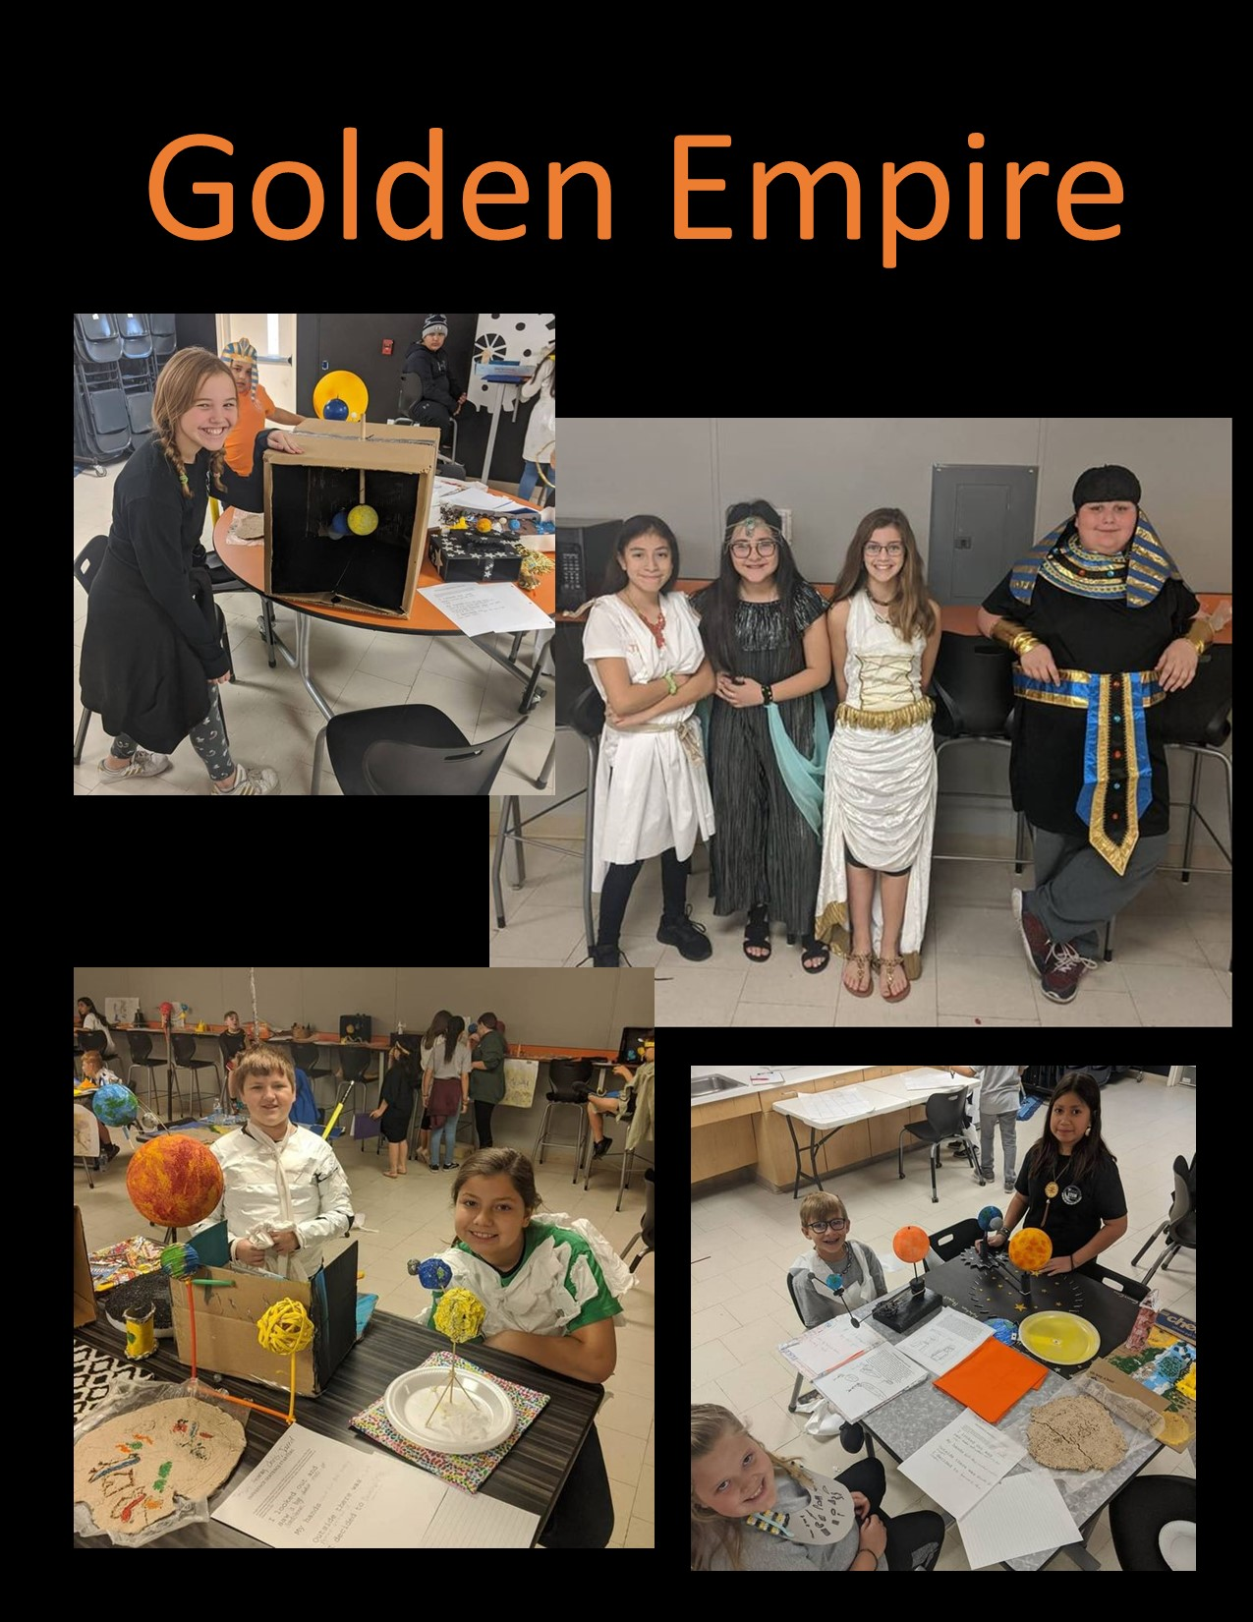
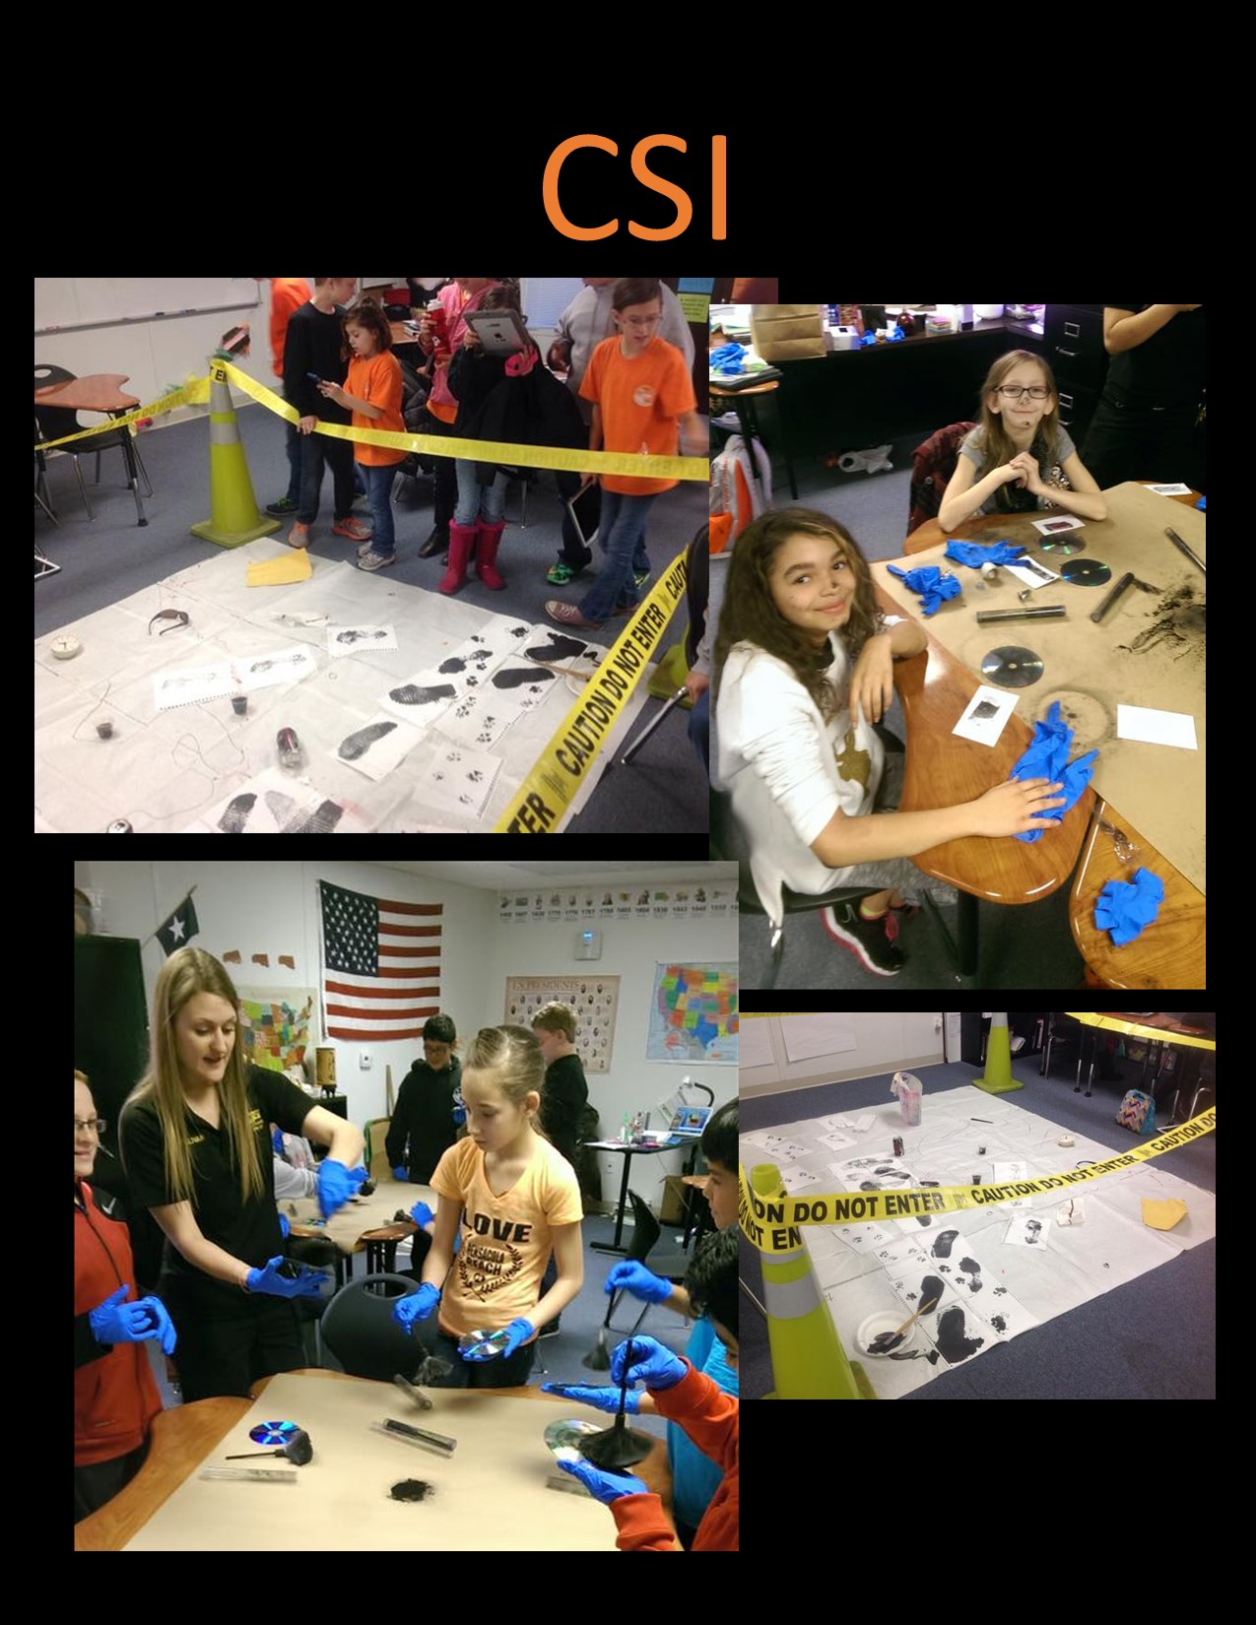
PBL Examples

Slide 12
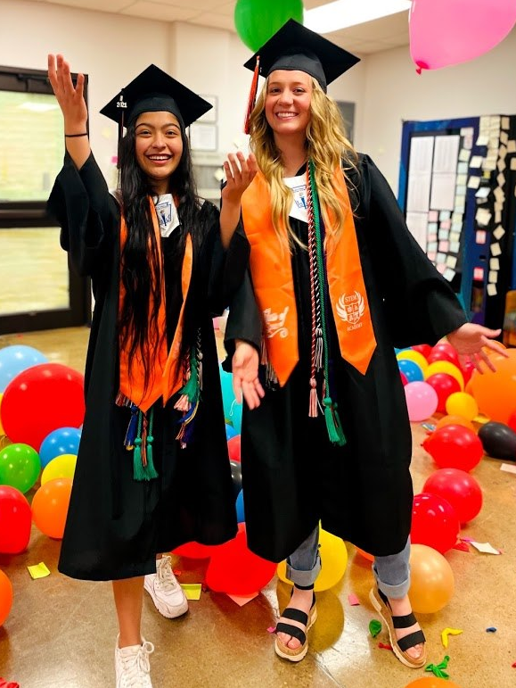
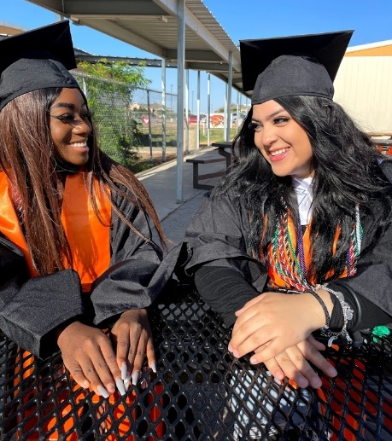
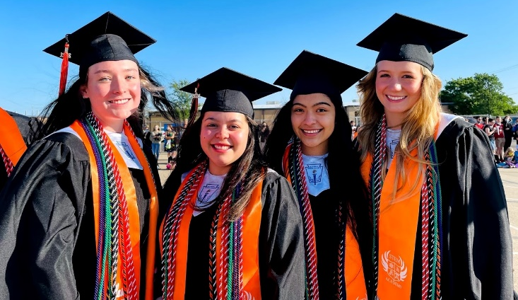
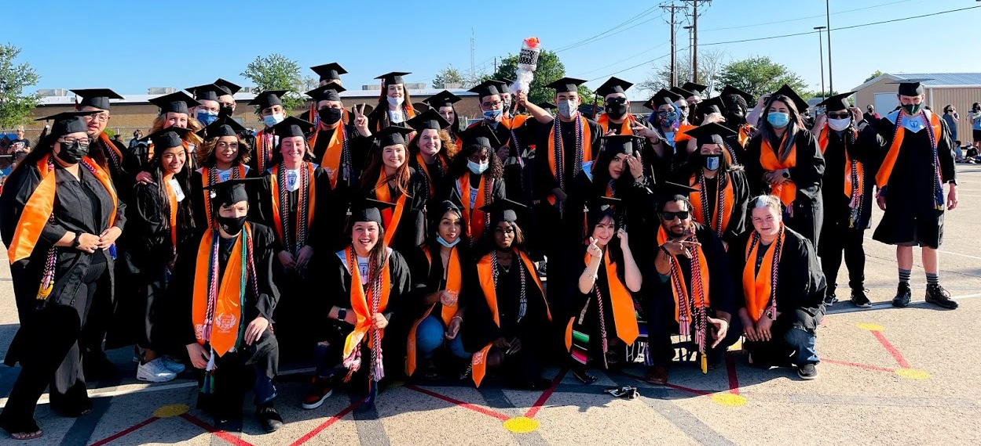
Post Secondary Focus
Post Secondary Ready
  Distinguished Level of Achievement
  CCMR Ready
Partner with UTPB Admissions Office
Dual Credit with UTPB
  Course fees paid by UTPB STEM
  Focus on Texas Core 42

Slide 13
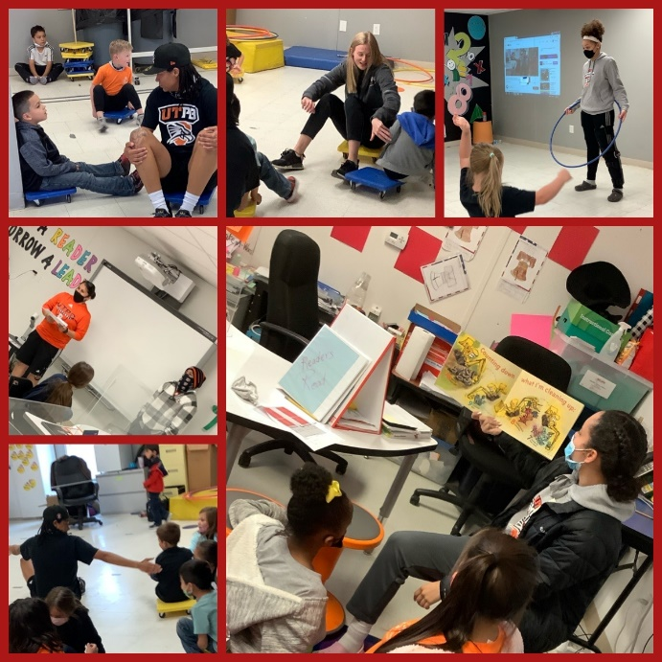
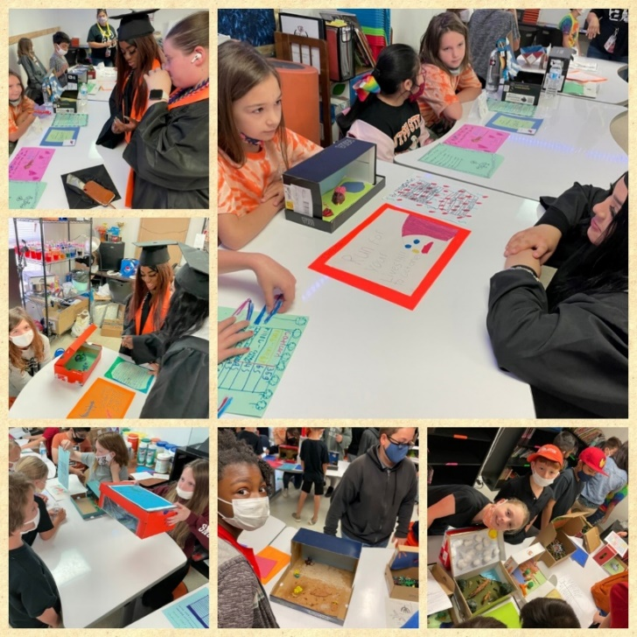
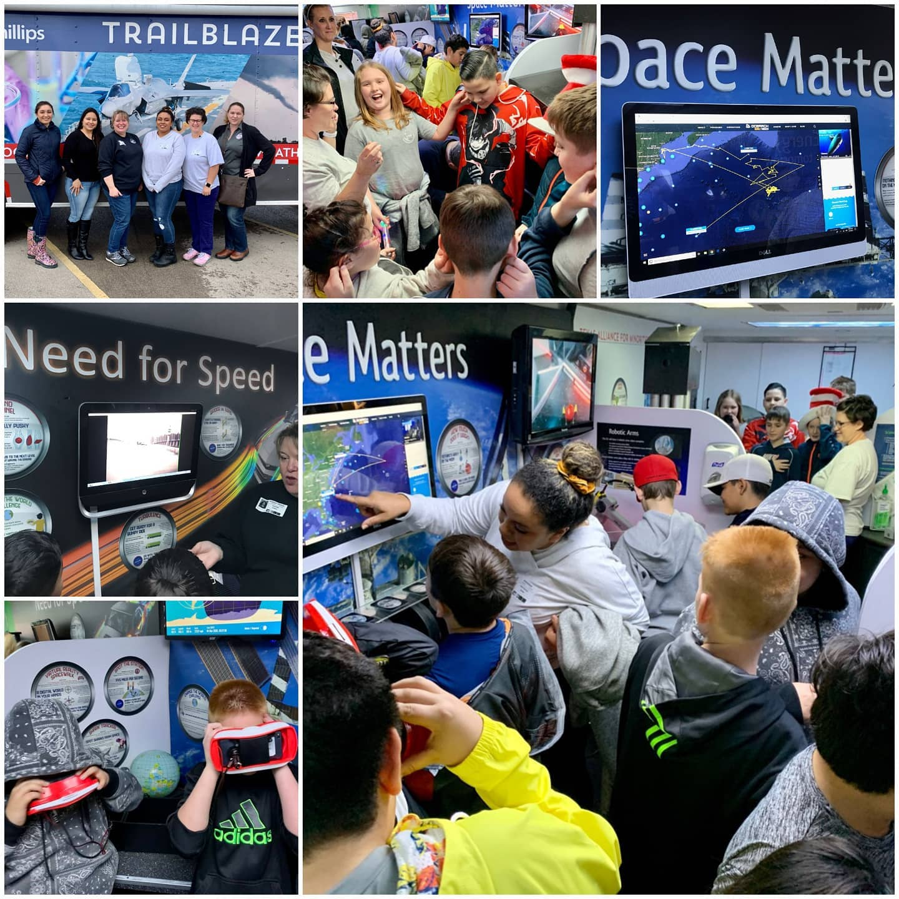
Parent Partnerships
Parent/School partnerships are the backbone of student success.
Family Engagement Activities
  Social Events
  Culminating Events of Projects

Slide 14



ECISD/STEM Partnership
Partnership Allows:
Students:
  athletics
  fine arts
Counseling Services
Transportation
Food Services

Slide 15
Choice Schools Parent Contract
The District may revoke an approved placement at a Choice School for the reasons listed below.
Use of false information submitted on the application.
Lack of parent support/cooperation with school staff
Persistent student misconduct.
Unsatisfactory academic progress. (Reagan & Hays only)
Excessive tardiness. (Exceeds 10 tardies, 10 early/late pickups)
Irregular attendance. (Exceeds 10 unexcused absences)
Failure by the parent to pick up the student at dismissal time. (10 early/late pick-ups)
Withdrawing student will automatically revoke placement at your Choice School.
Submitting an application to a Choice School other than the campus your student is currently attending, will result in loss of magnet seat at their current campus.
Any violation of ECISD Policy.

Slide 16
Student Expectations
Come to school every day ready to learn.
Complete all assignments on time and according to directions.
Respect the rights of others at all times.
Follow all school expectations.
Consistently monitor grades.
Actively engage and participate in collaborative group work and projects.
9-12th grade students are expected to:
Choose one of the 3 STEM pathways and complete all 4 years in pathway.
Work towards College Readiness- TSI testing and Dual Credit.

Slide 17
Parent Expectations
Ensure student is at school on time each day, students must be in their seats by 7:50 am.
Ensure student is prepared for each day and each learning project.
Consistently monitor students’ schoolwork and cordially communicate concerns with teachers. Parents and teachers are partners in the learning journey.
Support the school’s expectations of STEM and College Ready students.
Actively participate in STEM family events and student culminating events.

