Slide 1
ED Report
March 28, 2024

Slide 2
Budget Presentation

Slide 3

Financial Education–AMSA Budget
-3
0
Fiscal Year | Building Facility Costs | Includes
2021 | $1,338,836 | Rent/RE Taxes
2022 | $ 983,204 | Rent & Interest Only
2023 | $ 400,878 | Interest Only
2024 | $ 679,117 | Interest Only Thru October 2023 then Principal and Interest
2025 | $1,270,670 | Principal and Interest
+4

Slide 4
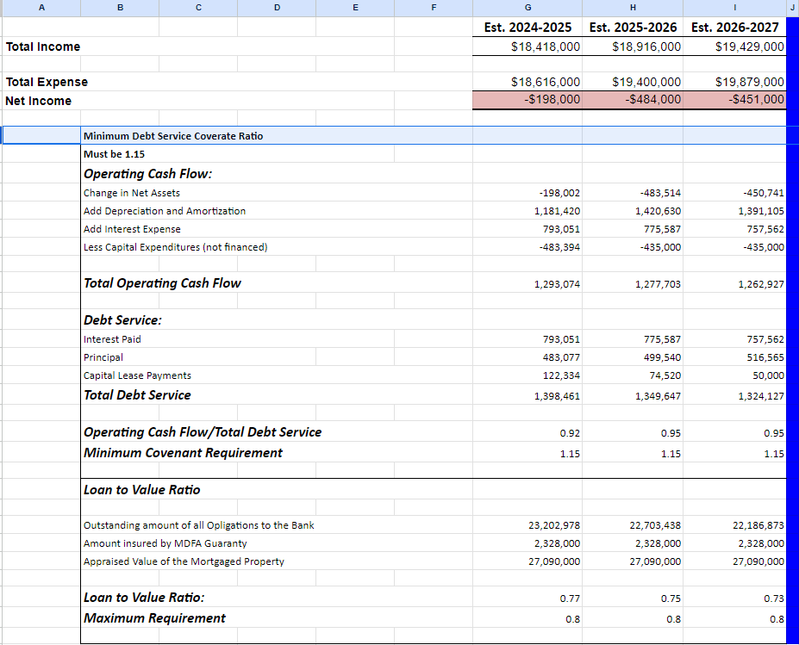
Assumptions
Tuition Increase 3%
All salary components calculated at the 2023-2024 rates
There are no reductions to personnel or programing

Slide 5
Attrition
&
Waitlist
0
+1

Slide 6
Grade 6
4 Marlborough
1 Hudson
1 returned to private
-3
0
+4

Slide 7
Grade 7
3 Marlborough
4 Moved too far
1 Private
-3
0
+4

Slide 8
Grade 8
2 Marlborough
1 Hudson
3 Moved too far
-3
0
+4

Slide 9
Grade 9
5 Assabet
1 Clinton
-3
0
+4

Slide 10
Grade 10
1 Marlborough
1 Hudson
2 Private
1 Moved too far
-3
0
+4

Slide 11
Grade 11 Grade 12
1 Marlborough 1 Early College
1 Private 1 Dropped
-3
0
+4

Slide 12
35 Students Have Withdrawn from AMSA
32 General Education Students
3 Students with IEP
27 Students Identifying as White
2 Students Identifying as Hispanic
5 Students Identifying as Black
1 Student Identifying as Asian/Black
Marlborough
Hudson
Clinton
Private
&
EC
Assabet
Moved
&
Left
11
3
1
5
6
9

Slide 13
AMSA Lottery Results
A Quick Explanation of Net School Spending Cap– (NSS) cap
NSS is the minimum amount of money that a district must spend to comply with state law.
Once a district reaches that level of spending they are not required to spend above that and Charter Public Schools are encouraged to skip over enrolling students from that district.
Any siblings of current students are reimbursed by the state and not the sending town.
AMSA’s decision
AMSA decided to not “skip over” Marlborough but to admit 25 students from Marlborough so as not to eliminate Marlborough students ut to stay within the NSS cap.

Slide 14
AMSA Lottery Results
Grade 6
140 Seats— 65 Siblings and 75 Others
Clinton 16
Hudson 52
Marlborough 56 (22 non-siblings)
Maynard 9
Other 3

Slide 15
AMSA Lottery Results
Grade 9
10 Seats— 6 siblings and 4 others
Marlborough 9
Hudson 1

Slide 16
AMSA Lottery Results
Grade 6 Waitlist 284
Grade 7 Waitlist 191
Grade 8 Waitlist 168
Grade 9 Waitlist 148

Slide 17
Construction Update
0
+1

Slide 18
