Slide 1



Bullying/Abuse Awareness
C/;C/;C/

Slide 2



What We Will Go Over:
Types of Bullying:
  Cyber Bullying
  Physical Bullying
  Verbal Bullying
  Covert Bullying
Types of Abuse:
  Child Abuse
  Relationship Abuse
  Physical, Emotional, Mental Abuse
How to get help

Slide 3


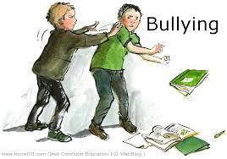
What is bullying?
Using superior strength or influence to intimidate another person, typically to force him or her to do what they want.
Notes:
http://www.dosomething.org/issues/bullying?gclid=CMGPi760gLcCFaU5QgoduAQAjQ

Slide 4


Cyber Bullying
What does it mean to be a "Cyber Bully"?
A person tormenting, threatening, harassing, or embarrassing another person using technology(Internet, cell phone).
Did you know:
Victims are 2 to 9 times more likely to consider committing suicide.
Only 1 in 10 victims will inform a parent or trusted adult of their abuse.
Girls are about twice as likely as boys to be victims and perpetrators of cyber bullying.
Notes:
http://www.dosomething.org/tipsandtools/11-facts-about-cyber-bullying

Slide 5
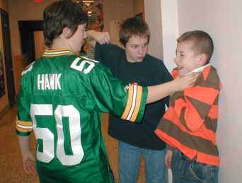
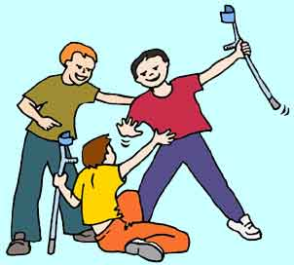
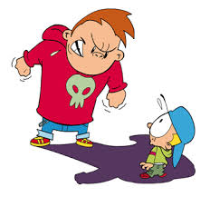
Physical Bullying
Any bullying that hurts someone's body or damages their possessions.
Forms include: stealing, shoving, hitting, fighting, and destroying property are types of physical bullying.
Notes:
http://www.respect2all.org/students/bullying-definitions

Slide 6
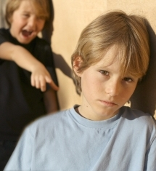

Verbal Bullying
Bullying done through speaking.
Forms include: calling names, spreading rumors, threatening somebody, and making fun of others.
Verbal bullying is one of the most common types of bullying.
Notes:
http://www.respect2all.org/students/bullying-definitions

Slide 7


Covert Bullying
Covert bullying is harder to recognise.
Can be carried out behind the bullied person's back.
Designed to harm someone's social reputation and/or cause humiliation.
Ex:
  lying and spreading rumours
  playing nasty jokes to embarrass and humiliate
  encouraging others to socially exclude someone
  damaging someone's social reputation or social acceptance

Slide 8



What is Abuse?
To hurt or injure through maltreatment; ill-use.
Types include:
  Child Abuse
  Dating/Relationship Abuse
  Physical Abuse
  Mental Abuse
  Verbal Abuse

Slide 9
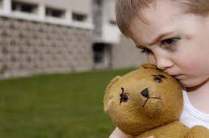

Child Abuse
Occurs when a parent or other adult causes serious physical/emotional harm to a child.
Can leave emotional scars for the rest of the victim's life.
Nearly a million children are abused every year just in the United States alone.
Majority of the kids know their abusers and the abuse occurs in the home.

Slide 10



Dating/Relationship Abuse
Physical, sexual, or psychological/emotional violence within a dating relationship, includes stalking.
Occurs in person or electronically and may occur between a current or former dating partner.
Long-term consequences in teens include: alcoholism, eating disorders, promiscuity, thoughts of suicide, and violent behavior.
Often begins 6th-12th grade. 72% of 13-14 year olds are “dating.”
Notes:
http://www.dosomething.org/tipsandtools/11-facts-about-teen-dating-violence

Slide 11

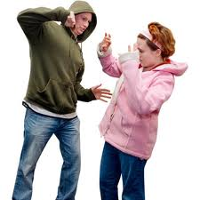

Physical Abuse
Physical Abuse:
  An act of another party involving contact intended to cause feelings of physical pain, injury, or other physical suffering or bodily harm.

Slide 12




Mental Abuse
Mental Abuse:
  Attempting to dominate another person by means of guilt, manipulation, or intimidation.
  A.K.A Emotional and psychological abuse.

Slide 13
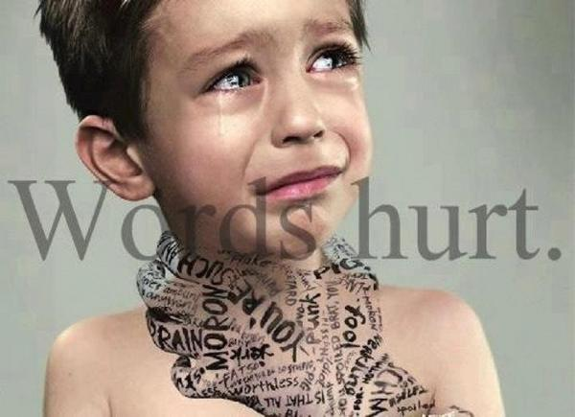
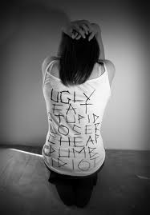

Verbal Abuse
Verbal Abuse:
  Using words to cause harm to the person being spoken to.
  Includes: shouting, insulting, intimidating, threatening, shaming, demeaning, derogatory language, etc.

Slide 14


How To Get Help
Tell a trusted adult(a family member, teacher, neighbor etc.)
Websites You Can Visit For More Information:
  http://www.stayteen.org/frontpanel
  CyberTipline
  800-843-5678
  Twenty-four hours a day, seven days a week
  http://www.cybertipline.com
  National Suicide Prevention Lifeline
  800-273-TALK (8255)
  Twenty-four hours a day, seven days a week
  http://www.suicidepreventionlifeline.org
Notes:
http://www.stayteen.org/frontpanel

