Slide 1
An Introduction to Structured Teaching
Presentation by: Eileen Webster
Autism/Behavioral Consultant
CKCIE- Salina USD305

Slide 2
TEACCH
Treatment and Education of Autistic and Related Communication-Handicapped Children
Notes:
The program began as a research project in the 1970’s by Dr. Eric Schopler, who was joined later by Dr. Gary Mesibov.
The thinking at that time was that autism was the result of poor parenting.
Program of structured teaching was developed as a means of reaching and teaching children with autism.
The research project ended in 1974,but parents of the children in the study wanted the structured teaching services to continue. Dr. Schopler agreed to continue the program if the parents could secure funding for it. They organized a breakfast, invited legislators who were won over by the children who had participated in the study. The TEACCH program continues to receive funding by the State of North Carolina to this day.

Slide 3
Philosophy
The primary aim of TEACCH is to prevent unnecessary institutionalization of persons with autism and to prepare them to live in society
Generalization of life skills
Develop comprehensive, coordinated, life-long, community-based services

Slide 4
Focus
Organically-based problems resulting in autism are not reversible, being normal is not the goal
Program designed around fundamental strengths and deficits of autism that impact learning and social interaction
Respect for the “culture” of autism

Slide 5
Common Causes of Behavior:
Lack of understanding, confusion=frustration
Anxiety
Change in routine
Know what to do but doesn’t know how to do it or apply it
Overwhelmed (do to too much stimuli)
Doesn’t know how to start of finish
Needs more time
Unable to ask for help
Want/need control

Slide 6
Structured Teaching can help Prevent Problem Behaviors
Provides more predictability
Allows them to see what work, how much work, and when work is finished
Routines and schedules provides consistency
Transitions are not unexpected
Extra and unnecessary stimuli are not available to distract or overwhelm
Control can be provided through structured choices
Visual cues/prompts provide communication tools students are missing

Slide 7
Goals of Structured Teaching
Provide meaning/understanding within the environment
Facilitate security and familiarity, leading to feelings of calm and comfort
Help eliminate irrelevant stimuli, focusing attention on relevant information, to make learning possible
Provide a prosthetic device for achieving independence
Teaching, then generalizing appropriate behaviors through the use of visual systems

Slide 8
Who is Structured Teaching for
EVERYONE Can benefit from having structure
Autism/other developmental disabilities
Self-contained
Recourse Classrooms
Gen.Ed. Teachers
In the home
At a job/job training/community
You can even structure things for your paras…..

Slide 9
Elements of Structure

Slide 10
Visual Structure of Tasks
The process of incorporating concrete visual cues into a task or activity.
Work System & Routines
A visual means of receiving and understanding information that allows a child to work independently.
Individual Schedule
A visual/concrete method used to tell a child which activities will make up their day and the order in which they will occur.
Physical Structure
The physical arrangement and organization of materials, furniture, and equipment in the learning environment.

Slide 11
I. Physical Structure

Slide 12
I. Physical Structure
Definition: The physical arrangement and organization of materials, furniture, and equipment within the learning environment
Purpose: To assist in developing independence; minimize visual and auditory distractions; provide clear visual boundaries that indicate where individual areas begin and end; and organize the environment to make it more meaningful

Slide 13
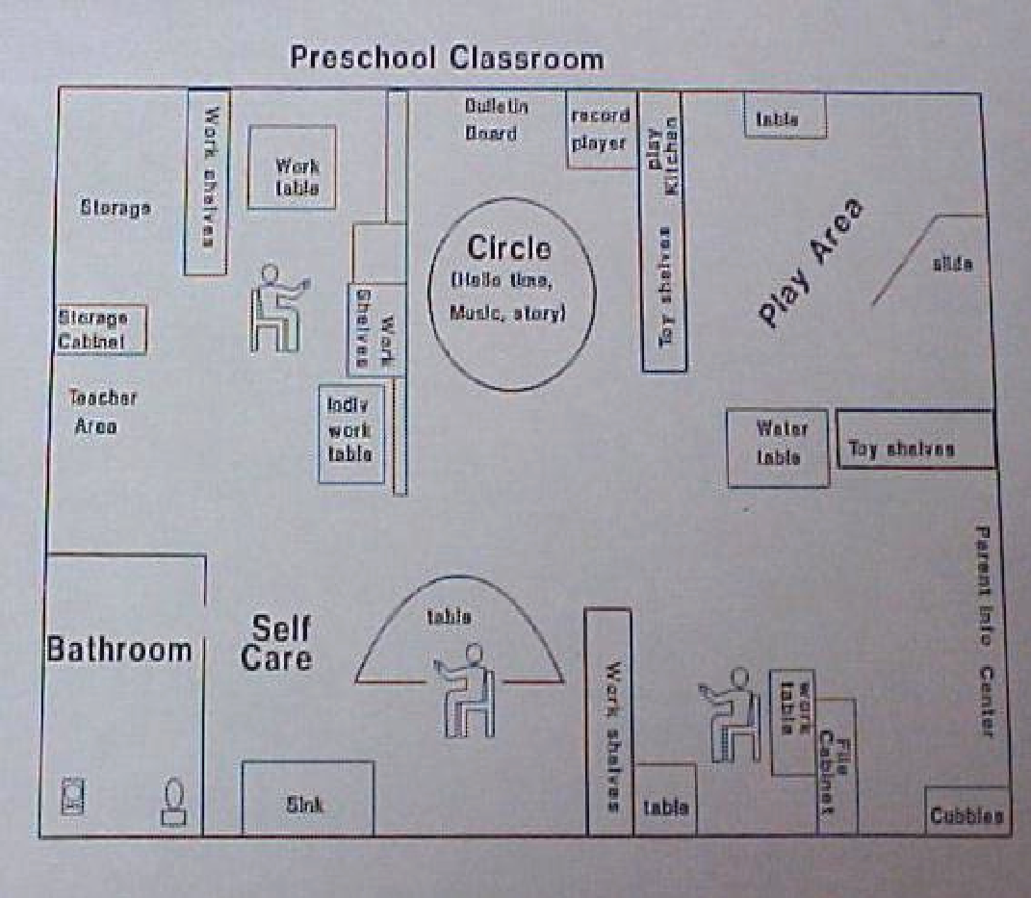

Slide 14
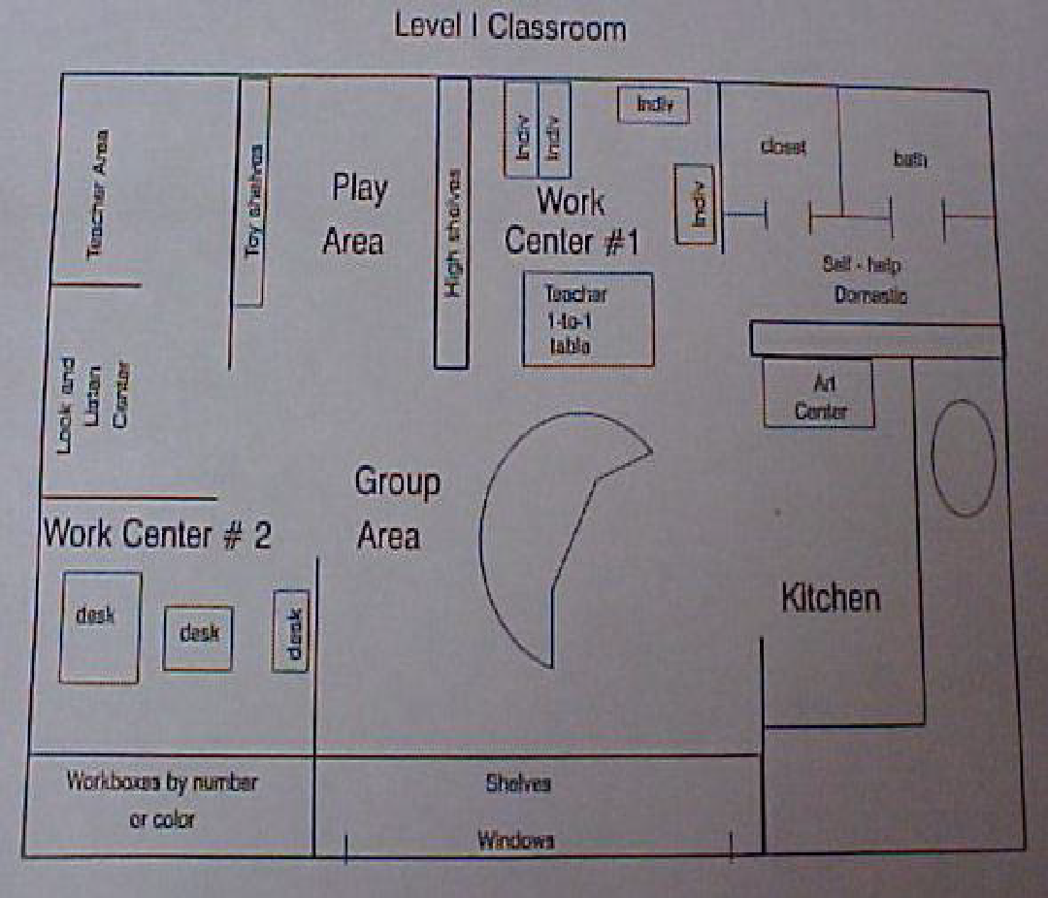

Slide 15
Considerations:
Need for clear meaningful boundaries
Minimizing distractions
Proximity and space
Developing teaching areas
  Group
  Break/play
  Transition
  Direct instruction
  Independent work
  And many more

Slide 16
II. Individual Schedules

Slide 17
II. Individual Schedule
Definition: A visual/concrete method used to tell a child which activities will make up their day and the order in which they will occur
Purpose: To teach flexibility; top to bottom/ left to right progression; to aid in transitions; to provide predictability; to establish a routine; to teach the concepts of first-then and finished; and, to accommodate receptive language deficits

Slide 18
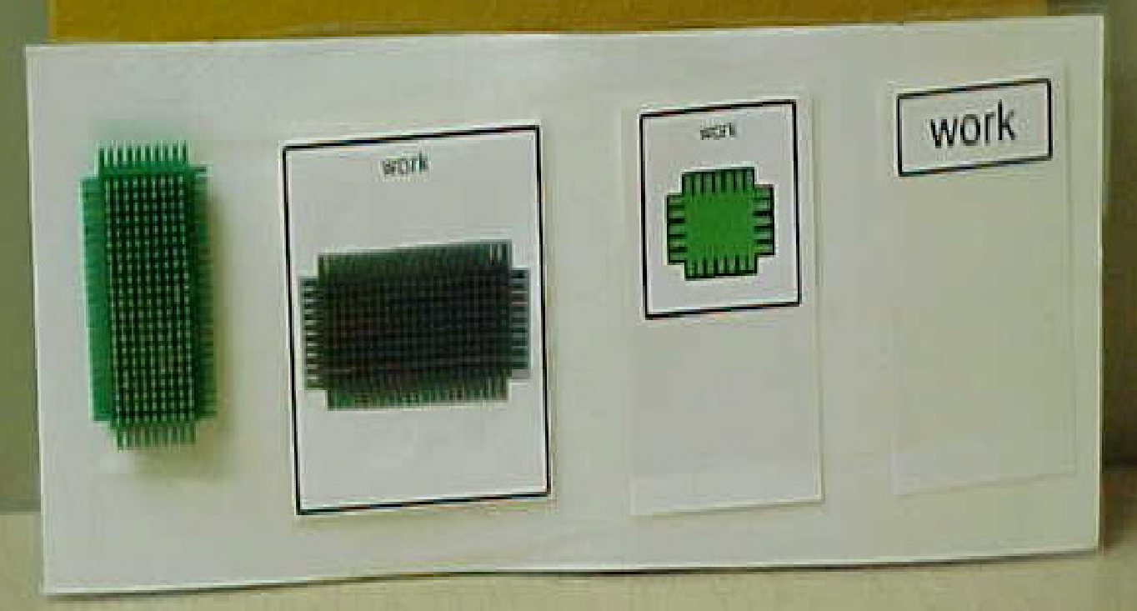
Form of Visual Cue:
-Concrete to Abstract
  Object
    A. Actual Object (Toy Bus- Time for Bus)
    B. Symbolic Objects (Random object to represent each transition)
  2. Photograph
    A. TOBI- True Object Based Icon
    B. Pictures
    C. Part of Product Label
  3. Line drawings
    A. Icons/Symbols
    B. With or w/o text
    C. Color or B/W
  4. Text only cards
  5. Text list/Checklists

Slide 19
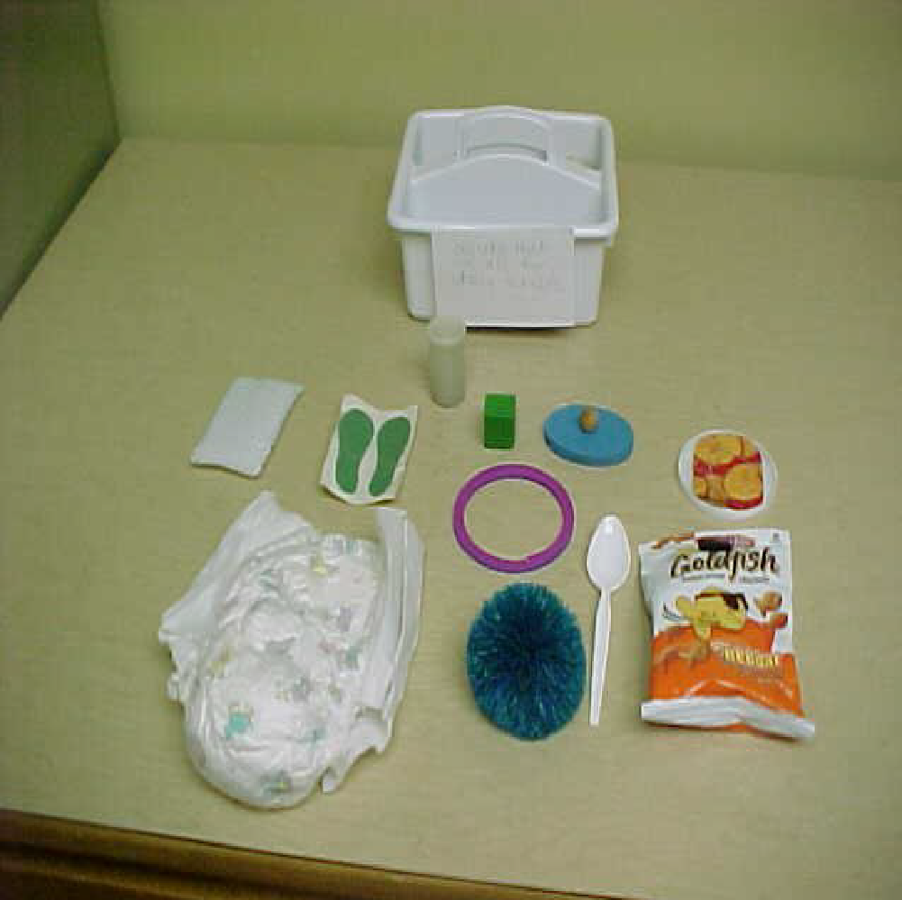
Object= Most Concrete

Slide 20
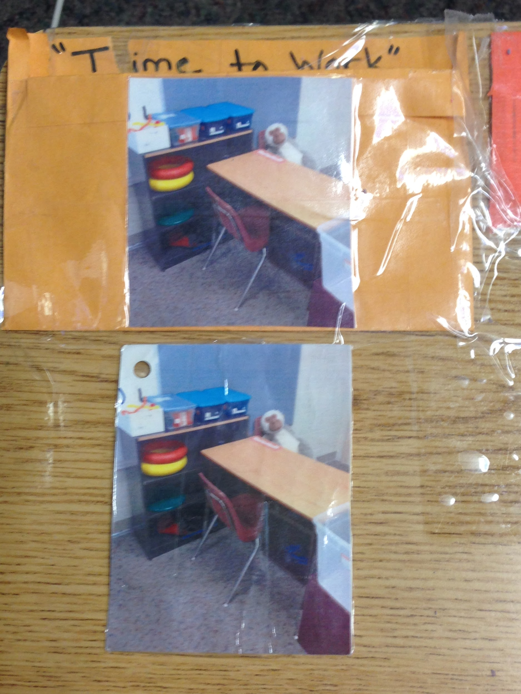
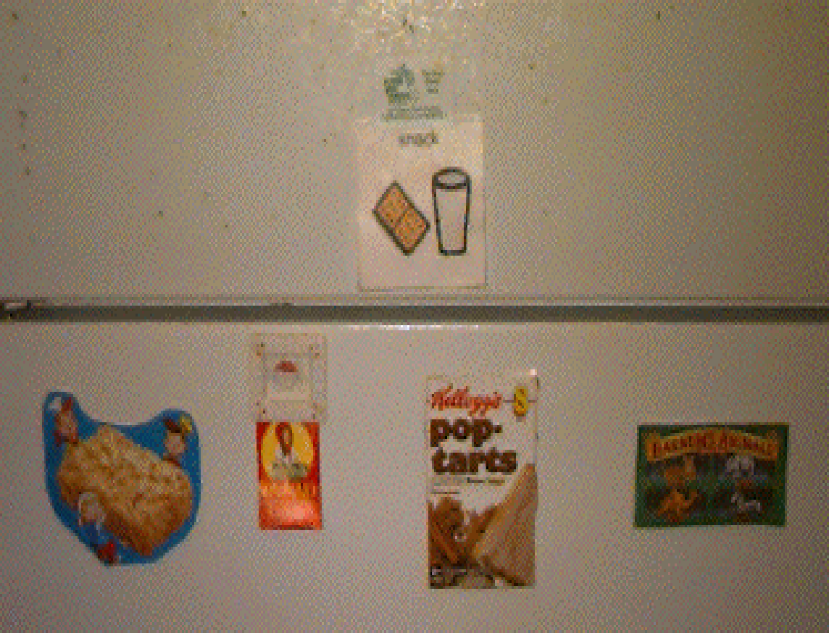
Photograph
Part of Product Label

Slide 21
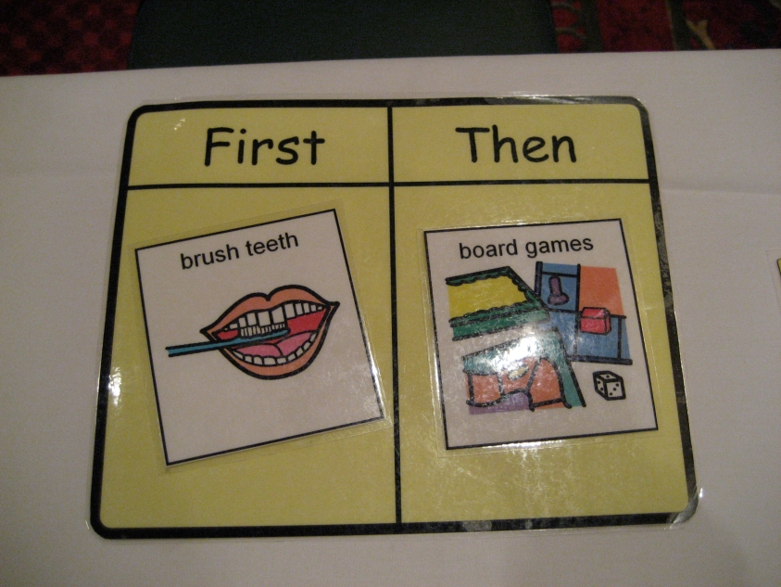
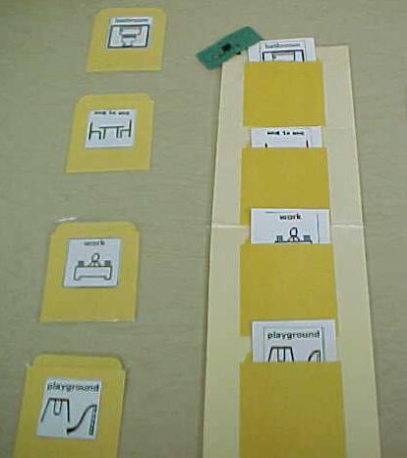
Line Drawings
Can use Boardmaker, ClipArt, SymbolStix, etc…
Notes:
Line color with words, without words, black and white with words or without words

Slide 22
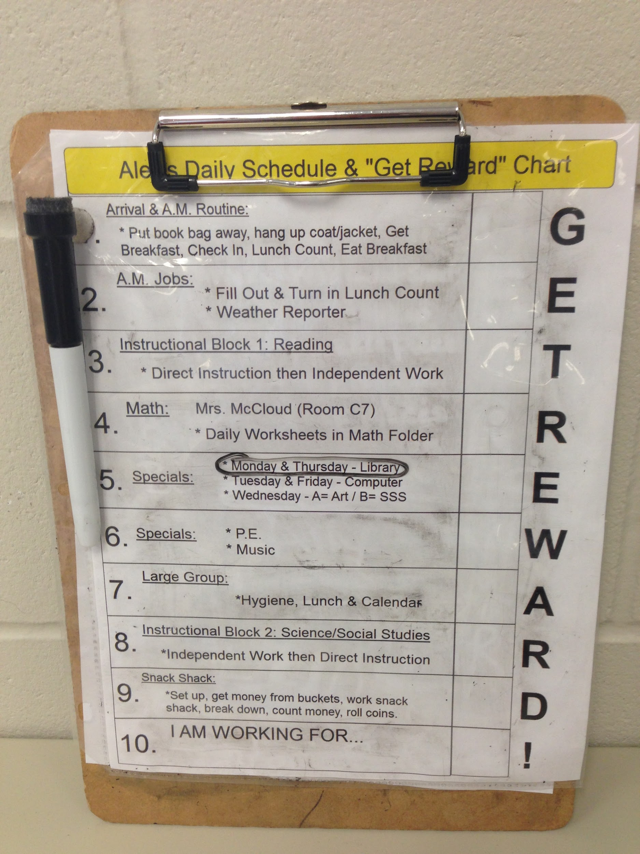
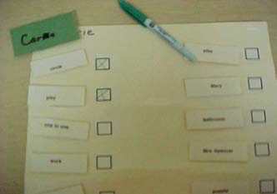
Text/Checklists= Most Abstract
Notes:
One work, two-three works, List with instructions or sub-lists

Slide 23
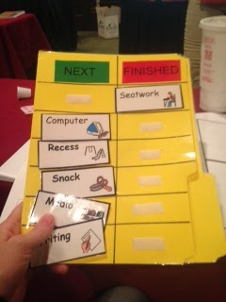
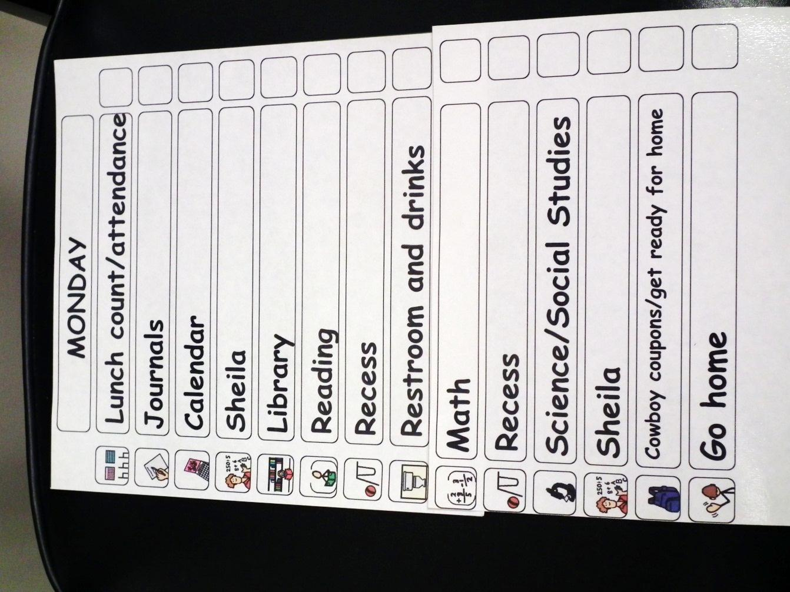
Combinations
Notes:
Also could include pictures with works/labels and icons with words

Slide 24
Length of Schedule:
One item at a time, signifying transition
Two items in a first-then
Three to four items up to an hour
Two hours
Part day
Full day
Notes:
Varies depending on individual students’ needs. Do they need one at a time so they are not overwhelmed. Will specific things in schedule make them distracted on all other transitions. First then schedules typically “Grandma’s Law”- Premack principal where you first work and then something more rewarding or enjoyable (high probability). A few at a time, part of the day or whole day.

Slide 25
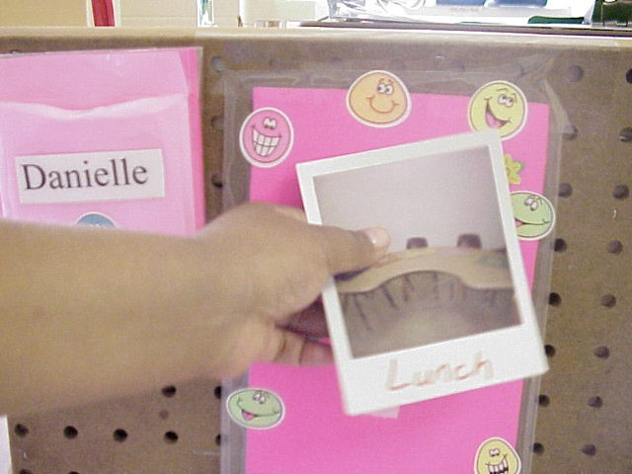
One at a Time
Either can be handed directly to the student to cue transition to next location or designated area schedule only displays one visual on schedule at a time.

Slide 26
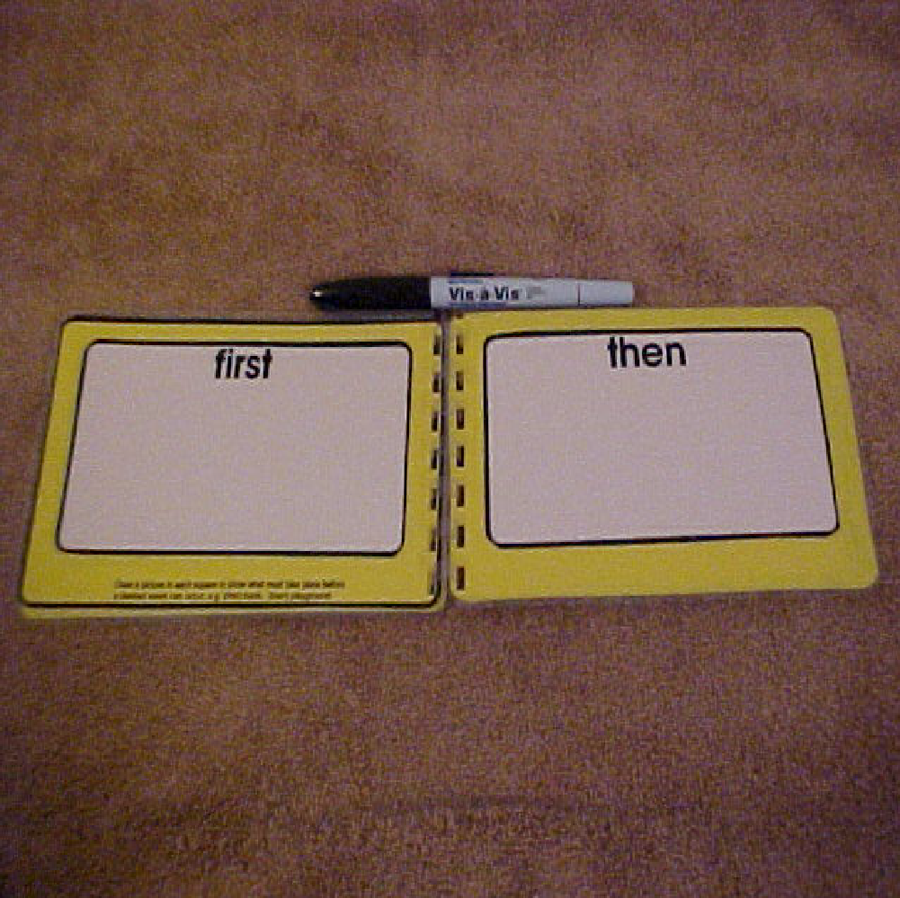
First/Then
Notes:
Premack Principal- Grandma’s Law First a low probability activity (work) then a high probability activity (break/reinforcer)

Slide 27
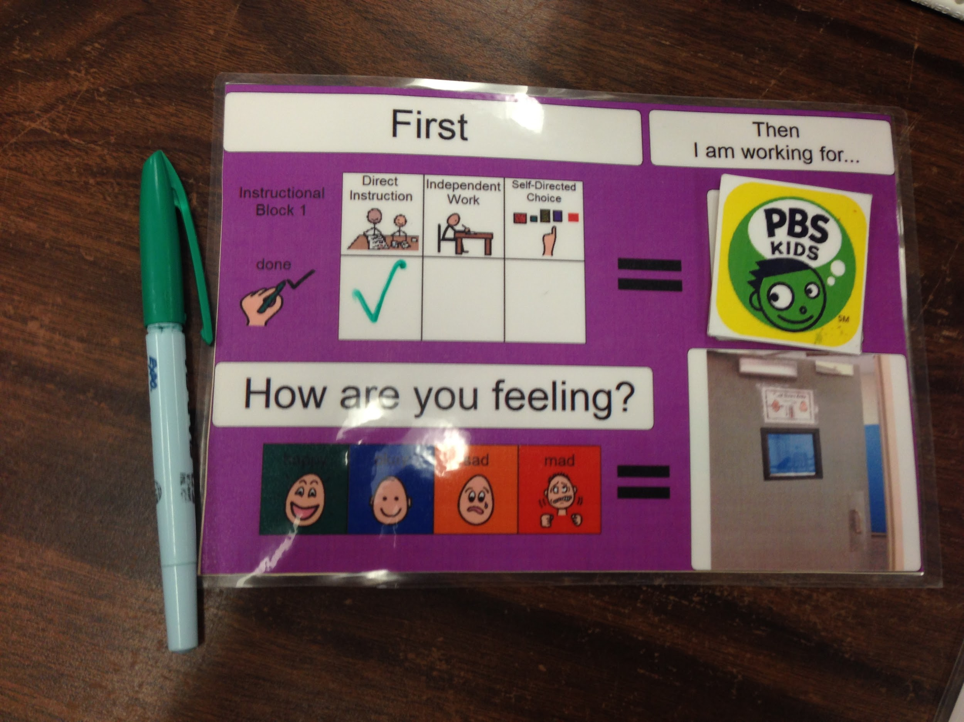
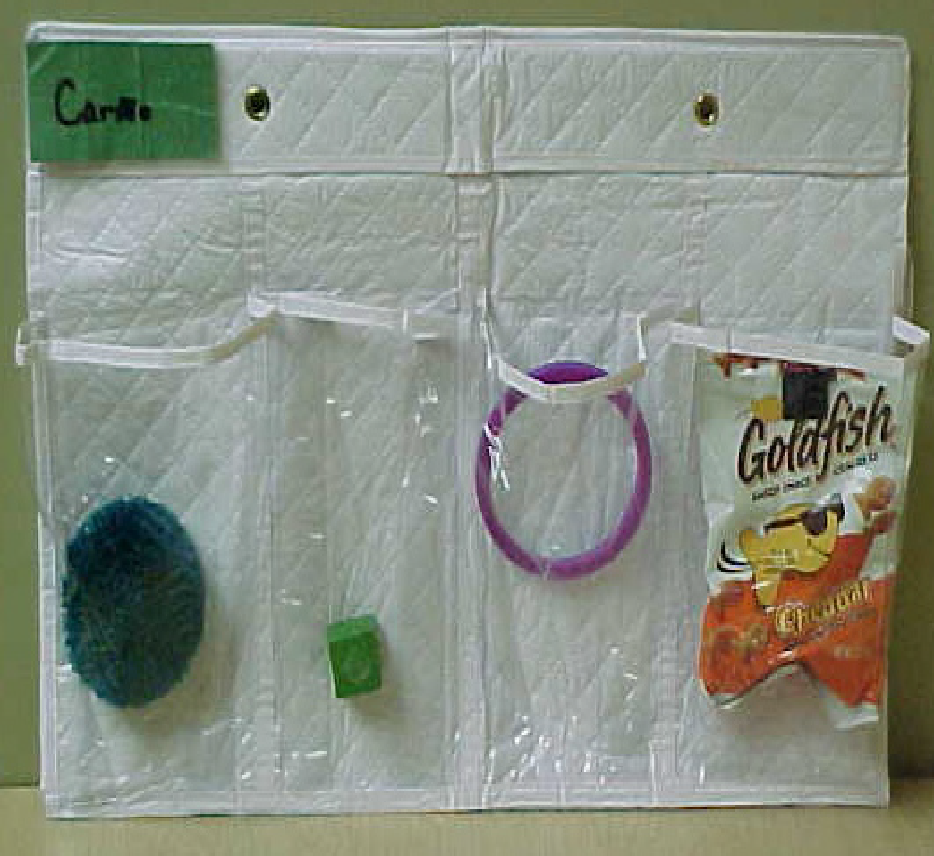
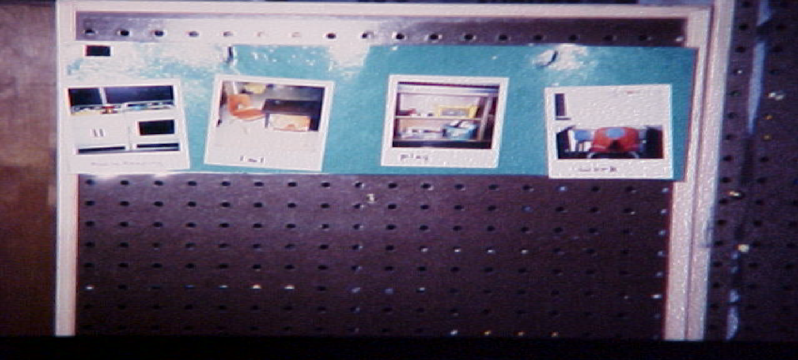
Part of Day- 3 to 4 Transitions

Slide 28
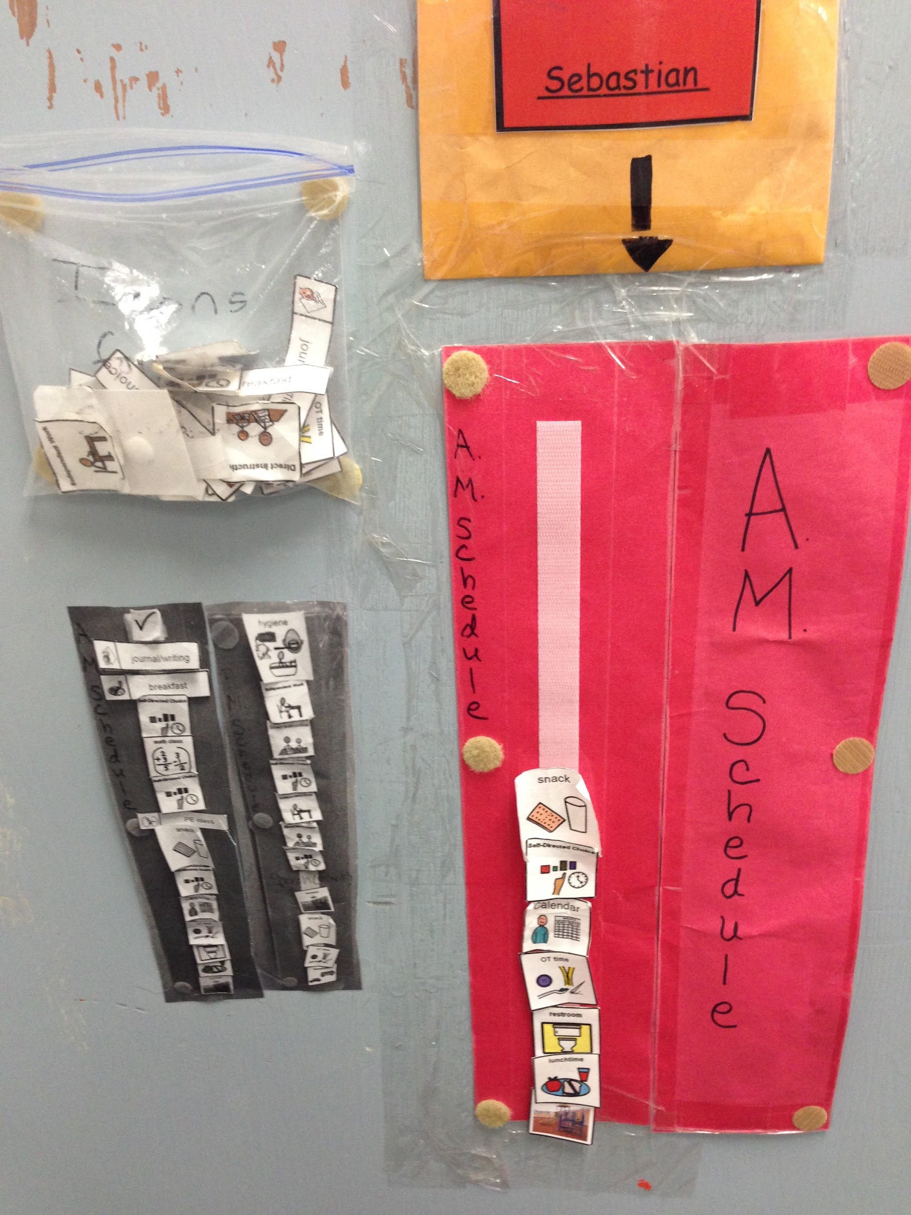
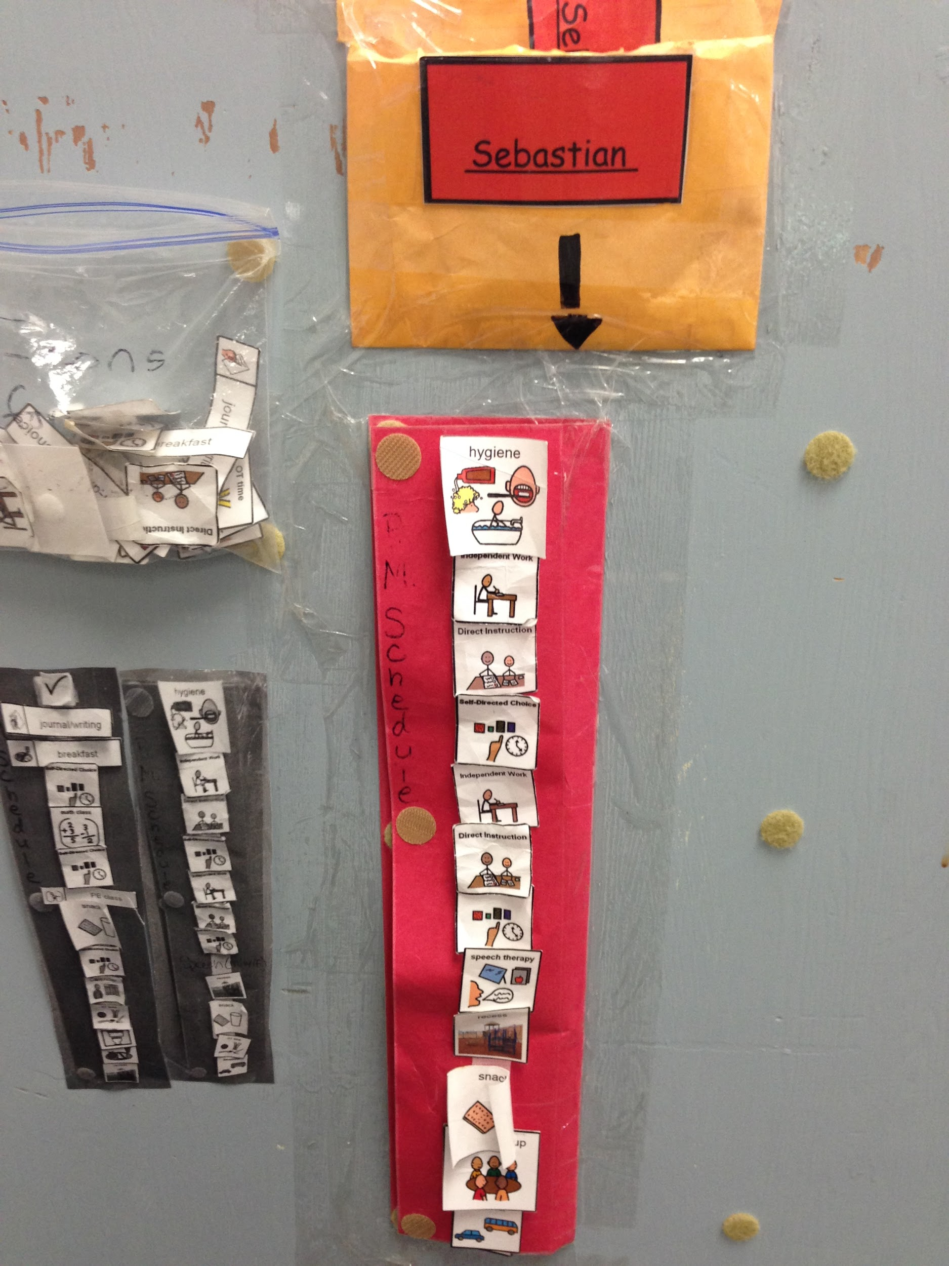
Half Day
AM
PM

Slide 29
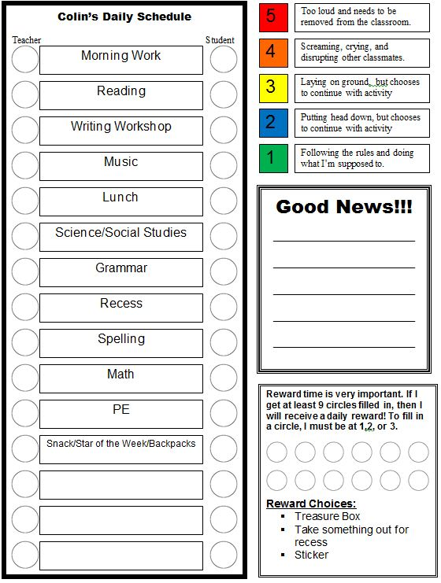
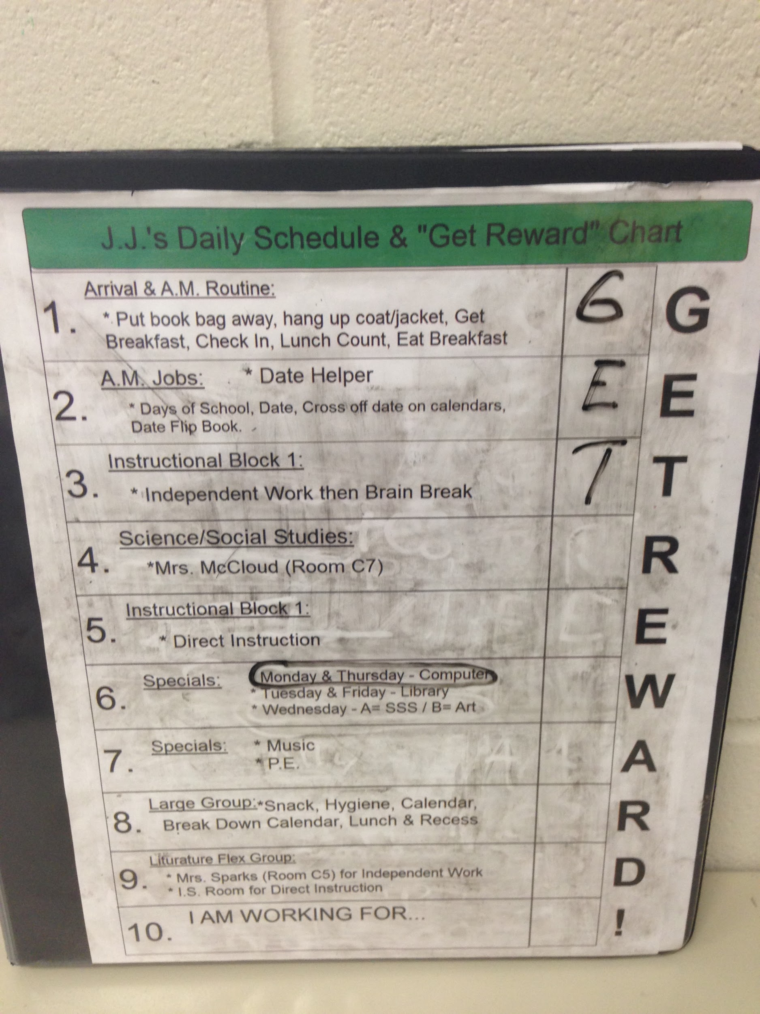
Full Day

Slide 30
Presentation Format:
One item at a time
Left to right sequence
Top to bottom sequence
Multiple rows

Slide 31
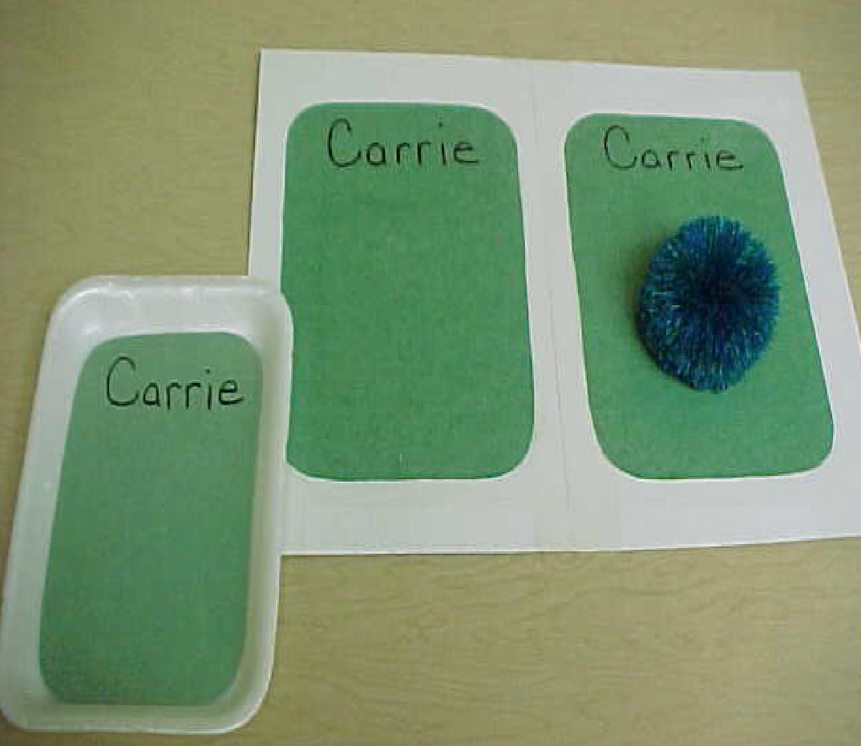
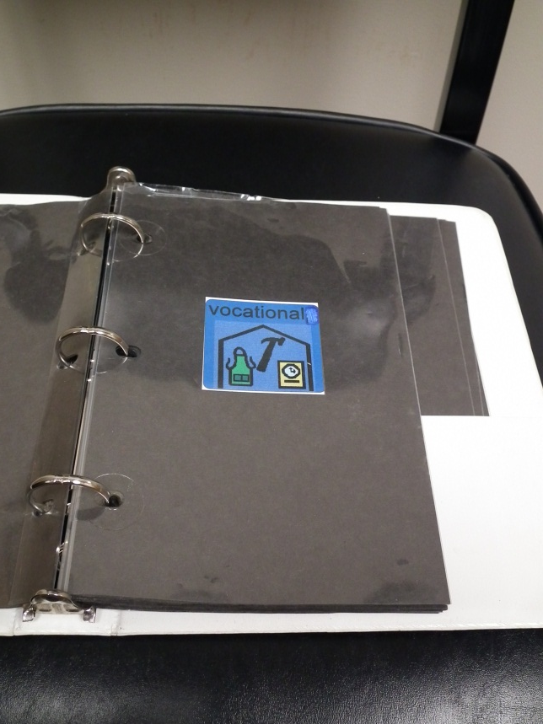
One at a time

Slide 32
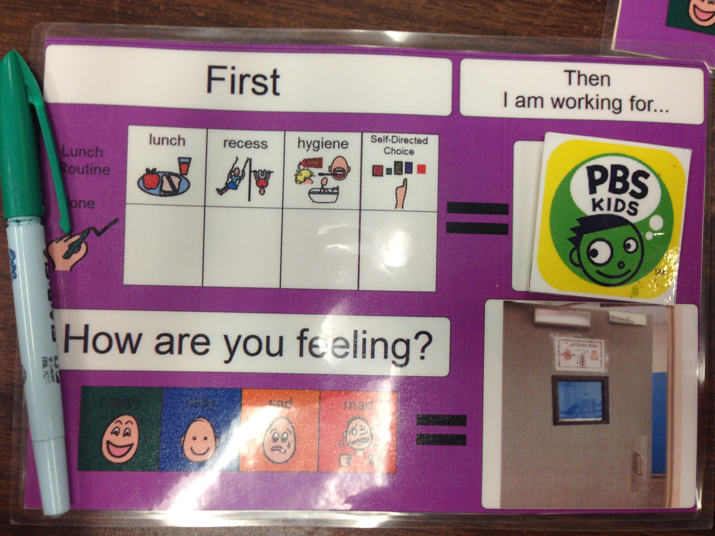

Left to Right

Slide 33
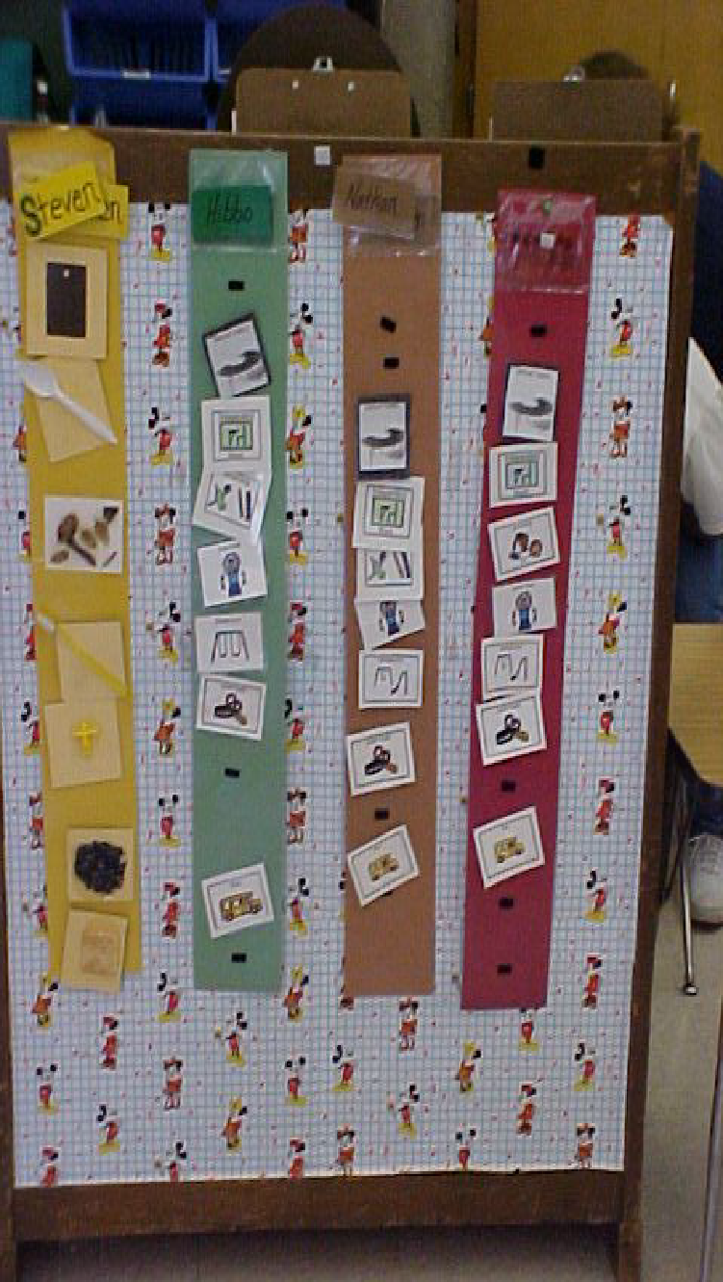
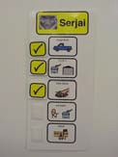
Top to Bottom

Slide 34
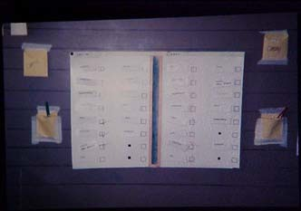
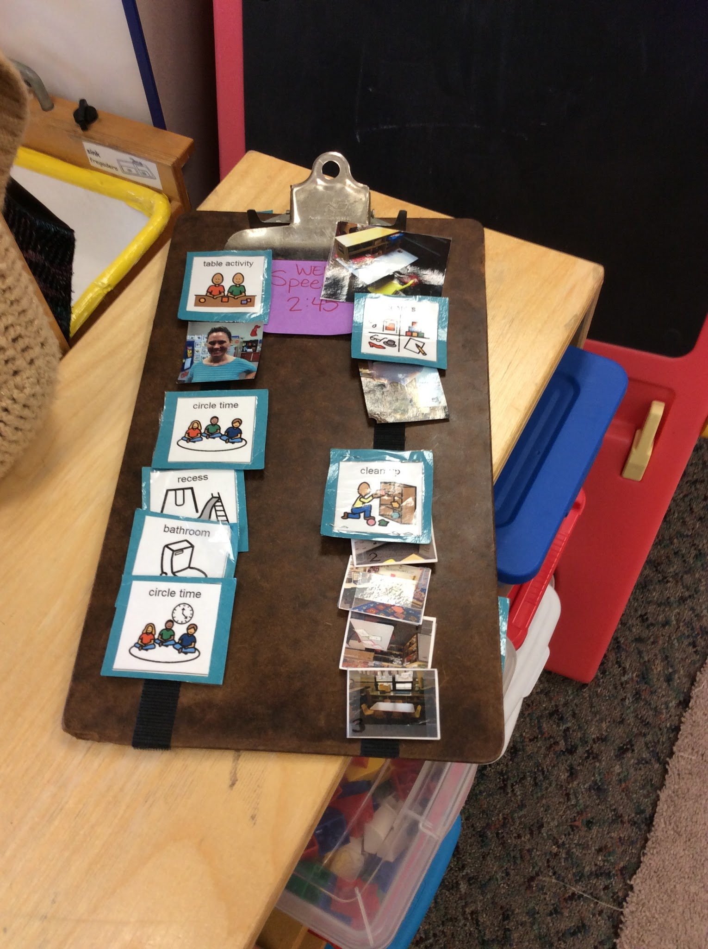
Multiple Rows

Slide 35
Manipulation of Schedule:
Carry object to use in activity
Carry visual cue to matching cue at intended destination
Turn over cue on schedule as completed
Mark off visual cue on schedule as completed

Slide 36
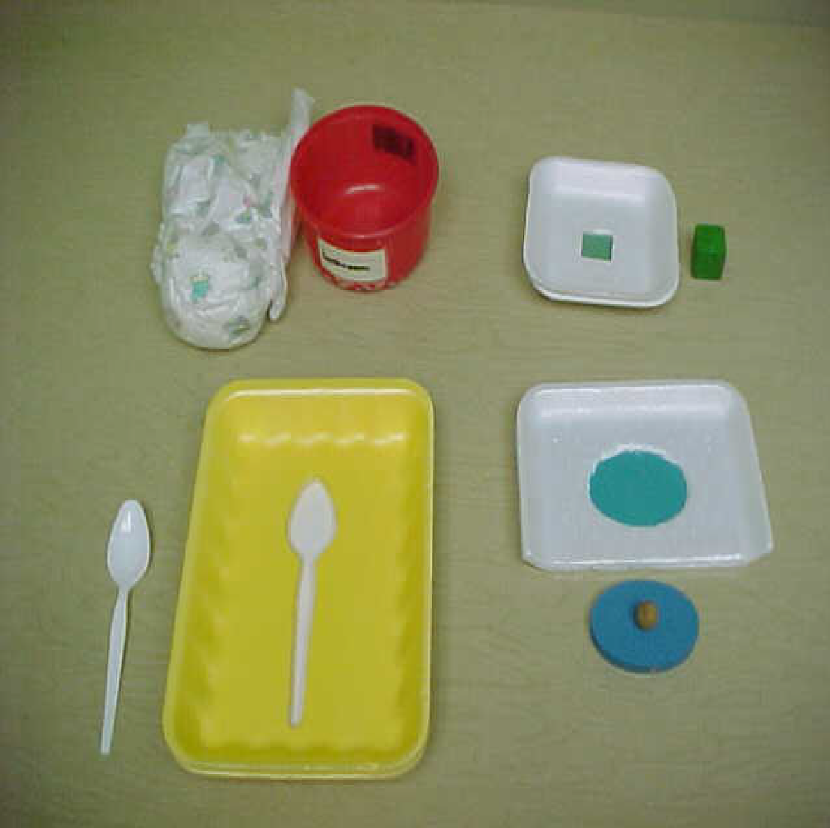
Carry Object to Activity

Slide 37
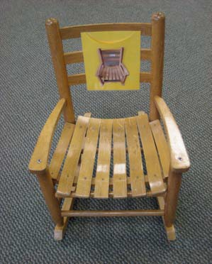
Carry Cue to Matching Cue

Slide 38
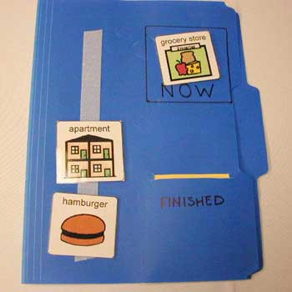
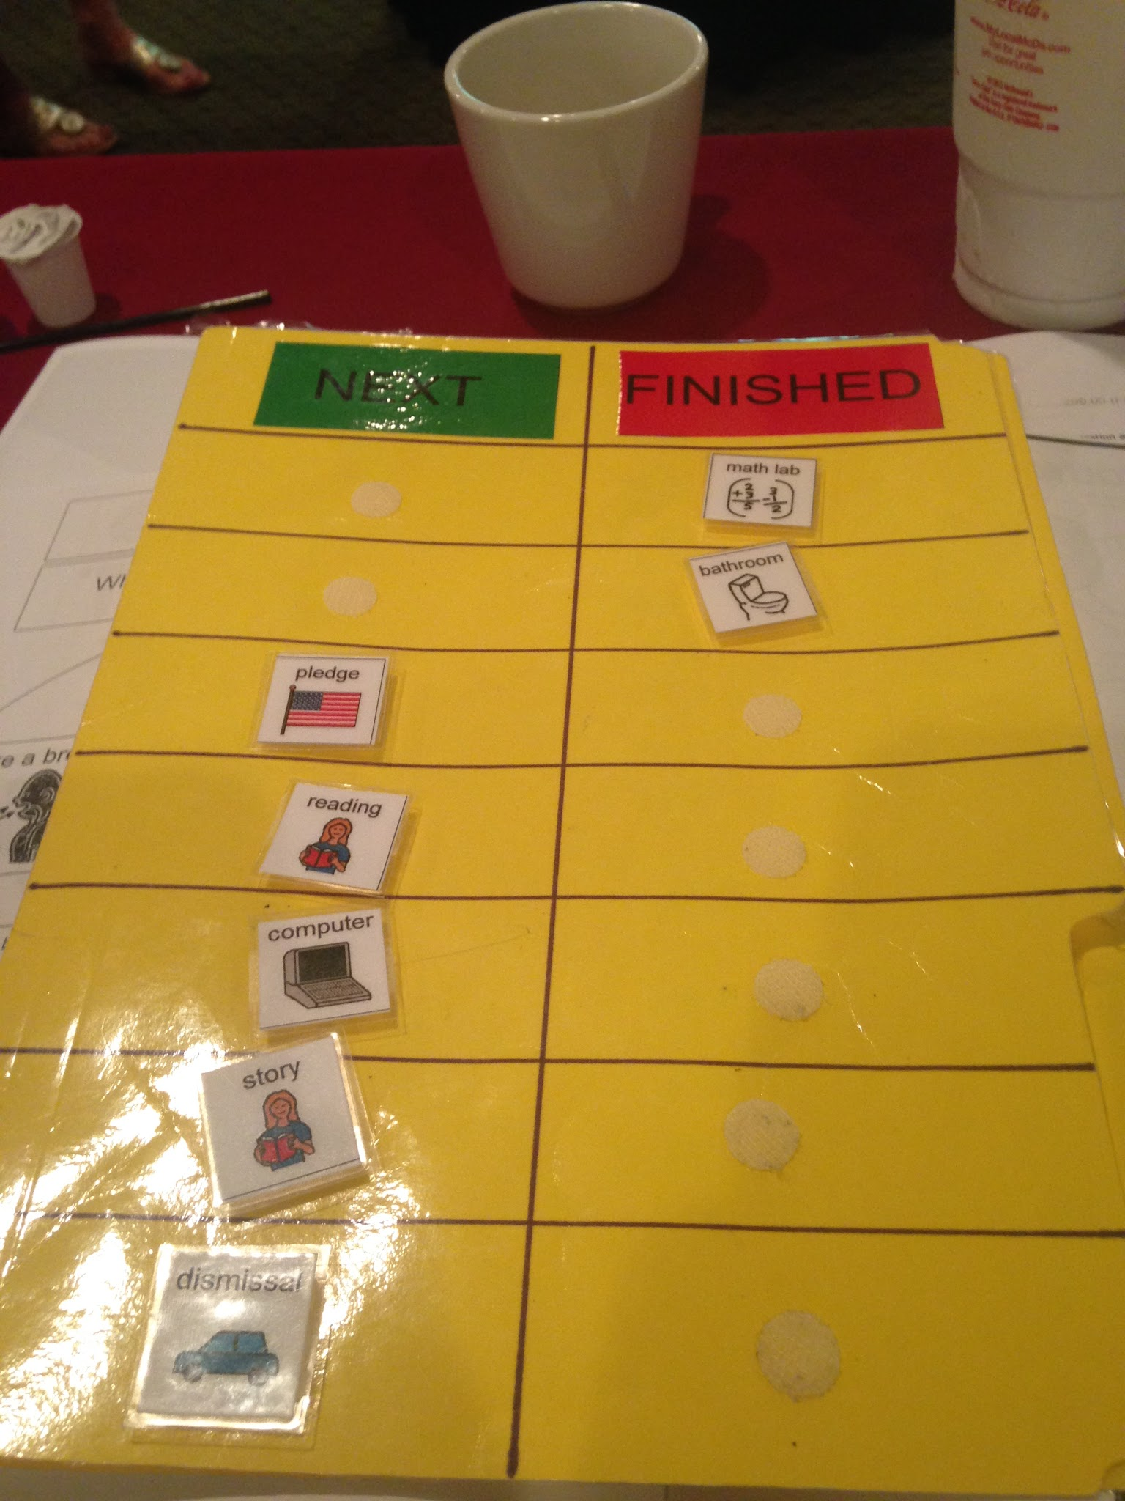
Turn over Cue to Finished

Slide 39
Mark as Finished

Slide 40
Location of Schedule:
Schedule brought to the student by an adult
Stationary schedule in central, neutral location
Stationary schedule in individual location
Portable schedule
Combined schedule and work system

Slide 41
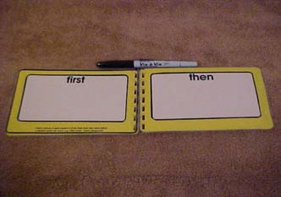
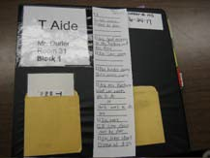
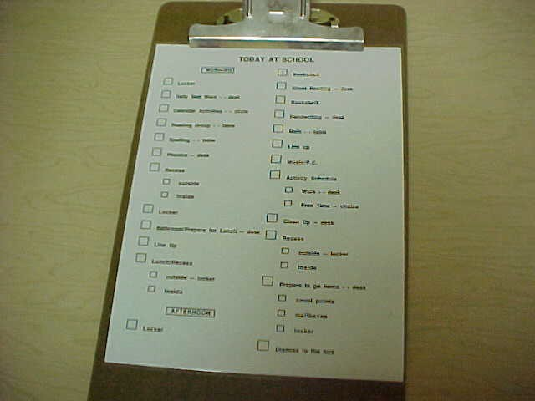
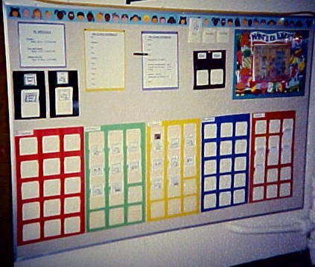

Slide 42
Initiation of use of Schedule:
Teacher takes transition cue to the student
Student goes to schedule with visual transition symbol
Student travels to schedule following verbal cue
Student spontaneously checks schedule

Slide 43
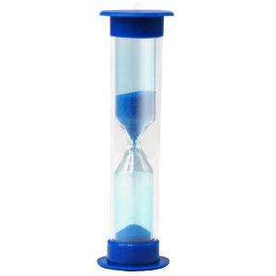
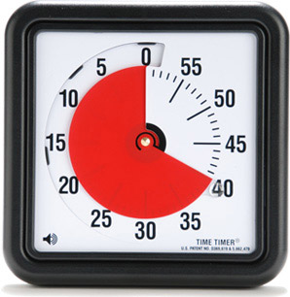

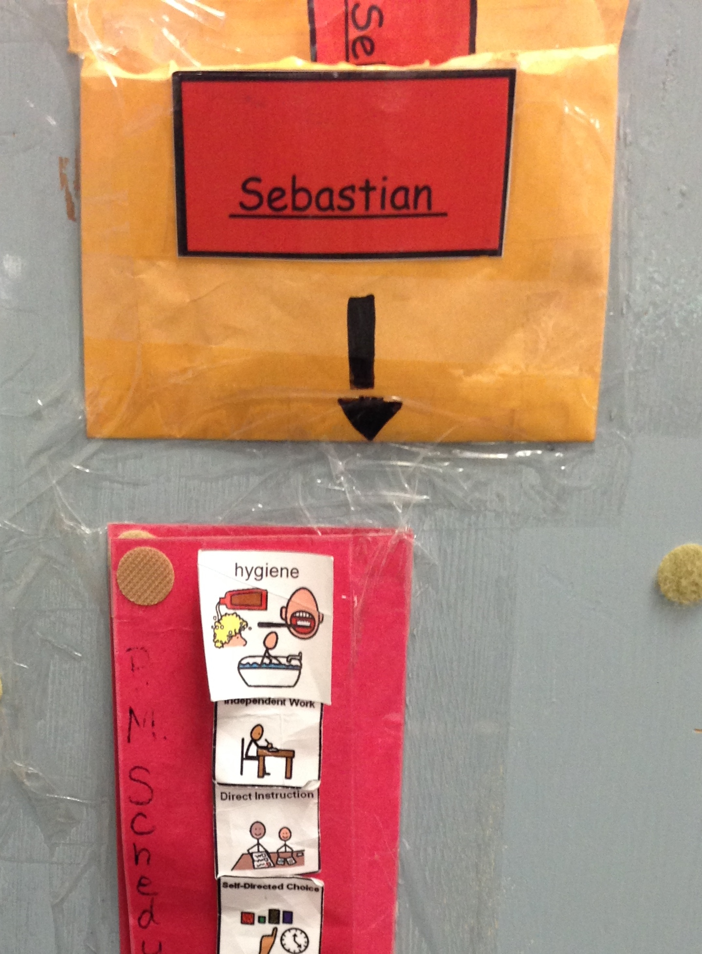
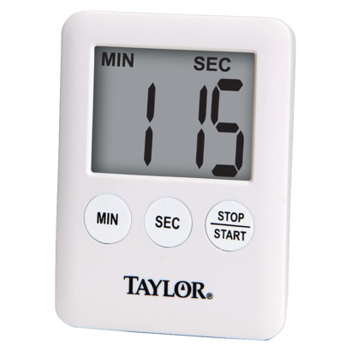
Notes:
Or by simply saying “what’s next”, “Check Your Schedule”

Slide 44
Concept of Finished:
A clear sense of closure or finished must be provided for all transitions
A receptacle or jig is used for the object level
A pocket or identical photograph/icon is provided for matching levels
A means of crossing out, or checking off items is used at the list level

Slide 45
Considerations:
Level of functioning
Flexibility
Mobility
Transition area
Routine for checking the schedule
Student’s interest
Visual cue for schedule
If you are struggling to determine what type of schedule your students needs and what components of the schedule will work- Mode Assessment will help you determine best fit
  If you would like for us to come help with Mode Assessments just reach out to Eileen.webster@usd305.com

Slide 46
III. Work Systems
Definition: A systematic means of presenting information in a way that is received and understood by the child. Following the system allows the child to work independently.
Purpose: To visually answer four key questions:
    How much work?
    What work?
    When is the task finished?
    What comes next?
Notes:
A work system refers to the systematic way in which a child receives and understands information.
By following a work system, a child is able to work independently. The purpose of the system is to answer four key questions for the child:
How much work?
What work?
When is the task finished?
What comes next?

Slide 47
Design:
Left to Right – Finished box
  Lowest level
Matching
  Color, shape, letters, numbers, words
Written
Meaningful to the student

Slide 48
Sequence:
All tasks at the left, complete in any order
Complete tasks in order (left to right, top to bottom)
Completes tasks in order using a matching system (left to right, top to bottom)
Completes tasks in order following a written list

Slide 49
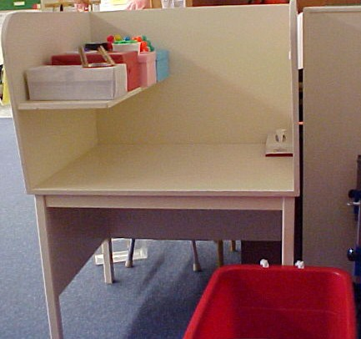
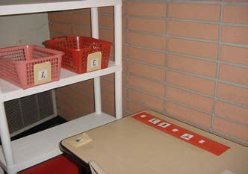
Tasks waiting on Left

Slide 50
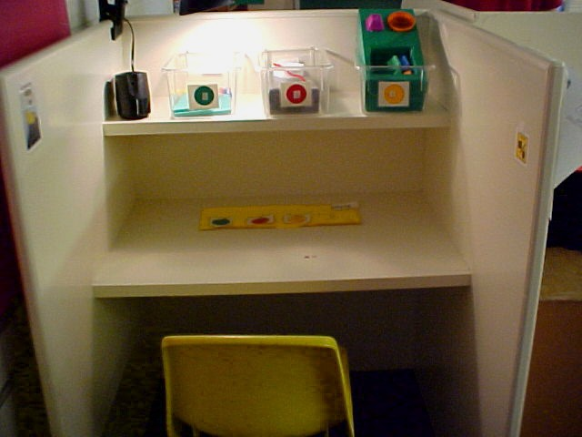
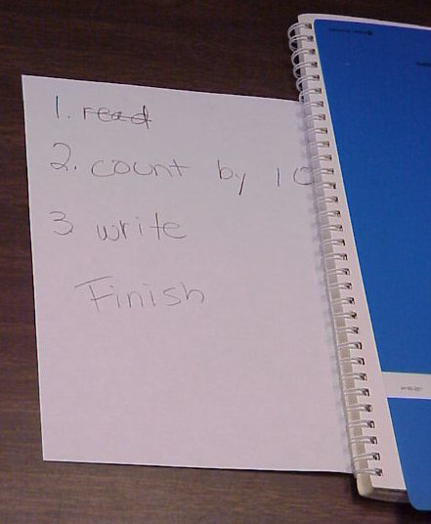
Tasks waiting at top &
Written List

Slide 51
Concept of Finished:
Materials disappear into a container on the right
Materials placed on a table or shelf on the right
All visual symbols are gone from work system and matched to assigned tasks
All visual symbols are turned over as tasks are completed
All items on list are marked off as tasks are completed

Slide 52
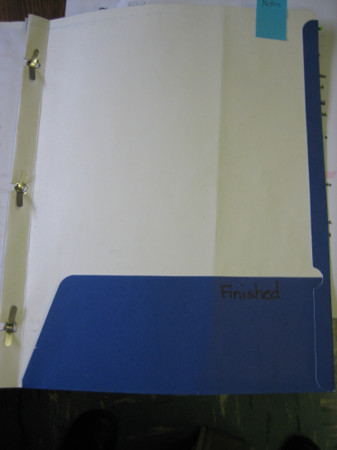
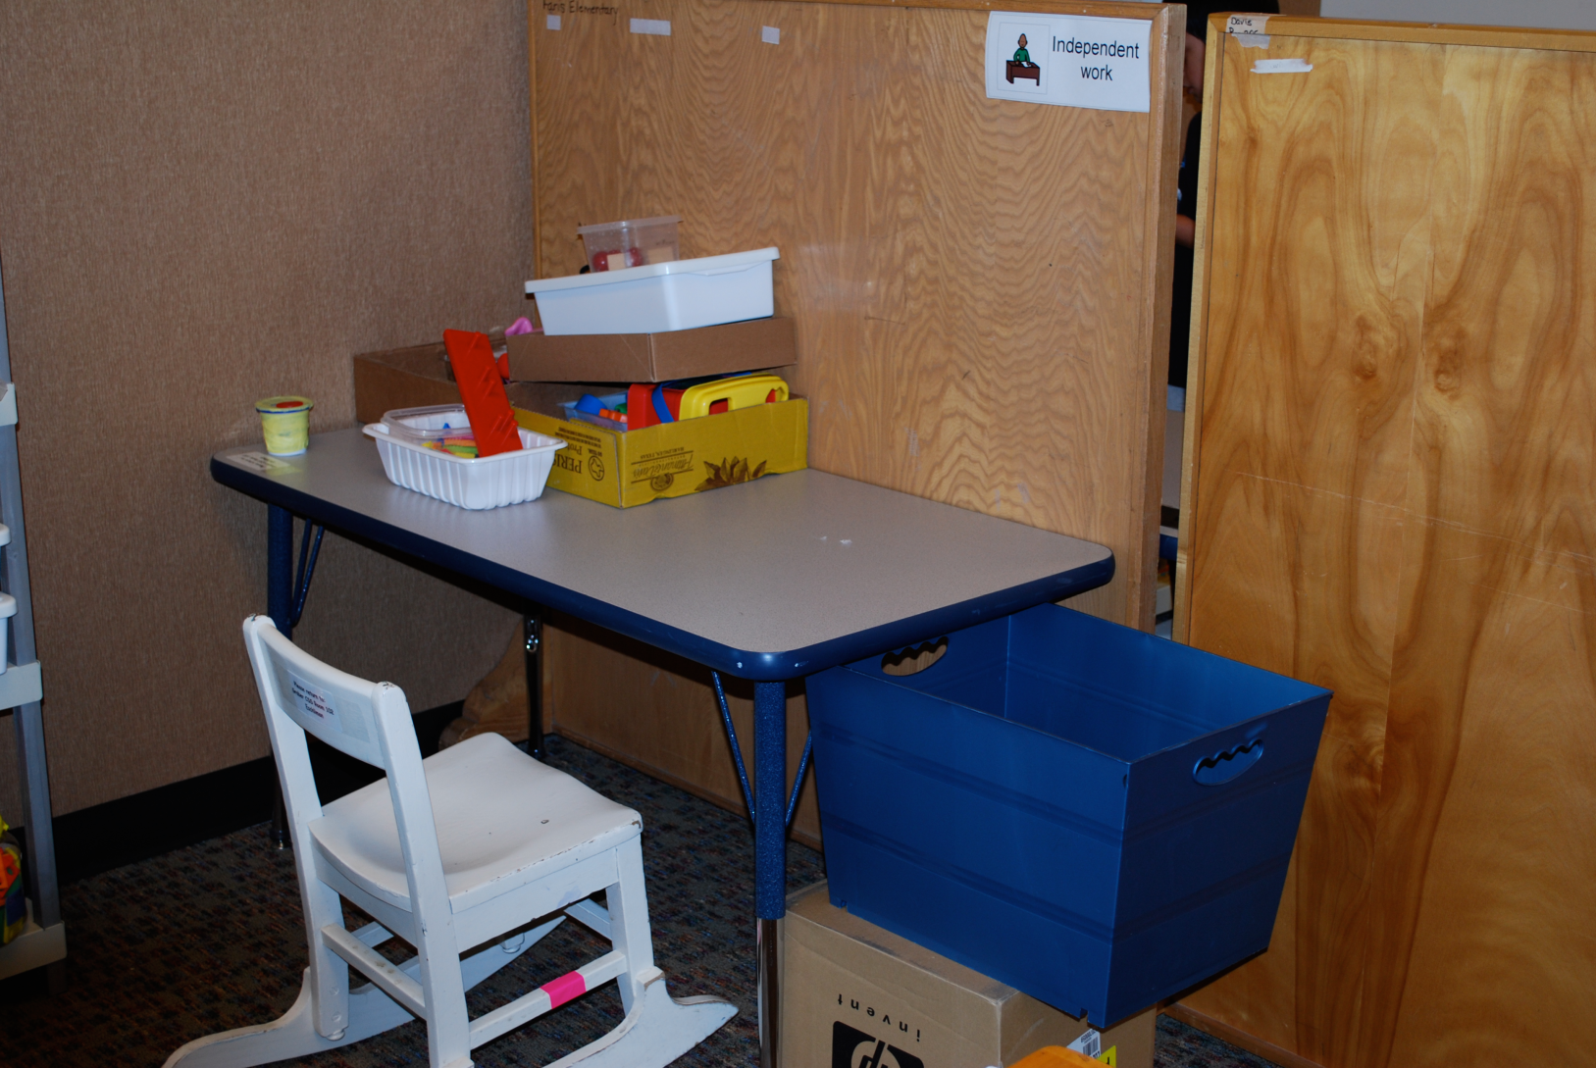
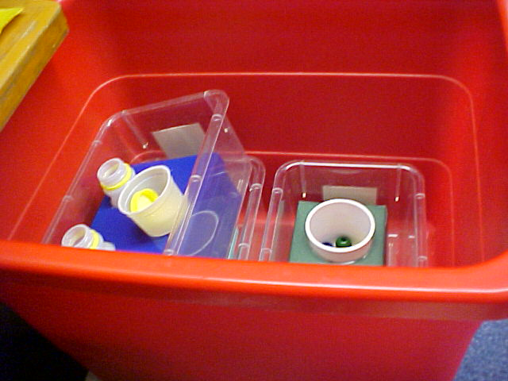
Finished Work

Slide 53
Length of Work System:
One task assigned in time allotted
Two or more tasks assigned in time allotted
Time allotted
Use of visual strips to show how much work

Slide 54
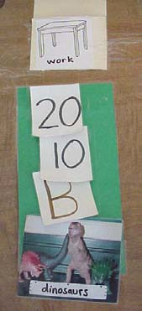

Matching Strips

Slide 55
Mobility:
No movement needed to get or return tasks
Stretch to reach task but not leave seat
Student leaves seat to get or return task, but only one or two steps
Student moves a short distance to get or return tasks
Student moves across the room to get or return tasks

Slide 56
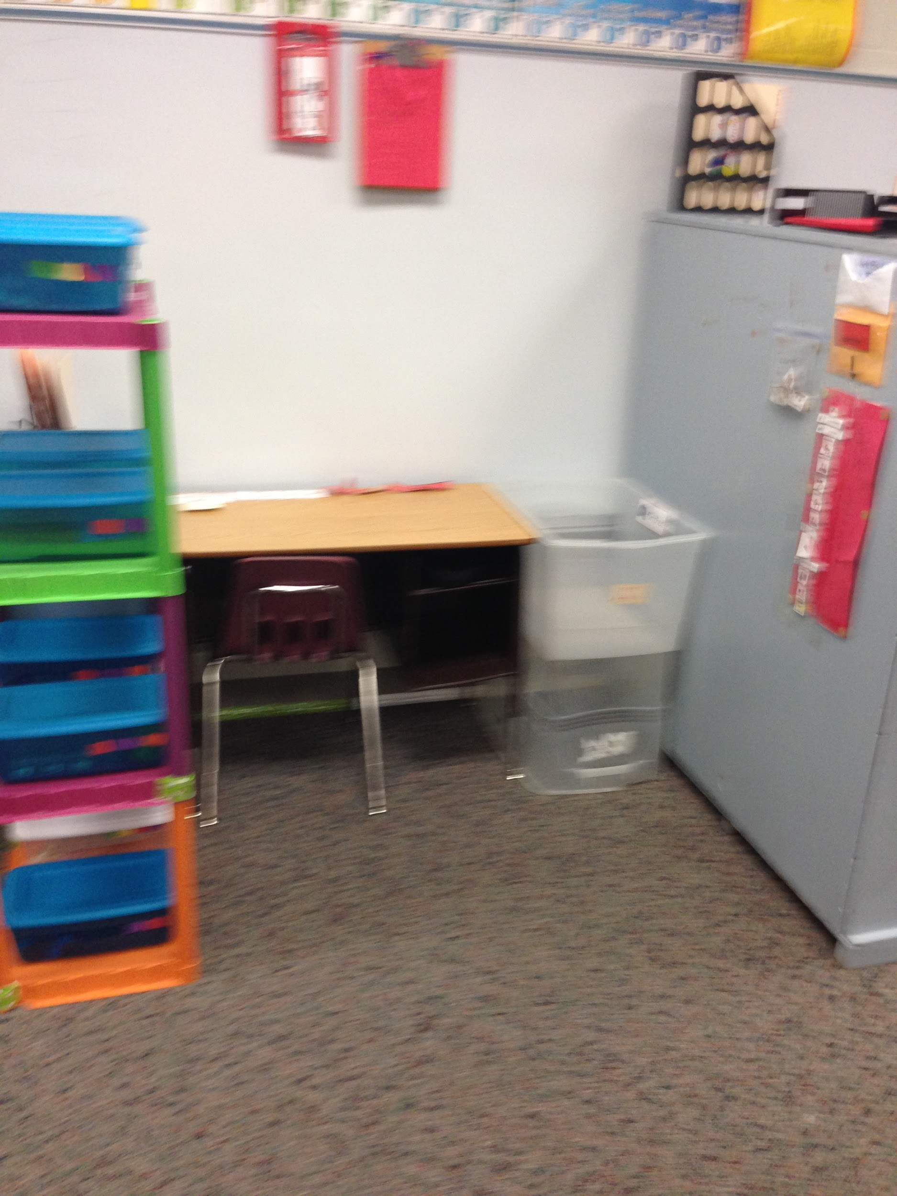
Putting it all together
Work Tasks on Left of desk going top to bottom.
Individual Visual Schedule in area students independent work station is
Desk provides Work System strip with number to match to work boxes on left. When all boxes are complete a check schedule name card is ready to take
Finished Box to the right of desk

Slide 57
Process:
Initial focus may be teaching in-seat behavior
Teach the child how to use the work system in a one-to-one setting
Move system into an independent work station
Generalize the system to other settings:
  home
  regular classroom
  leisure
Notes:
Keep in mind that one-to-one teaching and independent work are different
Errorless learning at independent work system

Slide 58
Why Use a Work System?
Experience shows that productivity increases when a person has a way of knowing how much work they have to do and when they are finished.
A work system clarifies the concept of finished and the teacher’s expectations.

Slide 59
Considerations:
Tasks that have been presented and mastered in one to one teaching sessions become part of a child’s work system.
The work system is not a choice board. The child must follow the system to arrive at the choice option.
The work system and daily schedule are separate components of structured teaching.

Slide 60
IV. Visual Structure
Definition: The process of incorporating concrete visual cues into a task or activity.
Purpose: To capitalize on visual strengths, while minimizing reliance on weaker auditory processing skills.
Notes:
Visual structure refers to the use of visual cues that provide the organization, clarification, and instruction necessary for completing tasks independently.
Purpose for including visual structure is to capitalize on visual strengths, while minimizing reliance on weaker auditory processing skills.
Organizing the environment with visual supports can create an orderliness in the environment that gives a child a sense of stability, provides predictability, helps a child function more independently, and enables a child to become more responsible for their own performance and belongings.

Slide 61
Three Key Elements
Visual instructions
Visual organization
Visual clarity

Slide 62
A. Visual Instructions
Show how to combine and organize a series of parts to obtain the desired outcome
Provide the necessary information to put parts or details of a task together in a systematic and meaningful way
Promote the use of the child’s strong visual skills in a functional way

Slide 63
Levels
Materials define the task
Jigs: show the layout of materials in the correct sequence to complete the task
  Cut out
    Inset puzzle
  Picture
    Life-size pictures, drawings, outlines
    Referral jig - smaller, representational pictures of components
    Repetitive jig – same jig used over and over
    Variable jig – different jigs for same materials, variety of combinations
    Picture list – shows correct sequence to complete task

Slide 64
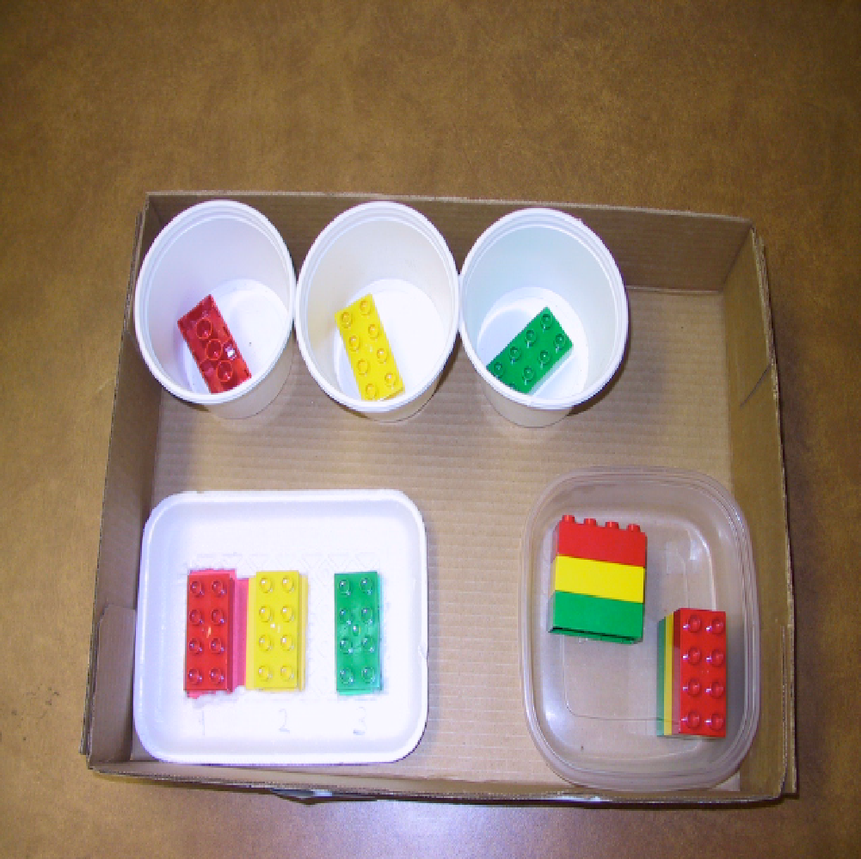

Jigs

Slide 65

Picture Lists

Slide 66
Levels (cont.)
Picture dictionary: reference list of pictures paired with the written word
Written instructions: single words or multiple word sequences to tell the child what to do
Product sample: a previously prepared example of the finished product

Slide 67


Can Crushing Written Steps

Slide 68
B. Visual Organization
Modulates sensory input by organizing materials and space within the work environment
  Placement of distinct materials into separate containers helps reduce distractions
  Limiting the work area space helps direct focus to relevant details

Slide 69




Notes:
Blocks are scattered- student could be overwhelmed with this and be unsure what to do with the blocks and just stem with them or swipe them.
The box provides a location/boundary that block should remain in until they are manipulated
The X marks where the blocks should go.
The finial picture provides a limited number of blocks to allow less frustration by eliminating distration

Slide 70
C. Visual Clarity
Further clarification of relevant information and key materials
Emphasizes significant parts of visual instructions
Shifts child’s focus to relevant details:
  Colors
  Pictures
  Numbers
  Words
  Removal of unnecessary or extra materials

Slide 71

Visual Clarity on Using Calculator

Slide 72
Mobile Behavior Systems

Slide 73
Graphic Organizers
Concept mapping
Outlining
Webs
Planning
Creative thinking
Diagrams

Slide 74
What They Do
Concept maps illustrate ideas and relationships.
Outlines visually organize thoughts for clearer writing.
Webs categorize information and reveal relationships.
Visual planning helps focus efforts and clarify ideas.
Makes creative thinking process more concrete.
Diagrams illustrate concepts and processes.

Slide 75
Story Web
Cinderella
Cinderella
Cottage
Setting
Characters
Stepmother
Castle
Problem or Conflict
Stepsisters
Cinderella is mistreated by her family
Prince
Events
Cinderella is not allowed to go to ball
Fairy Godmother visits
Cinderella goes to ball, loses shoe
Resolution
Prince finds Cinderella by fitting her shoe
Cinderella marries prince, leaves cruel family

Slide 76
Character Web
Cinderella
Old
Orphan
Cinderella
Stepmother
Cruel
Kind
Prince
Stepsisters
Ugly
Jealous
Rich
Handsome

Slide 77
Advantages of Using Structure
Utilizes visual strengths
Organizes environment to make it orderly and predictable
Incorporates routines and makes things familiar
Teaches flexibility
Focuses on narrow interests to engage and to broaden interests
Proactively approaches behavior management
Provides tools that allow use of skills in a variety of settings
Focuses on development of independence

Slide 78
If you need support:
Contact Information:
Eileen Webster
Autism/Behavioral Consultant
CKCIE-Salina USD 305
Eileen.webster@usd305.com
Kim Specht
Pre-K Behavioral Consultant
CKCIE-Salina USD 305
Kimberly.Specht@usd305.com

Slide 79

TASN Autism and Tertiary Behavior Supports is funded through Part B funds administered by the Kansas State Department of Education's Special Education Services. TASN Autism and Tertiary Behavior Supports does not discriminate on the basis of race, color, national origin, sex, disability, or age in its programs and activities. The following person has been designated to handle inquiries regarding the non-discrimination policies: Deputy Director, Keystone Learning Services, 500 E. Sunflower, Ozawkie, KS 66070, 785-876-2214

