Slide 1
RANK REVIEW
(In Order)

Slide 2

Cadet Private First Class

Slide 3

Cadet Lance Corporal

Slide 4

Cadet Corporal

Slide 5

Cadet Sergeant

Slide 6

Cadet Staff Sergeant

Slide 7

Cadet Gunnery Sergeant

Slide 8

Cadet First Sergeant

Slide 9

Cadet Sergeant Major

Slide 10
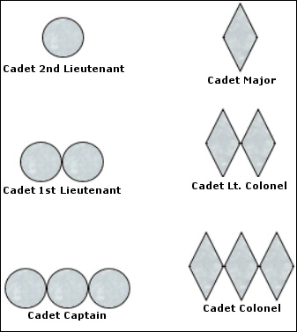
Cadet Second Lieutenant

Slide 11
Cadet First Lieutenant

Slide 12
Cadet Captain

Slide 13
Cadet Major

Slide 14
Cadet Lieutenant Colonel

Slide 15
Cadet Colonel

Slide 16

Private First Class

Slide 17

Lance Corporal

Slide 18

Corporal

Slide 19

Sergeant

Slide 20

Staff Sergeant

Slide 21

Gunnery Sergeant

Slide 22

Master Sergeant

Slide 23

First Sergeant

Slide 24

Master Gunnery Sergeant

Slide 25

Sergeant Major

Slide 26

Sergeant Major of the Marine Corps

Slide 27

Warrant Officer

Slide 28

Chief Warrant Officer 2

Slide 29

Chief Warrant Officer 3

Slide 30

Chief Warrant Officer 4

Slide 31
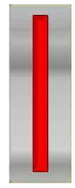
Chief Warrant Officer 5

Slide 32

Second Lieutenant

Slide 33

First Lieutenant

Slide 34

Captain

Slide 35

Major

Slide 36

Lieutenant Colonel

Slide 37

Colonel

Slide 38

Brigadier General

Slide 39

Major General

Slide 40

Lieutenant General

Slide 41

General

Slide 42
RANK REVIEW
(Random Order)

Slide 43
Cadet Staff Sergeant

Slide 44

Sergeant Major

Slide 45
Second Lieutenant

Slide 46
Cadet Corporal

Slide 47
Cadet Major

Slide 48
Cadet Second Lieutenant

Slide 49
Cadet Lance Corporal

Slide 50
Cadet First Lieutenant

Slide 51

Corporal

Slide 52

Warrant Officer

Slide 53

Major

Slide 54
Major General

Slide 55
Cadet Gunnery Sergeant

Slide 56

Staff Sergeant

Slide 57
Private First Class

Slide 58
Cadet Sergeant Major

Slide 59

Chief Warrant Officer 3

Slide 60

Colonel

Slide 61

Gunnery Sergeant

Slide 62

General

Slide 63
Cadet Private First Class

Slide 64

Lance Corporal

Slide 65

Master Sergeant

Slide 66
Chief Warrant Officer 5

Slide 67
Cadet Sergeant

Slide 68
Sergeant Major of the Marine Corps

Slide 69
Cadet Colonel

Slide 70
Captain

Slide 71
Master Gunnery Sergeant

Slide 72
Cadet Lieutenant Colonel

Slide 73
First Lieutenant

Slide 74
Cadet Captain

Slide 75
Lance Corporal

Slide 76
Cadet First Sergeant

Slide 77

Lieutenant Colonel

Slide 78
Sergeant

Slide 79
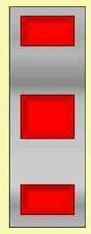
Chief Warrant Officer 4

Slide 80

Lieutenant General

Slide 81

First Sergeant

Slide 82
Brigadier General

Slide 83

Chief Warrant Officer 2

