Slide 1
De-escalation Techniques
Strategies for preventing the escalation of behavior in the school setting
Notes:
This training describes strategies that staff can use for preventing the escalation of behavior. It is aimed at preventing the need for seclusion and restraint, but can be helpful for many behavior issues and for interactions with all students.

Slide 2




Acknowledgements
Training Material Based on the Work of:
Dr. Geoff Colvin, Behavior Associates
Dr. George Sugai, University of Connecticut
Dr. Kathleen Lane, University of Kansas
Dr. Terry Scott, University of Louisville
Notes:
Thank you to these professionals for their collaboration and support.

Slide 3
OUTCOMES
Understand why it is important to be able to effectively manage disruptive and noncompliant behaviors
Understand problem behaviors occur within the acting-out cycle
Identify proactive, preventative strategies that may decrease the occurrence of escalating behavior
Identify the seven phases of escalating behavior and ways to intervene during each phase of the cycle and the importance of intervening early in an escalation
Notes:
This training is planned to accomplish these four outcomes. Other methods for preventing the need for an Emergency Safety Intervention can be found in the Prevention Techniques PowerPoint, which can also be found on the TASN website.

Slide 4


Notes
Goal: To become FLUENT so you respond in a planned way that is automatic and smooth when problem behaviors occur.
What will you stop doing?
What will you start doing?
What do you need to know more about?
What support do you need from others?
Schmitz, 2014
Notes:
You will see this slide again at the end of the presentation to help you develop an action plan. For now, think about whether you have some ideas already. Make notes whenever you see information that relates to how you will answer each of these questions later.

Slide 5

Key Message
We know far more about
effective prevention
strategies than we do about
how to address challenging
behavior once it occurs.
Notes:
The truth is there is no magic bullet for instantly returning the student to a more calm state. What we do know from many years of research is that prevention strategies are often overlooked and could thwart escalated behavior. The energy, effort, and resources are misplaced on the back end of the behavior. Once a student is escalated the risk for injury, property destruction, emotional damage, and other poor outcomes increases significantly. When we do respond during the peak of the behavior we may impact the severe aggression, property destruction, injury, etc…but we have not impacted the behaviors that lead up to the crisis. The non-compliance, disruption, or other lower level behaviors must be addressed or the behavior chain is still intact.

Slide 6
A Shift in Thinking about
Behavior Support
Moving from
Control and Exclusion
Effective Prevention & Intervention
to
“…the key to successful classroom management is to prevent problems before they start, not knowing how to deal with problems after they have begun.” – Brophy & Everston
Notes:
There is a long history of problem behaviors in educational settings (and other settings). Much of the early work related to behavior support focused on aversive and punitive methods that excluded individuals and attempted to “control” their behavior. Because of what we know now from many decades of research our focus is now on prevention and intervention – not aversive and punitive methods.

Slide 7
The Role of Adults
Effective classroom managers are known, not by what they do when misbehavior occurs, but by what they do to set their classroom up for academic success and prevent problems from occurring.
Notes:
All too often our behavior plans are crisis intervention plans when we should be focused on preventing problem behaviors. This about what you might be able to do to structure your classroom for academic success. How might you be able to change the environment in your school and classroom to help prevent problems from occurring?

Slide 8

Quote #1
Quote #2
“Educators who approach discipline as a process of establishing and maintaining effective learning environments tend to be more successful than educators who place more emphasis on their roles as authority figures or disciplinarians.” – Good & Brophy
“Unfortunately, most of the practical techniques used by teachers to respond to acting-out children are only of limited effectiveness and some, such as reprimands, arguing, and escalated hostile interactions, can actually strengthen the behaviors they are intended to suppress or terminate.” - Hill Walker , 1995
How do these quotes align (or not) with the present thinking of your staff? What attitudes or beliefs do staff in your building have that reflect a traditional view of behavior management?
Notes:
Find a time to discuss the questions with a colleague.

Slide 9
When acting out behavior occurs, we often tend to only look at end incident.
We must look earlier and focus on these critical components:
  Prerequisite Academic Skills
  Signs of Agitation
  Presence of Escalating Behavior Chain
  Presence of Successive Interactions
“Low achievement and problem behaviors go hand in hand”
~Kauffman, 1997 p.247
Notes:
We need to consider first is this a “can’t do” (Skill deficit) or a “won’t do” (motivation deficit). If the student doesn’t have the skills there is no punishment in the world that will teach them what to do instead.
Prerequisite Academic Skills: Does student understand the assignment? Does he have skills to complete the work? Or has he mastered subject and is bored?
Agitation is a critical variable in the acting out cycle. What are some signs of agitation? What are indicators that the student is upset. The agitated state must be addressed. “Are you doing ok?”
Signs of Agitation: Agitated state not addressed? What if teacher had said “Are you OK?” or “Do you need some time?” (supportive)
Interupt the behavior chain early.
Escalating Behavior Chain: Questioning-Arguing-Non-compliance & defiance-verbal abuse-assault. If this chain were interrupted at an early stage, there would be nothing to prompt the more serious behavior occurring at the end of the chain. If the preceding behavior is not present, or interrupted, then the next behavior will not occur.
Teacher behavior determines student behavior
Presence of Successive Interactions: for each student behavior there is a corresponding or reciprocal teacher behavior and vice versa (integrated experience)

Slide 10

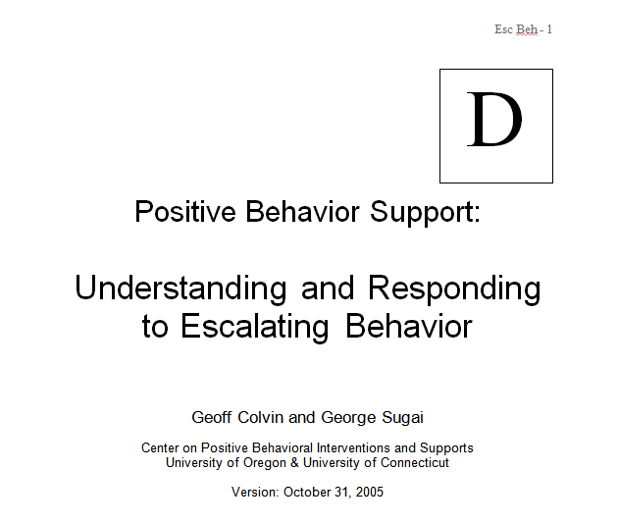
Worksheet
Notes:
Look for this handout titled Understanding Escalation. Use the form to record information as we go over the next slides.

Slide 11
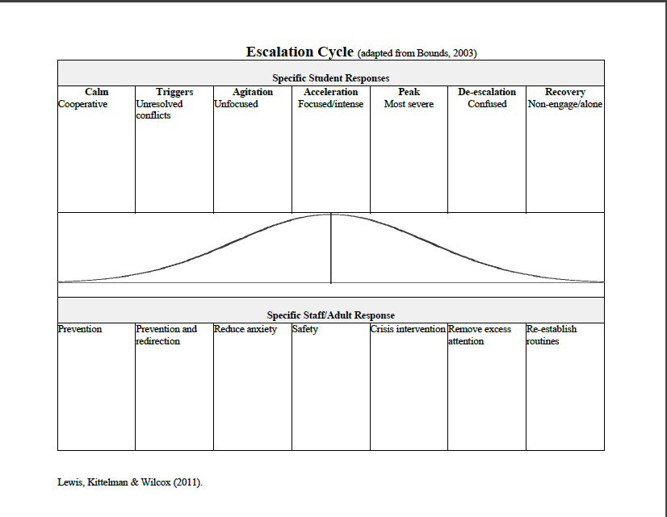
Student
Staff
Notes:
Also look for the Two-sided Escalation Cycle handout. You may want to refer to this handout for the upcoming slides. When looking at this handout, it’s helpful to think about a specific student, and to identify that student’s behaviors for each of the stages in the escalation cycle. We will use this handout for an activity later in the training.

Slide 12
FUNDAMENTAL ASSUMPTIONS
Behavior is learned (function).
Behavior is lawful (function).
Behavior is escalated through successive interactions (practice).
Behavior can be changed through an instructional approach.
Notes:
It is important that you understand and believe in these basic assumptions in order to use the practices described for de-escalation effectively. If behavior is learned, it can be changed through instruction and practice. However, changing behavior and maintaining behavior is difficult and takes time. Think about your own behaviors regarding a new work-out or diet.

Slide 13

Responding Personally to
Problem Behavior
Teachers may take student behaviors personally and react in a way that makes the student behavior worse
Teachers may abandon logical or best-practices responses (that they may use when calm) because they take behaviors personally
(Diffusing Disruptive Behavior in the Classroom, p. 21)
Notes:
It is so important and so difficult not to take student behaviors personally. Why do you think this happens?

Slide 14
Responding Personally to
Problem Behavior
Why?
  1) cultural/value based
  2) authority in question
  3) students know how to push buttons
Need to address problem student behaviors in effective ways and not escalate student behaviors
(Diffusing Disruptive Behavior in the Classroom, p. 21)
Notes:
If you feel yourself becoming angry with a student, how might you be able to interrupt that reaction? Is there a way you could use a colleague for support?

Slide 15
Two Essential Components for Managing Severe Acting-Out Behavior
1. Understand the Model
  Specific behaviors for each phase
  Know exactly where the student is in the cycle (placement in Model).
2. Develop strategies for each phase
  Implement strategies based on student placement and needs
Notes:
The acting out cycle is a conceptual model with a description of seven clearly defined phases. Once you have identified an acting out profile for the student, then you can develop a comprehensive behavior plan to interrupt the cycle and teach appropriate behavior.

Slide 16
The Model: Seven Phases of The Escalation or Acting-out Cycle
Peak
Covin & Sugai, 1989; Colvin, 2004
De-escalation
Whether the problem behavior is managed safely or not
or is defused
in large measure depends on
YOUR INITIAL RESPONSE
-Dr. Geoff Colvin
Acceleration
Agitation
Recovery
Trigger
Calm
Student’s ability to cognitively process what is happening in the environment.
Notes:
We will go over each of the stages, but what is important to think about is how you can learn the strategies for thinking and acting well enough so that they become your initial response.

Slide 17
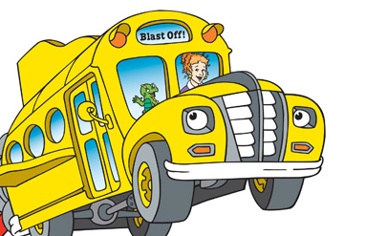
“The best time to intervene on problem behavior is when the behavior is not occurring” (Carr et al., 2002, p.9)
Behavior
Consequence
Antecedent
Notes:
Preventative procedures are focused on antecedent interventions that build student skills that then prevent undesirable behaviors from occurring
Changing class structure and environment can also be an effective preventative procedure
A variety of preventative procedures can be combined as an effective intervention.

Slide 18
The Model: Seven Phases of The Escalation or Acting-out Cycle
Peak
Colvin & Sugai, 1989; Colvin, 2004
De-escalation
Acceleration
Agitation
Recovery
Trigger
Calm
Student’s ability to cognitively process what is happening in the environment.
Notes:
Notice that as the student’s emotions and behavior become accelerated, the student’s ability to think about and process what’s happening decreases. That means you should not try to talk to them when they are at their peak because they cannot process what you are saying.

Slide 19
Strategies for Responding to Each Phase of the Acting-Out Cycle
Notes:
Remember that even if everything goes perfectly, you will still have students that escalate.

Slide 20
Phase One - Calm
Student is cooperative and behavior is acceptable.
Accepts corrective feedback
Follows directives
Sets personal goals
Ignores distractions
Accepts praise
On-task
Calm
What are other characteristics of students in the calm phase?
Schmitz, 2014
Notes:
Obviously we would like to have all students in the calm phase all the time in the classroom. However, that’s not realistic and we need to prepare for behavior escalation. Sometimes even typically well-behaved students may escalate because of emotional disruptions in their life. Describe other characteristics of students in the calm phase. What have you observed?

Slide 21
If you expect it…you must TEACH it!
Strategies
1. Calm
Intervention is focused on proactive
interventions. Focus on instruction and
positive behavior support.
Arrange for high rates of successful academic & social engagements
Use positive reinforcement
Teach social skills
Communicate positive expectations
Notes:
Pro-active Strategies:
Providing Classroom Structure
Providing Quality Instruction
Managing Attention
Teaching Behaviors (in the same way you teach academic skills)

Slide 22
Phase Two - Trigger
Also called “antecedents”
Conflicts/Failure
Demands
Changes in routine
Pressure
Ineffective problem solving
Facing correction procedures
Non-school based triggers
Trigger
What are other triggers do you see?
Schmitz, 2014
Notes:
Different students may have very different triggers. What are some other triggers you’ve observed?

Slide 23
Strategies
2. Trigger
Intervention is focused on prevention and redirection.
Increase opportunities for success
(e.g., pre-correction)
Respond to students exhibiting expected behavior
Reinforce the student’s first on task response
Intermittently reinforce on-task behavior
Pattern of behavior? Look at formal programs/services. Address non-school based triggers.
Notes:
Cumulative…built up at home or another environment/setting.
Three major areas:
1) Pre-Correction: anticipating the problem behavior and intervening beforehand
2) Formal programs or services: curriculum interventions, counseling, community services, medical assistance
3) Addressing non-school based triggers: parent conferences-partnerships, school support services, wrap-around services

Slide 24
Pre-Correction
(Colvin, Sugai, & Patching, 1993)
Anticipating problem behavior and intervening
before hand.
Pre-correction statements should be provided prior to the students involvement in particularly problematic behavior or prior to unstructured activities.
This will help facilitate the development of self-regulation skills.
Notes:
Pre-correction includes teacher behavior such as cuing a student to elicit a specific desired behavior. This includes teaching the desired behavior and the cue ahead of time. Eventually the student will learn to recognize when he needs to use a specific behavior, but the teacher providing a cue is an important intermediate step. Good teachers often provide pre-correction statements in the form of going over what how students need to behave just before a transition time, or just before an assembly, etc.

Slide 25
Phase Three - Agitation
Overall behavior is unfocused and distracted often due to an inability to handle the trigger(s).
Off-task
Questioning/Arguing
Out of seat and
other movement
Bothering others
Social withdrawal
Agitation
What are other characteristics of students who are agitated?
Schmitz, 2014
Notes:
When students are agitated they will have difficulty processing what a teacher says to them. This is not the time to teach a behavior. What other behaviors have you seen from students in the Agitation phase?

Slide 26
Strategies
3. Agitation
Intervention is focused on reducing anxiety.
Implement before onset of escalation
1. Avoid escalation responses (use empathy)
2. If not addressed student may escalate or remain distracted making instruction difficult
3. Provide reasonable options & choices
4. Involve in successful engagement (behavior momentum)
Notes:
Remember that you need to plan ahead of time how you will provide these responses, or you may not be able to be empathetic. It can be easy to respond to agitation in a way that escalates the situation if you don’t plan ahead.

Slide 27
Defusing Off-Task Behavior
Assess the situation: determine “can’t do” or “won’t do” (Is it an emergency situation? If so, follow crisis procedures. If not, follow off-task defusing steps)
Maintain the flow of instruction.
Recognize on-task students, making no response to off-task students.
Redirect (focus on task, brief language/gestures, prompt student of procedures for asking for help).
Praise compliance.
Notes:
It’s important to begin by determining whether the student actually has the skills to do what you are expecting. This applies to both academic and behavioral skills. If you aren’t sure which it is, assume it’s a “can’t do” situation and teach the skill. Try to teach the behavior in the same way you would teach an academic skill. Many teachers assume that the student knows how to do a task or exhibit a behavior, but often that is a false assumption. Most students will try to cover up not knowing something. They’d rather others think they are a “bad actor” than think they are stupid.

Slide 28
Keys to Addressing Provocative Behavior
(profanity, vulgarity, inappropriate actions/attire)
Teach what is and is not acceptable
Have a standard consequence and teach it
Provide warning and correction first
Speak privately to student
Identify as a problem for the student
Ask the student to take care of the problem
Present options and ask the student to select one
Acknowledge cooperation
Follow through with bottom line consequence
Scott, 2014
Notes:
Discuss with a colleague how you have used these teacher behaviors to address provocative behavior. Do you see that the first two bullets describe what needs to be accomplished before the behavior occurs?

Slide 29
Keys to Addressing Disruptive Behavior
Recognize and respond quickly to student agitation
Redirect
  Clearly state the expected task
Communicate concern
  Present options
  Allow space –do not hover
  Assist student to begin work
Attend to other students and prepare for the worst
Acknowledge compliance or institute standard consequence in neutral manner
Scott, 2014
Notes:
What to do before a behavior escalates:
Achieve eye contact
Use the student’s name
Use a non-verbal signal
Proximity/praise
Relaxation techniques
Do the unexpected (break the chain of behaviors).
Get them to think – give them time to decide.
Engage in movement activities
Give more “start” requests instead of “stop” requests

Slide 30
Phase Four - Acceleration
Overall behavior is staff-engaging- leading to further negative interactions.
Questioning/Arguing/Threats
Noncompliance and defiance
Provocation of others
Rule violations
Acceleration
What are other characteristics of accelerated behavior?
Schmitz, 2014
Notes:
Provocative behavior--we feel obligated to respond
Sometimes the student gets zeroed in on someone or something and it is very difficult to deflect this

Slide 31

Other Signs of
Escalating Behavior
Non-compliance/defiance
Verbal abuse
Disruption
Destruction of property
Whining/crying
Limit testing
Threats and intimidation
Escape/avoidance
Notes:
Think about a time when you have observed these behaviors. How did you try to deal with these difficult situations?

Slide 32
Keys to Addressing
Non-Compliance and Defiance
Teach what student is to do and be clear about what student is to do
  Provide reminders – especially at times where non-compliance is predictable
Have a standard consequence (or sequence) and teach it
Acknowledge the students who are on task/complying
Speak to student quietly rather than in front of entire group
Provide a single specific direction
  Stay with the direction – broken record
Acknowledge student cooperation or follow through with consequence
Continue to acknowledge other on-task students Scott, 2014

Slide 33

Strategies
4. Acceleration
Last Opportunity to Avoid Peak Behavior!!!
Intervention is focused on safety.
  Remove all triggering factors
  Avoid escalating prompts
  Maintain calmness, respect and detachment
  Approach the student in a nonthreatening manner
  Utilize non-confrontational limit-setting procedures
Notes:
At this phase, student will try to engage staff; response may escalate behavior. Escalating prompts are described on the next page. It is important that as the student becomes more angry or more upset that you become calmer and more detached.
Remember the student is using this behavior to try to obtain something or escape something. Try not to take the behavior personally.

Slide 34
Techniques that BACKFIRE
Holding a grudge
Raising your voice- yelling
Nagging
Drawing unrelated persons into the conflict
Preaching
Using sarcasm
Making assumptions
Bringing up unrelated events
Making comparisons with siblings or other students
Insisting you are right
Insisting on having the last word
Attacking the student’s character
What are other responses you have used or seen used that have or have the potential to backfire?
Notes:
Can you think of situations where you or someone else used one of these techniques and it backfired? How do you feel when someone else uses one of these techniques with you?

Slide 35
Phase Five - Peak
Overall behavior is out of control creating safety concerns.
Physical aggression
Severe tantrums
Property destruction
Self-injury
Running, screaming
Peak
Others?
Schmitz, 2014
Notes:
What else have you observed in students who are out of control? How did you feel when you were in these situations?

Slide 36
Strategies
5. Peak
Intervention is focused on safety only!
Focus is on crisis management
Behavioral Emergency – Room Clear example
Safe strategies - emergency safety intervention if there is a reasonable and immediate danger of physical harm to the student or others with the present ability to effect such physical harm. (If emergency safety intervention is used, document the incident and notify parents, as required by law.)
Learn from it…(Functional Behavior Assessment, Behavior Intervention Plan, Mental Health Assessment, etc.)
Notes:
Driven by emotion
This isn’t a thinking behavior
Not all behavior has to be dealt with right now (students have a memory)
Short-term interventions:
Isolation or removal of involved student
Allow time for student to “cool down”
Removal of other students (room clear needs to be taught to the whole class ahead of time)
Remind them that the phases can go back and forth
Some behaviors have to run their case

Slide 37
Keys to Addressing Fighting and Aggressive Behavior
Recognize conditions under which fights are likely and attempt to avoid
  Assign seats
  Space, options, preferred activities
  Teacher proximity – stay between as long as there is no physicality
  Independent activities
  Relaxation activities
If altercation becomes verbal - intervene verbally
  Provide specific and concrete directions
  Redirect – get attention off of altercation
  Separate as much as possible without placing hands on students
If altercation becomes physical - initiate crisis procedures
  Call office or send runner
  Provide clear, loud, and concrete directions to both students
  Clear other students away to keep safe
Wait for assistance
Notes:
Discuss these keys with a colleague. How have you used these ideas?

Slide 38
Responses to AVOID
Agitated behavior from staff (shouting)
Cornering the student
Engaging in power struggles
Moving into the student’s space
Touching or grabbing the student
Sudden or very quick responses
Making derogatory statements about the student
Arguing/becoming defensive
Body language that communicates anger or frustration
Do not communicate “urgency to gain control”
Notes:
Talk about these responses to avoid. Why do you think they should be avoided? Think about why these responses might create a worse situation when a student is in the Peak stage.

Slide 39
What can I do instead?
Speak calmly
Speak privately
Minimize body language
Keep a reasonable distance; Move slowly and deliberately toward the problem situation
Speak respectfully and privately
Establish eye level position
Be brief
Stay with agenda
Avoid power struggles
Give student space
Notes:
Why do you think these are recommended behaviors for a student at this point in the escalation cycle? What do you want these behaviors to accomplish?

Slide 40
Phase Six - De-escalation
Overall behavior shows confusion and lack of focus.
Confusion
Withdrawal—sleep, head down
Denial
Blaming others
May respond to concrete directions
May apologize and try to make up
De-escalation
Others?
Notes:
Give the student strategies to get back into the task—behavioral momentum
Mind kicks back in

Slide 41
Strategies
6. De-escalation
Intervention is focused on monitoring for re-escalation of behavior
Monitor for health/safety of all involved
Avoid blaming- provide opportunity for non-judgmental discussion
Allow cool-down time and space
Engage in independent work- provide easy/concrete tasks
Notes:
Provide independent work—even if others are working in small groups.
If uncooperative, student needs more time to settle or to complete task
Make sure it is a task that student has mastery of. Frustration from a task will escalate the behavior again.
Set reasonable standards for completion—neatness, time allotted. Do not move to next step until task is completed
After debriefing, determine an appropriate consequence. If tore up room, then must clean up. If upset another student, must do something nice for that student.
Restore environment refers to cleaning up. If area already cleaned up, then needs to be given some “community service” jobs in room.
Do small steps in order to gain gradual compliance.

Slide 42
Debrief and Problem Solve
After student is calm
Conduct this activity following consequences - separate from consequences
Use a problem solving format:
What did you do? (name the behavior)
Why did you do it? (capture student’s need)
What else could you have done that would
  Meet your need
  and
  Be acceptable?
Replacement Behavior
Notes:
Students have a memory…no need to do this in Phase 5 - Peak

Slide 43
Debriefing Session
Facilitates transition back to task/activity… not further negative consequence.
Goal is to increase appropriate behavior
Focus on problem solving
Pinpoint events that contributed to the incident
Teach replacement behaviors
Debriefing activities and forms

Slide 44
Phase Seven - Recovery
Overall behavior shows an eagerness for
busy work and a reluctance to interact.
Eagerness for independent work
Subdued behavior
Sleep
Recovery
Others?
Notes:
Students are still very fragile at this point.

Slide 45
Strategies
7. Recovery
Intervention focuses on returning to normal activities.
Follow through with consequences-but do not disrupt flow of instruction.
Positively reinforce any displays of appropriate behavior
Debrief/rehearse problem solving routine
Review and revise plan as needed
Notes:
Utilize effective consequences. This is not the same as punishment.
Does the consequence:
Model, instruct or teach a more appropriate behavior?
Interfere with the flow of the lesson?
Give the learner the choice to redirect and receive instruction?
Is the consequence effective?

Slide 46
Four Key Strategies
Teach and reinforce expected behavior skills.
Identify how to intervene early in the escalation sequence.
Identify environmental factors that can be manipulated.
Identify replacement behaviors that can be taught.
Notes:
The behavior skills identified in item #1 includes social skills.

Slide 47
Student
Staff
Notes:
Use this handout for the activity on the next slide.

Slide 48

Activity
Describe an event in which the student’s behavior escalates. Be sure to describe all seven phases of the acting-out cycle.
How can you prevent acting-out behavior?
How can you tell when a student’s behavior is escalating?
What do you do when a student is acting out?
How do you deal with a student who is fully escalated?
Identify strategies to increase appropriate behavior and decrease inappropriate behavior.
Complete the escalation cycle worksheet for this student.
Notes:
After completing this activity, use the escalation cycle worksheet you created. How did it work? What do you need to improve?

Slide 49

Proactive Strategies
Have a school-wide positive behavior support system in place
Emphasize quality instruction and engagement leading to increased academic achievement
Emphasize teaching and prevention techniques
Notes:
Just planning de-escalation strategies on a student by student basis is not enough. Systemic school-wide strategies and supports need to be in place for effective prevention of problem behaviors.

Slide 50
Time to Action Plan!
Goal: To become FLUENT so you respond in a planned way that is automatic and smooth when problem behaviors occur.
What will you stop doing?
What will you start doing? What will you take back to your school/classroom and do differently tomorrow?
What do you need to know more about?
What support do you need from others?
Notes:
Think about the what you have learned from this De-escalation PowerPoint, then answer the questions on this slide. Write down your answers to the questions and make a plan to follow-up on obtaining more information or support and on checking to see if you really accomplished stopping and starting certain behaviors.

Slide 51
Resources
Addressing Disruptive and Noncompliant Behaviors: Understanding the Acting-Out Cycle with Dr. Kathleen Lane: http://iris.peabody.vanderbilt.edu/module/bi1/
Midwest Symposium for Leadership in Behavior Disorders: www.mslbd.org
Association for Positive Behavior Support: www.apbs.org
Dr. Geoff Colvin’s Behavior Associates: http://www.behaviorassociates.org/
KSDE TASN: www.ksdetasn.org
Building and Sustaining Student Engagement Project: (strategy briefs) http://k12engagement.unl.edu/

Slide 52
Contact Information
For more information:
  Laura Jurgensen at ljurgensen@ksde.org or 785-296-5522
  or
  Julie Ehler at jehler@ksde.org or 785-296-1944
This and other resources can be found on the KSDE TASN website at www.ksdetasn.org

