Slide 1

The mission of the Hazlehurst City School District is to address the needs of our students and empower them for global success through the channel of positive education, parental support, and community involvement essential to become active citizens and responsible stewards.
Learners Today—Leaders Tomorrow

Slide 2
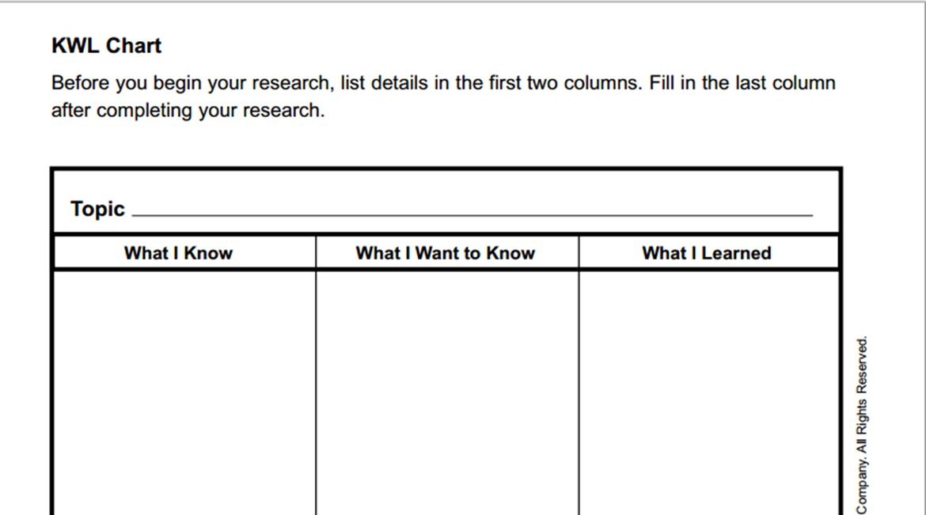
RTI ?
Small Group Activity
Each group will construct a KWL. In the K column groups will write down what they KNOW about the RTI process and in the W column groups will compile a list of What they want to know about the RTI process. We will save the L for the end of class.
Learners Today—Leaders Tomorrow

Slide 3
RTI large group discussion
          What do we know?
          What do we want to know?
Learners Today—Leaders Tomorrow

Slide 4
Essential Components of RtI
http://www.rti4success.org/video/what-rti-and-what-are-essential-components-must-be-present
Learners Today—Leaders Tomorrow

Slide 5
RtI large group discussion
          What do we have in place?
Learners Today—Leaders Tomorrow

Slide 6
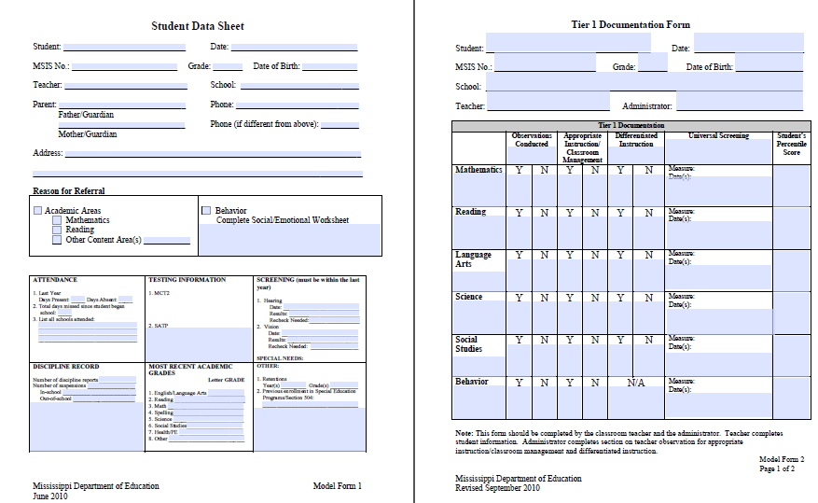
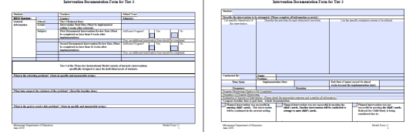
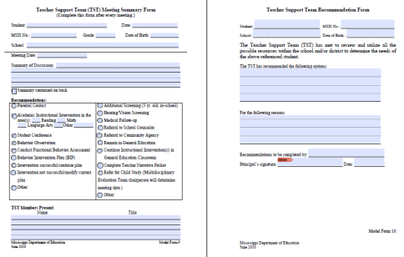
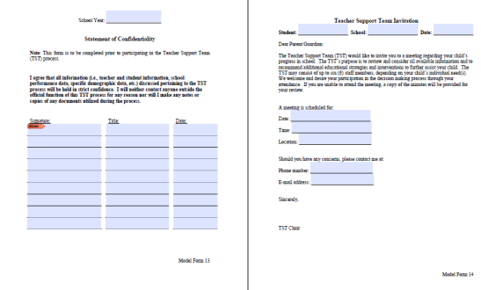
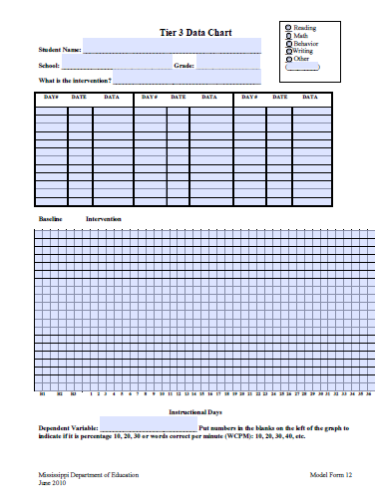
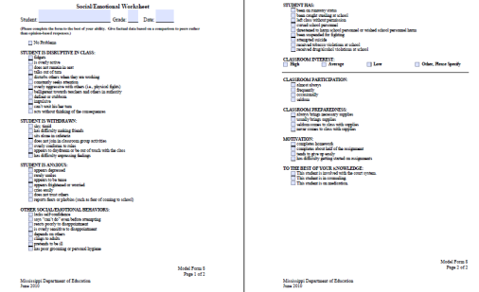
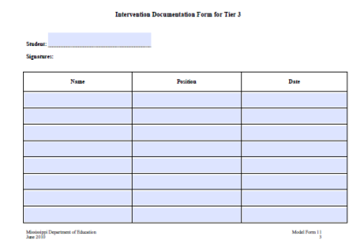
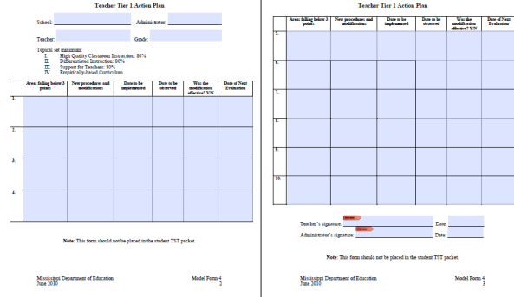
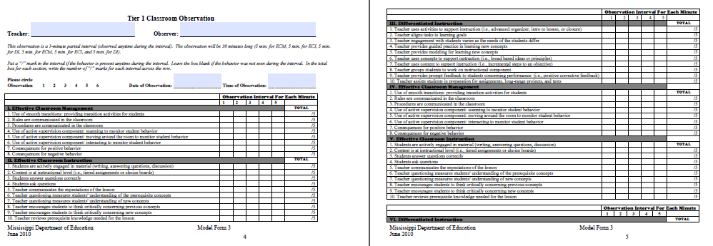
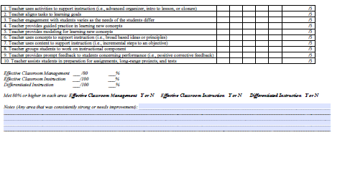
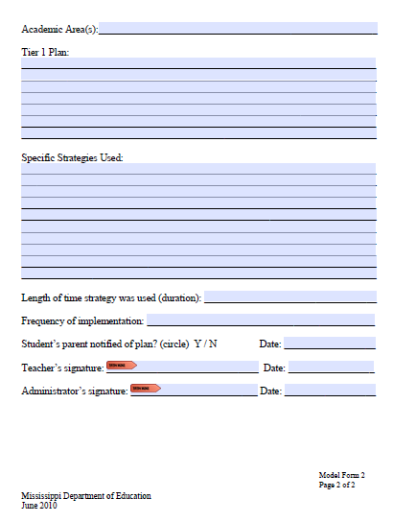
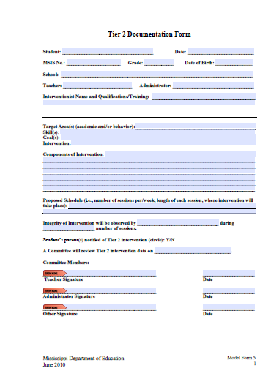
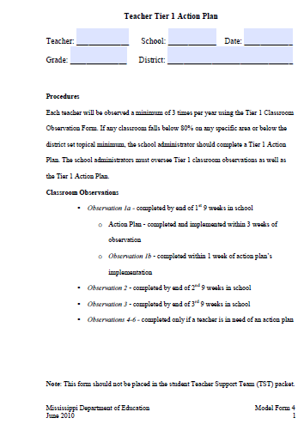
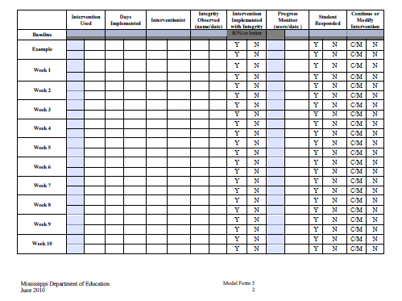
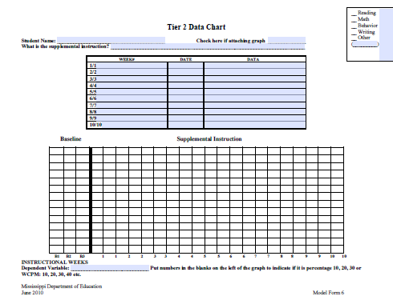
MDE’s Current Documents
Learners Today—Leaders Tomorrow

Slide 7

But…
A Change Is Gonna Come
Learners Today—Leaders Tomorrow

Slide 8
State board of education 5 year strategic plan for 2016-2020
      All students Proficient and Showing Growth in All Assessed Areas
      Every Student Graduates High School and is Ready for College and Career
      Every Child has Access to a High-Quality Early Childhood Program
      Every School Has Effective Teachers and Leaders
      Every Community Effectively Using a World – Class Data System to Improve Student Outcomes
Learners Today—Leaders Tomorrow

Slide 9
Office of intervention services
    The Office of Intervention Services
    Established February 2015
Learners Today—Leaders Tomorrow

Slide 10
Multi-tiered System of supports
    MDE Established the Office of Student Intervention Services to:
          successfully implement and sustain a Multi-Tiered System of Supports,
          accelerate and maximize student academic and social emotional outcomes through the application of collaborative data-based problem solving utilized by effective leadership at all levels of the educational system,
          coordinate the implementation of policies and procedures related to State Board Policy 4300,
Learners Today—Leaders Tomorrow

Slide 11
Multi-tiered System of supports
    MDE Established the Office of Student Intervention Services to:
          provide professional development on “Multi-Tiered System of Support” for school based teams, administrators, staff, parents, and agencies,
          offer guidance on appropriate intervention data collection, data-based decision making, evaluation, and progress monitoring for students in need of supplementary intensive academic and behavioral supports in order to ensure all students graduate high school college and career ready.
Learners Today—Leaders Tomorrow

Slide 12
Multi-tiered System of supports
    Recruitment:
          Currently interviewing and recruiting personnel to support the districts, schools, and teachers with the implementation of a Multi-Tiered System of Supports for instruction and behavior interventions as well as the collection of data for ALL student populations
                Elementary Support staff
                Middle School and Secondary Support Staff, and
                English Language Learner Support Staff
Learners Today—Leaders Tomorrow

Slide 13
Office of intervention services
    Revising the Process
    Response to Intervention/Multi-Tiered System of Supports
Learners Today—Leaders Tomorrow

Slide 14
Terminology: making the shift
    Multi-Tiered System of Supports
          Integration of RtI for academics and RtI for behavior into a unified model that recognizes the reciprocal influence academic performance and social/emotional/behavior has on each other
Learners Today—Leaders Tomorrow

Slide 15
Process for Implementing the Multi-tiered System of supports
      Phases of creating your Blueprint
                Building Support
                Develop a Plan
                Implement Your Plan
                Evaluate Effectiveness
                Sustainability
Learners Today—Leaders Tomorrow

Slide 16
MTSS: What does it take
      Leadership
      Professional Development
      High Quality Core Curriculum Assessment and Instruction
      Empowering Culture
                Common Language about MTSS
                Shared Vision
                Staff Support
                Acceptance of Principles/Practices
Learners Today—Leaders Tomorrow

Slide 17
MTSS: Goal
          Being prevention oriented: knowing who needs support as early as possible each year and putting those supports in place
          Implementing evidenced based interventions for all students and tailoring interventions based on student’s needs
          Using progress monitoring data to know when to make changes in instruction
Learners Today—Leaders Tomorrow

Slide 18
    State Board Policy 4300
    Dyslexia Addition: Currently out for APA Comments
Learners Today—Leaders Tomorrow

Slide 19
State board policy 4300
      State Board Policy 4300 was adopted January 21, 2005 (revised January, 2014) and currently out for public comment for an additional revision.
          1. The Mississippi Department of Education shall require every school district to follow the instructional model which consists of (3) three tiers of instruction:
              Tier 1: Quality Classroom instruction based on Curriculum Frameworks
              Tier 2: Focused supplemental instruction
              Tier 3: Intensive interventions specifically designed to meet the individual needs of students
Learners Today—Leaders Tomorrow

Slide 20
State board policy 4300: Addition
      A dyslexia screener must be administered to all students during the spring of their kindergarten year and the fall of their first grade year. The screening must include the following components:
          Phonological awareness and phonemic awareness
          Sound symbol recognition
          Alphabet knowledge
          Decoding skills
          Encoding skills
          Rapid naming (quickly naming objects, pictures, colors, or symbols (letters or digits) aloud.
Learners Today—Leaders Tomorrow

Slide 21
State board policy 4300: change
    All students in Kindergarten and Grades 1 through 3 shall may be administered a state-approved screener within the first 30 days of school and repeated at mid-year and at the end of the school year to identify and deficiencies in reading. In addition to failure to make adequate progress following Tier I and Tier II, students will be referred to the TST for interventions as specified in Response to Intervention guidelines developed by MDE if any of the following events occur:
          Failure to make adequate progress following Tier I and Tier II
          Students will be referred to the TST if any of the following events occur:
Learners Today—Leaders Tomorrow

Slide 22
State board policy 4300
              Grades 1-3: A student has failed one (1) grade;
              Grades 4-12: A student has failed two (2) grades;
              A student failed either of the preceding two (2) grades and has been suspended or expelled for more than twenty (20) days in the current school year; or
              A student scores at the Minimal level on any part of the Grade 3 or Grade 7 Mississippi Curriculum Test,
              A student is promoted from Grade 3 to 4under a good cause exemption of the Literacy Based Promotion Act.
              Note: students who do not make adequate progress following Tier I and Tier II should be referred to TST and can be pulled into the Screens by the district users.
Learners Today—Leaders Tomorrow

Slide 23
State board policy 4300
    The first two criteria:
              Grades 1-3: A student has Failed on (1) grade;
              Grades 4-12: A student has failed two (2) grades;
          MSIS will pull from month nine (9) any student who meets the criterial above if their Sped indicator is set to N (exception to this rule is the Language Speech only students that can populated or pulled into the screen).
          MSIS will populate these students at the beginning of each school year.
  Note: Referrals to the TST must be made with the first twenty (20) school days of a school year if the student meets any of the criteria listed.
Learners Today—Leaders Tomorrow

Slide 24
State board policy 4300
    For the third criteria:
              A student failed either of the preceding two (2) grades and has been suspended or expelled for more than twenty (20) days in the current school year
        MSIS will run a procedure each weekend to check for any suspensions or expulsions to populate these students to the screen.
        Users should check at the beginning of each week for any of these students.
  Note: these students won’t populate before the 20th day school is in session.
Learners Today—Leaders Tomorrow

Slide 25
State board policy 4300
    For the fourth criteria:
              A student scores at the Minimal level on any part of the Grade 3 or Grade 7 Mississippi Curriculum Test
        MSIS will populate these students at the beginning of each school year once test scores are received at MDE
        Users have twenty (20) school days from the beginning of school to refer these students to TST for intervention
Learners Today—Leaders Tomorrow

Slide 26
State board policy 4300 —
Good Cause Exemption
    For the fifth criteria:
              A student is promoted from Grade 3 to 4 under a good cause exemption of the Literacy Based Promotion Act.
          Note: These students will need to be entered by the district appointed individual
Learners Today—Leaders Tomorrow

Slide 27
State board policy 4300
    After referral, the TST must develop and begin implementation of an interventions within two weeks.
        TST Review
                1st Review—No later than 8 weeks (determine success of intervention)
                2nd Review—No later than 16 weeks (determine success of intervention)
                If the intervention is unsuccessful, then the student will be referred for a comprehensive assessment.
Learners Today—Leaders Tomorrow

Slide 28
Process Standard 20
    Process Standard 20 is currently being revised to ensure that we address the following requirements:
              Literacy Based Promotion Act
              State Board Policy 4300
Learners Today—Leaders Tomorrow

Slide 29
    Intensive Acceleration Class
    &
    Transitional Class
    (Forthcoming MDE Guidance)
Learners Today—Leaders Tomorrow

Slide 30
Transition Class
    Transition Classes are:
        Designed for students with identified reading deficiencies
        Established for students not promoted
        Intended to provide intensive instruction and intervention
        Designed to produce learning gains sufficient to meet the current grade level performance standards
        Designed to remediate the reading deficiency so the student can advance to the next grade
Learners Today—Leaders Tomorrow

Slide 31
Intensive Acceleration Classes
    § 37-177-15. Purpose of Intensive Acceleration Class for certain students.
          For students retained in Grade 3 who were previously retained in Kindergarten or Grades 1 through 3
          To increase student’s reading level at least two (2 grade levels in one (1) school year
          Should provide instruction and intervention for the majority of the student contact each day
          Incorporates opportunities to master the Grade 4 state standards in other core academic areas
Learners Today—Leaders Tomorrow

Slide 32
    Student Intervention Services
    New Resources
Learners Today—Leaders Tomorrow

Slide 33
2015 - 2016 new resources
      RtI Flow-Chart
      Multi-Tiered System of Supports Documentation Packet
      RtI Quick Reference Guide
      RtI Resources
      Parent Family Guide to RtI
      English Language Learners
              Classroom Teacher Manual
              Administrator Resource Manual
              RtI Resource Manual
Learners Today—Leaders Tomorrow

Slide 34
Multi-tiered System of supports documentation
      The all Inclusive Intervention Documentation Packet was developed to:
          Assist districts, schools, and educators with the process of implementing and documenting interventions for ALL students
          Provides the means to collect data to improve Pre-K—12 student outcomes
Learners Today—Leaders Tomorrow

Slide 35
Multi-tiered System of supports documentation
    Recommendations are included for districts, schools, and teachers in selecting the appropriate forms needed to document Pre-K –12 intervention:
          Tier I High Quality Classroom Instruction
          General Education Students Tier II
          General Education Students Tier III
          Special Education Students Intensive Reading Interventions K-4
          Dyslexic Students
          English Language Learners
Learners Today—Leaders Tomorrow

Slide 36
Multi-tiered System of supports documentation
    The Intervention Services Documentation Packet (DRAFT) is organized as follows:
              Student Profile
              Tier I
              Tier II
              Teacher Support Teams (TST)
              Tier III
              Appendix
Learners Today—Leaders Tomorrow

Slide 38
Office of intervention services
    The Office of Intervention Services website is currently being updated to reflect changes and the development of new documents.
              www.mde.k12.ms.us/intervention
Learners Today—Leaders Tomorrow

Slide 39
Office of elementary education and reading contacts
        Nathan Oakley, Executive Director noakley@mde.k12.ms.us
        Robin Lemonis, Director of Intervention Services (K-12) rlemonis@mde.k12.ms.us
        Dr. Kymyona Burk, Director of Literacy (K-12) kymoyona.burk@mde.k12.ms.us
        Dr. Tenette Smith, State K-3 Literacy Coordinator tenette.smith@mde.k12.ms.us
Learners Today—Leaders Tomorrow

Slide 40
Finish Kwl
What did you learn?

