Slide 1




Flexible Spending Account (FSA)
Click symbol for audio presentation

Slide 2
Flexible Spending Account (FSA)
Who is The Preferred Group & What is their role?
The Preferred Group is the District's 3rd party administrator for the flexible spending accounts.
They provide the following services:
Enrollment
Claims Processing
Customer Service - All Questions
Reimbursement
Plan termination
Call (800) 573-7474 with any questions

Slide 3

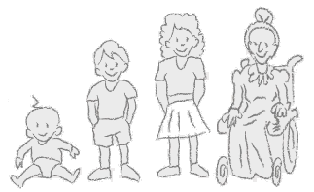

Flexible Spending Account (FSA)
What is it?
Account that provides tax relief on unreimbursed medical expenses and dependent child/elderly day care.
Employees contribute pre-tax dollars that are not subject to FICA, federal and state payroll taxes.
Savings up to 30-40% on expenses

Slide 4

Adding it up: income savings
Employee A
Employee B
 | Without FSA | With FSA
Gross Income | $80,000 | $80,000
FSA Account for Day Care Expenses | - | -$5,000
Taxable Income | $80,000 | $75,000
Estimated Taxes (30%) | $24,000 | $22,500
Income After Taxes | $56,000 | $52,500
Day Care Expenses | -$5,000 | -
Income | $51,000 | $52,500
Estimated savings |  | $1,500

Slide 5

Adding it up: health care savings
ESTIMATED ELIGIBLE EXPENSES | EXAMPLE
Prescription drugs | $230
Doctor visits | $180
Dental visits | $50
Dental fillings and crowns | $200
Orthodontia (braces) | $1,300
Prescription glasses and sunglasses | $300
Over-the-counter products* | $240
FSA - unreimbursed medical expenses | $2,500
Taxes (30%) | x 0.30
Estimated savings | $750
*Over-the-counter medicines require a prescription as of 1/1/2011

Slide 6
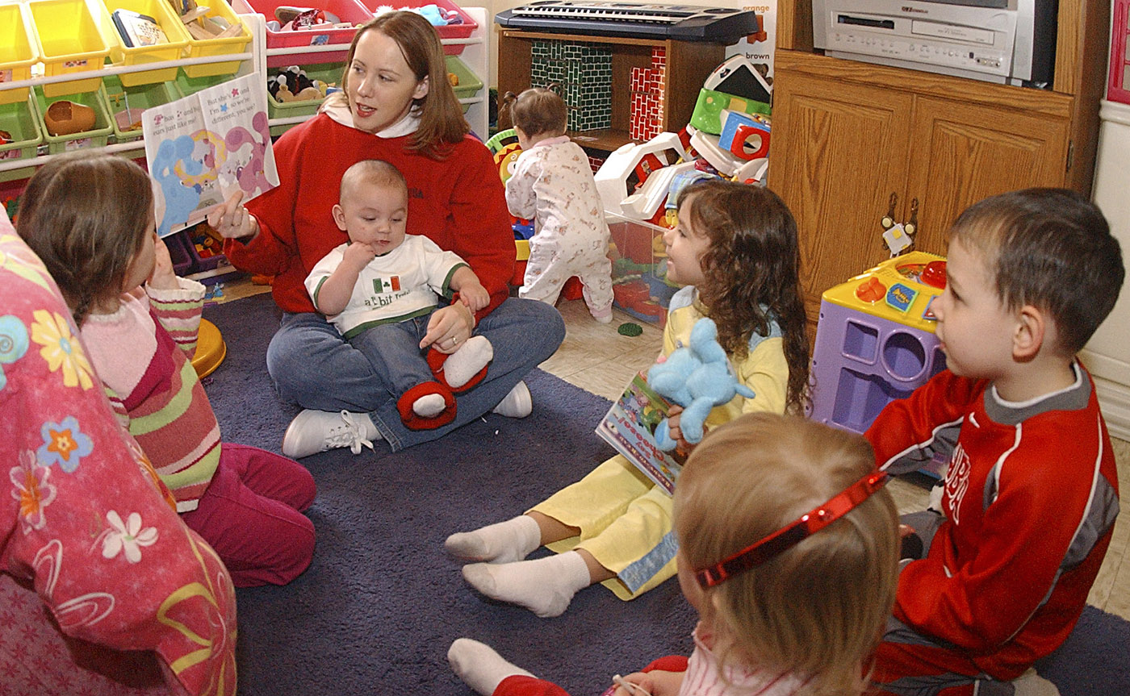
Adding it up: dependent care savings
ESTIMATED ELIGIBLE EXPENSES | EXAMPLE
Day care / nursery school | $5,000
Babysitting / au pair | —
Before- and after-school programs | —
Summer day camp | —
Pre-school | —
Elder care | —
FSA - dependent day care | $5,000
Taxes (30%) | x 0.30
Estimated savings | $1,500

Slide 7
Flexible Spending Account (FSA)
What is Eligible?
Unreimbursed Medical Expenses
  Including but not limited to medical, dental, hearing and vision co-pays, prescription drug co-pays, doctor prescribed over-the-counter drugs, Lasik eye surgery
Minimum Amount: $250
Maximum Amount: $2,500
Must submit receipts, invoices or explanation of benefits
Keep your receipts!
$

Slide 8
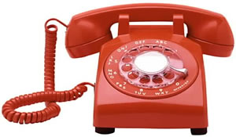
Unreimbursed Medical - Examples
Eligible
Denture Adhesives
Diagnostic tests & monitors
Elastic bandages & wraps
Eye care & contact lens
Eye care solution & drops
Family planning kits
Fiber laxatives
First aid supplies
Hearing aid batteries
Infant electrolytes and dehydration solutions
Infant teething pain supplies
Insulin & Diabetic supplies
Nebulizers
Orthopedic aids
Ostomy products
Reading glasses
Smoking deterrents
Syringes
Thermometers
Wheelchairs
Walkers
Canes
Sleep Aids & Sedatives
Stomach Remedies
Not Eligible
Acid Controllers
Allergy & Sinus
Antibiotic Products
Antidiarrheals
Anti-Gas
Anti-Itch & Insect Bites
Anti-Parasitic Treatments
Laxatives
Baby Rad Ointments/Creams
Cold Sore Remedies
Cough, Cold & Flu
Digestive Aids
Feminine Antifungal/Anti-Itch
Hemorrhoidal Preps
Motion Sickness
Pain Relief
Respiratory Treatments
Call (800) 573-7474 for questions about eligible products.

Slide 9
Flexible Spending Account (FSA)
When can I make a claim for reimbursement?
Unreimbursed Medical Expenses Only:
Full year contribution can be claimed at any time.
Example: Employee A elects a deduction of $2,500 for unreimbursed medical expenses.
February 1st - Employee A elects to have Lasik Eye surgery. Employee A can submit for reimbursement immediately regards of having only had 2 paycheck deductions.

Slide 10
Flexible Spending Account (FSA)
What is Eligible?
Dependent Daycare
  For children under 13 and disabled and elderly dependents at any age.
  Family members must be working or attending school full-time during day care.
Maximum Amount: $5,000

Slide 11
Dependent Daycare
Eligible
Daytime Care
Babysitter/Au Pair Services
Before/After School Programs
Summer Day Camps
Nursery School
Elderly Care/Centers
Requirements:
Child under 13
Dependent
Parents work or attend school full-time
Not Eligible
Overnight Camps
Kindergarten Tuition
Call (800) 573-7474 for questions about eligible products.

Slide 12
Flexible Spending Account (FSA)
When can I make a claim for reimbursement?
For Dependent Daycare Only:
Reimbursements can only be made based on the amount deducted from paycheck at the time of submission.
Example: Employee B elects a deduction of $5,000 for dependent day care.
Estimated $250 per paycheck.
If an employee submits a claim for reimbursement after 4 paychecks they will be eligible to receive reimbursement for up to $1,000 of expenses ($250 X 4 paychecks).
Claims can be made every paycheck, monthly, quarterly or annually.

Slide 13

Important Deadlines
Enrollment
FSA Enrollment form is due by the first day of school in January.
All employees must sign up each year.
Submission of Claims
All claims must be submitted within 90 days of December 31st.
Claims for reimbursement are only permitted for expenses that occurred from January 1st to December 31st time period.
Termination of Deductions- due to leave or end of assignment
Termination of service form must be complete within 90 days of leave/termination date.

Slide 14

Making election changes
After a new plan year begins, you generally cannot change your benefit election. However, if there is a family status change, you may be able to change your election.
Status changes include:
Marriage or divorce
Birth or adoption
Death of spouse or child
Change in your or your spouse’s employment status, including termination
Unpaid leave of absence
Call (800) 573-7474 for questions about election changes.

Slide 15

Flexible Spending Account (FSA)
How is it deducted from paycheck?
Deducted from 20 paychecks regardless of 10/12 month pay schedule.
  January - June : 12 deduction from paycheck
  September - December: 8 deduction from paycheck

Slide 16
Important Plan Changes - Carry Over Funds
NO CARRYOVER funds will be available.
    All funds deducted must be expensed.

Slide 17


Flexible Spending Account (FSA)
How do I submit for reimbursement?

Slide 18
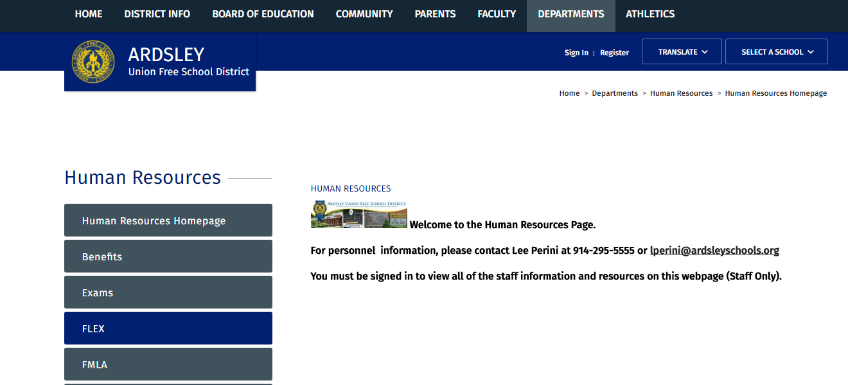

Flexible Spending Account (FSA)
How do I submit for reimbursement?

Slide 19
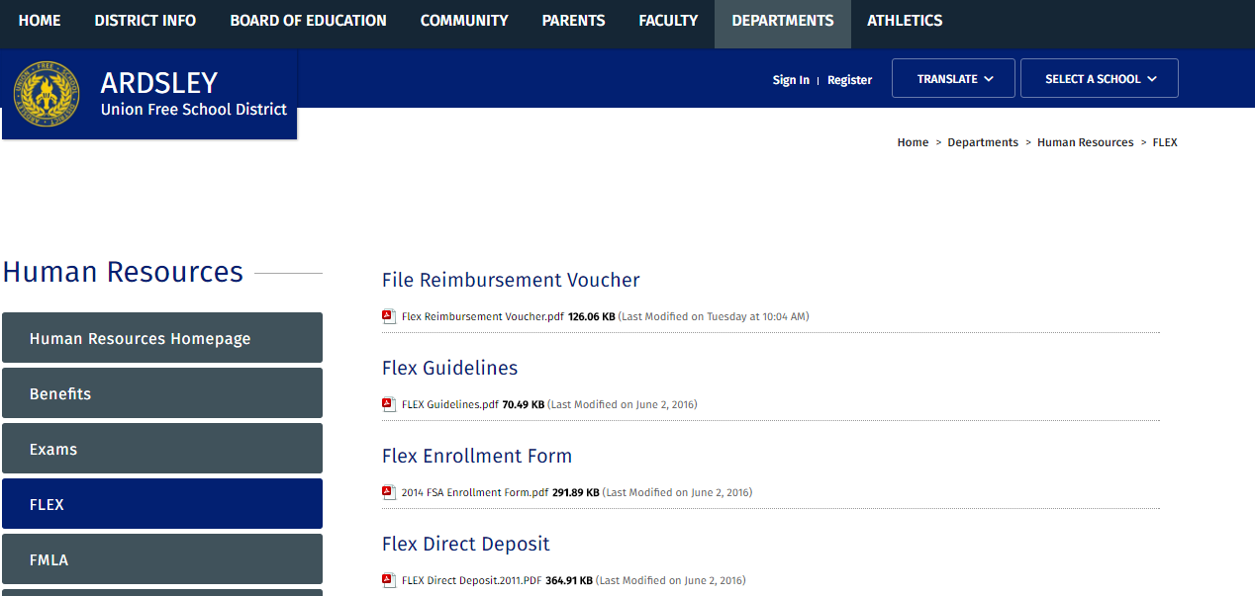
Flexible Spending Account (FSA)
How do I submit for reimbursement?

Slide 20

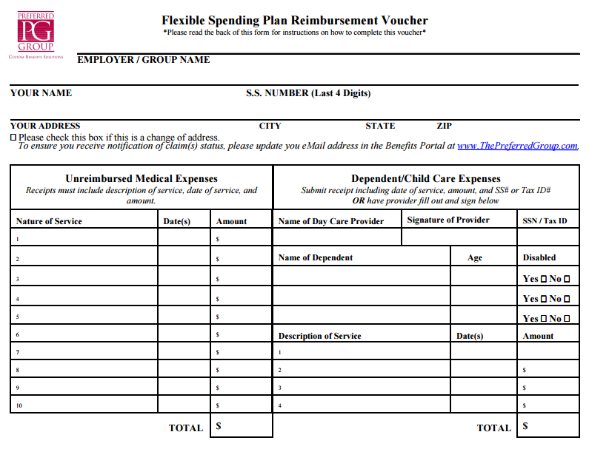
Complete Form: Fax or Complete Online

Slide 21
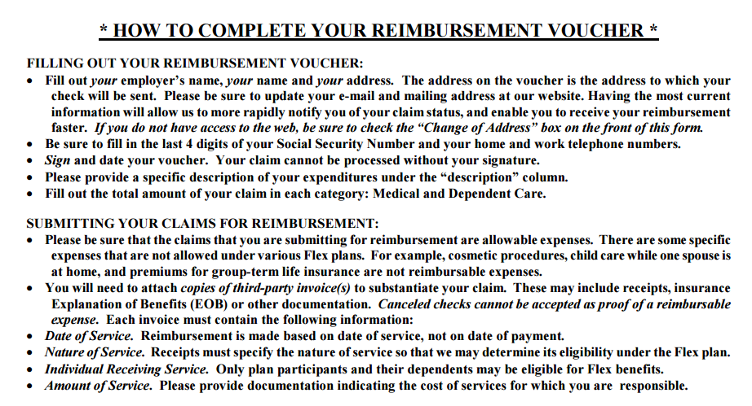

Slide 22
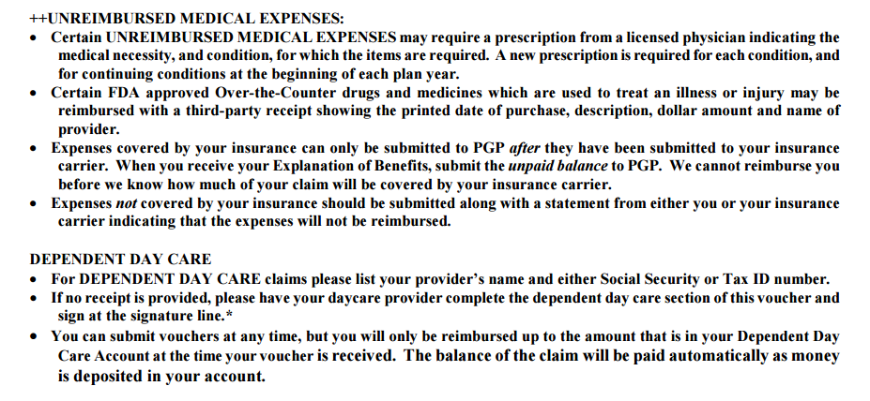

Slide 23
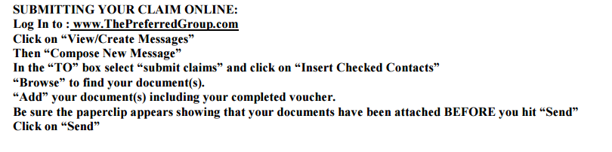
If you have any questions regarding your Flex Account, please contact The Preferred Group at (518) 641-0321 or (800) 573-7474 from 8:00 - 5:00 pm Monday through Friday.

