Slide 1


Slide 2

According to Oxford Learning:
Summer learning loss may also be called summer setback or the summer slide.
Summer learning loss is when students return to school at a lower academic level than the end of the last school year. This happens when your child doesn’t use or practice the skills he or she learned at school during summer vacation.

Slide 3

Some facts…
The equivalent of one month of learning is lost after summer vacation.
2.6 months of math skills are lost over the summer.
• 2 months of reading are lost over the summer.
• 6 weeks are spent re-learning old material in the fall to make up for summer learning loss

Slide 4


Let’ s Watch!

Slide 5


Slide 6

Keep Reading….
Develop an enjoyable reading routine.
Join summer book clubs at local libraries or bookstores.
Read a chapter book as a family.
Read road signs, the GPS, and other environmental print.
Hold a neighborhood book club.
Swap books or comics with friends.
Use technology tools such as tablets and e-books.
Explore a new book series.
Take a “fun” book on vacations and car rides.

Slide 7

Keep Writing….
Encourage your child to keep a daily journal or story journal.
Write a play or story as a family.
Compose and send a letter or an email to a family member.
Suggest that your child create a comic strip or book.
Let your child see YOU reading and writing.

Slide 8
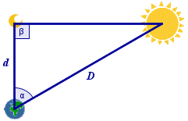
Math—
Keep Practicing
Have your child practice basic math facts.
Play card and board games.
Design and build with blocks, toys, or
household materials.
Let him/her count money and calculate discounts with you at the store.
Cook together using a recipe.
Find the math in the “everyday moments.”

Slide 9
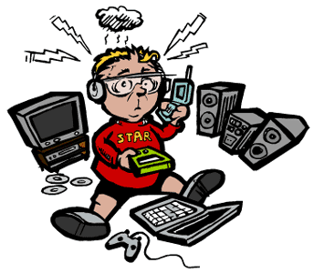
Limit TV and
Video Game Time
Use technology for learning fun.
Explore FREE educational apps and websites for kids such as Moby Max and Storylineonline.com.
Take a “virtual field trip” together.
Limit “mindless” game time.

Slide 10

Explore Web Resources for Parents
National Summer Learning Association
NBC News Learn “Parent Toolkit”
Onslow County Public Library
Scholastic for Parents
PBS Parents
Discovery Education
Read, Write, Think
Note: Click on underlined text to follow the web links.

Slide 11

Digital Learning Resources
Storyline Online
Storynory
Into the Book
UNC-TV for Kids
Oxford Owl for Home
Cool Math
Khan Acadamy
Splash
MathGames.com
Kids Discover
GoNoodle
Access your child’s OCS Reading Eggs, Reading Eggpress, and Education City using Clever school login
OCS Media Center/Research Portal
International Children’s Digital Library
Read to Me International
Free Children’s Stories
Note: Click on underlined text to follow the web links.

Slide 12

Resources for
English Learners
WIDA Activities for Families (English)
WIDA Activities for Families (Spanish)
North Carolina Department of Public Instruction (NCDPI) EL Resources
Makers Station Home Pack
ESL Video
Spanish/English Sight Word Lists
Note: Click on underlined text to follow the web links.
This Photo by Unknown Author is licensed under CC BY-SA

Slide 13


Stay Active and Healthy…
It Assists Concentration
Spend family time outside.
Exercise and play together.
Join a recreation center.
Enter a race or community event.
Choose healthy snacks for everyone.
Remind children to play safely.

Slide 14
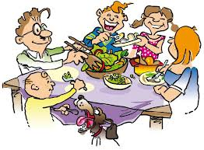
Increase Family
“Talk Time”
Discuss books read and movies watched.
Enjoy technology-free dinners with conversation.
Share events and the best parts of your day.
Discuss and plan weekly events or meals together.
Take a family day trip or “virtual field trip”
Share favorite memories and stories from the past.

Slide 15

Have fun,
encourage continued learning, stay active,
and spend time together.
The possibilities are as endless
as the imagination!

Slide 16


Slide 17
Resources
Scholastic--https://www.scholastic.com/parents/books-and-reading/raise-a-reader-blog/summer-slide.html
Oxford Learning--https://www.oxfordlearning.com/summer-learning-loss-and-how-to-prevent-it/
Parent Toolkit--https://www.parenttoolkit.com/
Parent Toolkit (Spanish)-- https://www.parenttoolkit.com/home?lang=es
Note: Click on underlined text to follow the web links.

