Slide 1

TITLE IX
Understanding the New
Title IX Regulations
BIBB COUNTY SCHOOL DISTRICT
Leadership. Scholarship. Citizenship.
Jamie Cassady
Assistant Superintendent of Student Affairs
Canon Hill & Renee Rainey
Jones Cork, LLP
November 2, 2020

Slide 2
  Title IX
  Title IX of the Education Amendments of 1972
  No person in the United States shall, on the basis of sex, be excluded from participation in, be denied the benefits of, or be subject to discrimination under any educational program or activity receiving Federal financial assistance.​

Slide 3
  A Very Brief History of Title IX and Schools
  1975: U.S. DOE promulgated rules to enact Title IX
  1997: U.S. DOE included sexual harassment under Title IX
  1998: Gebser v. Lago Vista: SCOTUS rules a educational entity is liable for Title IX teacher-on-student harassment if it is “deliberately indifferent” to “actual notice” of discrimination
  1999: Davis v. Monroe Co., GA BOE: SCOTUS rules peer-on-peer harassment is actionable under Title IX.
  2001: U.S. DOE included “interim measures” to help victims
  2011 and 2014: Additional guidance from OCR on sexual harassment
  2017- U.S. DOE/OCR’s guidance on sexual harassment was rescinded

Slide 4
  What’s the all the fuss about the new Title IX regulations?
  New regulations effective on August 14, 2020
  U.S. DOE’s Guidance document is over 2,000 pages
  Concerns across the nation on major Title IX changes during a pandemic
  Significant changes on how Title IX is addressed when a report is made
  Additional requirements on the District to investigate and respond
  Extensive training requirements

Slide 5
  BCSD’s Title IX Coordinator – Mr. Jamie Cassady
  Receives reports of sexual harassment
    Mr. Cassady is identified on BCSD’s website as our Title IX Coordinator.
  Also included on our Title IX page:
    Non-Discrimination Statement under Title IX
    Title IX Grievance Procedures
    BCSD’s Title IX Complaint Form
    Title IX Coordinator’s: Office address, email address and phone number
  Title IX Coordinator will maintain training records

Slide 6
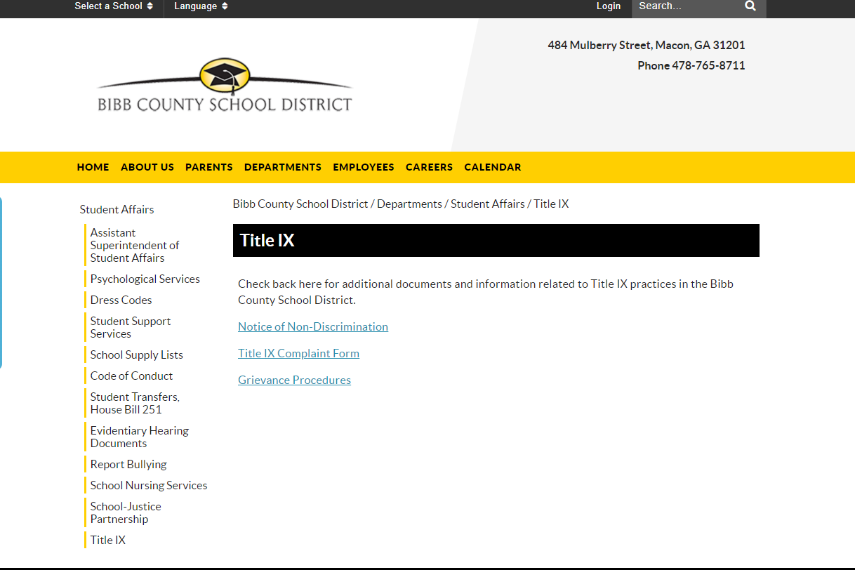
Title IX and BCSD

Slide 7
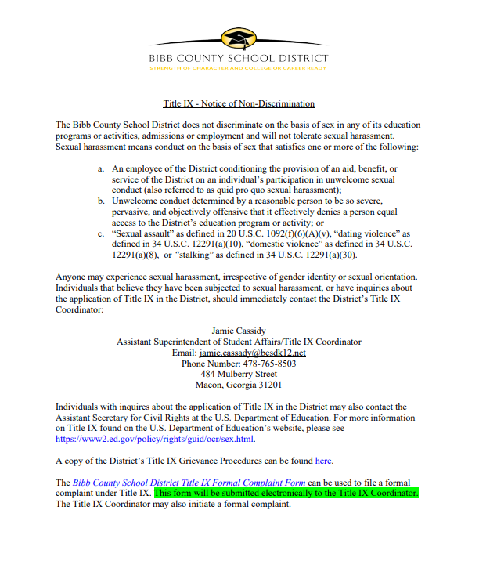
Title IX and BCSD

Slide 8
Common Examples of
Sexual Misconduct or Harassment
Unwelcome sexual advances​
Sexual jokes, gossip regarding another’s sex life, sexual orientation, or gender identity​
Leering, whistling, obscene gestures​
Insults or threats based on sex or gender​
​

Slide 9
Specific Definition of Sexual Harassment
  Sexual Harassment – Conduct on the basis of sex that satisfies one or more of the following:
    A District employee conditioning the provision of an aid, benefit, or service of the District on an individual’s participation in unwelcome sexual conduct;
    Unwelcome conduct determined by a reasonable person to be so severe, pervasive, and objectively offensive that it effectively denies a person equal access to a District education program or activity; or
    “Sexual assault” as defined in 20 U.S.C. 1092(f)(6)(A)(v), “dating violence” as defined in 34 U.S.C. 12291(a)(10), “domestic violence” as defined in 34 U.S.C. 12291(a)(8), or “stalking” as defined in 34 U.S.C. 12291(a)(30).

Slide 10
Sexual Harassment under the
New Title IX Regulations
Not all reports will lead to a formal Title IX investigation ​
Always err on the side of caution – REPORT

Slide 11
  Title IX vs. District Code of Conduct
  Student conduct involving sexual discrimination, harassment or assault automatically invokes Title IX
    Must be handled differently than other conduct matters
    Must involve your Title IX coordinator
    Must follow the District’s Title IX Grievance Procedures if a formal complaint is filed
  Sexual misconduct involving students may result in a Title IX investigation
    Likely addressed through the student discipline process/Code of Conduct.

Slide 12
  Responsibility to Respond
  District must respond to any complaint of sexual harassment
  The District cannot be “deliberately indifferent” to sexual harassment
    Cannot put your head in the sand
    This incudes conducting a thorough investigation – more on investigations in a moment
    Providing support measures for the complainant and respondent

Slide 13
  All District Employees Must Report Potential Sexual Harassment or Assault
  The regulations require:
    The District to respond when it has actual knowledge of sexual harassment in one of its education programs or activities against a person in the United States.
      The District will respond promptly in a manner that is not deliberately indifferent.
      The District would only be deliberately indifferent if its response to sexual harassment is clearly unreasonable in light of the known circumstances.
    Actual Knowledge – Notice of sexual harassment or allegations of sexual harassment to the District’s Title IX Coordinator, any District official who has authority to institute corrective measures on behalf of the District or any District employee.
  What does this mean for our building administrators? -- Train all your staff of this requirement!

Slide 14
  When do the Title IX Grievance Procedures apply?
  Covered:
  Complainant MUST be a current student or attempting to enroll
  Any school event and any location where a school event took place
    Includes remote/ virtual learning

Slide 15
  When do the Title IX Grievance Procedures apply?
  Formal Complaints = Initiation of the Title IX Grievance Procedures
  Formal Complaint –
    Document filed by a complainant or signed by the Title IX Coordinator alleging sexual harassment against a respondent and requesting that the District investigate the allegation of sexual harassment.
    If a student makes a verbal complaint, you can ask the student to write out the complaint

Slide 16
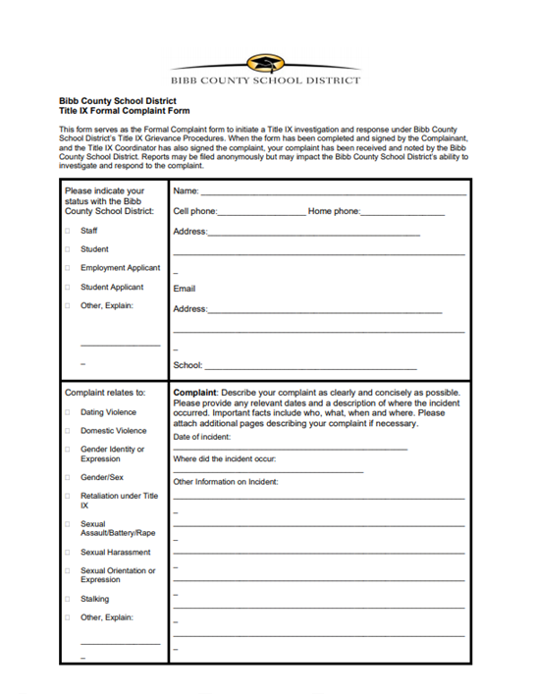
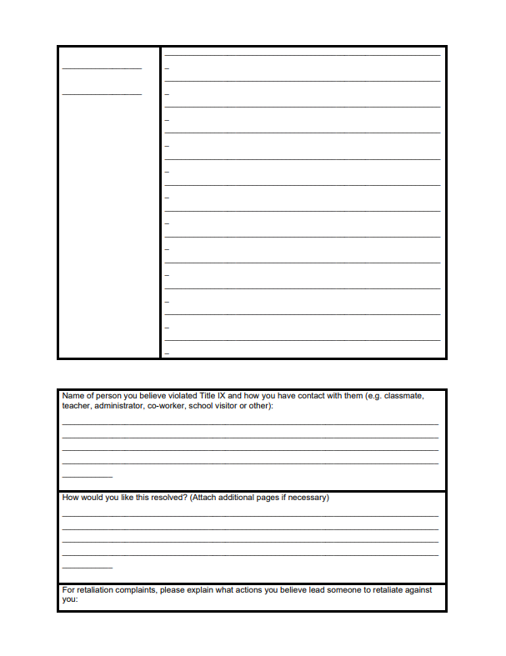
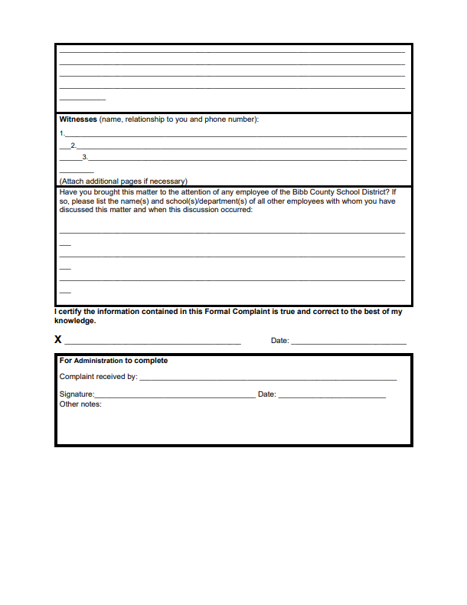
BCSD’s Title IX Complaint Form - found on the District’s Website

Slide 17
  Formal Complaints
  If the complainant withdraws a complaint, this must be respected and the investigation ends under Title IX.
  HOWEVER, the Title IX coordinator can continue to investigate if the complaint is severe and it makes sense to continue
      Ex: Multiple complaints against the same student
      Ex: Concerns the complainant withdrew the complaint out of fear

Slide 18
When do the Title IX Grievance Procedures apply?
  District MAY dismiss a formal complaint if:
  If the respondent is no longer enrolled
  The complaint withdraws the complaint
  An accused employee resigns or is no longer employed with the District
  Off-campus conduct that is not school-related
  **Notice of a non-covered event may trigger other reporting obligations and responses, e.g. Georgia’s Mandatory Reporter Statute, Bullying Policy, Discrimination under Policy JAA, etc.

Slide 19
Dismissing Title IX Complaints
The new Title IX Regulations provide that a formal complaint must be dismissed:
    If the allegations would not constitute sexual harassment;
    Did not occur in a District program or activity; or
    Did not occur against a person in the United States.
A dismissal may be appealed. More on the appeal process in a moment.
Remember: Always evaluate whether the alleged complaint constitutes a violation of the Code of Conduct or other district policy.

Slide 20
You be the judge… Sexual Misconduct vs. Title IX Sexual Harassment
Scenario #1: Students engage in sexual misconduct at a school event where there is no allegation of rape, assault or unwanted conduct.
Scenario #2: A teacher tells a student that they will not receive a passing grade in their class unless they provide some sort of sexual favor.

Slide 21
You be the judge… Sexual Misconduct vs. Title IX Sexual Harassment
Scenario # 3: Off campus misconduct of a sexual nature interfering with school operations.
Scenario #4: A female student alleges a male student forced her to have sex during an overnight field trip.

Slide 22
You be the judge…Sexual Misconduct vs. Title IX Sexual Harassment
Scenario #5: A transgender male alleges a group of students are making fun of him for using the unisex bathroom, continuing to call him by his biological female name, and using other discriminatory words. This student is now requesting to learn remotely.
Scenario #6: A group of students snapchatting comments of a sexual nature about another group of students.

Slide 23
You be the judge…Sexual Misconduct vs. Title IX Sexual Harassment
Scenario #7: A teacher and a student are exchanging flirty texts of a sexual nature using their personal electronic devices.
Scenario #8: A female student reports a group of male students harassed her at a party after the prom.
Scenario #9: A female student reports that a male student grabbed her butt.

Slide 24
  Online Sexual Harassment
  A student sexually harassing a student online while off campus is not covered under the new rules - no requirement to investigate under Title IX
    HOWEVER…If activity finds its way back to campus or District technology was used, there is an obligation to report and investigate under Title IX
    Can ALWAYS investigate the matter under the District’s Code of Conduct, Bullying Policy, or Policies JAA and GAAA, even if not required by Title IX

Slide 25
Title IX Grievance Procedures
What is the big deal about these new Grievance Procedures?
How are they different from what we have done in the past in responding to Title IX allegations?

Slide 26
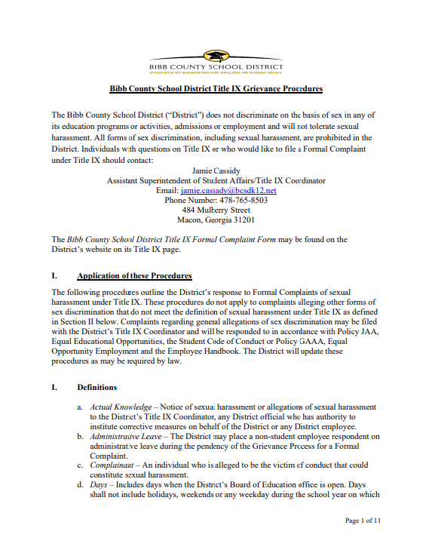
Title IX Grievance Procedures - found on the District’s Website

Slide 27
  Grievance Process – The Investigation
  Emphasis on fair, equitable and without bias
  No conflict of interest
  The District has the burden of gathering the evidence
  The investigator(s) cannot be the decision-makers
  Principals and Assistant Principals will be involved in Title IX investigations

Slide 28
Title IX Investigations
    Remain unbiased
    Notify students and parents of the allegations (more on this later)
    Treat both parties equitably
    Do not make decisions on stereotypes or past experiences with the students
    Consider supportive measures throughout the investigation process
    Allow both parties (complainant and respondent) to share their stories
    Ask both parties for names of witnesses or other evidence

Slide 29
Title IX Investigations
    Obtain witness statements
    Conduct interviews and follow up interviews
    Consider all evidence presented by both parties
    Take detailed notes
    Review and save video footage
    Determine if there is any other physical evidence
    Work with law enforcement and social services, if necessary

Slide 30
What are supportive measures?
Non-disciplinary, non-punitive individualized services
Free to both parties. Before or after the filing of a Formal Complaint
Designed to restore or preserve equal access to a District education program or activity without unreasonably burdening the other party
Including measures designed to protect the safety of all parties or the District’s educational environment, or deter sexual harassment

Slide 31
Examples of Supportive Measures
Counseling
Extension of deadlines or other course-related adjustments
Modifications of work/class schedules
Campus escort services
Mutual restrictions on contact between the parties
Changes in work locations
Leaves of absence
Increased security and monitoring of certain areas of the campus

Slide 32
Supportive Measures Requirements
Must maintain as confidential any supportive measures (to the extent that doing so would not impair the District’s ability to provide the supportive measures)
The Title IX Coordinator oversees the implementation of the effective supportive measures
May be implemented even if a Formal Complaint is not filed

Slide 33
Title IX Investigations – New Provisions
Notice Requirements
Provide notice to a party (not a witness) who is invited or expected to attend, written notice of the date, time, participants, purpose, and location of any investigative interview, hearing, or other meeting with enough time to allow the party to prepare to participate.
Both parties have the same opportunities to have others present during interviews or other related proceedings, including an advisor who may but is not required to be an attorney.

Slide 34
New: Parties to Review Evidence
Both parties and their advisors, if any, must have an equal opportunity to review all evidence that is directly related to the allegations in the formal complaint.
  Such evidence must be provided prior to the completion of the final investigation report and in time to give the parties at least 10 days to prepare a written response, which the investigator must consider prior to completing the investigation report.

Slide 35
New: Parties to Review Evidence
What about student privacy concerns and sharing all this evidence?
  This may feel uncomfortable, but Title IX requires transparency
    Very tricky to navigate
      Use student initials when appropriate
      Do not promise complete confidentiality
      Provide adult witness names

Slide 36
New: Investigation Report Requirements
Title IX Coordinator and/or designee must prepare a written investigation report that fairly summarizes the relevant evidence.
MUST provide the report to the parties and their advisors, if any, for their review and written response, at least 10 days before a hearing or other determination of responsibility.
* More on the Determination of Responsibility in moment.

Slide 37
New: Emergency Removals
  May remove a respondent (accussed student) from their education program or activity on an emergency basis during the investigation and up to the hearing.
  Must undertake an individualized safety and risk analysis to determine if there is an immediate threat to the physical health or safety of any student or other individual arising from the allegations of sexual harassment justifies removal.
  Must provides respondent with notice and an opportunity to challenge the removal decision

Slide 38
New: Emergency Removals
        School principal will determine if an emergency removal is appropriate
        Students subject to emergency removal may be allowed to participate in remote learning options
        Appeals on emergency removals are made to the Title IX Coordinator

Slide 39
New: Informal Resolutions
Informal resolution process is available to resolve allegations of sexual harassment between students
Process is not available for sexual harassment allegations against an employee
Student participation in voluntary
Informal resolution can be reached any time prior to a final decision, or determination of responsibility

Slide 40
New: Informal Resolutions
Resolution must be agreed to by both parties in writing
If a resolution is reached, the formal complaint is dismissed
Complainant is precluded from filing a second complaint concerning the original allegation
  BUT patterns of conduct may be considered in subsequent complaints involving the same respondent

Slide 41
New: Informal Resolutions
At any time prior to agreeing to a resolution, any party may withdraw from the informal resolution process and resume the grievance process
Title IX Coordinator designates an impartial facilitator for the informal resolution process

Slide 42
Title IX Hearings - Determination of Responsibility
New Title IX regulations, provide K-12 programs with an opportunity to conduct a “paper hearing”
Our Decision Maker (Chief Simmons) will facilitate an exchange of questions and statements between the parties and witnesses
Burden of proof is on the District
  Preponderance of Evidence standard (same as student discipline hearings)

Slide 43
Title IX Hearings - Determination of Responsibility
Decision Maker issues a notice to the parties with deadline to submit questions and the date responses are due.
May ask up to 25 written questions
        May exclude irrelevant questions, but Decision Maker must explain why
  Not allowed to ask questions or seek evidence about prior sexual acts
    UNLESS, it is used to prove someone other than the respondent committed offense

Slide 44
Written Determination of Responsibility
The decision, or Written Determination of Responsibility, sets forth the following:
Identifies allegations potentially constituting sexual harassment;
Describes procedural steps taken;
Findings of fact supporting the determination;
Conclusions regarding the application of the District’s Code of Conduct to the facts;
Statements of, and rationale for, the result as to each allegation, including a determination regarding responsibility, and whether remedies designed to restore or preserve equal access to the District’s education program or activity will be provided by the District to the complainant; and
District’s procedures and permissible bases for the complainant and respondent to appeal.

Slide 45
Written Determination of Responsibility
Decision Maker has 15 days to prepare written decision after all questions and statements have been submitted
  Written decision provided to both parties simultaneously
  Send via hand delivery, statutory overnight delivery or certified mail

Slide 46
Title IX Appeals
Either party may appeal the Determination of Responsibility
District’s Student Disciplinary Hearing Officer will review appeal
Deadline to file appeal: 20 days from the Determination of Responsibility or allegation is dismissed
Discipline imposed remains in place during the appeal
  May be suspended by the Superintendent pending the outcome of the appeal

Slide 47
Reasons for an Appeal
Procedural irregularity that affected the outcome of the matter.
New evidence that was not reasonably available at the time the determination regarding responsibility or dismissal was made, that could affect the outcome of the matter.
Title IX Coordinator, investigator, or Decision Maker had a conflict of interest or bias for or against complainants or respondents generally or the individual complainant or respondent that affected the outcome of the matter.
Disciplinary sanction was excessive or there is an inherent disproportion between the offense and the disciplinary action.

Slide 48
Appeals - Decision
The Student Discipline Hearing Officer will be responsible for:
  Notifying the other party in writing when an appeal is filed and implementing appeal procedures equally for both parties.
  Giving both parties a reasonable, equal opportunity to submit a written statement in support of, or challenging, the outcome.
  Issuing a written decision describing the result of the appeal and the rationale for the result.
  Providing the written decision simultaneously to both parties.
    Decision is due 10 days from the date the parties submit written statements.

Slide 49
Appealing Student Disciplinary Sanction to BOE
Any student that receives discipline sanctions under the District’s Code of Conduct in response to a Formal Complaint, may appeal the discipline sanctions to the Board of Education as provided by O.C.G.A. § 20-2-754(c).
Appeals to the Board of Education regarding the discipline imposed, must be made within twenty (20) days from the date the District’s Student Discipline Hearing Officer renders a written decision on the appeal.

Slide 50
Record Retention Requirements
  The District will maintain for seven years the following records:
    Documents and evidence collected during a Title IX investigation
    Audio or audiovisual records or transcripts
    Disciplinary sanctions implemented
    Remedies
    Supplemental measures
    Written Determinations of Responsibility
    Title IX training materials

Slide 51
  Retaliation Prohibited
  All parties, including the witnesses are protected
  Examples of possible retaliation:
    Intimidation, threats, coercion, or discrimination, including charges against an individual for code of conduct violations that do not involve sex discrimination or sexual harassment, but arise out of the same facts or circumstances as a report or complaint of sex discrimination, or a report or formal complaint of sexual harassment.

Slide 52


