Slide 1
Hudson City School District
Five Year Forecast
FY 2018 thru FY 2022
Board of Education Meeting
October 23, 2017
Presented by Kathryn L. Sines, Treasurer/CFO

Slide 2
Forecast Purpose
Forecast was created by the 122nd General Assembly in 1997-98 via H.B. 412.
A forecast is intended to assist the school district in the financial management of its resources.
A forecast serves as a basis for determining the district’s ability to sign the 412 certificate for multiple year contracts, as required by ORC 5705.412.

Slide 3
Revenue, Expenditures and Cash Balance
 |  |  |  | Fiscal Year | Fiscal Year | Fiscal Year | Fiscal Year | Fiscal Year
 |  |  |  | 2018 | 2019 | 2020 | 2021 | 2022
Beginning Balance |  |  |  | 31,956,651 | 32,022,881 | 29,712,647 | 25,098,834 | 17,956,486
+ Revenue |  |  |  | 61,348,158 | 61,238,829 | 61,363,171 | 61,409,829 | 61,279,258
+ Proposed Renew/Replacement Levies |  |  |  | - | - | - | - | -
+ Proposed New Levies |  |  |  | - | - | - | - | -
- Expenditures |  |  |  | (61,281,929) | (63,549,063) | (65,976,984) | (68,552,178) | (71,242,714)
= Revenue Surplus or Deficit |  |  |  | 66,230 | (2,310,234) | (4,613,813) | (7,142,348) | (9,963,456)
Ending Balance |  |  |  | 32,022,881 | 29,712,647 | 25,098,834 | 17,956,486 | 7,993,030

Slide 4
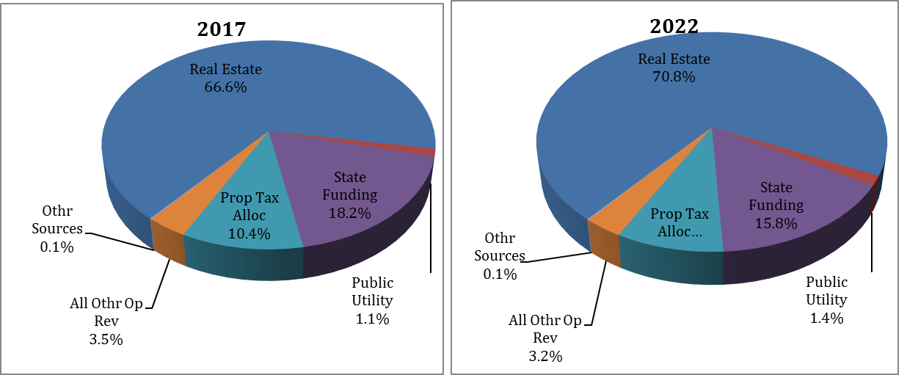
Revenues
8.8%

Slide 5
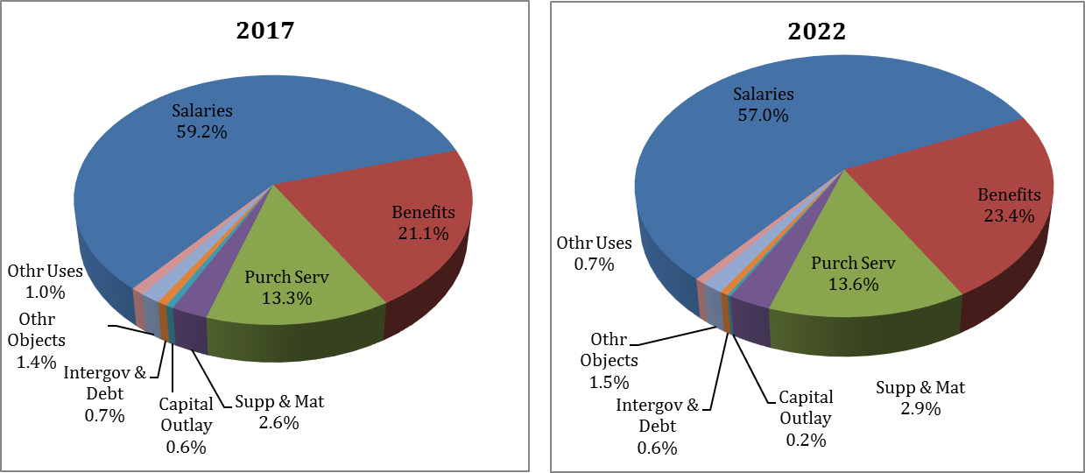
Expenditures

Slide 6
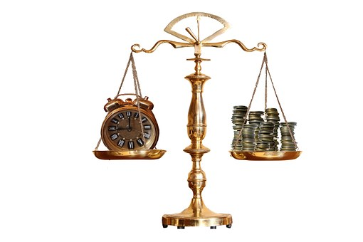
Targeted Cash Balance
 | 2018 | 2019 | 2020 | 2021 | 2022
Total Unreserved Fund Balance Line 10.01 | 31,022,881 | 28,712,647 | 24,098,834 | 16,956,486 | 6,993,030
Total Expenses Line 5.05 | 61,281,929 | 63,549,063 | 65,976,984 | 68,552,178 | 71,242,714
Total Ending Balance % of Expenses = 8.3 % of line 5.05 | 5,086,400 | 5,274,572 | 5,476,090 | 5,689,831 | 5,913,145
Targeted True Days Cash Carryover | 30 days | 30 Days | 30 Days | 30 Days | 30 Days
Difference in Target Balance | 25,936,481 | 23,438,075 | 18,622,744 | 11,266,655 | 1,079,885
The district’s cash balance will meet the minimum required for financial stability and support the Board of Education’s cash balance policy through FY 2022. The Board’s cash policy sets a minimum balance of 30 days or 8.3% of expenses.

Slide 7
Summary
The district has a positive cash balance through the forecast. The revenue shortfall (expenses exceeding revenue) grows from a 2018 revenue surplus to a revenue shortfall in 2022.
The 2022 level, and the trend toward it, is unsustainable with projected revenues and expenditures.
The district will continue to make sound budget decisions and proactive financial recommendations. Each year the district will review spending and adjust decisions to help ensure ongoing stability.

Slide 8
Questions?
Questions??
Questions???
Submitted by Kathryn L. Sines, Treasurer/CFO
BOE Meeting October 23, 2017

