Slide 1

Second Quarter Financial Report
Board of Education
January 31, 2023

Slide 2

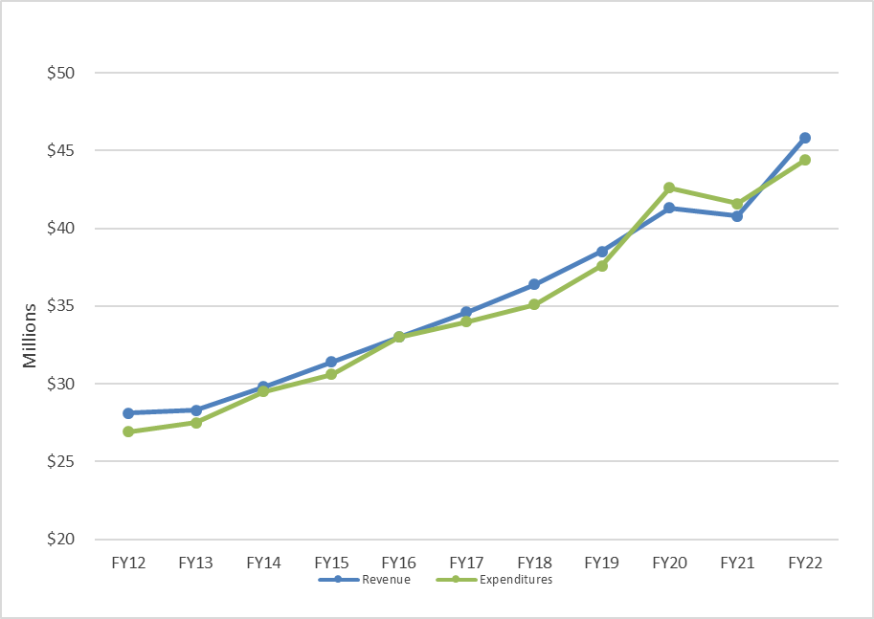
Annual Revenue and Expenditures

Slide 3
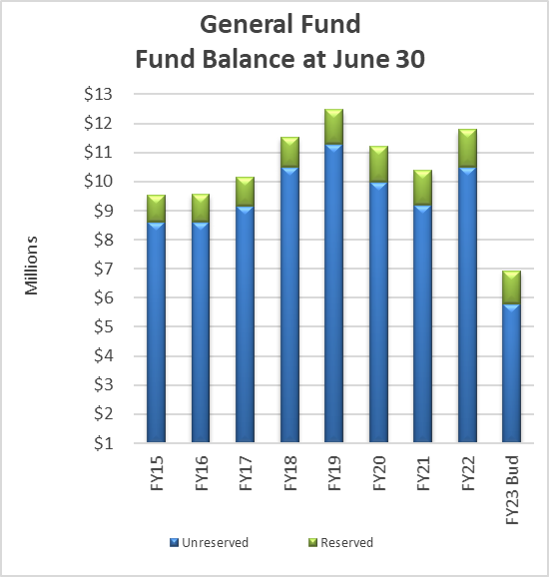
Annual Mill Levy and Fund Balance

Slide 4
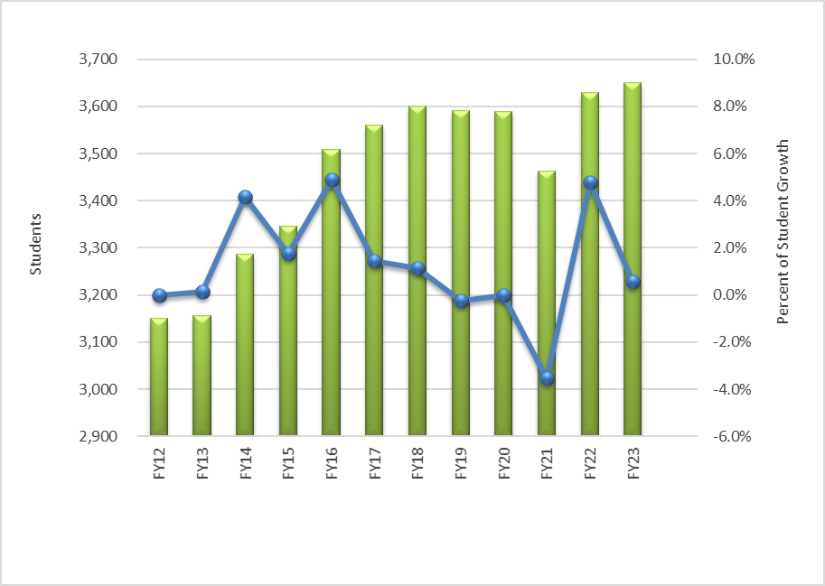
Annual Enrollment

Slide 5
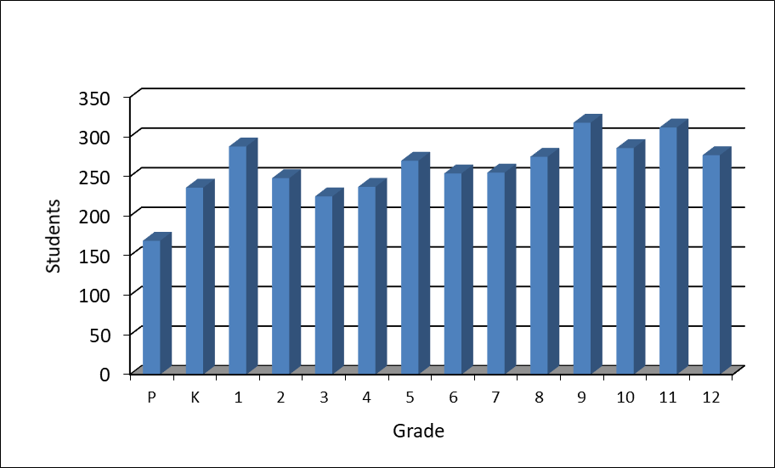
Enrollment by Grade
Enrolled Student By Grade – Oct 2022

Slide 6
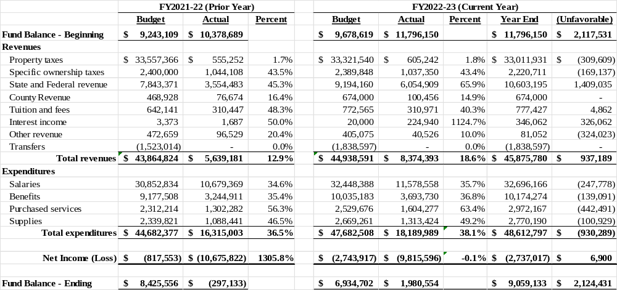
General Fund

Slide 7
General Fund – Resources for general operations
Changes in GF Revenue – $937,189
Additional Total Program Funding - $930,289
Changes in other revenue - $6,900
Changes in GF Expense – ($930,289)
Additional 2.0 FTE for SHS due to increase in enrollment ($187,000)
Board Certification payments to Special Service Providers ($100,000)
Additional spending for substitute teachers ($99,000)
Additional Purchased Services ($544,289)
  Additional spending to support Strategic Plan, Building Security Systems, Banking and Legal Fees ($139,993)
  Additional spending for utilities Natural Gas and Electric ($110,000)
  Additional spending for Technology and/or Curriculum Materials ($208,356)
  SWAP grant matching fund ($85,940)

Slide 8
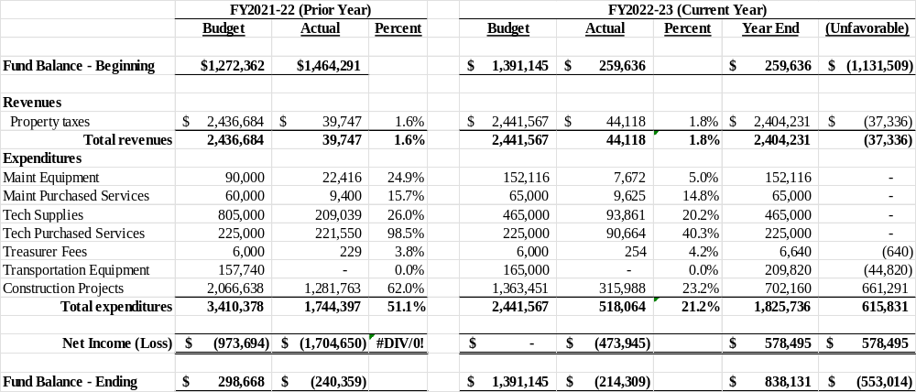
Supplemental Capital Construction & Technology Fund

Slide 9
Supplemental Capital Const, Maint & Tech Fund
Used for funding capital construction, new technology, upgrades to existing technology and maintenance of the District.
Changes in Revenue – ($37,336)
Property taxes collected will be lower than budgeted due to actual Assessed Valuation
Changes in Expense – $615,831
Savings compared to budget due to timing of construction projects. A large portion of 2022-23 projects were completed in June 2022.

Slide 10
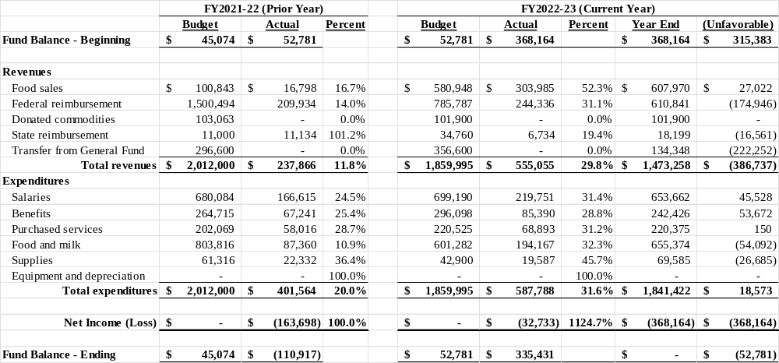
Food Service Fund

Slide 11
Food Service Fund
Used to account for all activity in the food service program.
Changes in Revenue – ($386,737)
Federal Reimbursement less than expected
Transfer from General Fund less than expected due to fund balance from 2021-22
Changes in Expense – $18,573
Additional spending on food and supplies is being offset by savings in salary

Slide 12
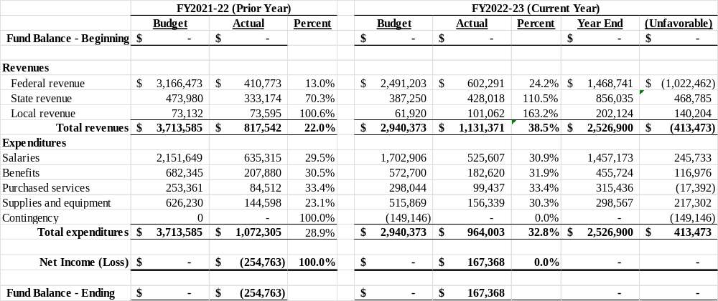
Grant Fund

Slide 13
Grant Fund
Used to account for all federal, state and local grants.
Changes in Revenue – ($413,473)
Current projected revenue is less than budgeted
Changes in Expense – $413,473
Savings in spending is in alignment with revenue
The District has received new grant awards since budget adoption and may need a supplemental budget at year end.

Slide 14
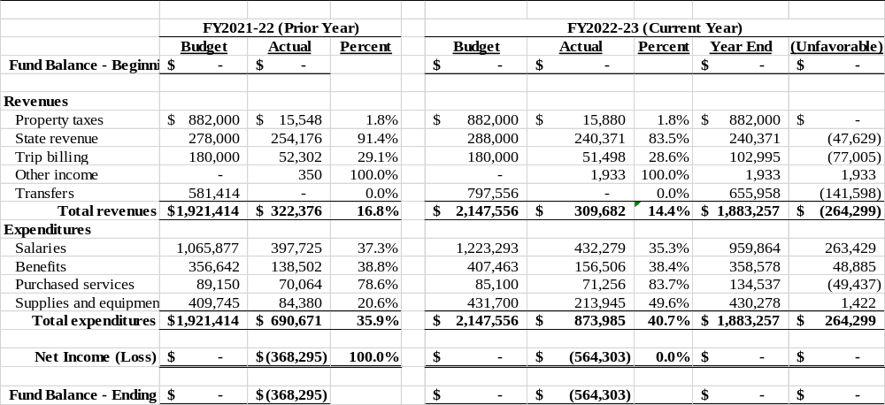
Transportation Fund

Slide 15
Transportation Fund – Resources for transportation costs
Used to account for all transportation costs of the district.
Changes in Revenue – ($264,299)
State reimbursement and trip billing less than expected
Transfer from General Fund less than expected due to lower expenditures
Changes in Expense – $264,299
Savings in salary and benefits due to vacant positions

Slide 16
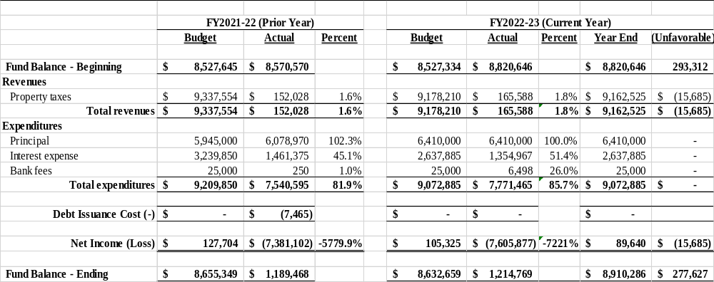
Bond Fund

Slide 17
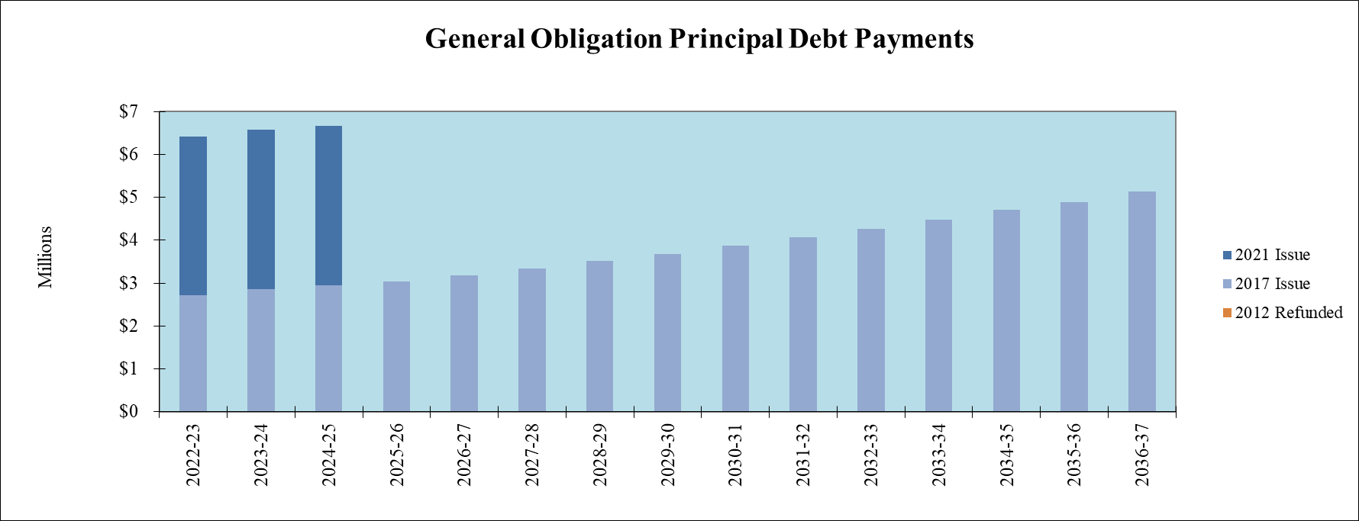
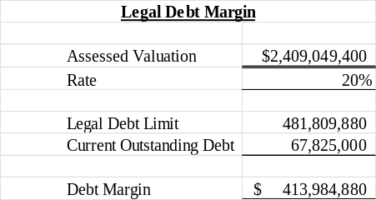
Bond Fund

Slide 18
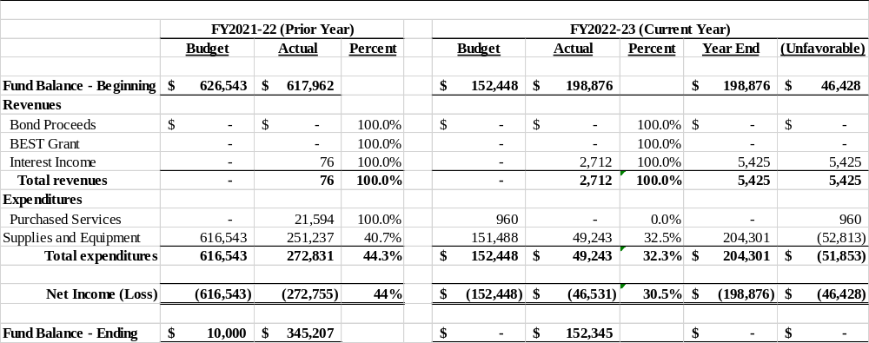
Building Fund

Slide 19
Building Fund – Resources for capital construction from bond proceeds
Revenue is used to account for acquisition of land, construction and acquisition of equipment from Bond Proceeds.
Changes in Revenue – $5,425
Additional revenue from interest income
Changes in Expense – ($52,813)
Expenditures higher than planned due to timing of construction projects

Slide 20
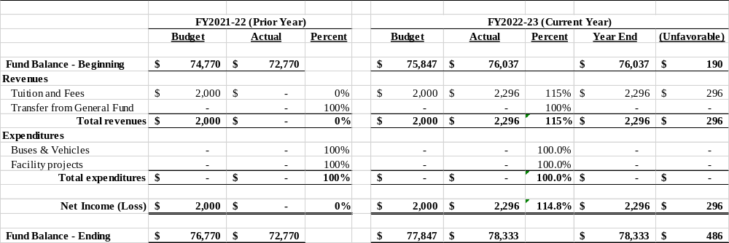
Capital Reserve Fund

Slide 21
Capital Reserve Fund
Revenue is used to account for acquisition of land, construction and acquisition of equipment.
Changes in Revenue – $296
Additional revenue from interest income
Changes in Expense
No changes in planned expenditures

Slide 22
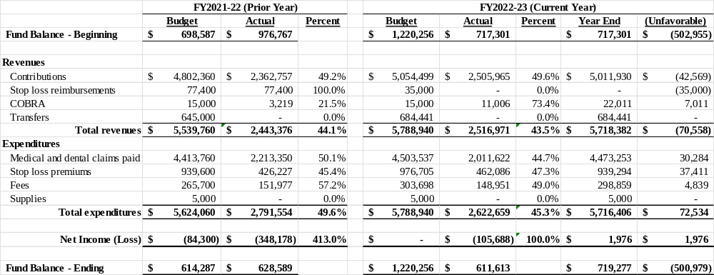
Health Benefits Fund

Slide 23
Health Benefits Fund
Revenue is used to account for the self funding of employee health, dental, vision, life and disability insurance.
Revenue Changes – ($70,558)
Revenue lower than expected due to lower contributions and stop loss reimbursements
Expenditure Changes – $72,534
Expenditures lower than budget due to projected savings in medical and dental claims

Slide 24
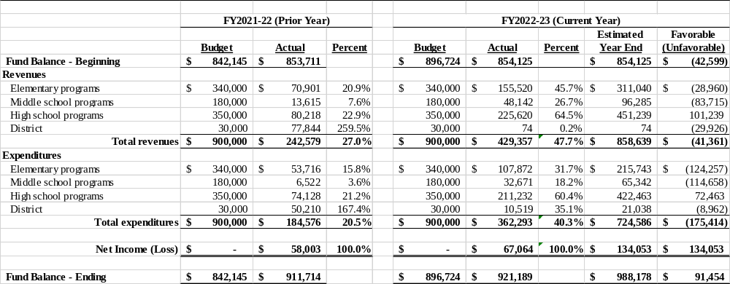
Student Activity Fund

