Slide 1
US History STAAR Review
East View High School

Slide 2
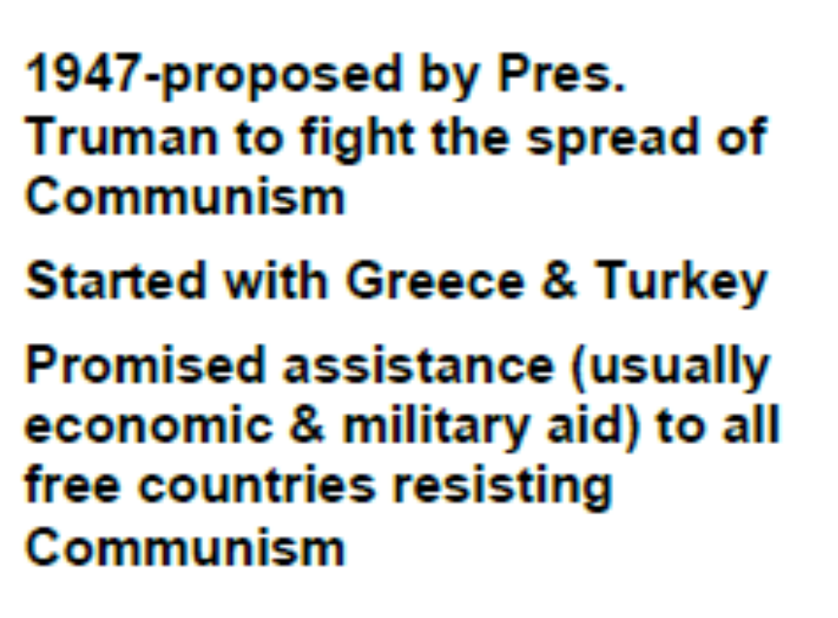
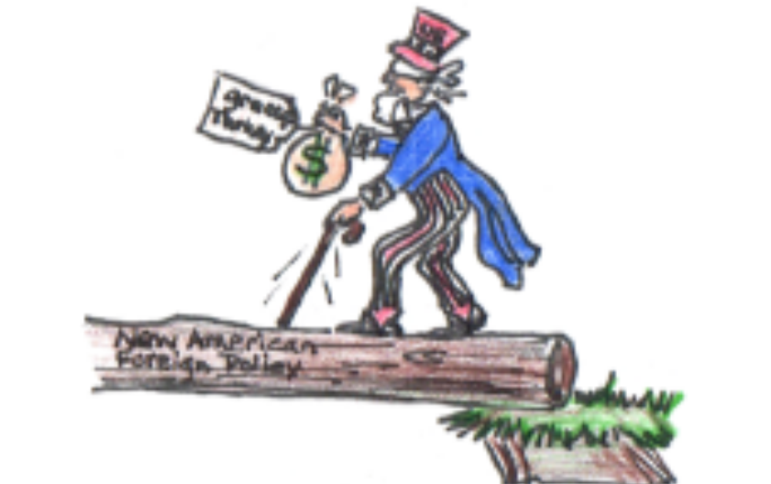
Truman Doctrine

Slide 3

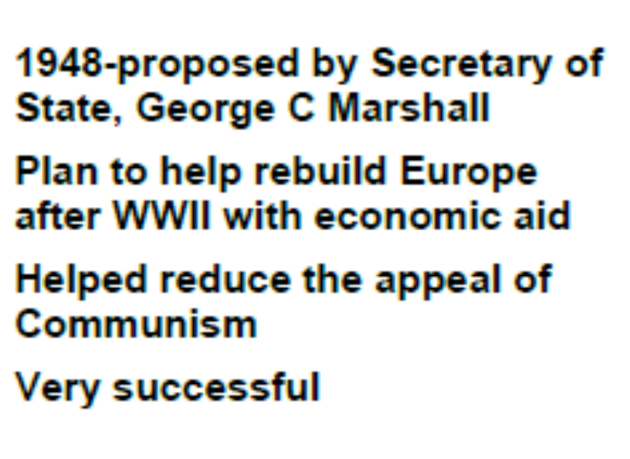
Marshall Plan

Slide 4

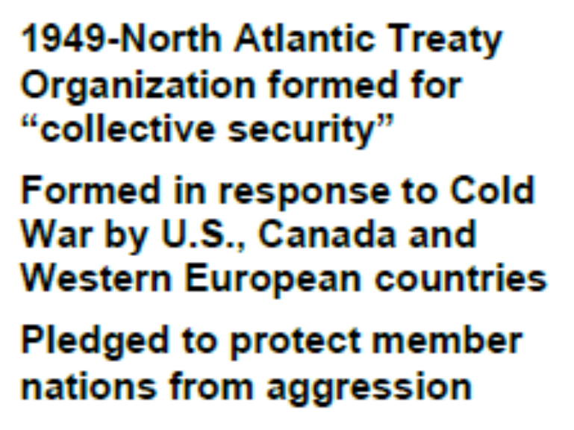
North Atlantic Treaty Org. (NATO)

Slide 5
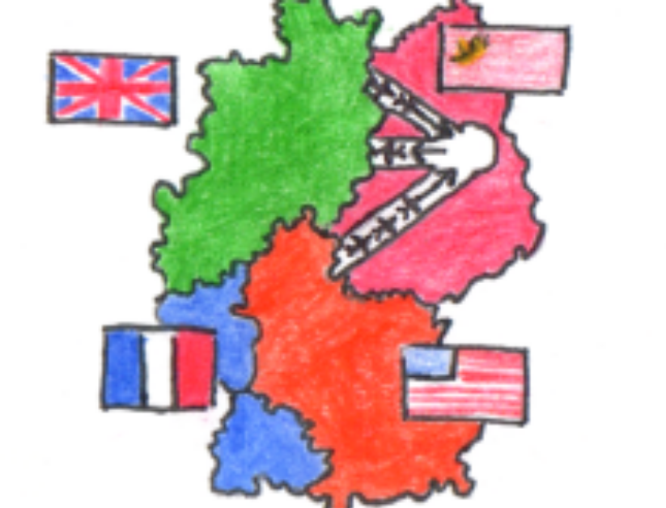
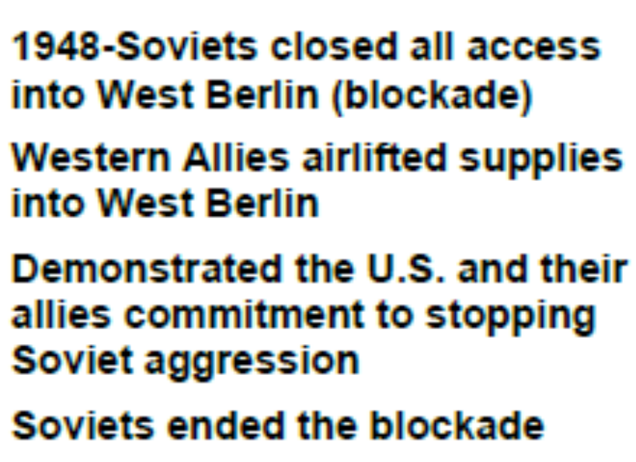
Berlin Airlift

Slide 6
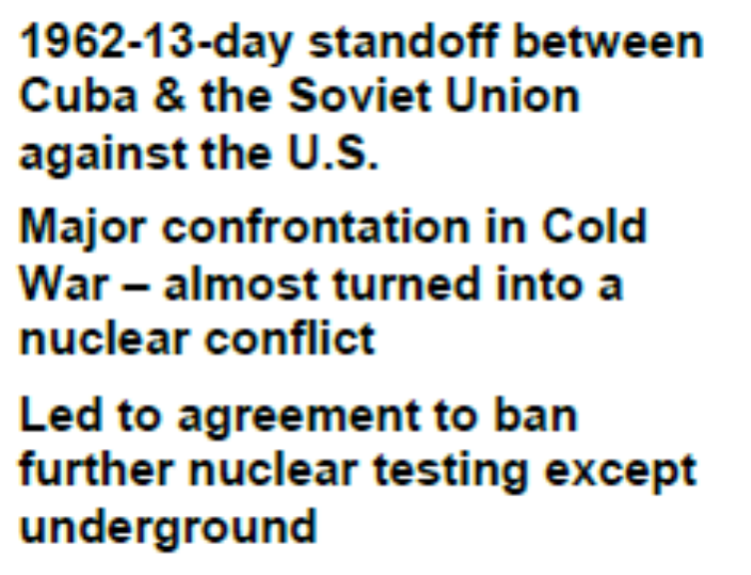

Cuban Missile Crisis

Slide 7
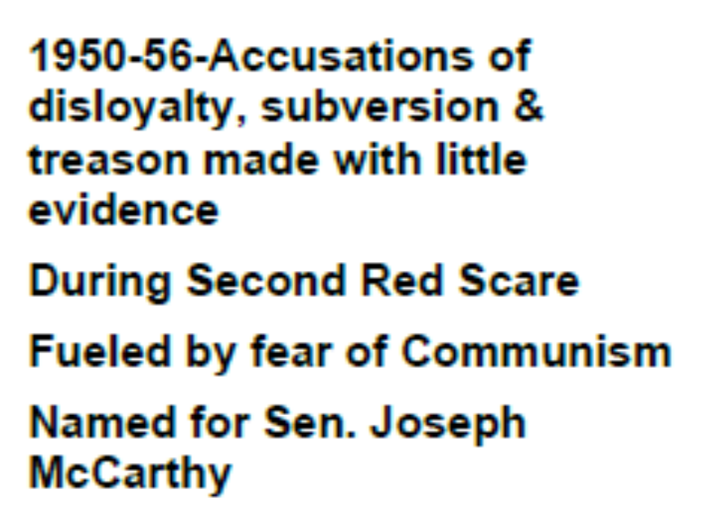
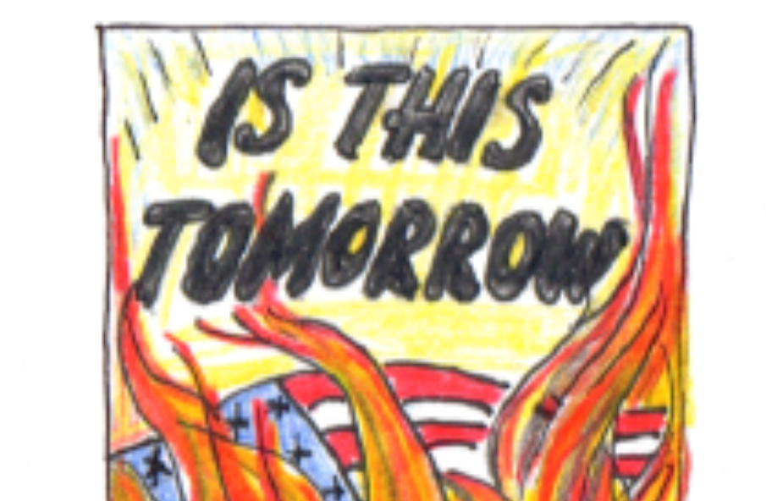
McCarthyism

Slide 8
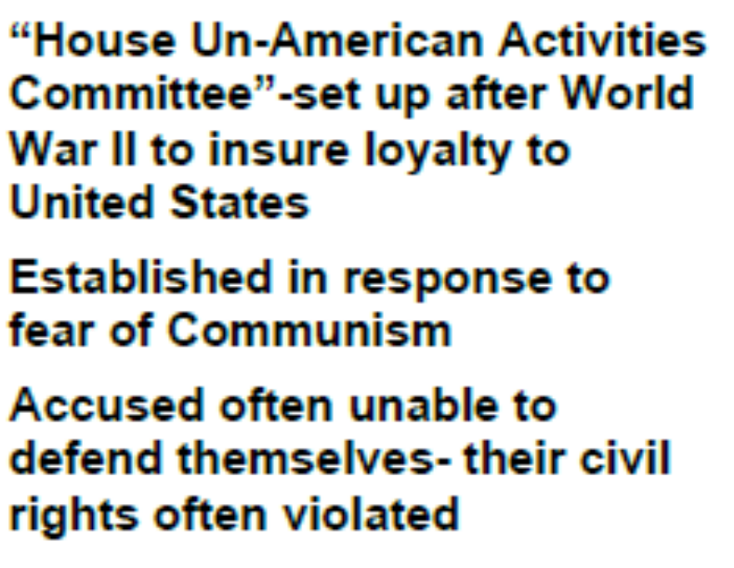
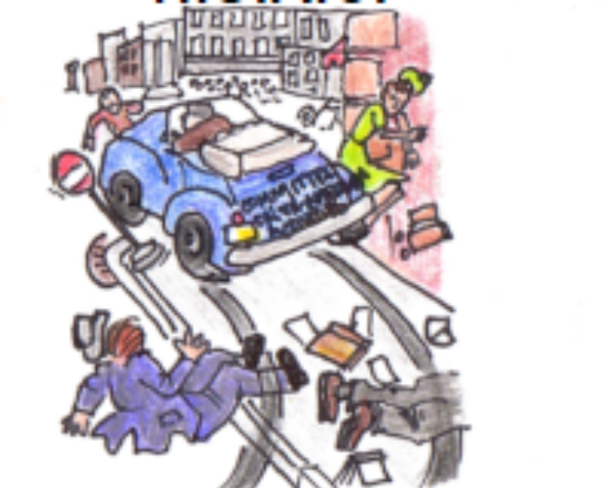
House Un American Activities Committee (HUAC)

Slide 9

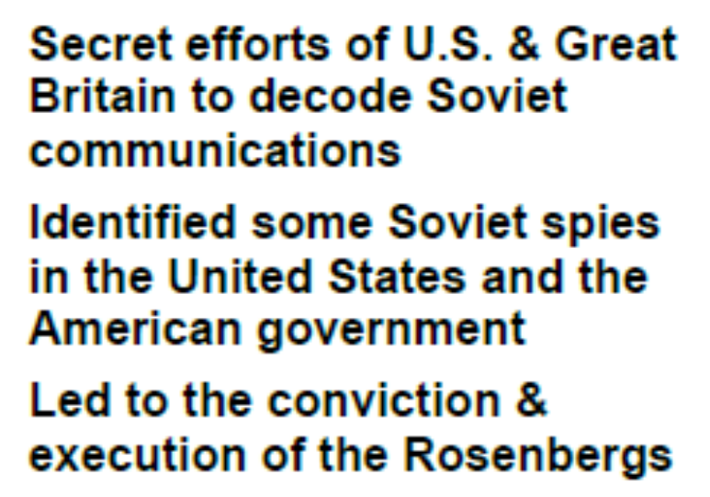
Venona Papers

Slide 10
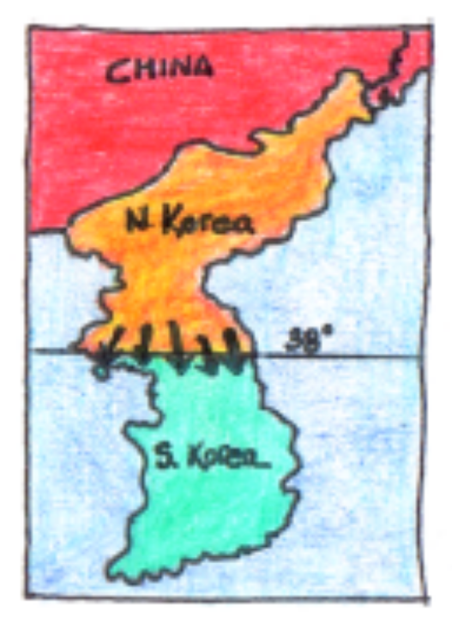
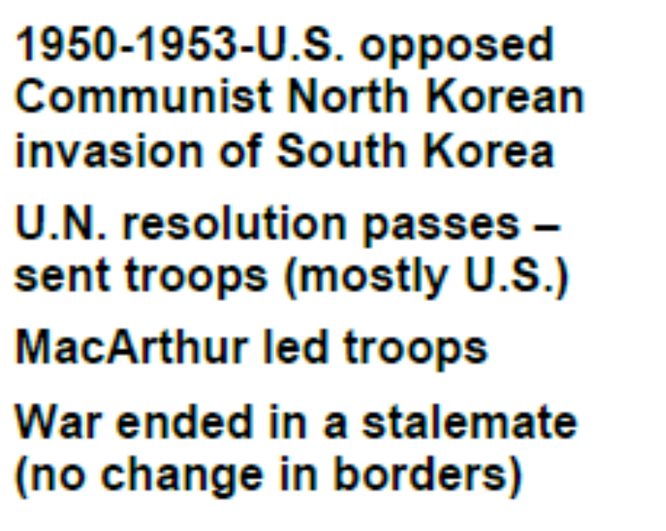
Korean War

Slide 11
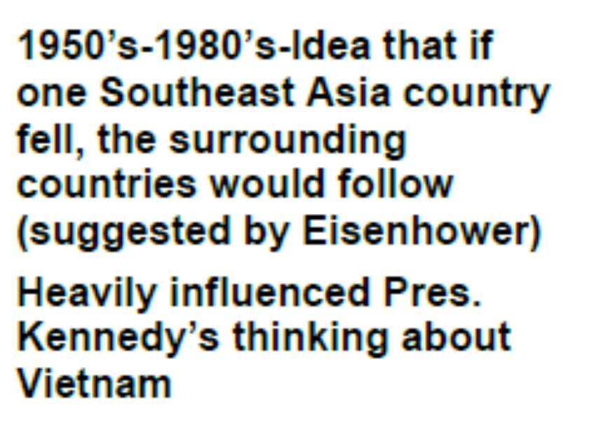
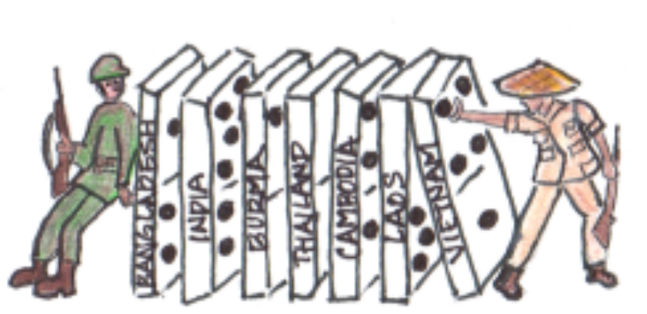
Domino Theory

Slide 12
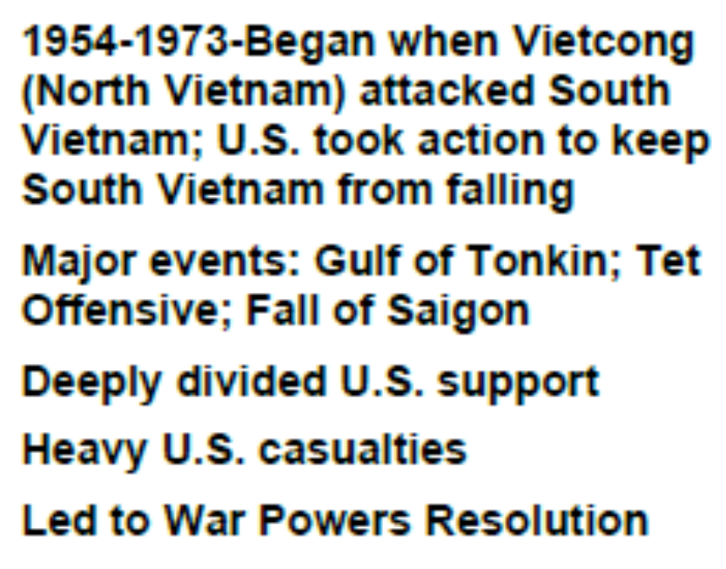
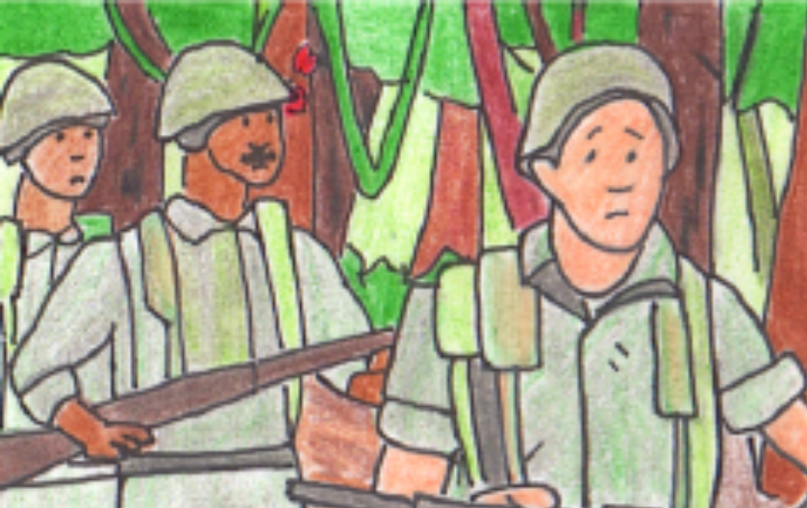
Vietnam War

Slide 13
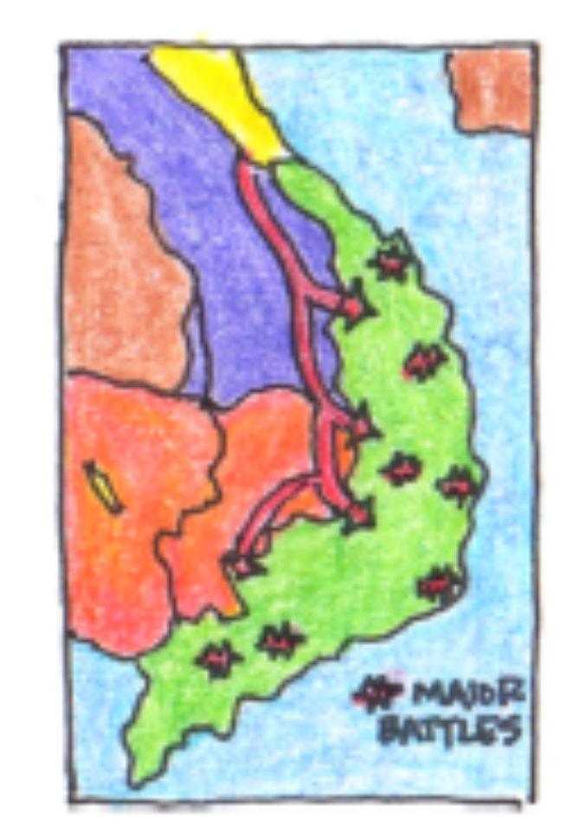
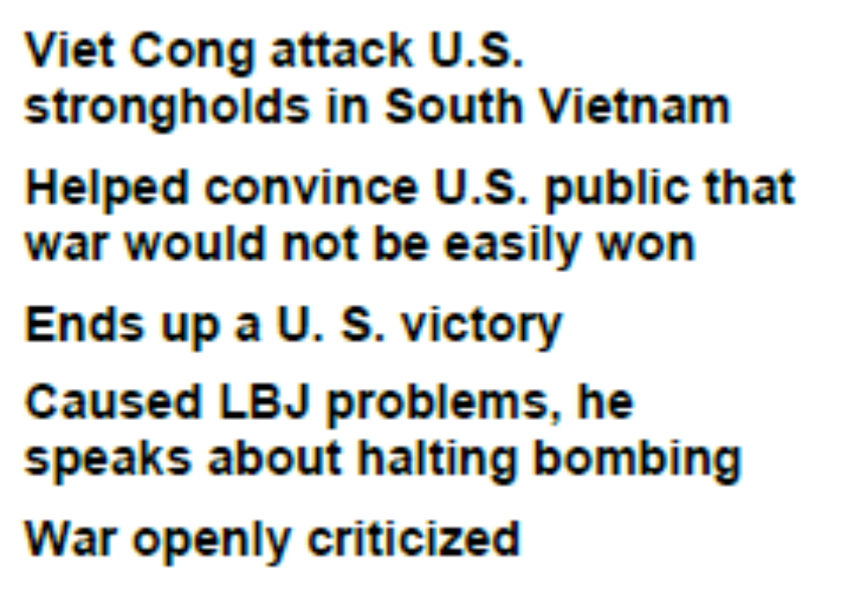
Tet Offensive

Slide 14
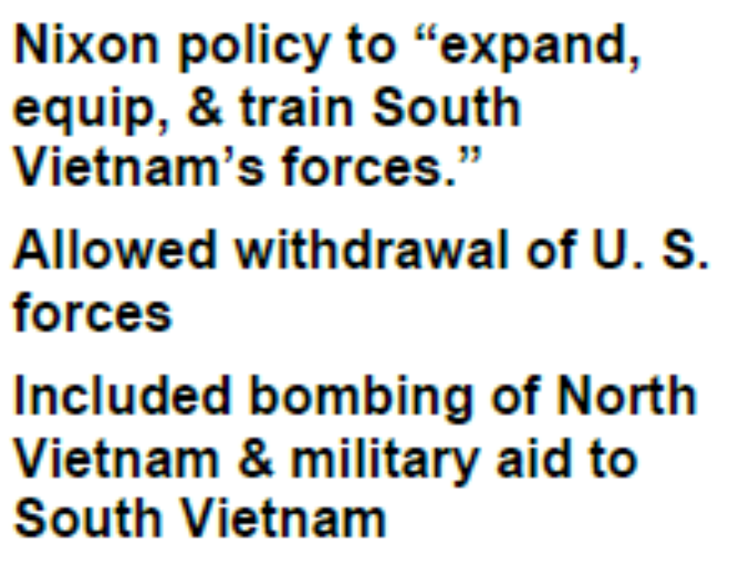
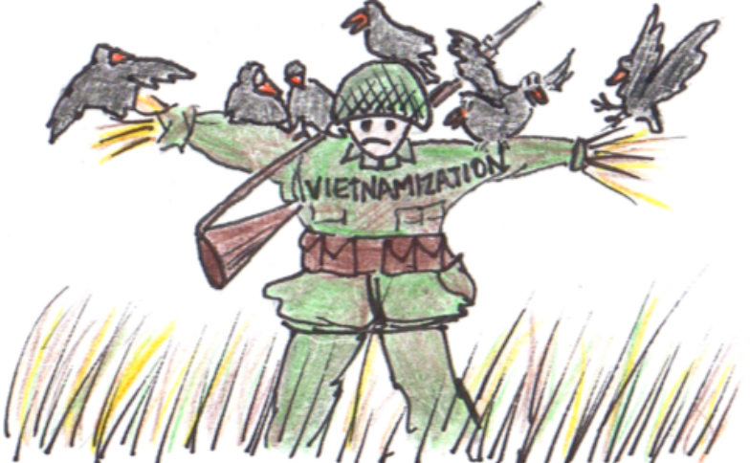
Vietnamization

Slide 15
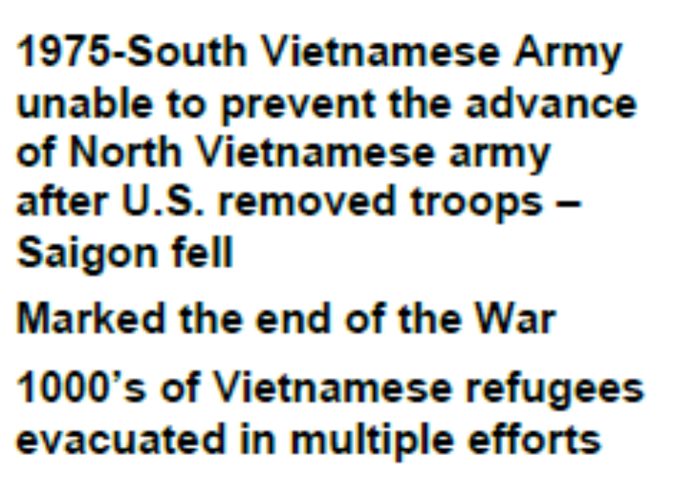
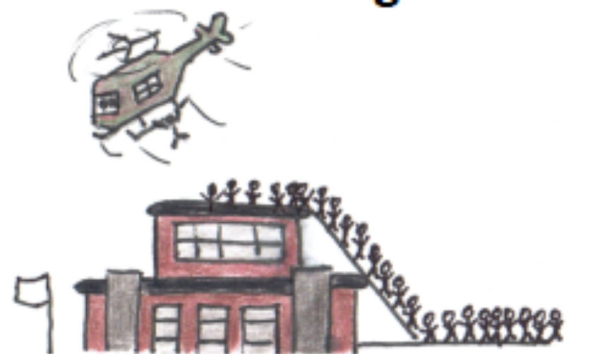
Fall of Saigon

Slide 16
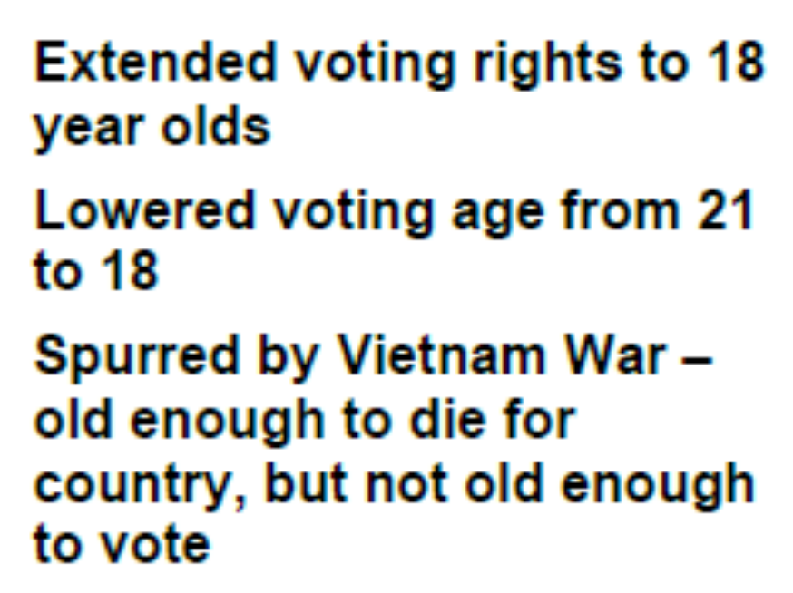

26th Amendment

Slide 17
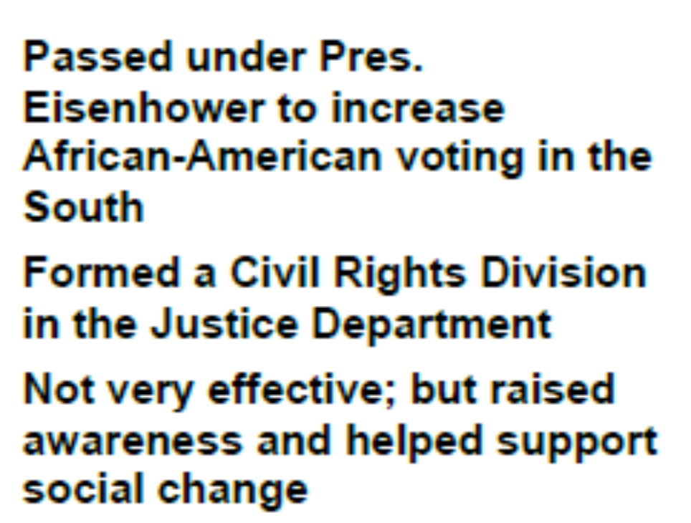
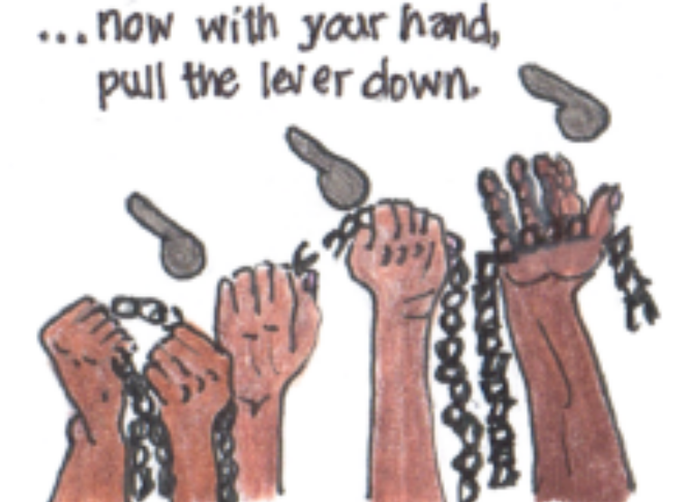
Civil Rights Act of 1957

Slide 18
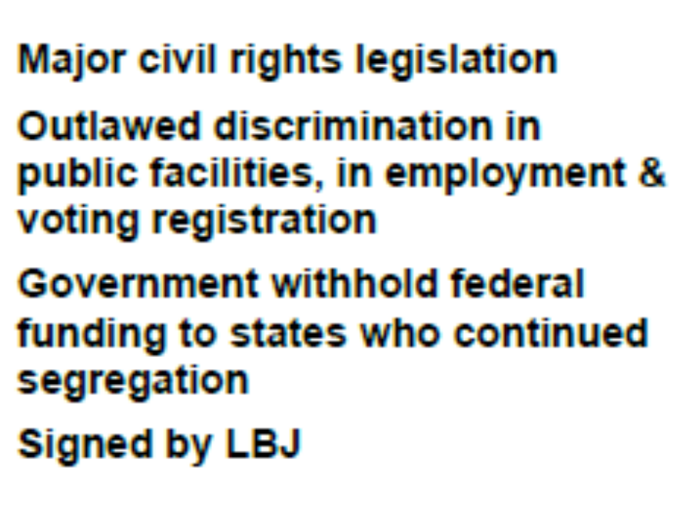

Civil Rights Act of 1964

Slide 19
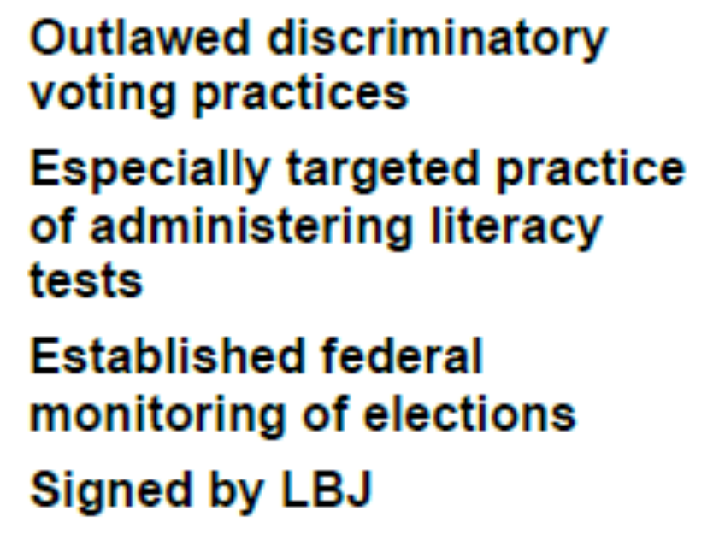
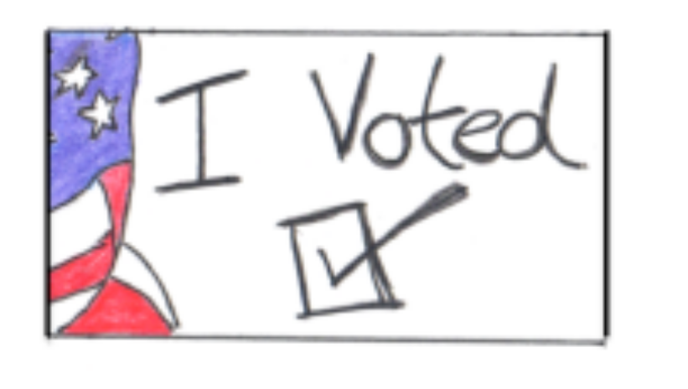
Voting Rights Act of 1965

Slide 20

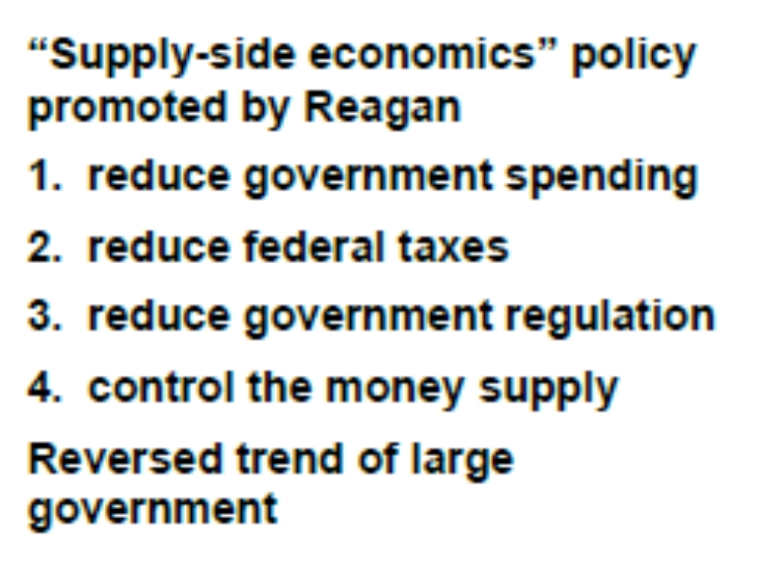
Reaganomics

Slide 21
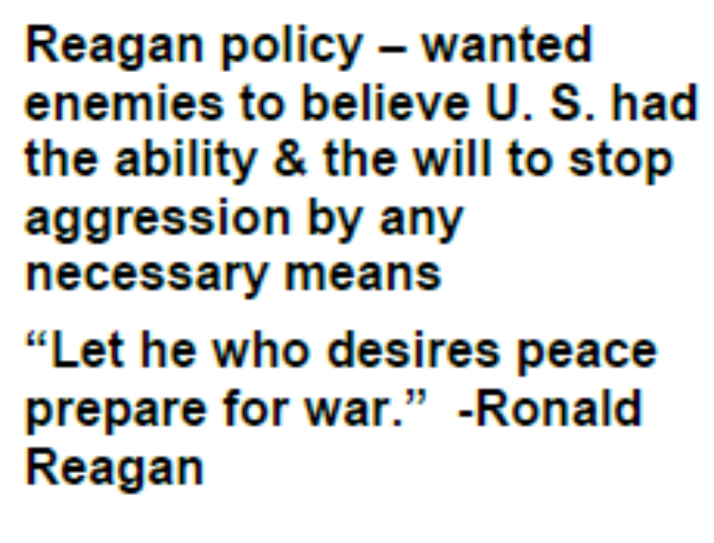

Peace Through Strength

Slide 22
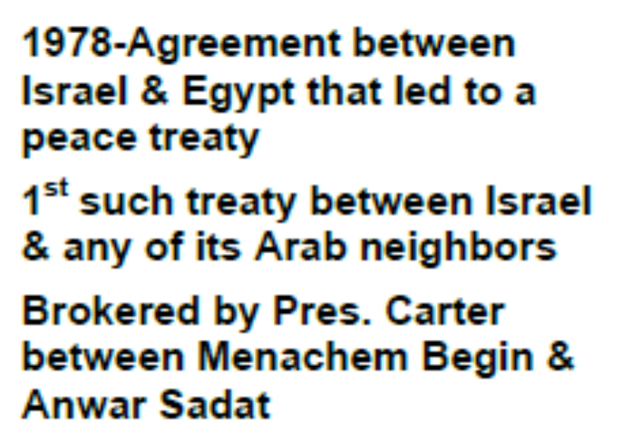

Camp David Accords

Slide 23
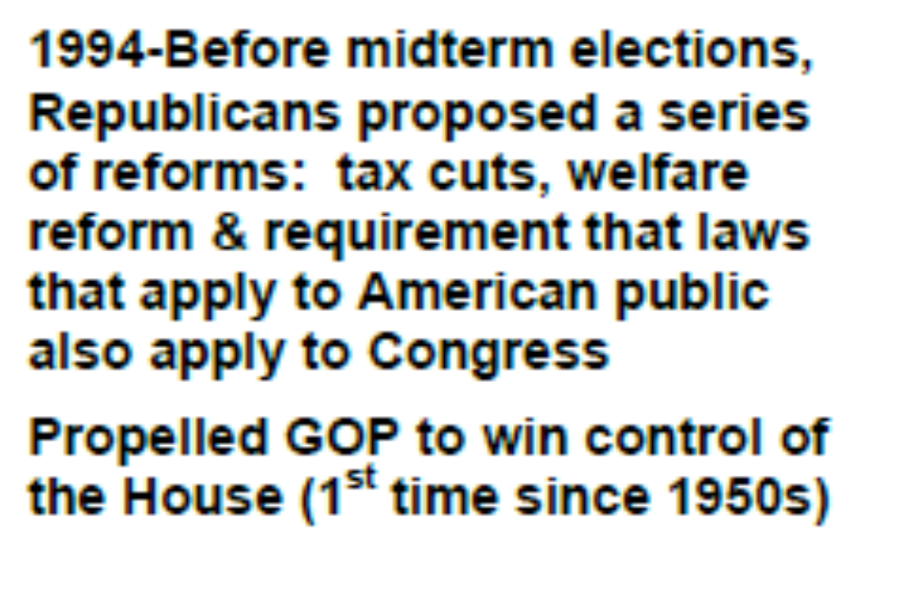

Contract With America

Slide 24
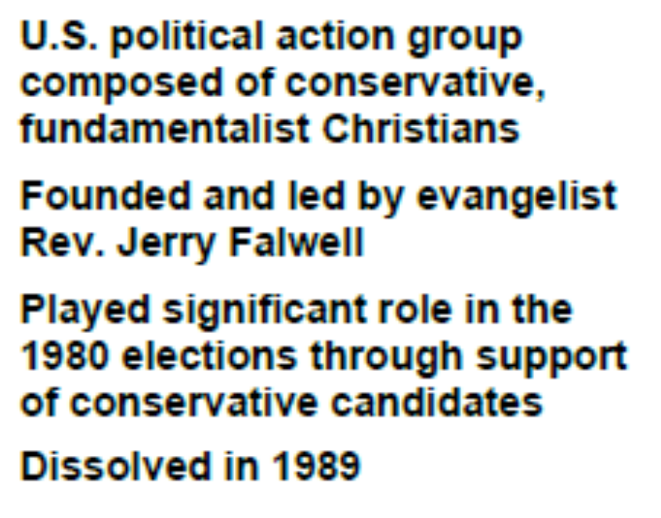

Moral Majority

Slide 25

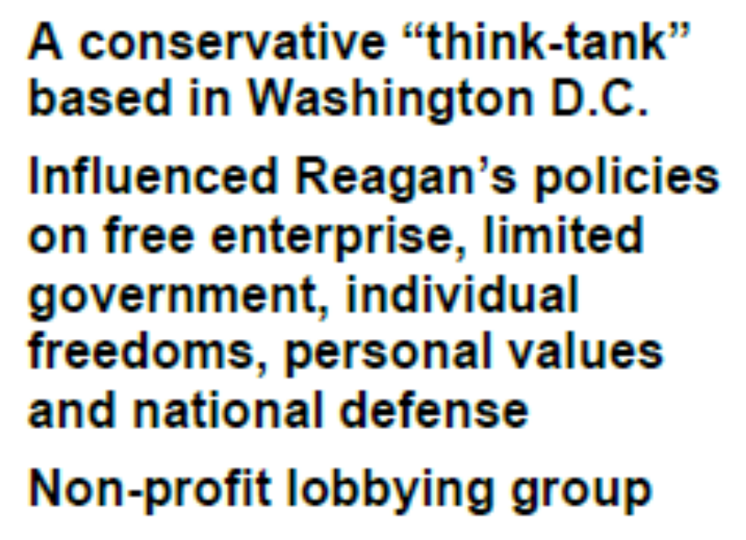
Heritage Foundation

Slide 26
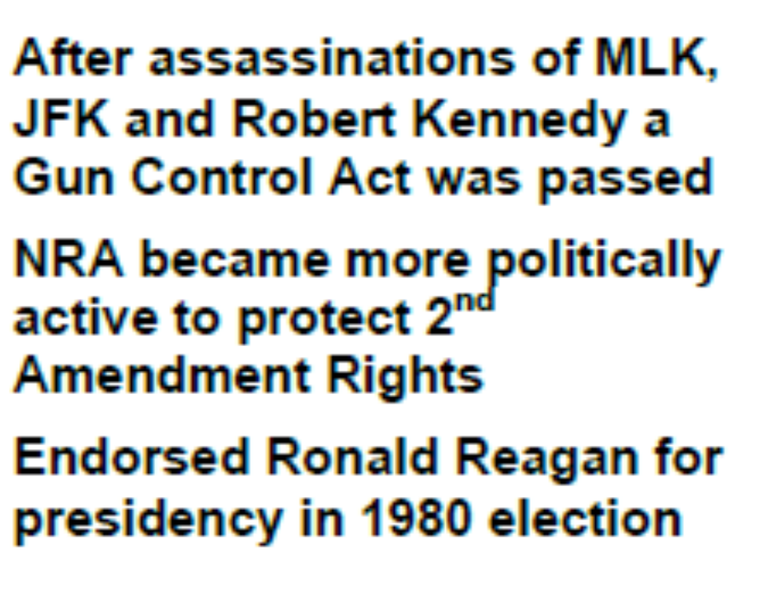

National Rifle Association

Slide 27
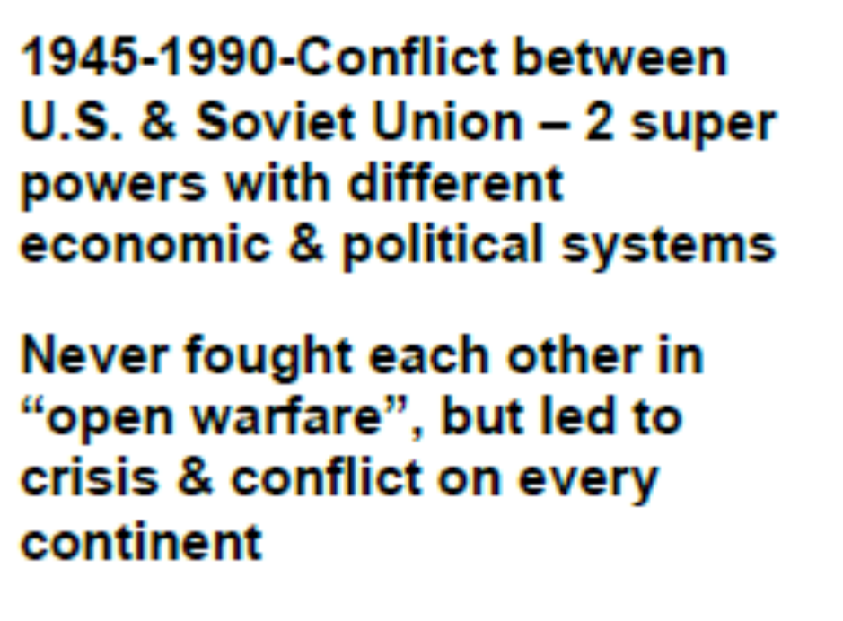
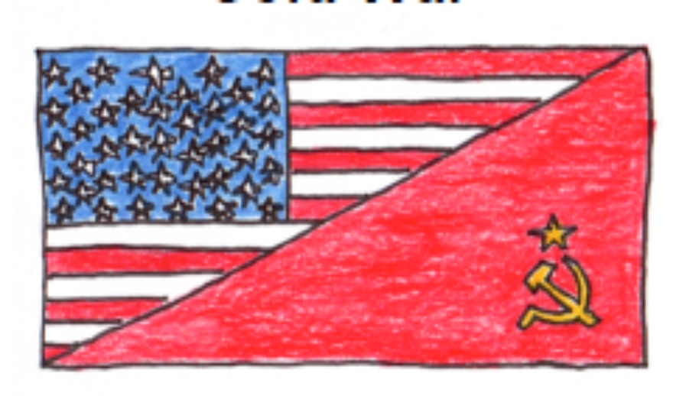
The Cold War

Slide 28
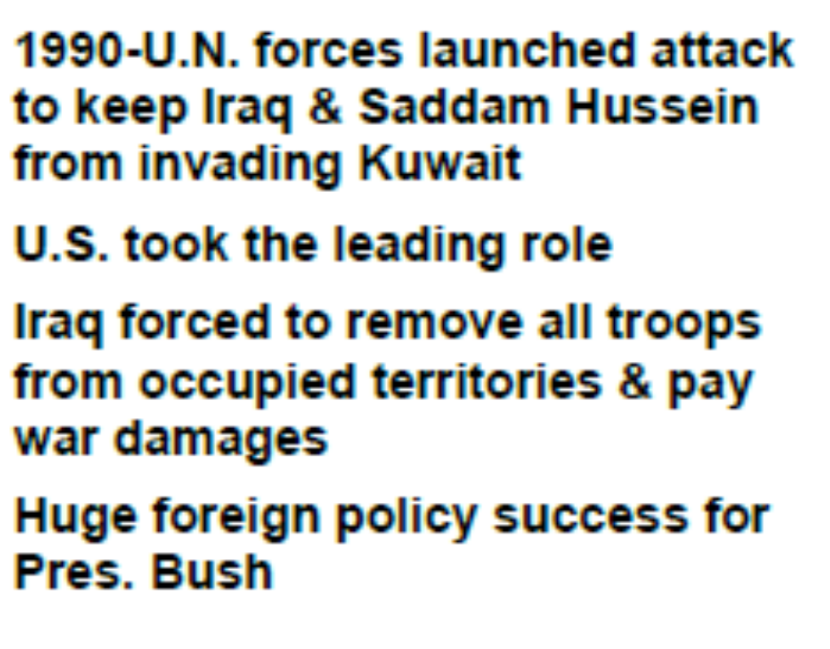
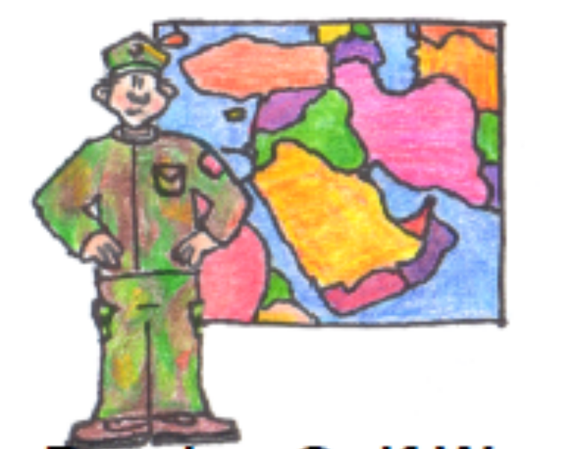
Persian Gulf War

Slide 29
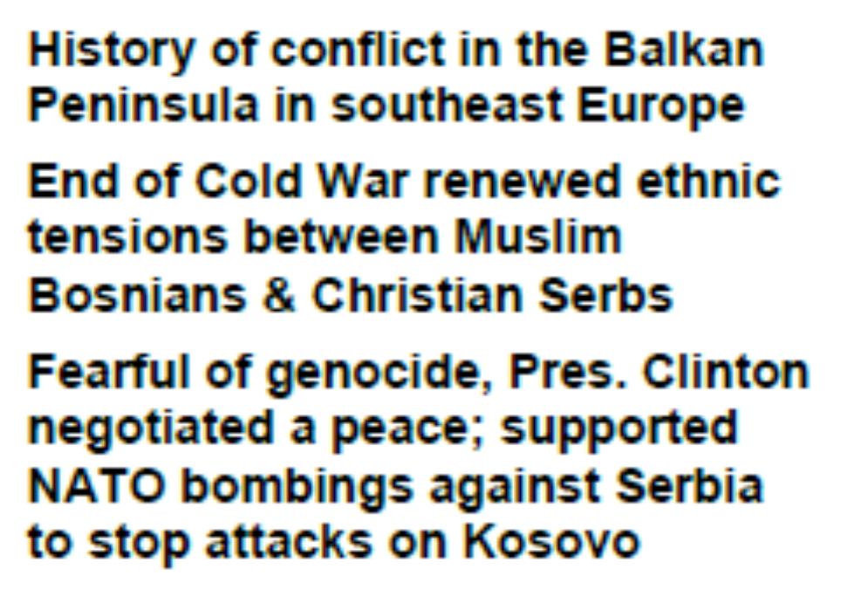
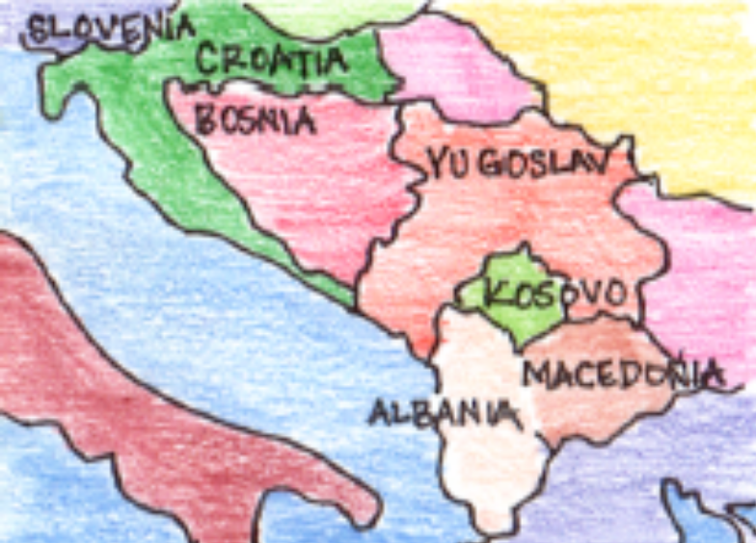
Balkans Crisis

Slide 30
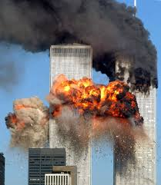
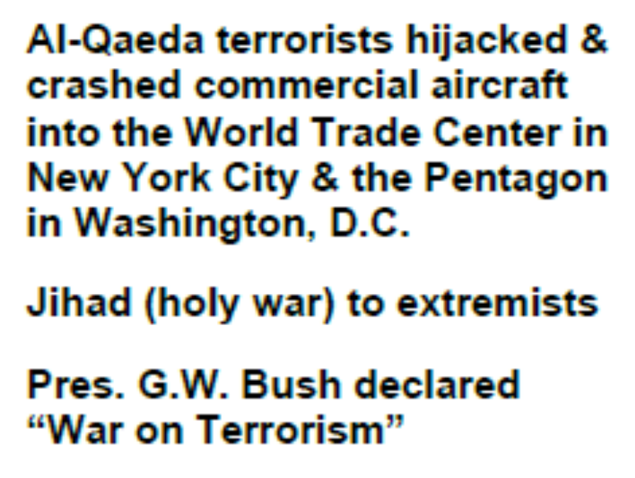
9-11-2001

Slide 31
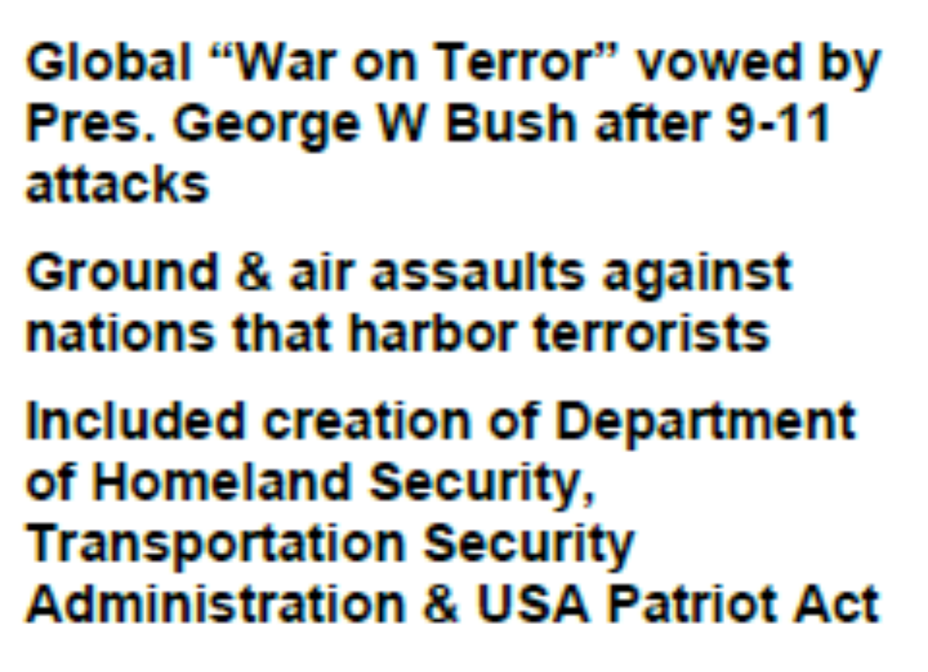
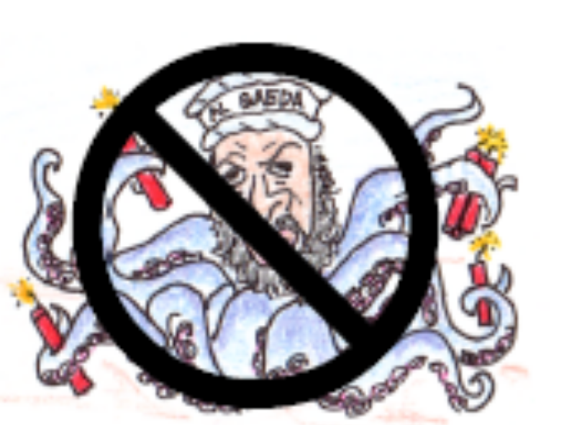
War on Terror

Slide 32
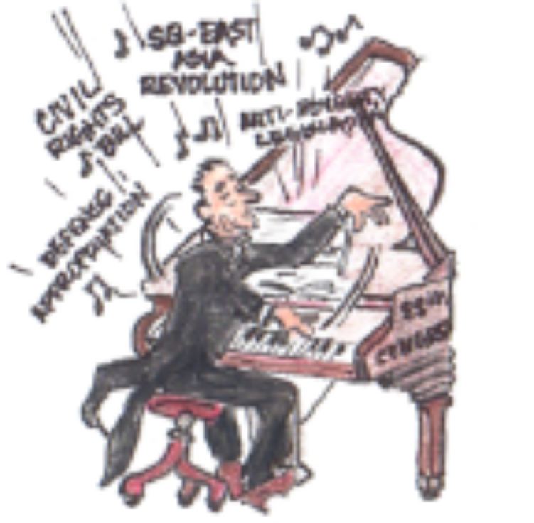
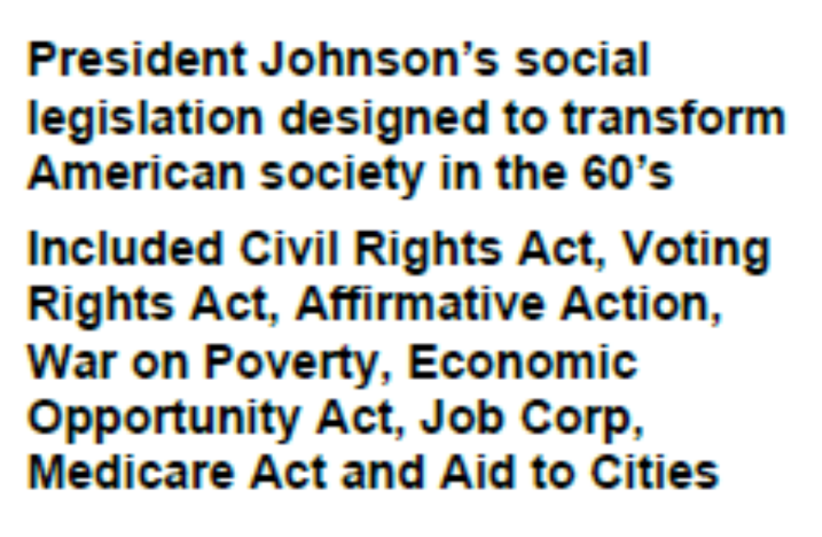
Great Society

Slide 33
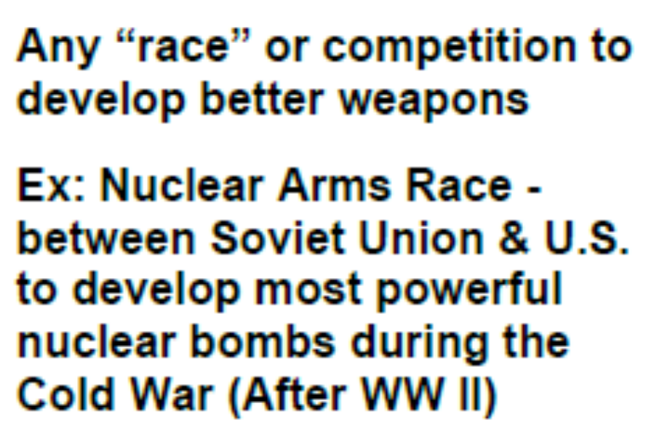

Arms Race

Slide 34


Watergate Scandal

Slide 35


Gulf of Tonkin Resolution

Slide 36


War Powers Act of 1973

Slide 37


Iran Contra Affair

Slide 38


16th Amendment

Slide 39


17th Amendment

Slide 40


18th Amendment

Slide 41


19th Amendment

Slide 42


American Expeditionary Forces (AEF)

Slide 43


American Expansionism

Slide 44


Axis Powers

Slide 45


Bataan Death March

Slide 46


Battle of the Argonne Forrest

Slide 47


Battle of Midway

Slide 48


Chinese Exclusion Act

Slide 49


Eugenics

Slide 50


Executive Order 1066

Slide 51


Federal Reserve Act

Slide 52


Flying Tigers

Slide 53


Wilson’s Fourteen Points

Slide 54


Great Depression

Slide 55


The Great Migration

Slide 56


Interstate Commerce Act

Slide 57


Japanese Internment

Slide 58


Nativism

Slide 59


Navajo Code Talkers

Slide 60


New Deal

Slide 61


Normandy Invasion

Slide 62


Pearl Harbor

Slide 63


Populism

Slide 64


Progressive Era

Slide 65


Prohibition

Slide 66


Red Scare

Slide 67


Return to Normalcy

Slide 68


Social Darwinism

Slide 69


Social Gospel

Slide 70


Spanish American War

Slide 71


Tuskegee Airmen

Slide 72


Treaty of Versailles

Slide 73


World War I

Slide 74


World War II

Slide 75


Victory Gardens

Slide 76


Capitalism

Slide 77


Entrepreneur

Slide 78


Globalization

Slide 79


Inflation

Slide 80


Protective Tariff

Slide 81


Americanization

Slide 82


Commerce

Slide 83


Ethnic Ghetto

Slide 84


Gilded

Slide 85


Industrialization

Slide 86


Labor Union

Slide 87


Laissez-Faire

Slide 88


Monopoly

Slide 89


Robber Baron

Slide 90


Strike

Slide 91


Suffrage

Slide 92


Tenement

Slide 93


Trust

Slide 94


Urbanization

Slide 95


Alliance

Slide 96


Armistice

Slide 97


Communism

Slide 98


Conscription

Slide 99


Diplomacy

Slide 100


Imperialism

Slide 101


Isolationism

Slide 102


Militarism

Slide 103


Mobilize

Slide 104


Nationalism

Slide 105


Socialism

Slide 106


Totalitarianism

Slide 107


Affirmative Action

Slide 108


Civil Rights

Slide 109


Containment

Slide 110


Counter Culture

Slide 111


Migrant

Slide 112


Segregation

Slide 113


Suburbs

Slide 114


Anti-Semitism

Slide 115


Appeasement

Slide 116


Blitzkrieg

Slide 117


Fascism

Slide 118


Genocide

Slide 119


Neutrality

Slide 120


Nazism

