Slide 1
Welcome to IB and AP Information Night
Kindra Smith, Principal
Tim Doherty, College Board Coordinator
Diane Kopkas, IB Coordinator
Riverwood International Charter High School

Slide 2
Essential Questions Parents
Want to Know:
1. What does AP mean?
2. Who can take AP classes?
3. Are there limits in how many AP courses a student may take?
4. What are the advantages and disadvantages of taking AP classes?
5. How stressful is an AP class?
6. Where can I obtain more information about specific AP courses?

Slide 3
What is AP?
“AP” stands for Advanced Placement. AP courses are challenging, with content that better prepares students for the rigors of college. Every AP class has an end-of-course AP test; if a student passes the exam with a score of 3 or higher (on a 5 point scale) he/she can earn college credit for the course.
AP

Slide 4
What are the benefits?
Why take an AP Course?
Students learn rigorous college-level content and skills
Taking AP is valued in the college admissions process
AP courses are interesting and rewarding academic experiences
Opportunity to earn valuable credit and placement in college – Flexibility and Cost Savings

Slide 5
Credit and Placement Opportunities
Each college and university has its own policies regarding AP® credit and placement. The College Board offers information about AP credit at thousands of college and universities at https://apstudent.collegeboard.org/creditandplacement/search-creditpolicies
• Search by school name or alphabetically
• Data for each school includes a direct link to that school’s Web page detailing AP credit and placement policies
• A statement from the college or university about its AP policy

Slide 6
Georgia Universities
First Year Statistics
University | GPA | SAT | AP/IB/DE
Georgia | 4.00 – 4.27 | 1330 - 1460 | 7 - 11
Georgia Tech | 4.02 | 1400 -1530 | 8 -12
Georgia State | 3.51 | 970 -1170
Georgia College | 3.58 | 1150 - 1290
Georgia Southern | 3.34 | 1150 - 1290
Kennesaw State | 3.22 | 1080 - 1240
North Georgia | 3.60 | 1030 - 1080

Slide 7
AP Courses Currently Offered at RICS
17 Courses
Math 10th – 12th
Calculus AB
Statistics
Computer Science A
Computer Science Principles
On-line 11th – 12th
Human Geography 9th
Art History
European History
Macro and Micro Economics
Physics 1 and 2
Psychology
Computer Science Principles
CAP approval required
Visual Arts 10th– 12th
Studio Art Drawing
Studio Art 2D and 3D
Social Studies
Government and Politics 9th
United States History 10th
World History 10th
AP Geography 10th - 12th
Psychology 11th – 12th
Macro and Micro Economics 12th
Language
Spanish Language and Literature 10th– 12th
English Language and Composition 11th
English Literature and Composition 12th

Slide 8
Advanced Placement
How many AP courses am I allowed to take?
We RECOMMEND no more than 3 AP/IB/Honors
Accelerated courses in a single year.
Time constraints: you can often plan on 3 hours of homework per class.
High stress level in keeping up.
Colleges look at much more than just the number of AP courses on your transcript. Having a variety of extracurricular activities can project a well-rounded, multi-talented individual with good time management skills.

Slide 9
Emotionally Equipped to Handle the Stress?
DON’T PUSH STUDENTS FARTHER THAN THEIR LIMIT. THEY OFTEN HEAR:
“THIS IS HOW IT IS IN COLLEGE.”
ONE STUDENT’S REPLY:
“GUESS WHAT…I’M NOT IN COLLEGE; I’M 15 AND IN HIGH SCHOOL FOR A REASON.”

Slide 10
RECAP
Advantages
Challenging and engaging coursework.
Increases the competitiveness of your college application.
A greater sense of pride in your academic accomplishments.
Increased College readiness; you may earn college credits while in high school.
Challenges
Increased work load and academic responsibility.
Increase in school--‐related stress and anxiety.
Sense of inadequacy failure; you cannot drop once enrolled.
Heavy demands on your time and energy.

Slide 11
Advanced Placement
Students looking to apply to 4-year colleges and universities….especially “elite” schools.
A healthy progression for AP generally follows a sequential process of adding 1 AP course per year. Students should normally avoid adding 2 or more additional AP courses from their current load.
But …….choose wisely… once enrolled you are in it for the entire year!
Who should I take an AP course?

Slide 12
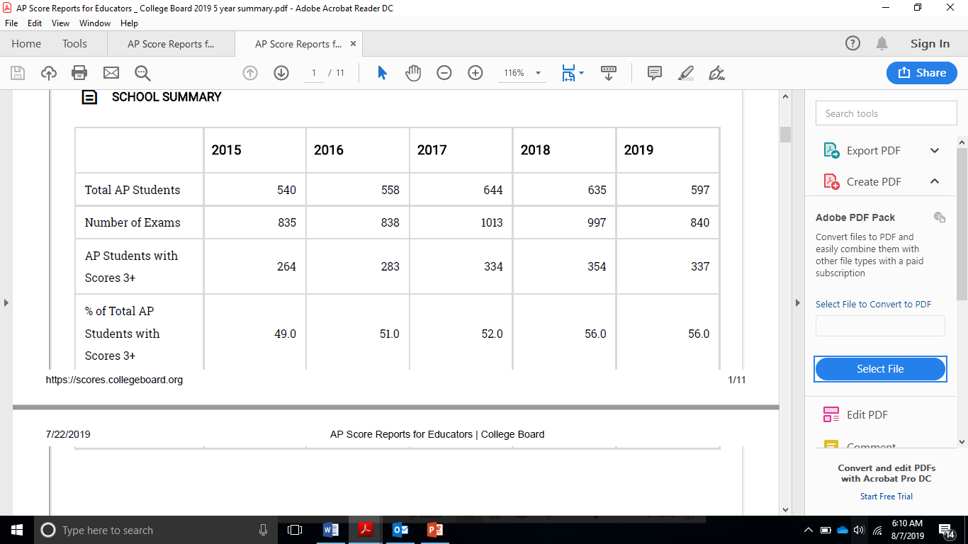
The 5 year report

Slide 13
What is new from College Board?
AP 2019-2020
Personalized Learning
https://apcentral.collegeboard.org/about-ap/news-changes/ap-2019/support-students-new-online-tools

Slide 14
AP: Resources Worth Exploring for Students and Families
AP information:
https://apstudent.collegeboard.org/exploreap
https://apstudent.collegeboard.org/exploreap/for-parents apstudent.collegeboard.org
Personalized feedback, practice and college planning based on your PSAT/NMSQT® results: My College QuickStart™ www.collegeboard.org/quickstart
AP credit policy information from colleges and universities: www.collegeboard.org/apcreditpolicy

Slide 15
AP Potential Expectancy Tables
AP Potential Report
AP Potential Expectancy
https://cb.collegeboard.org/ap-potential/app/expectancy.html
Course | Level 3 | Level 4 | % pass
English Lang 11th | 550 | 630 | 50
AP Govt 9th | 1120 | 1320 | 50
Psychology 11th & 12th | 1090 | 1210 | 70
Statistics 10th and 12th | 1170 | 1320 | 60

Slide 16

Any Questions???
Mr. Tim Doherty
dohertyt@fultonschools.org
(470) 254-1908
Assistant Principal
AP Coordinator

