Slide 1
Elementary ELA Instructional Materials Review and Adoption Committee
Welcome!
September 11, 2023
4:00-6:00 PM
Laguna

Slide 2
Agenda for Wednesday, September 11, 2023
Welcome and Roll Call
2. Approval of Committee Meeting Minutes from September 5, 2023
3. Review Committee Agenda, Norms, and Expectations
4. Review timeline and rubric for instructional resources
5. Review submitted resources
6. Future Meetings

Slide 3
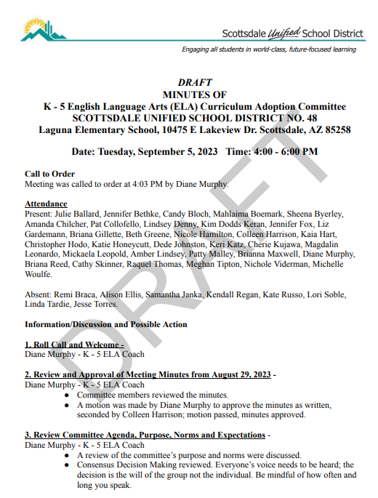

Approval of Committee Meeting Minutes

Slide 4

Committee Norms
We will be…
be fully present.
listen to understand and ask questions for clarification.
be open to new ideas.
invite and welcome the contributions of every member.
be mindful of how often and how long you speak.
support the group’s recommendation after consensus is reached.
questions and challenges are welcomed. Question and challenge the idea, not the person.

Slide 5
Timeline for Phase 2
Date | TENTATIVE focus of meeting (subject to change)
Wed., Aug 23 | Review Phase I, laws, adoption criteria, rubric, review materials
Tues., Aug 29 | Review materials
Tues., Sept 5 | Review materials
Mon., Sept 11 | Review materials
Mon., Sept 18 | Review materials; recommend programs for presentations
Wed., Sept 27 | Review material recommended for presentation
Mon, Wed., Oct 2/4 | Presentations - 8:00-4:00
Tues. Oct 24 | First read of recommendation to Governing Board
Tuesday, Nov 14 | Governing Board action on recommendation

Slide 6

Consensus Decision Making
Consensus decision making is a group decision making process that seeks consent of all participants where everyone’s opinions are heard and understood.
It is an acceptable resolution; one that can be supported, even if it is not the “first choice” or “favorite” of each individual.

Slide 7
Consensus is…
consenting to a proposal because group members choose to cooperate with the direction of the group rather than insist on their personal preference.
“Is this proposal something you can live with?” While group members may be willing to go along with a proposal, they do not actually need to favor it above another choice.
to “consent” means that even if group members disagree, there is still overall consent to move forward in order to settle the issue.

Slide 8
Clarifying Decision-Making Process
Defining Consensus
If all members of a committee/group must agree - or if every member of a committee can veto taking action - groups will be subjected to constant inaction… a state of perpetual status quo.
Without a shared understanding of consensus, persons determine their own standards.
Consensus decision making is a group decision making process that seeks consent of all participants where everyone’s opinions are heard and understood. It is an acceptable resolution; one that can be supported, even if it is not the “first choice” or “favorite” of each individual.
Defours et al - Definition of Consensus:
All points of view have been heard.
The will of the group is evident even to those who most oppose it.

Slide 9
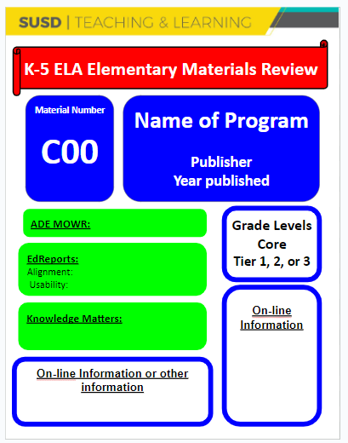
Reviewing Materials
Sample materials (TE, student books, resources, etc.)
Binder or additional information online (if applicable)
Place cards
Online links to information about program and teacher/student links (if applicable)
MOWR, EdReports, state reports
Support as a team - score as an individual
Evaluate ELA (not alignment with SS or Sci)
“Cone of Silence”

Slide 10
Review Programs
Review of the programs that your small group has not yet evaluated.
Remember, your rating is individual, not a group rating on the rubric.
Please make a list of questions, if needed.
02 2, 9, 12, 11, 24, 34
03 4, 22, 23, 25, 35, 37
05 3, 7, 16, 14, 26, 27
07 6, 10, 15, 21, 26, 29
09 7, 13, 19, 20, 28, 33
10 5, 8, 17, 18, 32, 36, 38

Slide 11

Future Meetings
Monday, September 18, 2023
4:00 - 6:00
Laguna Elementary, Room 500
Focus: Review Materials
Wednesday, September 27th

