Slide 1

AP Chemistry
Chattahoochee High School – Mrs. Jessica Ames
amesjp@fultonschools.org

Slide 2
Course Description
The AP Chemistry course provides students with a college-level foundation to support future advanced coursework in chemistry. Students cultivate their understanding of chemistry through inquiry-based investigations, as they explore content such as: atomic structure, intermolecular forces and bonding, chemical reactions, kinetics, thermodynamics, and equilibrium.
College Course Equivalent The AP Chemistry course is designed to be the equivalent of the general chemistry course usually taken during the first college year.
Prerequisites Students should have successfully completed a general high school chemistry course and Algebra II.

Slide 3
Major Topics of Study
Chemical Reactions, especially aqueous reactions
Stoichiometry
Atomic Structure and Periodic Trends
Bonding
Properties of Solids, Liquids, and Gases
Thermochemistry
Equilibrium
Acids and Bases
Electrochemistry
Kinetics

Slide 4
Structure of Course
We complete 6 units of study each semester, each ending with a unit test that has multiple choice questions, free response questions, and “no calculator” questions. Each unit of study is about 2 ½ - 3 weeks long.
A typical class period starts with a warm up or a demonstration and then involves “notes” showing students how to solve problems, read questions, think about the underlying concepts, draw diagrams, and integrate topics.
About 4 -5 class periods of each unit are devoted to laboratory experiments and analysis which reinforce what is being learned in class.
Frequent homework assignments and quizzes are given.

Slide 5
Learning Chemistry
Chemistry can be very mathematical and also very abstract.
The AP Chemistry course has a lot of breadth and depth. We will be moving quickly through a lot of material!
  Some AP courses are equivalent to a one semester college course, but some, like AP Chemistry, can be equivalent to a full year college course along with lab. Indeed, some colleges will award 8 hours of credit for a passing score (or higher) on the AP Chemistry exam.
Students are expected to complete regular homework assignments to practice what is learned. Answers are provided so students can see if they are on the right track or not.
Beyond homework, students are expected to be engaged, ask questions, and use the textbook and other resources to help them understand difficult concepts.

Slide 6
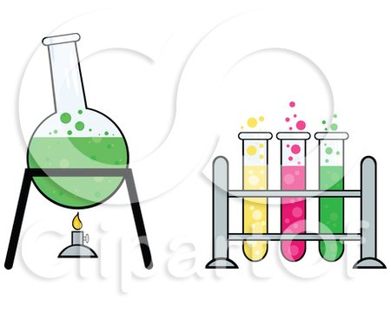
What are the benefits to taking AP Chemistry?
Excellent preparation for a science major in college. Freshman science classes can often be taught as “weed out” courses and are quite rigorous at nearly every college or university. AP Chemistry prepares students by laying a strong foundation in the sciences.
Pre-med? Chemistry is the subject that prevents many students who want to be doctors from going to medical school.
Love science? Chemistry combines mathematical and conceptual concepts in a way that can be very deeply satisfying to people who like to understand how the world around them works.
You will develop and strengthen science-related skills such as problem solving, abstract thinking, and laboratory skills.
You will absolutely strengthen student skills applicable to all courses such as time management, effective studying, taking timed assessments, and showing what you know in a variety of ways.

Slide 7
Ideal Student Profile
A student who will be successful in this class –
Has a genuine interest in science.
Was successful in a first year chemistry course.
Has strong math skills.
Has a strong work ethic.
Has roughly an hour a night to devote to completing homework (practicing problems), studying the notes packet, and reading the textbook.

Slide 8
AP Chemistry Exam
Students are expected to take the College Board AP Chemistry exam in May at the end of the course.
This exam is structured as follows:
Multiple Choice (90 min., without a calculator)
Free Response Questions (115 min., with a calculator)
  3 “long” questions with many parts, and
  4 “short” questions with a few parts.

Slide 9
Typical AP Chemistry Multiple Choice Question
A 1.0 L sample of a pure gas is found to have a lower pressure than that predicted by the ideal gas law. The best explanation for the observation is that the molecules of the gas
a. have a combined volume that is too large to be considered negligible when compared to the volume of the container
b. have a low molecular mass and therefore do not strike the container walls with as much force as expected
c. are attracted to each other and do not exert as much force on the container walls as they would if they had no mutual attractions
d. are attracted to the sides of the container and strike the container walls with more force than expected

Slide 10
Another Typical AP Chemistry Multiple Choice Question
Sample Mass of Carbon Mass of Hydrogen
A 60. g 12 g
B 72 g 12 g
C 84 g 10. g
D 90. g 10. g
The masses of carbon and hydrogen in samples for four pure hydrocarbons are given above. The hydrocarbon in which sample has the same empirical formula as propene, C₃H₆?
a. Sample A
b. Sample B
c. Sample C
d. Sample D

Slide 11
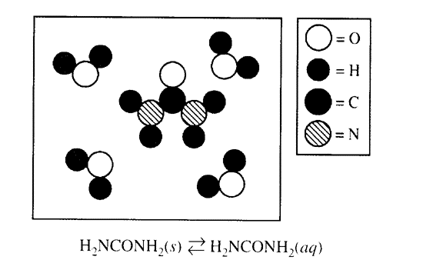
Typical AP Chemistry Free Response Question
2019 AP Chemistry
1. The compound urea, H₂NCONH₂, is widely used in chemical fertilizers. The complete Lewis electron dot diagram for the urea molecule is shown above.
a. Identify the hybridization of the valence orbitals for the carbon atom in the urea molecule.
b. Urea has a high solubility in water, due in part to its ability to form hydrogen bonds. A urea molecule and four water molecules are represented in the box below. Draw ONE dashed line (- - - -) to indicate a possible location of a hydrogen bond between a water molecule and the urea molecule.
This is a long FRQ from rom the 2019 AP Chemistry Exam

Slide 12
Typical AP Chemistry Free Response Question
2019 AP Chemistry
The dissolution of urea is represented by the equation above. A student determines that 5.39 grams of H₂NCONH₂ (molar mass 60.06 g / mol) can dissolve in water to make 5.00 mL of a saturated solution at 20 ºC.
c. Calculate the concentration of urea, in mol / L, in the saturated solution at 20 ºC.
d. The student also determines that the concentration of urea in a saturated solution at 25 ºC is 19.8 M. Based on this information, is the dissolution of urea endothermic or exothermic? Justify your answer in terms of LeChatelier’s principle

Slide 13
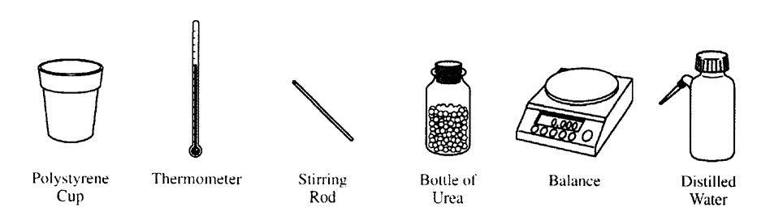
Typical AP Chemistry Free Response Question
2019 AP Chemistry
The equipment shown above is provided so that the student can determine the value of the molar heat of solution for urea. Knowing that the specific heat of the solution is 4.18 J / (g ºC), list the specific measurements that are required to be made during the experiment.
Sº (J / (mol K))
H₂NCONH₂(s) 104.6
H₂NCONH₂(aq) ?
The entropy change for the dissolution of urea, ΔS_{soln}º, is 70.1 J / (mol K) at 25 ºC. Using the information in the table above, calculate the absolute molar entropy, Sº of aqueous urea.
Using particle level reasoning, explain why ΔS_{soln}º is positive for the dissolution of urea in water.
The student claims that ΔSº for the process contributes to the thermodynamic favorability of the dissolution of urea at 25 ºC. Use the thermodynamic information above to support the student’s claim.

Slide 14

More Questions?
Check out the College Board AP Chemistry website:
https://apstudents.collegeboard.org/courses/ap-chemistry
Contact Jessica Ames, the teacher, at amesjp@fultonschools.org

