Slide 1


Digital Citizenship in
Fulton County Schools
Beth Valentine
Media & Ed Tech Instructor
Hapeville Elementary School

Slide 2
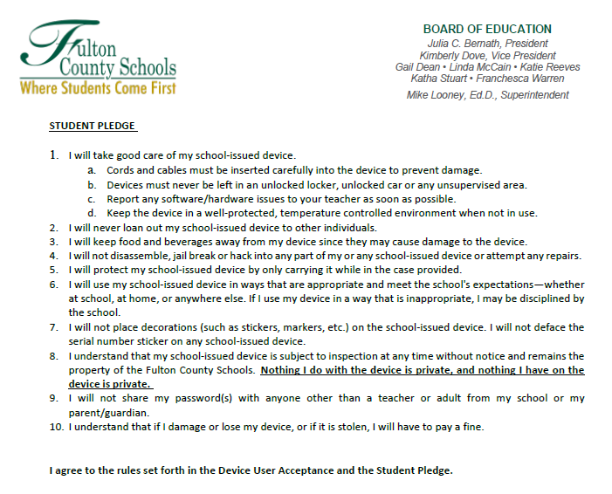
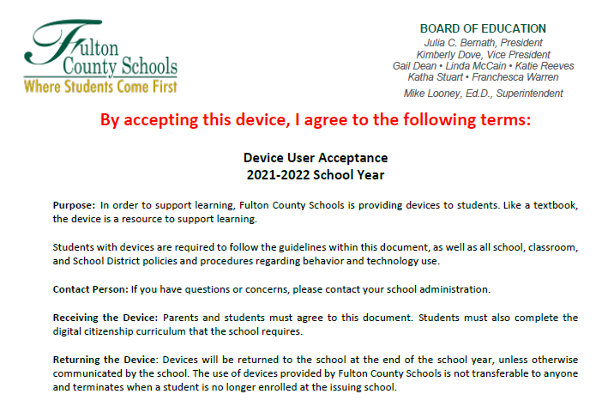
Fulton County Schools provides resources to teach device care

Slide 3
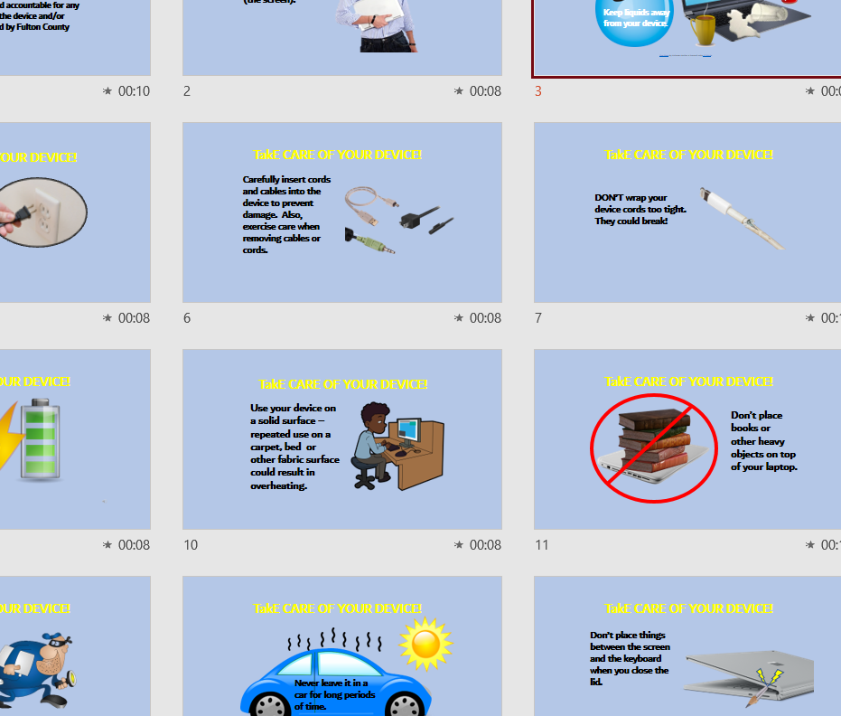

Slide 4

Common Sense Media
Digital Citizenship curriculum is taught at the beginning of every school year in the media center

Slide 5
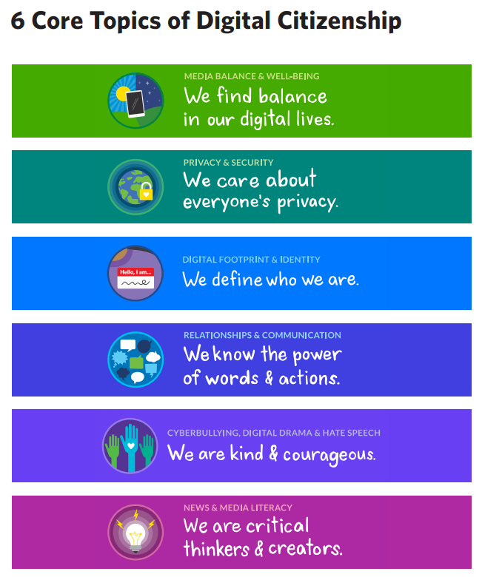
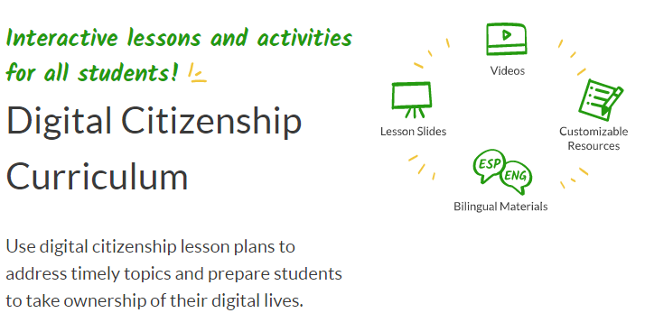


Slide 6


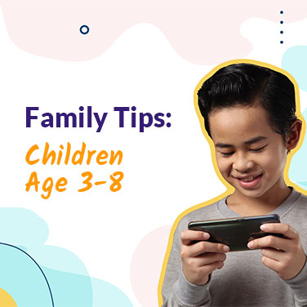
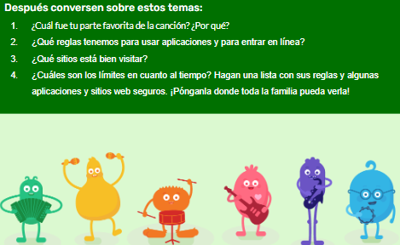
Common Sense also provides great family resources!
Working together, schools and families can prepare kids to think critically and use technology in positive, creative, and powerful ways.
The K–12 Digital Citizenship Curriculum’s
Family Tips and Family Activities cover all
six curriculum topics and are available
in English and Spanish.

Slide 7
Digital Citizenship skills and device care are reinforced throughout the year in the media center every week and every day in the classrooms.

Slide 8
