Slide 1
Digital Citizenship
Establishing a culture of respect and civic responsibility
FCS Parent Meeting, Spring 2022

Slide 2



Introduction
Martha Bongiorno, Ed.S.
Media and Education Technology Instructor
Innovation Academy
bongiornom@fultonschools.org

Slide 3
There's no one way to teach digital citizenship
…but we should always model behaviors and expectations.

Slide 4
Our Approach to Digital Citizenship
Direct instruction on digital citizenship for students as well as staff
Modeling these behaviors throughout the year
Working alongside parents to teach and model these behaviors at home
Giving students ample opportunities to practice these behaviors throughout the year
Notes:
The digital world is evolving rapidly and so must the way we educate students about navigating it. For over a decade now, digital citizenship has been mainly about the don'ts: Don't share your passwords, don't steal the intellectual property of others, don't post or share inappropriate content on social media.
The skills required to thrive as a digital citizen go beyond just online safety. They include recognizing fact from fiction online, using technology to engage in civic action and being respectful of people with differing viewpoints from our own.
At the beginning of the year, I personally conduct a workshop with teachers on the components to digital citizenship, focusing on the need for mentoring and reflective practices to continue throughout the year. At the end of the workshop, teachers reflect on their learning and how they will implement digital citizenship practices into their classrooms on our Flipgrid topic.
At the beginning of the year, students undergo a four-week unit on digital citizenship based on the Common Sense Media lessons for high school. We use Nearpod self-paced lessons so that students can work at their own pace and our teachers can work in small groups to reteach as needed. During our advisory periods, students practice the lessons with their classmates.
I build on skills students learn during their initial digital citizenship unit at the beginning of the year. Each grade level focuses on something different and builds on the previous year.

Slide 5

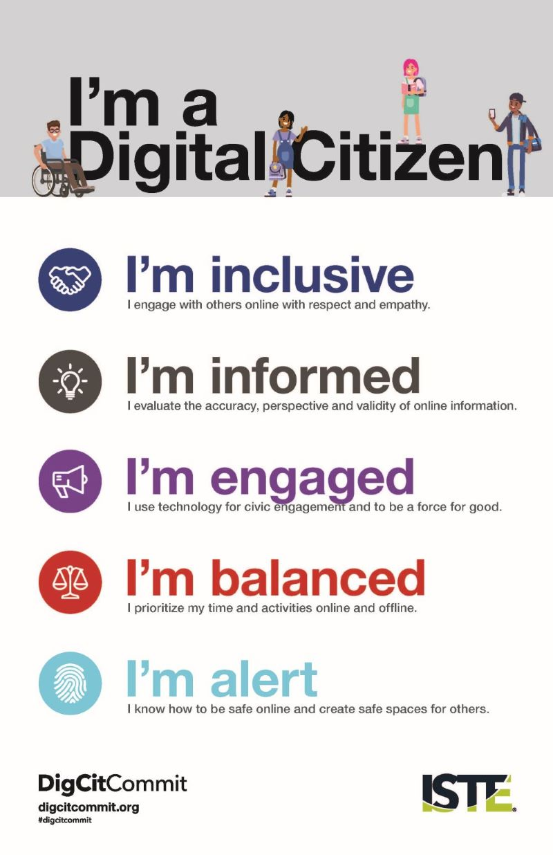
Guided By Best
Practice
ISTE Standards
Common Sense Media
Notes:
ISTE Standards for Students: Standard #2 - Students recognize the rights, responsibilities and opportunities of living, learning and working in an interconnected digital world, and they act and model in ways that are safe, legal and ethical.
ISTE Standards for Teachers – Standard #3 - Teachers inspire students to positively contribute and responsibly participate in the digital world.

Slide 6
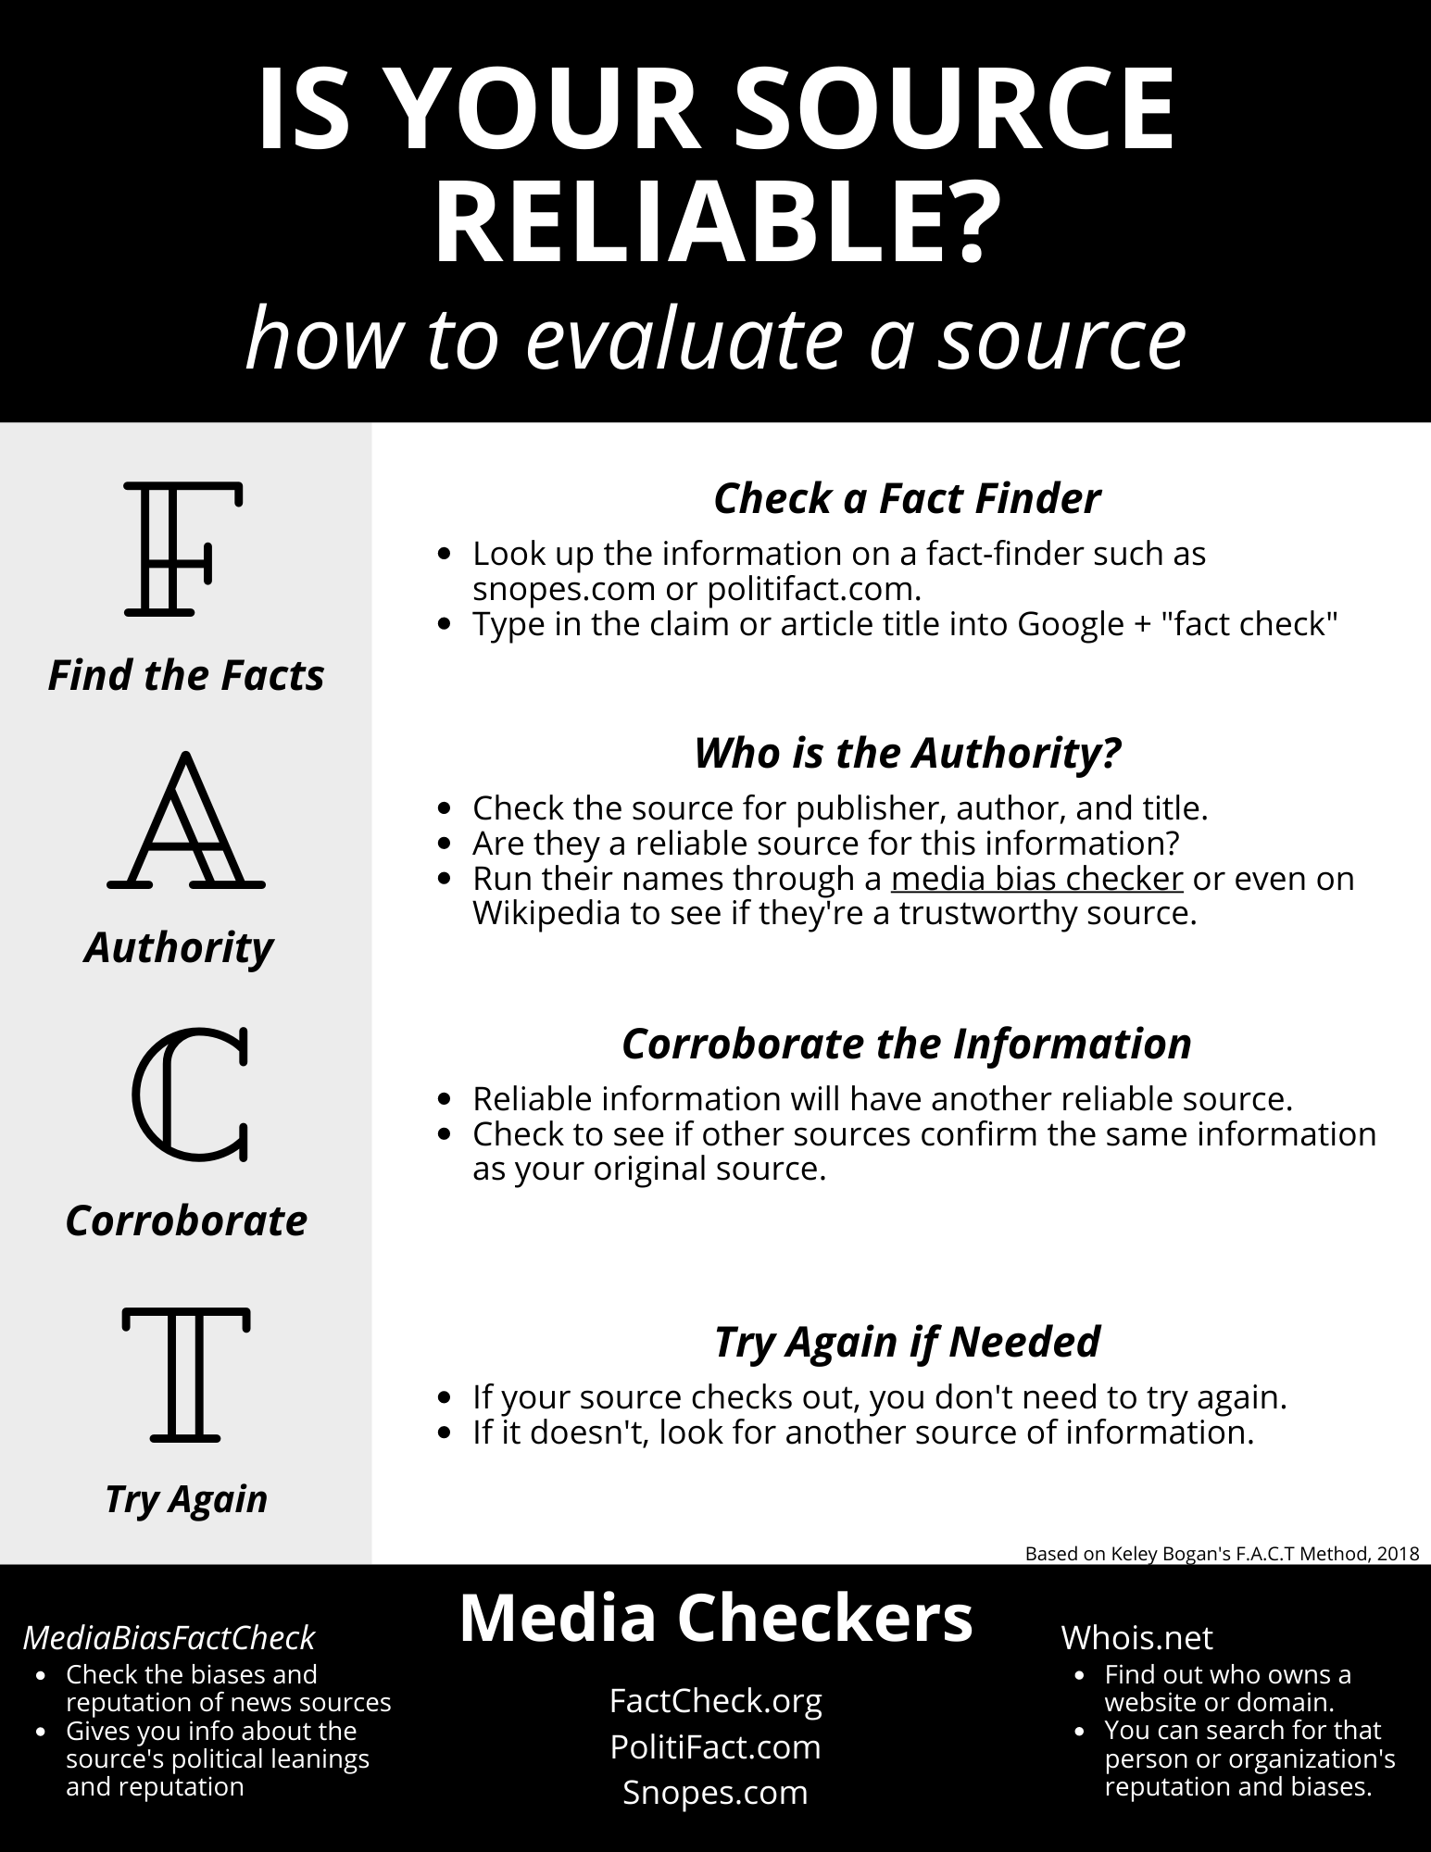
Embedded Digital Citizenship
This is a part of our school culture
“All-Student” Microsoft Teams
  Discussion threads = modeling and redirection in a safe environment
Research Classes and Projects
MakerSpace & Technology Competitions
PBIS
Notes:
However, teaching digital citizenship is not the same as promoting classroom community, kindness, or character education.
Students do best when they have a go-to specific strategy to use in a tricky situation. In elementary, that might be learning how to click X to close an ad, how to close a window, or what avatar name to use in place of their own. In high school, that might be how to craft a respectful email to various audiences.
Throughout the year, students participate in numerous research and technology-related projects. Every student here at IA has a research introduction lesson they do with me in science classrooms. We build on those skills with additional projects.
In addition to this, our Student Tech Team and I host maker lunch and learns. During this time, students learn how to create apps, learn to 3D print, and more. We always go over attribution, finding and using templates in acceptable ways, and what it means to infringe upon creators' rights.

Slide 7
Climate is to Reactiveness
As Culture is to Responsiveness

