Slide 1


Internet Safety for Parents
GBI Special Agent Jackie Gittins

Slide 2
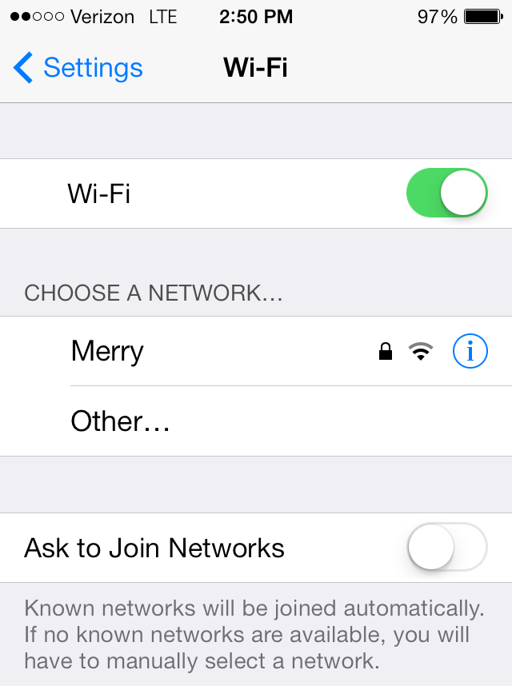
How to Protect Your Home Internet – WI-FI
Password protect your wireless account!
  Use a complicated password
    (ex: 9Pa#%7NH$ffG32)
    Use a Password Manager to manage all passwords
Do NOT share your password with others
  All internet activity will be traced back to your account and residence
  If you do share, consider changing your password

Slide 3
How Can You Keep Your Children Safe Online?
Teach child how to be safe online
1
Set parental controls on child’s phone
2
Periodically examine child’s phone
3
Take phone away at night
4
Educate yourself about popular apps
5
Cell phone monitoring tools
6

Slide 4
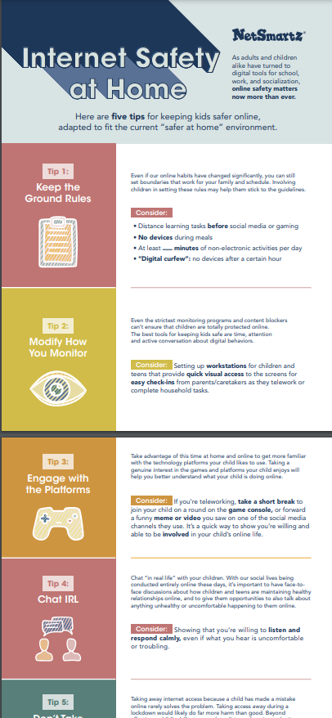
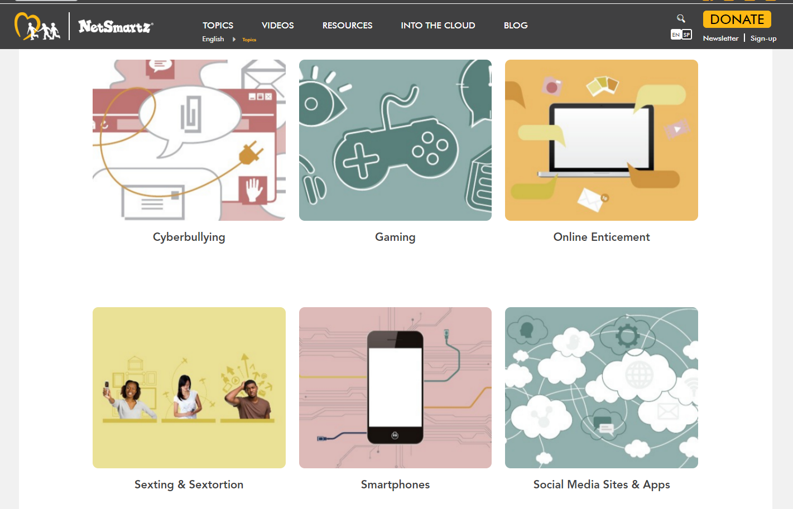
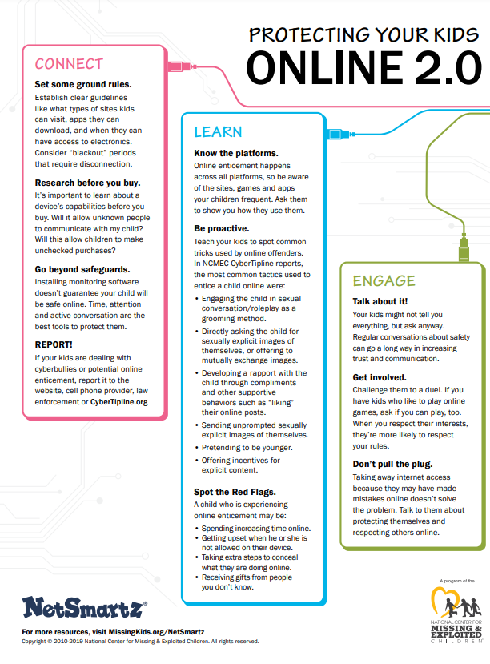
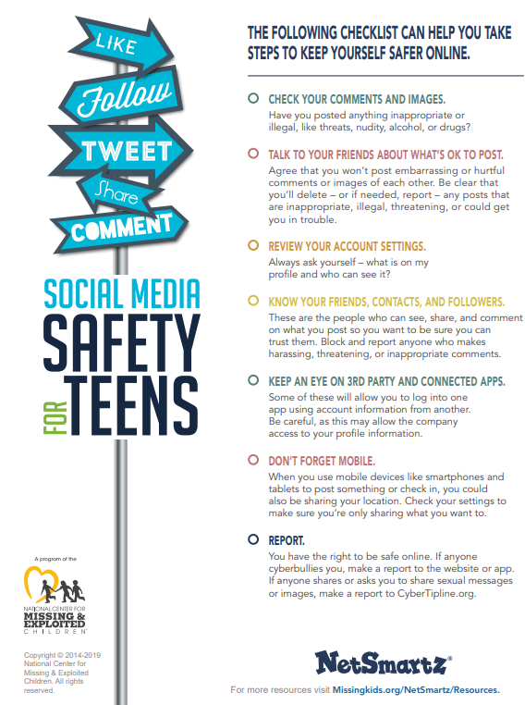

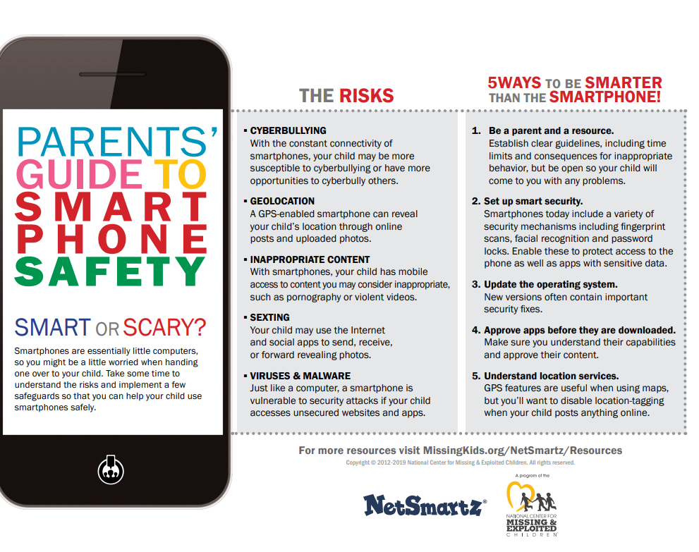
Teaching Internet Safety at Home

Slide 5
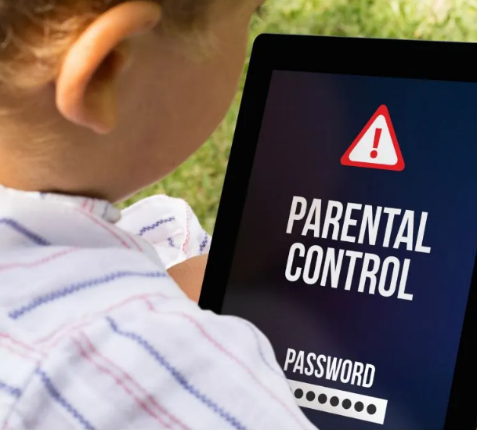
Parental Controls
Parental Controls prevent children from accessing inappropriate, unsuitable, or illegal content online.
Can be implemented in the following ways:
Computer operating system (Windows, Apple)
Internet Service Providers (AT&T, Charter, WOW, etc.)
Electronic device settings (cell phones, tablets, gaming consoles, etc.)
Search engine settings
Chat software settings

Slide 6
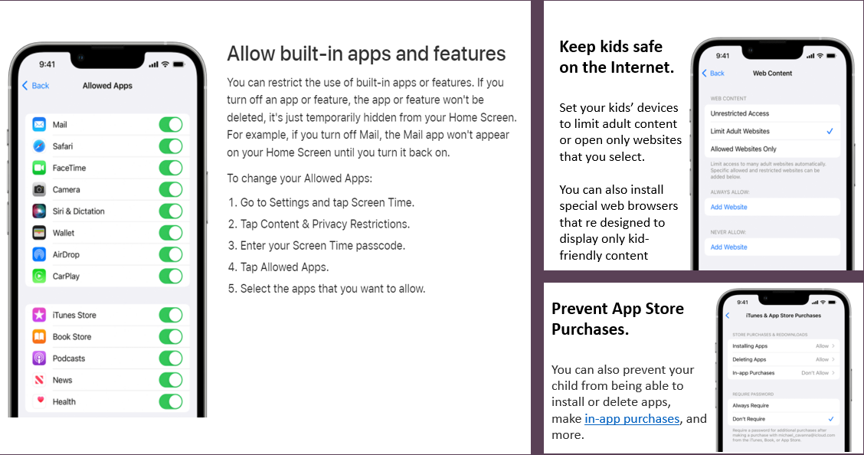
Apple iPhone Parental Control Settings

Slide 7
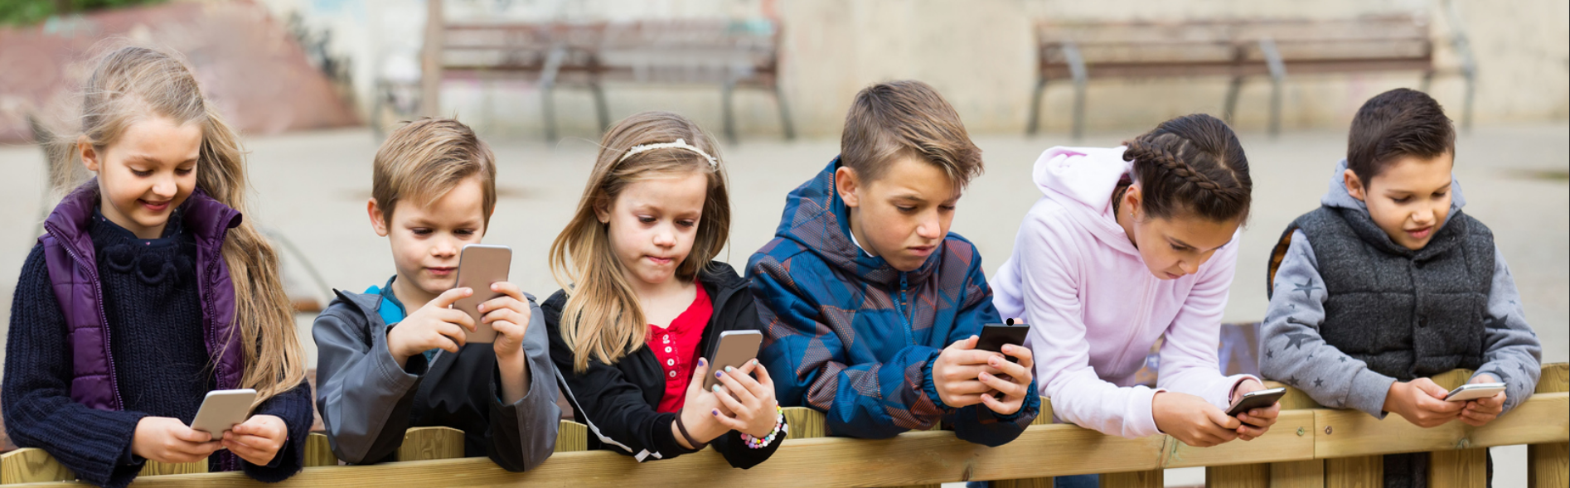
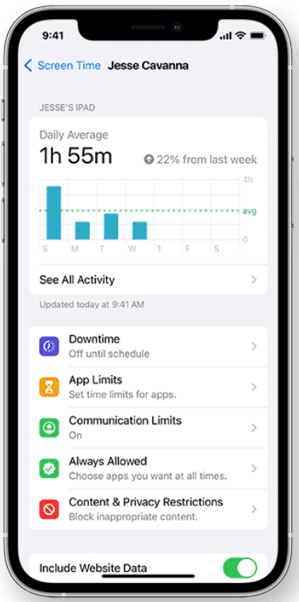
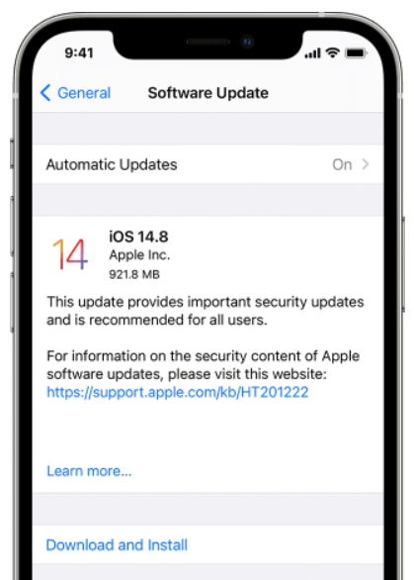
Setting Limits
on Screen Time
Screen Time lets you know how much time you and your kids spend on apps, websites, and more. This way, you can make more informed decisions about how you use your devices, and set limits if you'd like to.
Update, Update, Update!
iPhone is designed to protect your data and your privacy. Built-in security features help prevent anyone but you from accessing the data on your iPhone and in iCloud.

Slide 8
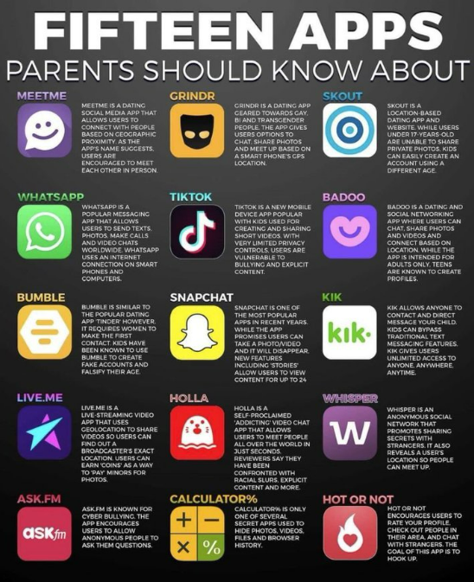

Parents:
Do you know which apps are on your child’s cell phone…and what each app does?

Slide 9
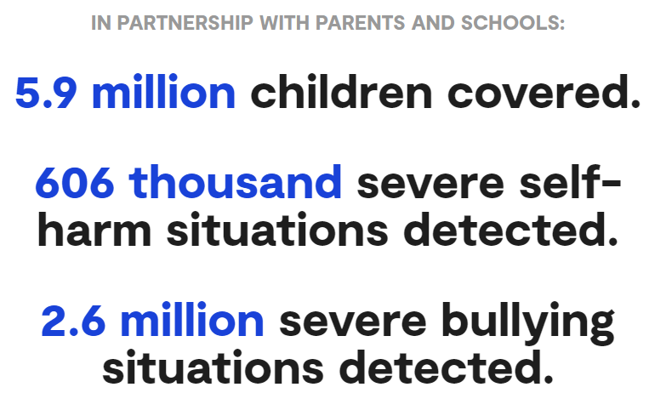
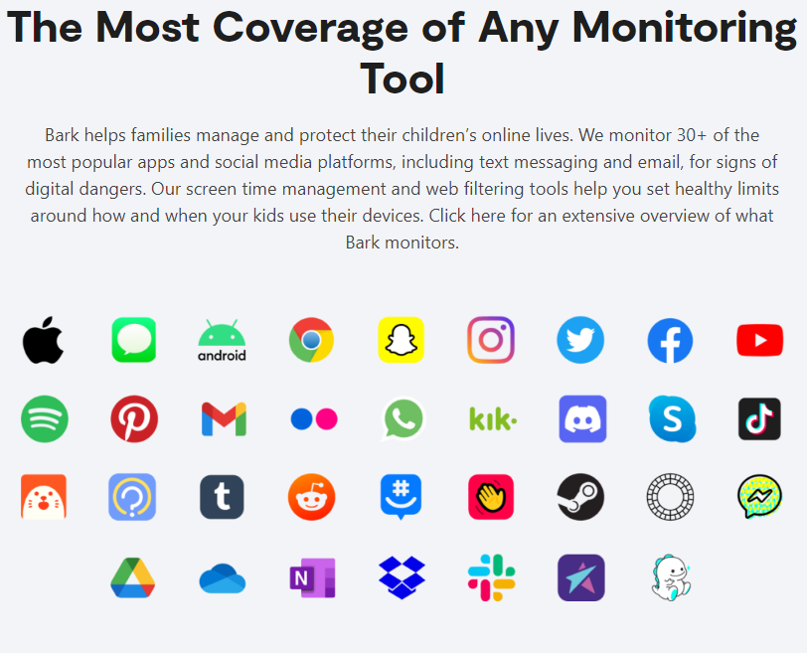

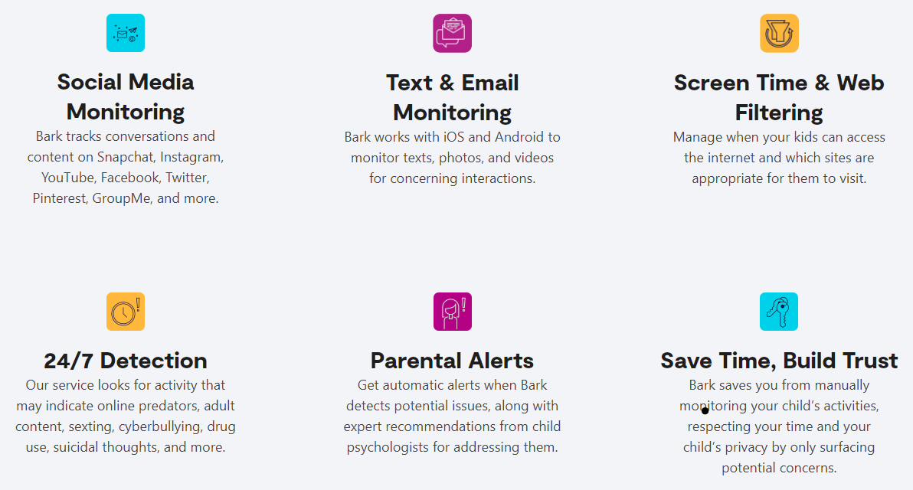
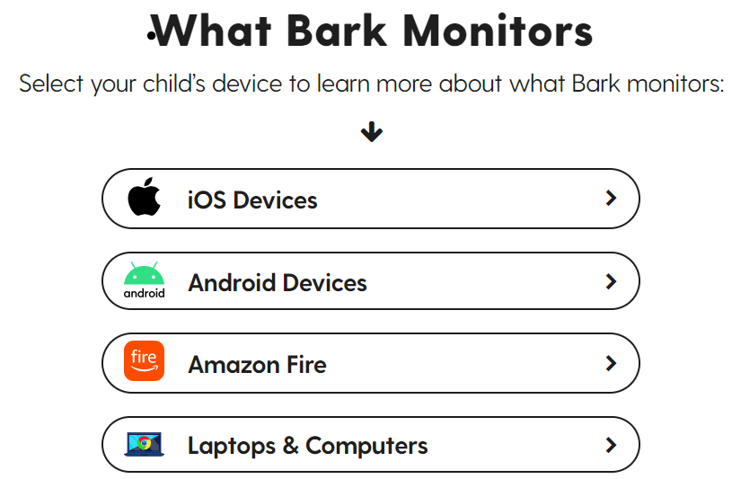

Slide 10
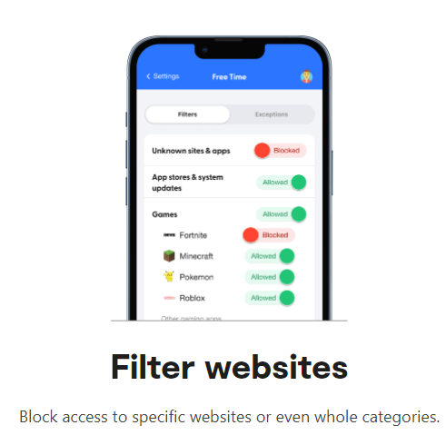

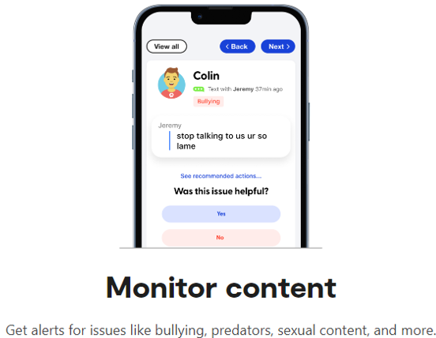
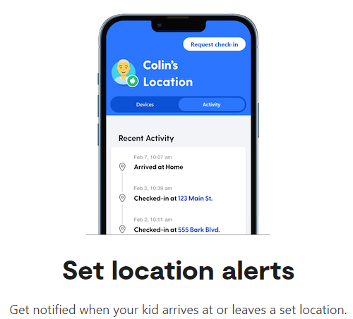
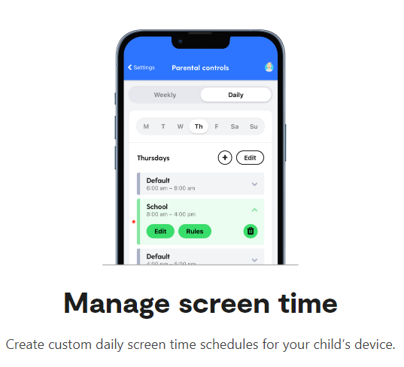

Slide 11
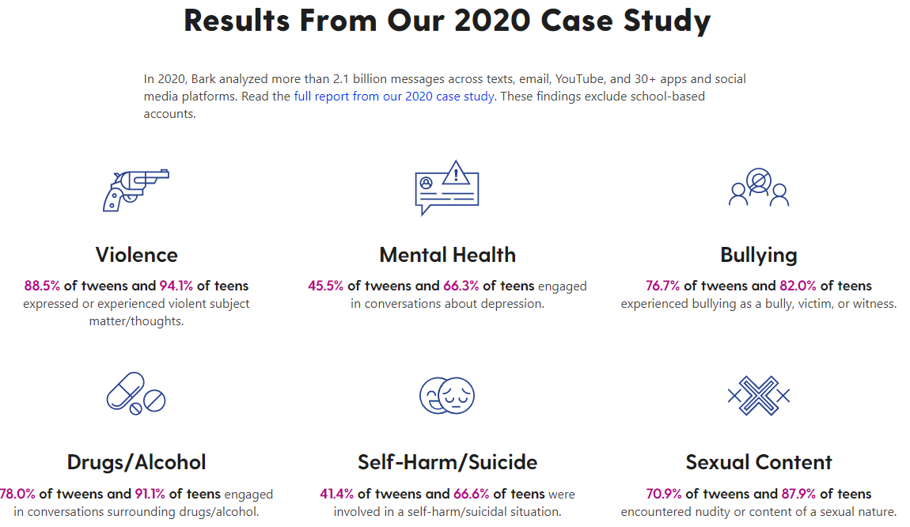

Slide 12
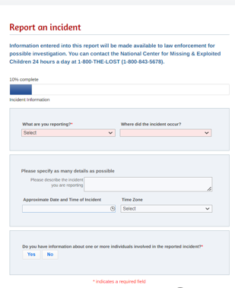
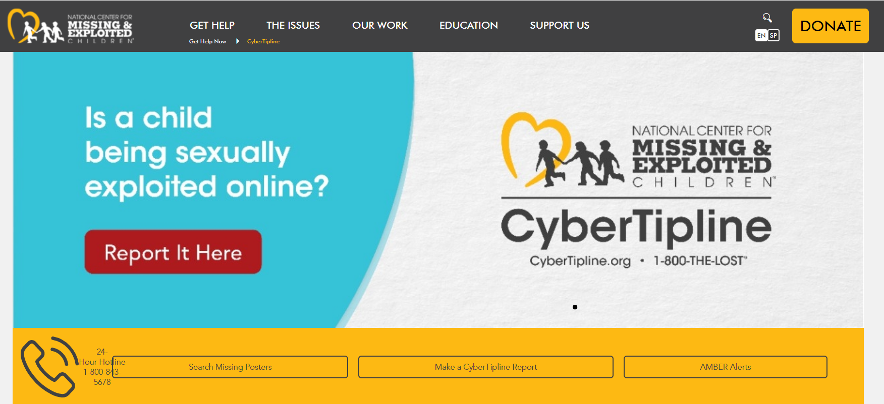
How to Report Inappropriate Internet Activity

