Slide 1
VAF Workshop
VAF Flowchart
July 26 & 28, 2022

Slide 2

Agenda
Tiered-Flexibility Model
Opt-In/Opt-Out Waivers
Value-Added Flexibilities
Application Process
Supports and Resources

Slide 3
Tiered-Flexibility Model
Allows FCS to designate firm policies and leverage flexibility universally across the district
Leads to a menu of flexibility options for schools to select from
Promotes community-driven approaches to innovative problem-solving that create added value to existing frameworks
District Flexibility
Opt-In/Opt-Out
School-Level Innovations

Slide 4
Updates
Tiered Flexibility Model
6/30/22
Current Waivers Expire
7/1/22
New Waivers Active
Approved Waivers
Plan for Monitoring
  Intended Outcomes & Expected Improvements
  Data Measurements & Assessment
  Continued Implementation

Slide 5
Overview
Opt-In/Opt-Out
PE Course Replacement
(HS Only)
Menu of preapproved waivers
Based on scalable flexibilities
Guidance for implementation
Monitored by Program Eval.
  Increased Eligibility Options
  Uniform Process for Implementation
Itinerant Conversions (ES Only)
  Increased Class Size in Special Areas
  Allows for Focused Content Exposure

Slide 6
Notification of Adoption
Opt-In/Opt-Out
9/1/22
11/1/22
Initial Notification of Adoption Due
Finalized Notification of Adoption Due
Accessible on Charter System Website
Simplified Online Application
School Information & Rationale
Requires 2/3 SGC Vote for Adoption
Requires 30-Day Public Comment Period
*Prior to final submission, councils must complete 30-Day Public Comment Period & vote to approve the submission

Slide 7
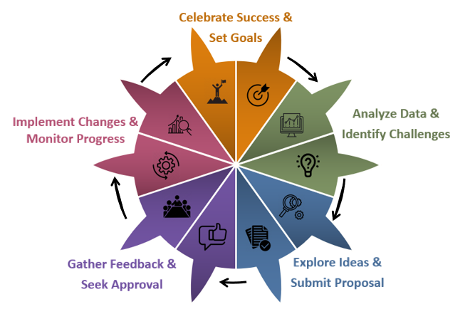
Process Overview
Value-Added Flexibilities
School or district requests for local and state policy waivers that strategically support planning efforts by adding value for defined stakeholder groups.
Notes:
Next slides will really focus on the submission through approval spokes of the process, but if you need support with earlier focuses such as analyzing data or identifying challenges the S & G team is responsible and able to support you in those areas.

Slide 8
Determining Eligibility
Value-Added Flexibilities
Policy Structures
State Board Rules
O.C.G.A. Title 20
FCBOE Policy Manual
Exceptions
Non-Waivable State Policies
Opt-In/Opt-Out Waivers
Non-Waivable FCS Policies
Notes:
In order to do a VAF, you might come on a problem where policy isn’t the problem, so VAF might not be the answer. You can still use a creative problem-solving method

Slide 9
Value-Added Flexibilities
School-Level Flexibility Requests
FCBOE Policy
Opt-In/Opt-Out List
No FCBOE Policy
No O.C.G.A. or State Board Rule
Autonomy*
Not on Ineligible List
Ineligible List
Ineligible for VAF
Eligible for
Opt-In
Eligible for VAF
O.C.G.A. or State Board Rule
Ineligible List
Ineligible for VAF
Not on
Ineligible List
Eligible for VAF
Steps
Eligible
Ineligible
*School-level decision determined by local leadership
Notes:
Ineligible = release day for professional development
Eligible = TAG delivery
Autonomy = school uniform

Slide 10

On-line Platform
VAF Application Process
Accessible on Charter System Website
Embedded Feedback Rubric
Automated Workflow Notifications
Areas of Focus
  Impact & Purpose
  Technical Soundness
  Feasibility
Notes:
Link to platform and show them how to fill it out. Run through application process a little with them. Show them

Slide 11
Iterative Review Sequence
Application Process
Strategy & Governance
Zone Superintendents
Cabinet

Slide 12
Council Actions
Application Process
VAF Overview Training
30-Day Public Comment Period
2/3 Vote for Final Submission

Slide 13
Timeline
Application Process
9/1/22
9/15/22
10/3/22
10/15/22
11/1/22
Initial VAF Submission Due
Feedback from S & G
Revised VAF Submission Due
Feedback from Zone Superintendent
Final VAF Submission Due*
December 2022
Notification of Final Approval
*Prior to final submission, councils must complete 30-Day Public Comment Period & vote to approve the submission
Notes:
Graphic to stick in communication

Slide 14
Additional Resources
Guiding Documents
Policy Navigation
Support Opportunities
Data Analysis Protocols
Application Guide
Public Comment Requirements
Strategic Problem-Solving Techniques
Opportunities for Community Engagement

Slide 15


