Slide 1



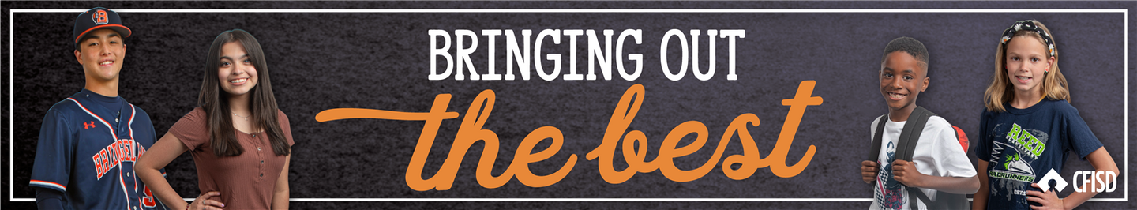






March Character Trait
COURTESY

Slide 2





TEACHERS
In the presentation, students will learn what it means to have courtesy in different situations.
Each slide will contain interactive activities and guided questions for “Bring Out The Best” Courtesy Character Trait for grades 6-8.
COURTESY

Slide 3
CAMPUS MATRIX
COURTESY

Slide 4



The Learner will...
01
Define what it means to be courteous
LESSON OBJECTIVES
02
Explore courteous actions and words that can be used towards others
COURTESY

Slide 5





WARM-UP
LET’S GET MOVING!
  Stand up & listen to what I am asking you to do
COURTESY

Slide 6
WARM-UP
THINK SIMON SAYS, BUT BEFORE EACH TASK YOU HAVE TO SAY “CAPTAIN, MAY I?” BEFORE PERFORMING EACH TASK.
      Teacher says, “Stand on one foot”, then the student needs to say: “Captain, may I stand on one foot” and teacher says “yes”, then the student does the task
IF YOU DO THE ACTION WITHOUT ASKING, YOU ARE OUT OF THE GAME.
Let’s see who’s the last one standing!
COURTESY

Slide 7


To have COURTESY is to have polite behavior that shows respect for others.
DEFINITION
Traits of a COURTEOUS person:
Considerate, Compassionate, polite
COURTESY

Slide 8
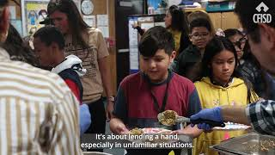
COURTESY

Slide 9
01
Share any reflections you have from the video.
VIDEO REFLECTION
02
Can you think of someone you know who is courteous?
COURTESY

Slide 10
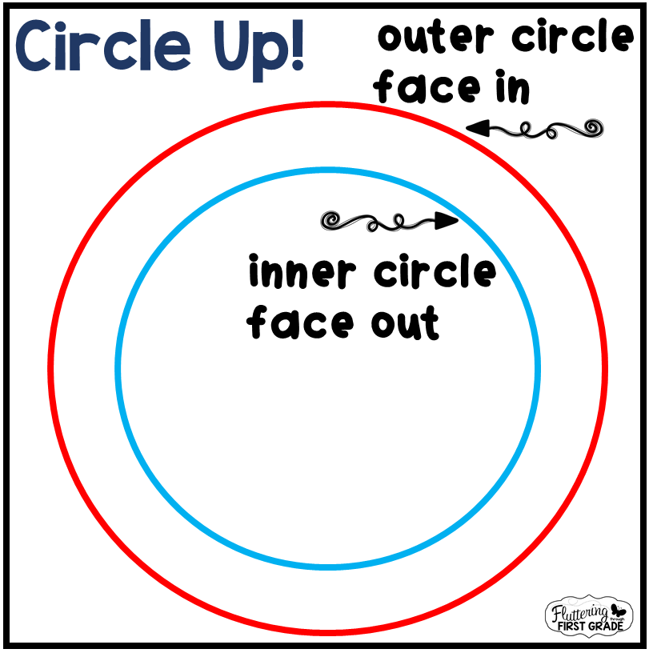
WHOLE GROUP
ACTIVITY
Divide students up into 2 groups, one will stand in a circle as the INNER CIRCLE
the next group will stand facing another student to create the OUTER CIRCLE
COURTESY

Slide 11
Students will practice taking turns
      shaking hands, making eye contact, smiling and saying their:
              Name
              Age
              Favorite candy
              Thank your partner for sharing
WHOLE GROUP
ACTIVITY
COURTESY

Slide 12
After about 30-45 seconds teacher will
      tell the inner circle to move one step to the right.
      And ask the same questions to their new partner.
      students thank their partner for sharing.
WHOLE GROUP
ACTIVITY
Teachers:
Depending on time, you may rotate a few times
COURTESY

Slide 13

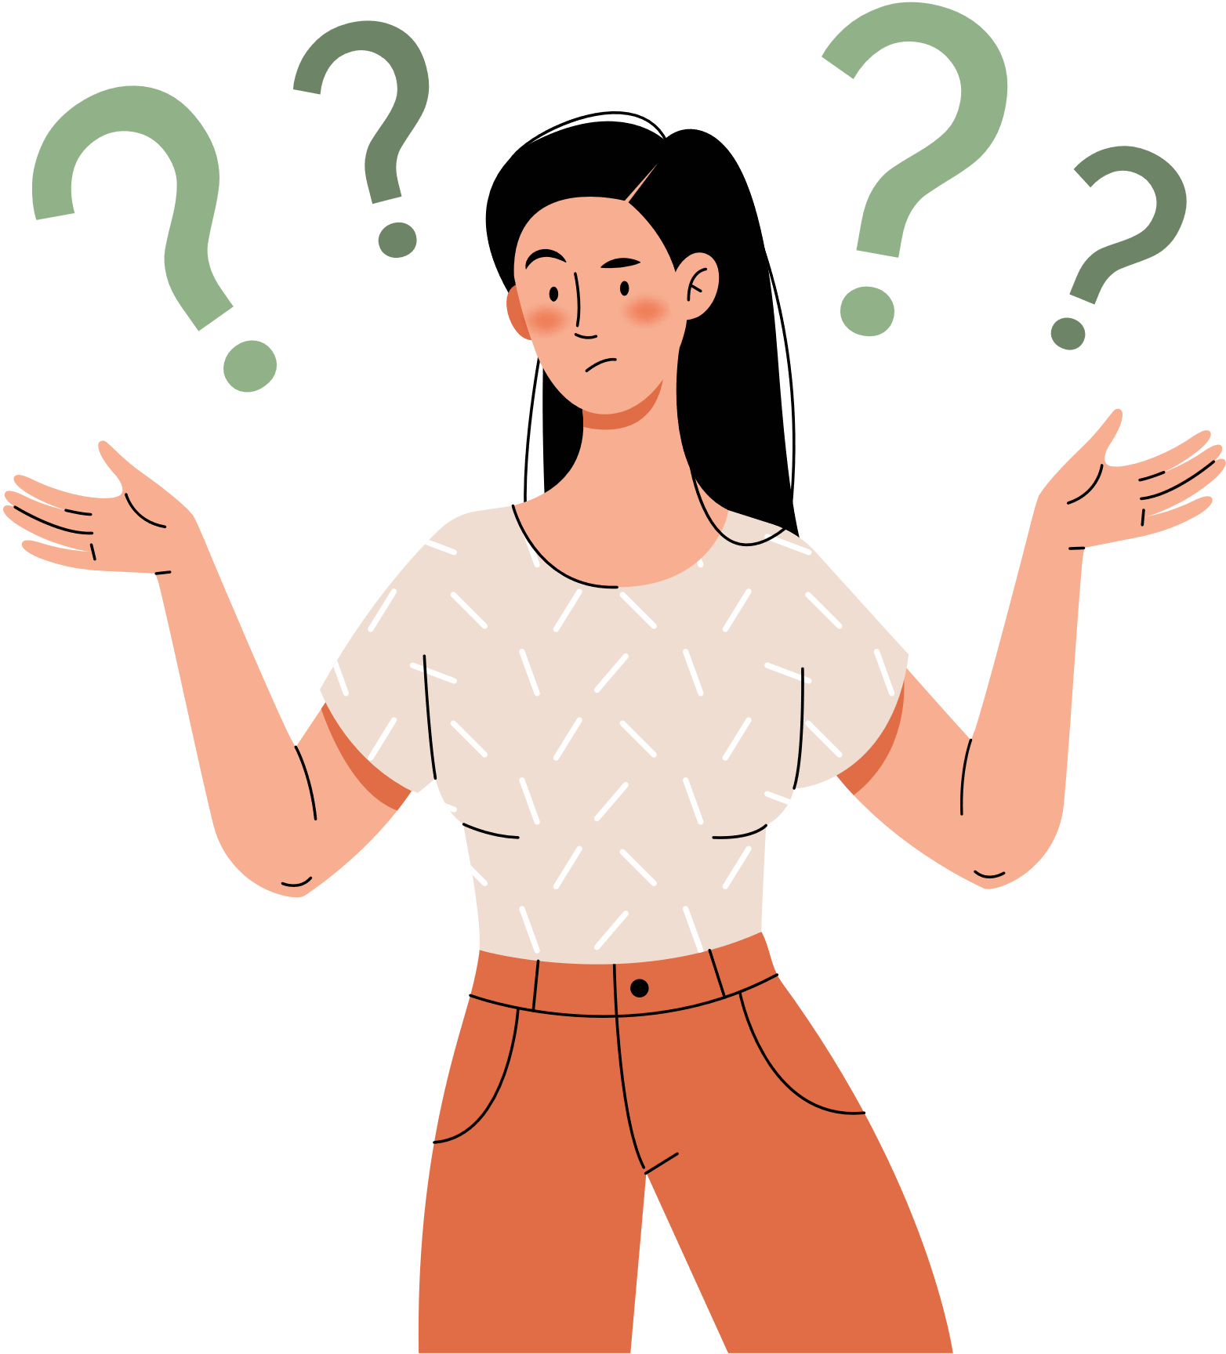

CLOSURE:
SELF-REFLECTION
  Think back at our warm-up, how did you show Courtesy?
  Think about the circle activity we just did. How did you show Courtesy?
  Showing courtesy shows you have respect and appreciation for the person:
        With the words you use, being polite
        Having eye contact, listening
        Smiling at the person, being kind
COURTESY

Slide 14
HOME ACTIVITY
Courtesy Challenge: Today students learned about the character trait COURTESY.
  The At Home Activity is to perform a courteous deed:
        Help a family member with a chore
        Ask a family member how their day was and actively listen with eye contact
        Ask a family member for something using polite and kind words
COURTESY

Slide 15



EXTENSION LESSONS
WANT ANOTHER ACTIVITY TO CONTINUE OUR TRAIT OF THE MONTH?
  CREATE A COMPETITION BETWEEN EACH CLASS PERIOD THAT IS SHOWING COURTESY
  CLICK HERE ON WORD CLOUD CHOOSING WORDS WITH THE CLASS THAT DEFINES COURTESY IN THEIR OWN WORDS.
  CREATE A CLASS SPOTIFY LIST HERE BASED ON THE CHARACTER TRAIT: COURTESY
FOR
'S
ONLY
COURTESY

