Slide 1
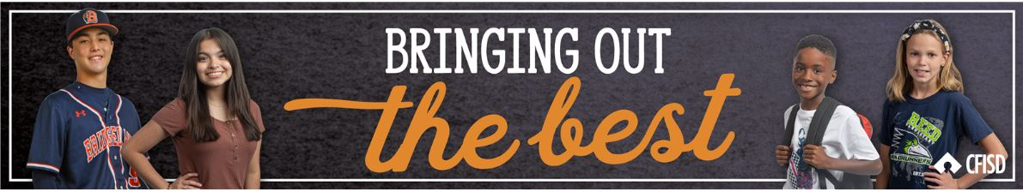
March
COURTESY

Slide 2
Today we will…
Define courtesy
Describe the differences and similarities among gratitude, respect, and courtesy
Practice polite behavior that shows respect for others

Slide 3
Courtesy:
Polite behavior that shows respect for others

Slide 4
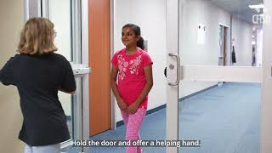

Slide 5
Discussion:
What examples of COURTESY did you notice in the video?
When someone is courteous to you, how does it make you feel?

Slide 6
Let’s Review!
Gratitude: A feeling of appreciation or thanks.
*BOTB Trait Nov/Dec 2022
Respect: Is a feeling or understanding that someone or something is important and should be treated in an appropriate way.
*BOTB Trait May 2023
Courtesy: Polite behavior that shows respect for others.
*BOTB Trait March 2024
How do these traits relate?

Slide 7

Brainstorm
List ways to show acts of courtesy
Time: one minute

Slide 8
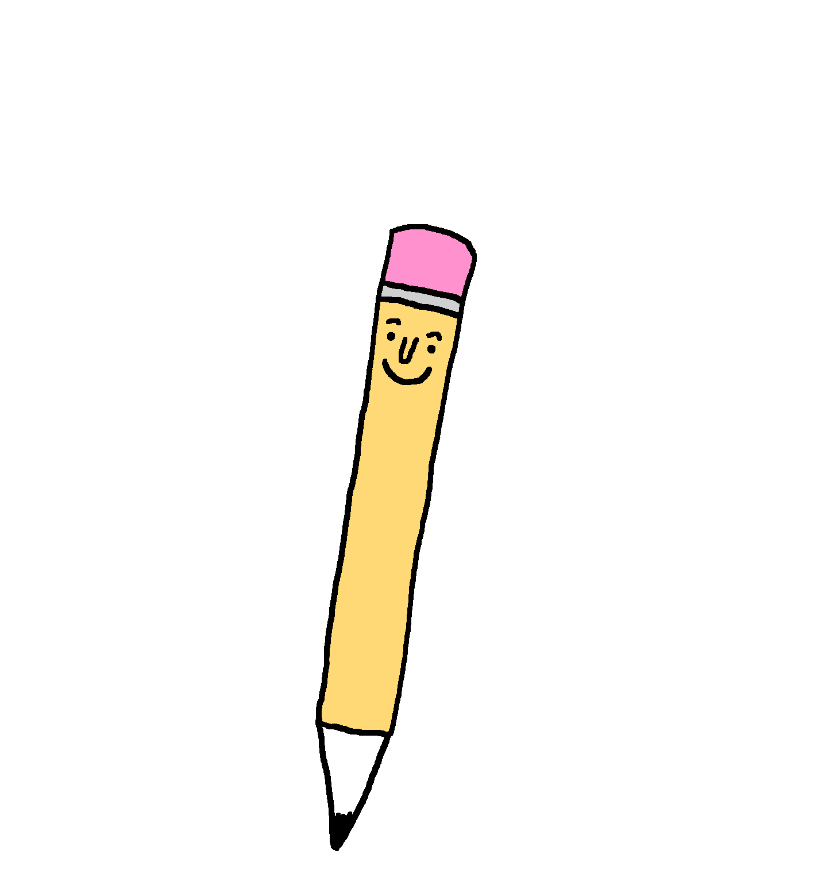


Take Note!
Write a little, kind note to give to someone who is not in your classroom (ex: custodian, cafeteria worker, bus driver, front office secretary, administrator).
Dear ______________,
Thank you for ___________________________.
I appreciate all you do!
Respectfully,
_______________

Slide 9
Big Concept
COURTESY is treating people with kindness and respect… essentially showing the polite behavior you want others to show to you.

Slide 10

Home Activity
Be courteous and write a thank you note to someone who has been kind to you.
(ex: gave you a pencil, took you somewhere, invited you to play with them, etc.)

