Slide 1



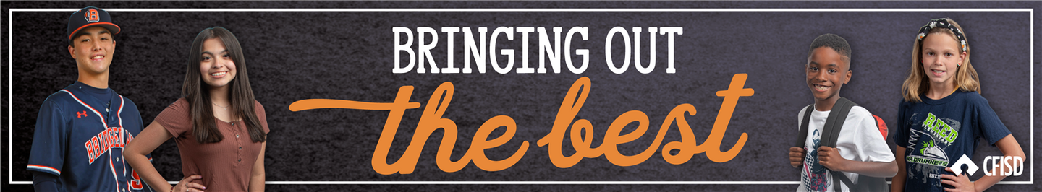






January Character Trait
Freedom from Prejudice

Slide 2





TEACHERS
In the presentation, students will learn what it means to display freedom from prejudice in different situations.
Each slide will contain interactive activities and guided questions for “Bring Out The Best” Freedom from Prejudice Character Trait for grades 6-8.
Freedom from prejudice

Slide 3
CAMPUS MATRIX
Freedom from prejudice

Slide 4



The Learner will...
01
Define what it means to be free from prejudice
LESSON OBJECTIVES
02
Explore prejudice behaviors and what prejudice acts feel like.
Freedom from prejudice

Slide 5


You show Freedom from Prejudice by understanding that despite differences, you seek to understand those around you
DEFINITION
Freedom from prejudice

Slide 6
DISTRICT VIDEO
Freedom from prejudice

Slide 7
GROUP DISCUSSION...
  Have you ever been included in a team or group and you were different from the others?
How did it make you feel?
  Have your ever been Excluded from a team or group?
Did the exclusion from others make you feel or act a certain way?
Why or why not?
WHOLE GROUP ACTIVITY
Freedom from prejudice

Slide 8



CLOSURE:
SELF-REFLECTION
Now that you understand freedom from prejudice, how can we use empathy to include others?
Give examples and explain your answer.
Freedom from prejudice

Slide 9





HOME ACTIVITY
STUDENTS, NOW THAT YOU HAVE AN UNDERSTANDING OF WHAT HAVING FREEDOM FROM PREJUDICE MEANS, YOU WILL:.
  CHOOSE A FAMILY MEMBER OR SOMEONE IN YOUR HOME TO SHARE A TIME WHEN THEY EXPERIENCED BEING INCLUDED OR EXCLUDED FROM A GROUP.
HOW DID IT MAKE THEM FEEL?
Freedom from prejudice

Slide 10



EXTENSION LESSONS
WANT ANOTHER ACTIVITY TO CONTINUE OUR TRAIT OF THE MONTH?
  CREATE A COMPETITION BETWEEN EACH CLASS PERIOD THAT IS SHOWING FREEDOM FROM PREJUDICE
  CLICK HERE ON WORD CLOUD CHOOSING WORDS WITH THE CLASS THAT DEFINES FREEDOM FROM PREJUDICE IN THEIR OWN WORDS.
  CREATE A CLASS SPOTIFY LIST HERE BASED ON THE CHARACTER TRAIT: FREEDOM FROM PREJUDICE
FOR
'S
ONLY
Freedom from prejudice

