Slide 1

FREEDOM From PREJUDICE

Slide 2
Today We Will...
01 Define prejudice
02 Celebrate similarities and differences
03 Identify Keys to “BEE” Free from Prejudice

Slide 3
Prejudice defined.
Prejudging.
An opinion not based on reason or actual experience.
Notes:
In order to define freedom from prejudice, we must first understand what prejudice is… Prejudice is Prejudging. An opinion not based on reason or actual experience.

Slide 4
Prejudice “BEE” Stinging!!
Not playing with someone because he or she can’t run fast.
Ignoring someone because he or she is in a wheelchair.
Making fun of someone’s weight.
Teasing people because they speak a different language.

Slide 5
Insert CFISD Video here

Slide 6
“BEE” FREE!!
What does Freedom from Prejudice mean?
Despite differences, seek to understand those around you.

Slide 7
“BEE” Accepting of Differences
Stand up when you can relate to the statements on the following slide.

Slide 8
Can read and write another language.
Knows someone who uses a hearing aid.
Has a grandparent living with them.
Has been to another state.
Has parents who are from different cultures.
Has friends from other religions.
Is left-handed.
Has one brother and one sister.
Has ridden a horse.
Has a dog for a pet.
Is the oldest child in their family.
Was born somewhere other than Houston.

Slide 9
How to “BEE” Free from Prejudice
Realize you are special and unique.

Slide 10
How to “BEE” Free from Prejudice
Accept the fact that everyone is not the same or just like you.

Slide 11
How to “BEE” Free from Prejudice
Practice expressing yourself without putting others down.

Slide 12
How to “BEE” Free from Prejudice
How to “BEE” Free from Prejudice
Communicate openly and listen without judgment.

Slide 13
“BEE”-ing Free from Prejudice is Sweeter Than Honey!
“BEE” an upstander.
“BEE” curious about other people, cultures, and countries.
“BEE” open to learn about others without judgment.
“BEE” the person you want others to “BEE” to you.

Slide 14
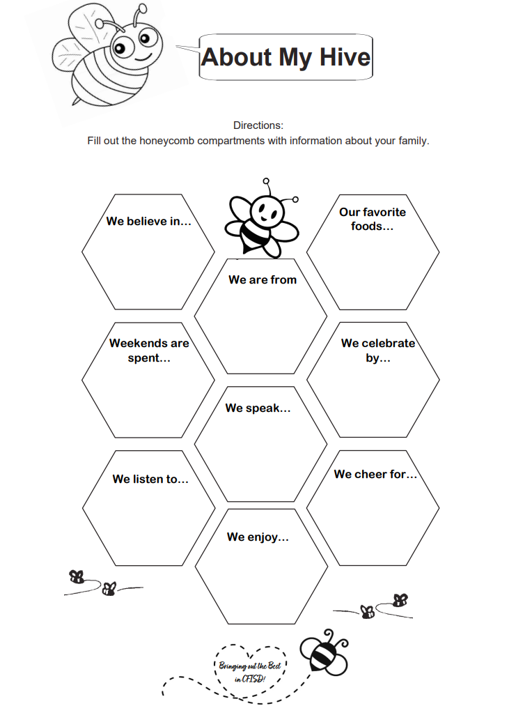

Home Activity
Give us the BUZZ on your family hive.

